Slide 1
Anchoring Extension Elements
Taxonomy Advisory Group Meeting
Louis Matherne/Melissa Nicholson
February 11, 2021

Slide 2
Agenda
Recap from July TAG
What is Anchoring?
Anchoring Mechanisms with Examples
Appendix A (separate excel file for Mechanisms)
Roadmap for anchoring from present to future state
Appendix B (separate excel file for Roadmap)
Minimize extensions/Better anchoring
Threshold questions

Slide 3
Recap—July 23 TAG meeting
Background
SEC announces permission in March 2020
Mechanisms—existing and potential
Examples
Not easily accommodated by existing mechanisms
Additional considerations
Tools
Guidance
Feedback
Concerns with anchor having different attributes
Possible need for additional relationships
Not strong support for reference as an anchor

Slide 4
Why do filers create extensions?
Semantics
Reference: No element exists for disclosure per Codification paragraph
Definition does not align with information to be tagged
Label does not align with information to be tagged
Syntax
Different data type (Ex: Taxonomy element is a string, but need a monetary element)
Different period type
Different balance type*
* Not criteria for element selection

Slide 5
Extension Information
What is currently provided for user consumption?
Entity/Reporting Period
Element Name
Period Type
Data Type
Value (unit, currency)
Label
Definition
Balance Type (if monetary)
Presentation Group (indicates whether Statement or Note)
Calculation relationship (certain monetary)
Definition relationship
if extension member or if extension tagged with axis element

Slide 6
What is Anchoring?
European Securities Market Authority (ESMA) European Single Electronic Format (ESEF) regulation
Requires anchoring of extension elements in primary financial statements only (excludes subtotals)
Anchoring, as required by ESEF, links an extension concept to an appropriate concept in the ESEF taxonomy, which is either wider or narrower in accounting meaning or scope.
Guidance 3.3 of ESEF Reporting Manual (Definition Linkbase)
Anchor extension concepts: wider-narrower arcrole
Anchor domain member extensions: domain-member arcrole
Anchor dimension extensions: hypercube-dimension arcrole
Anchor hypercube extensions: all arcrole

Slide 7
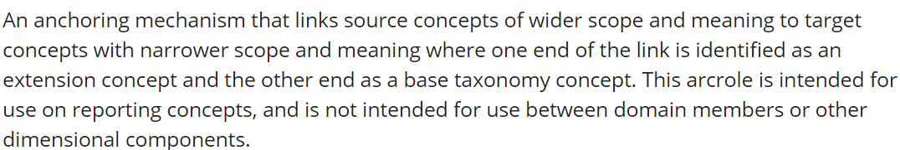
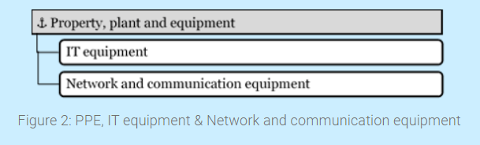
Anchoring Mechanism—Wider-Narrower Arcrole
Definition (Registry)
Example of wider accounting meaning and/or scope
Attributes (monetary, instant, debit) are the same.
Taxonomy element is wider than the extension element.

Slide 8
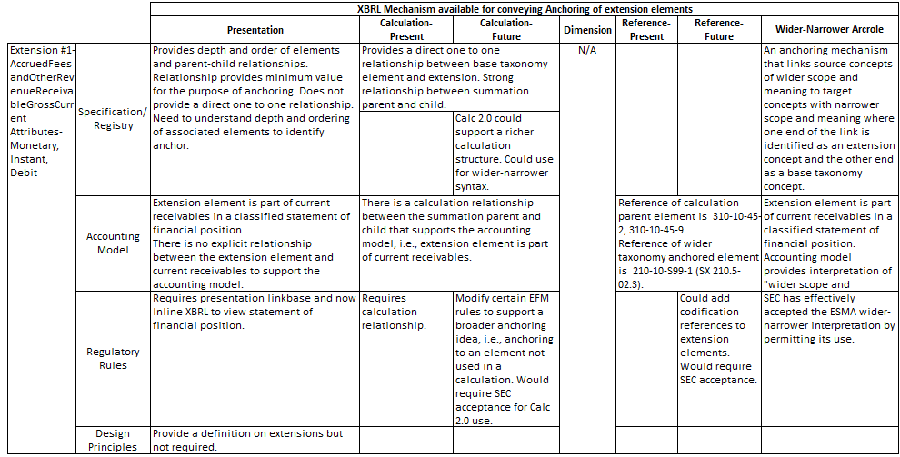
Anchoring Mechanisms—Example #1
See Appendix A (separate Excel file)

Slide 9
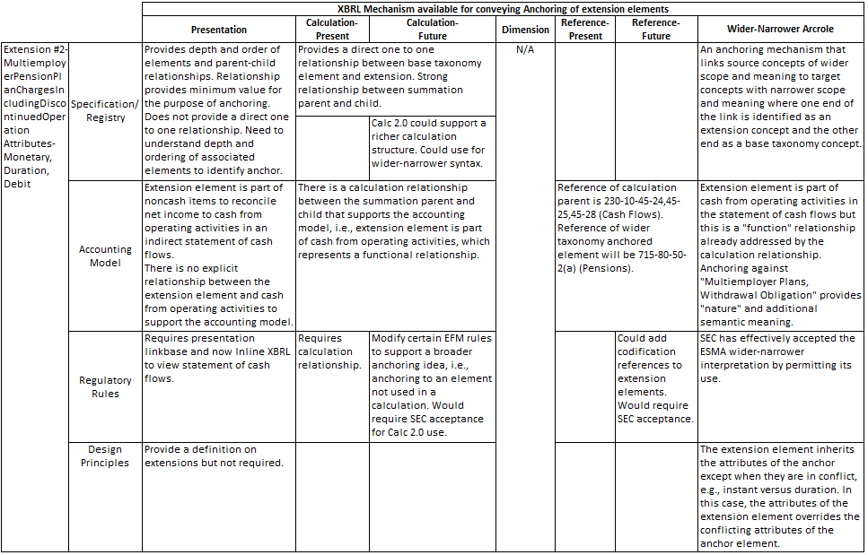
Anchoring Mechanisms—Example #2
See Appendix A (separate Excel file)

Slide 10
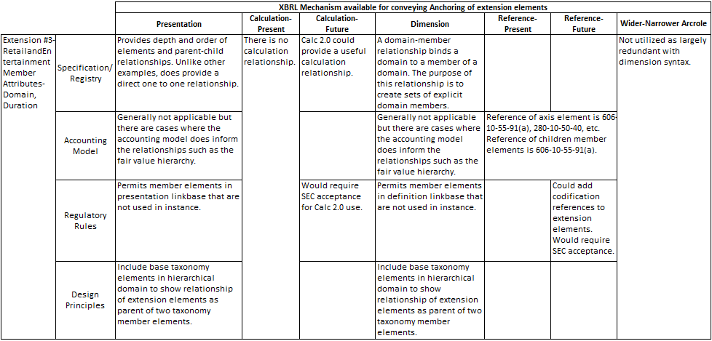
Anchoring Mechanisms—Example #3
See Appendix A (separate Excel file)

Slide 11
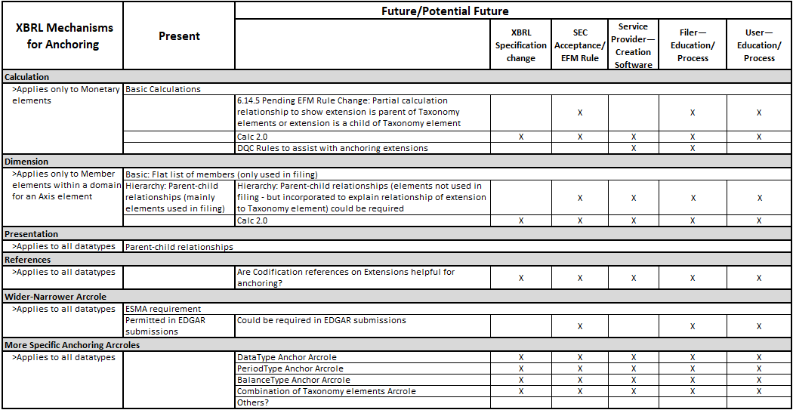
Anchoring Roadmap
See Appendix B (separate Excel file)

Slide 12
Minimize Extensions/Better Anchoring
What else could be provided in or around the Taxonomy that could help users electronically consume extensions and understand their meaning?
Within Taxonomy
Typed dimensions
Period increase/decrease elements for areas requiring/common practice disclosure of changes in balances
Around Taxonomy
Additional arcroles/relationships

Slide 13
Threshold Questions
Should the same base attributes be present in Taxonomy element in order to use element for anchoring an Extension?
Can we assume that the extension element attributes take priority over the base taxonomy attributes?
Should additional relationships be considered if attributes are different?
Is there a hierarchical selection for anchoring?

Slide 14
Threshold Questions
Should references be considered as a mechanism for anchoring?
Do all extensions need an anchor? If not, what types do not? Is there utility in trying to anchor all extensions?

Slide 15
Entity Specific Disclosure Resources
XBRL International, Inc. Entity Specific Disclosure Task Force
Published “How to address Entity Specific Disclosures in XBRL reports”
“… identify and recommend mechanisms for including entity-specific disclosures (ESDs) in XBRL reports to optimize their utilization for automated processing by users.”
Published a public draft “Using the ESEF rules for anchoring extensions”
“This guidance is primarily aimed at preparers of Inline XBRL (iXBRL) reports complying with the requirements set out in the European Securities and Markets Authority’s (ESMA) European Single Electronic Format (ESEF) regulation, who seek to better understand when and how to anchor entity-specific concepts to ESEF taxonomy concepts.”
Final RTS on the European Single Electronic Format, Annex II
Annex IV (Note: this is an Annex nested within Annex II), Points 9 & 10
The ESEF Reporting Manual
Guidance 1.4. Anchoring
Guidance 3.3. Extension taxonomy anchoring

Slide 16
Thank You

