Slide 1
DQC Errors
DQC meeting with SEC Staff
April 23, 2019

Slide 2
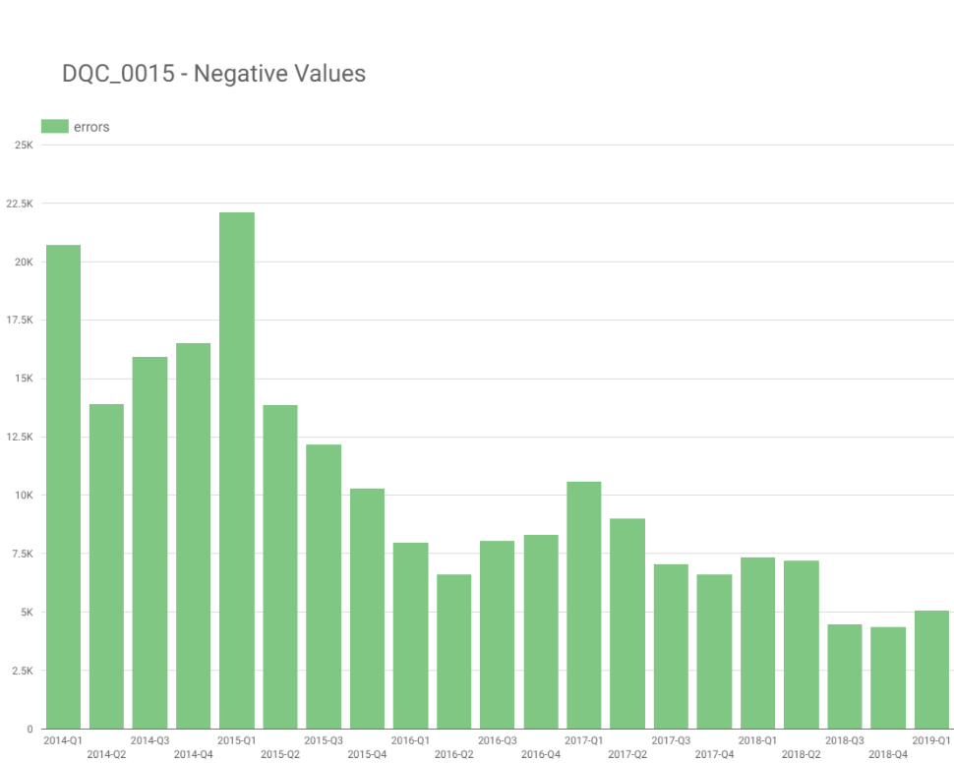
Rule approved

Slide 3
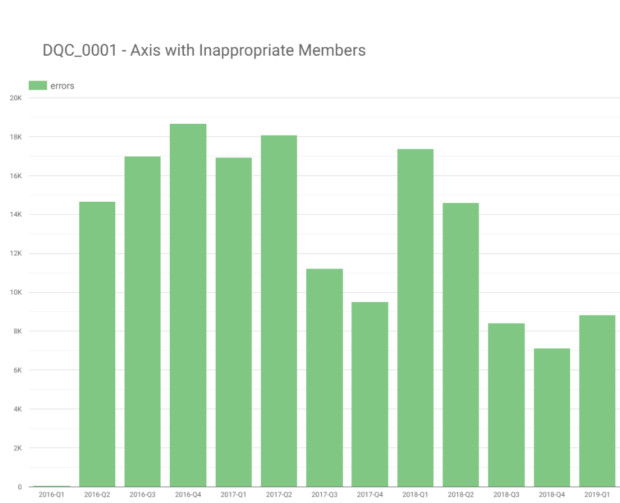


Slide 4
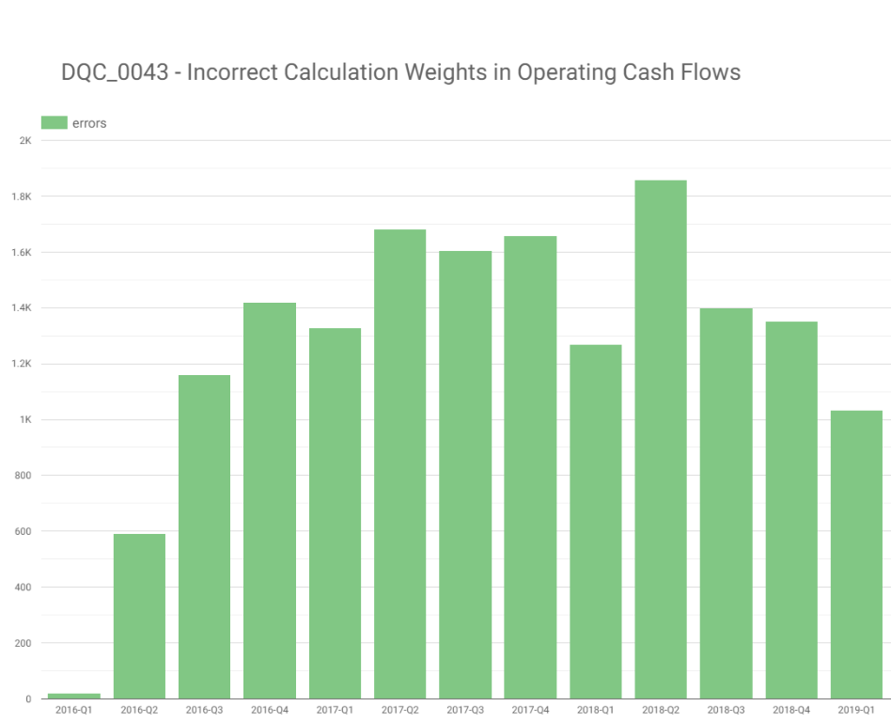
Rule approved

Slide 5
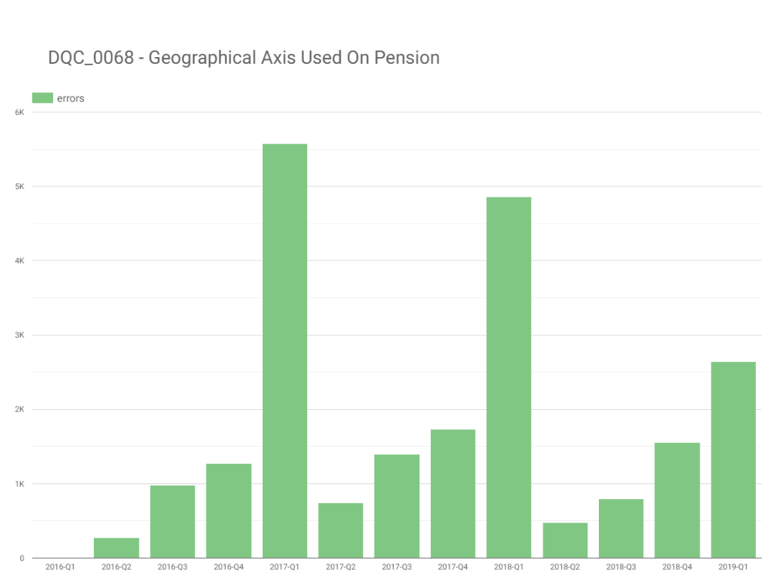
Rule approved

Slide 6
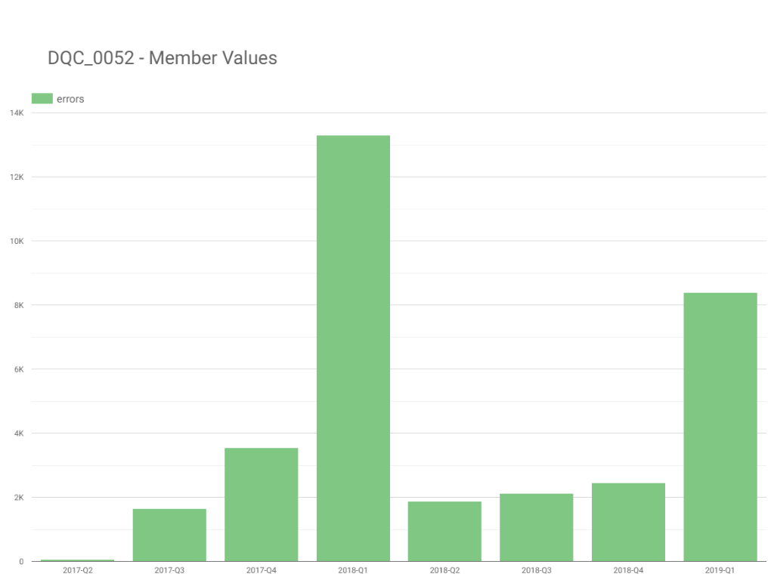
Rule approved

