Slide 1
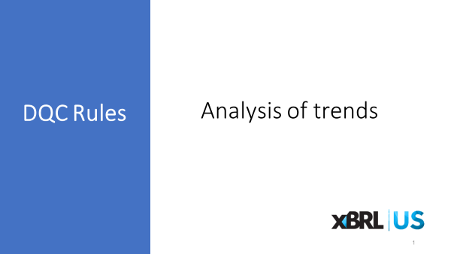

Slide 2
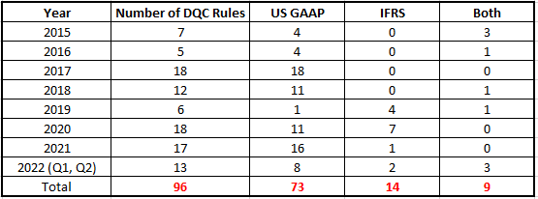
DQC Rules Approved

Slide 3
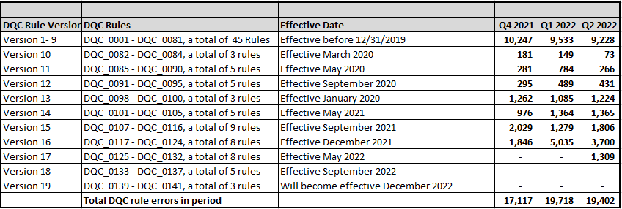
DQC Errors – Analysis of Trends

Slide 4
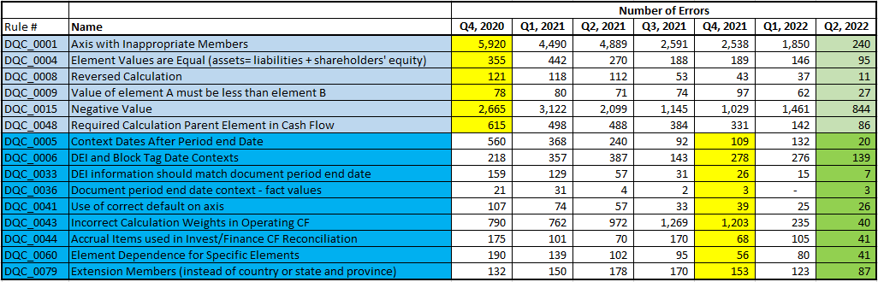
DQC Errors – Analysis of Trends DQC Rules included in the DQC Rules Taxonomy
Significant quality improvement for all DQC Rules include in the DQCRT:

Slide 5
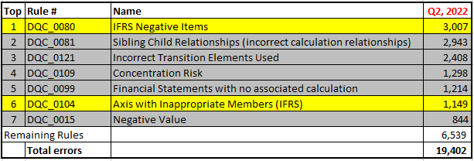
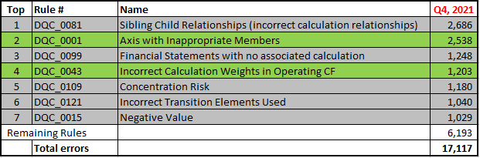
DQC Errors – Analysis of Trends Top errors
Rules in “grey” appear in both periods.
Rules in “yellow” apply to the IFRS filings that are mostly submitted in Q1/Q2 each year.
Rules in “green” are included in DQC Rules Taxonomy.

Slide 6
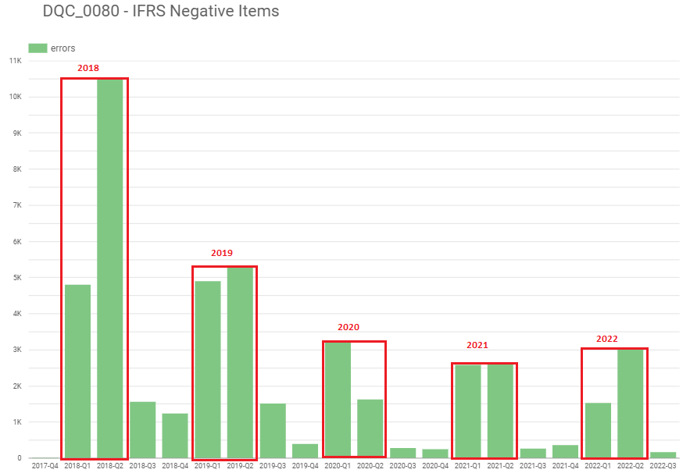
DQC Errors – Analysis of Trends DQC_0080 Negative Values (IFRS) -
This rule became effective in May 2019.
Decrease in number of errors since the
first year of XBRL mandate on IFRS filings
15 filers had more than 100 errors in 2022.
- None of them are new registrants.
- Many of them already had errors in 2021.
- Number of errors for these filers increased in 2022.
- It appears that some of these filers may be tagging
every value with parenthesis as negative.
What is the next step?
- Contact filers, incorporate IFRS negative value validation into EDGAR system…etc.

Slide 7

DQC Errors – Analysis of Trends DQC_0121 Incorrect Transition Elements Used -
This rule became effective in December 2021.
Number of errors:
DQC_0121 detects errors when filers use line items that should no longer be used after adoption of:
ASU 2016-01 Financial Instruments - Overall (Subtopic 825-10): Recognition and Measurement of Financial Assets and Financial Liabilities
ASU 2016-02 Leases (Topic 842)
ASU 2016-18 Statement of Cash Flows (Topic 230): Restricted Cash (a consensus of the FASB Emerging Issues Task Force)
ASU 2017-12 Derivatives and Hedging Topic 815): Targeted Improvements to Accounting for Hedging Activities
ASU 2018-07 Compensation—Stock Compensation (Topic 718): Improvements to Nonemployee Share-Based Payment Accounting
Prior DQC rules which detect errors when filers use line items that should no longer be used after adoption of:
ASU 2014-09 Revenue (Topic 606) – DQC_0067
ASU 2015-17 Income Taxes (Topic 740): Balance Sheet Classification of Deferred Taxes – DQC_0086

