Slide 1
Extensions

Slide 2
Discussion Topics
More dimensions on face statements

Slide 3
PP&E disclosures
Taxonomy contains two ways to model detailed PP&E disclosures - as line items, and as members on a dimension.
Filers use line items on the balance sheet and in the footnotes, and dimensions in the footnotes.

Slide 4
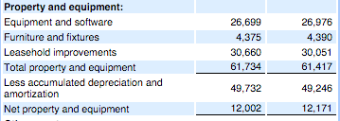
PP&E detail from a balance sheet

Slide 5
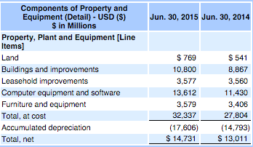
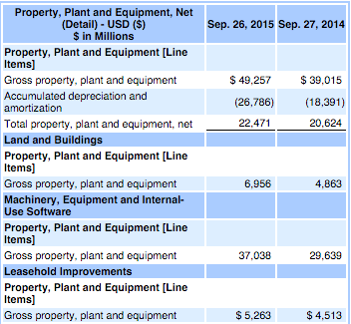
Multiple ways of tagging the same disclosure
Footnotes from two companies in the same industry - one dimensionalized, one not

Slide 6
Discussion
Which is preferable for modeling PP&E, line items or dimensions?
If dimensions are preferable, should filers use the same materiality criteria for selecting members as for line items, in the interest of preserving comparability?

Slide 7
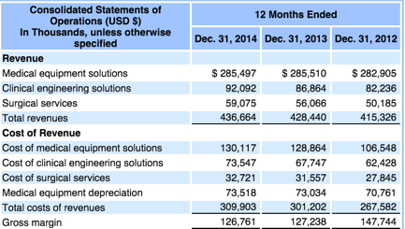
Services revenue breakdown revisited
Income Statement

Slide 8
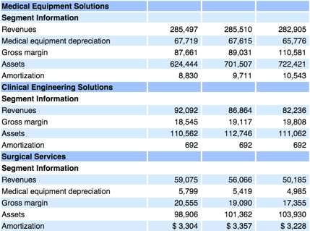
Footnote
Disaggregation is by reportable segments

Slide 9
Discussion
Should filers use the Segment axis on the income statement if revenues are disaggregated by segement?

