Slide 1
Data Quality Committee
Questions for DQC related to Extension Analysis
January 2016

Slide 2
Income Statement
Revenue:
Casino 120
Food, beverage and other 20
Total revenue 140
Question 1: To tag the disclosure of “Food, beverage and other” on the income statement, should the company use the US GAAP Taxonomy tag “Food and Beverage Revenue” or should the company create an extension?

Slide 3
Income Statement
Revenue:
Casino 120
Food, beverage, racing
and other 20
Total revenue 140
Question 2: To tag the disclosure “Food, beverage, racing and other” should the company use the US GAAP Taxonomy tag “Food and Beverage Revenue” or should the company create an extension?

Slide 4
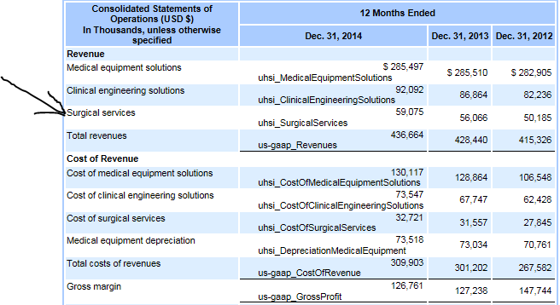
The company's revenue disclosure on the face of income statement shows three types of revenue, primarily sales to hospitals. The company created extensions for all three Revenue items, including extensions for each of the Cost of Revenue items. See next page for questions.

Slide 5
Question 3: For the disclosure of "Medical Equipment Solutions" a possible UGT element is "Sales Revenue, Goods" since that is the only revenue item on the company’s income statement that pertains to goods. Although the UGT element "Sales Revenue, Goods" is somewhat broad to describe medical equipment solutions, is it an appropriate since it is the UGT element that most closely matches the disclosure? Or should this disclosure be an extension? Or is there another tag in the UGT that is appropriate?
Question 4: The second and third types of revenue are primarily consulting services (based on descriptions in the footnotes). There is no UGT element with a revenue type that specifically, or generally, describes these types of service revenue. Is it appropriate to create an extension for these two disclosures?
Question 5: Another option to eliminate the extensions that the company made for the Revenue and Cost of Revenue disclosures is to create a dimensional structure and use the “Revenue, Net” and the “Cost of Goods and Services Sold” elements from the UGT as the primary line item and create dimension members for a) Medical Equipment Solutions b) Clinical Engineering Solutions and c) Surgical Services. Would this be the best option for tagging these disclosures?

Slide 6
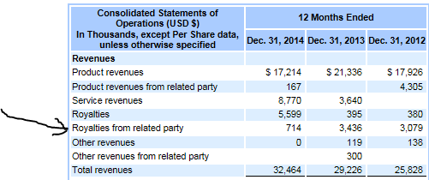
The company's income statement has a disclosure for Royalty revenue and also has a disclosure for Royalty revenue from related parties. The US GAAP Taxonomy only has an element for royalty revenue.
Question 6: For the disclosure “Royalties from related party” do you agree that an extension should be created?
Question 7: For the disclosure “Royalties” should the company use the US GAAP Taxonomy tag “Royalty Revenue” or should the company create an extension since the company’s total royalty revenue is the sum of both “Royalties” and “Royalties from related party”?

