Slide 1


Documenting your Power BI Models with Tabular Editor & GenAI
Péter Szécsi Co-founder & CEO
DataRock Labs
https://datarocklabs.hu

Slide 2



Our services
Data engineering
Artificial intelligence
Business intelligence

Slide 3
Problem statement
Root cause: IT project... lack of time and motivation to documenting
It can cause serious problems:
Inconsistency
Difficult troubleshooting
Knowledge gaps
Lack of different level of documentation

Slide 4
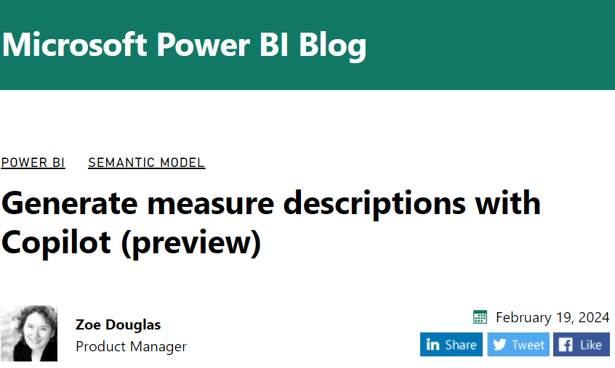
Out-of-the-box Fabric solution
https://powerbi.microsoft.com/en-us/blog/generate-measure-descriptions-with-copilot-preview/

Slide 5
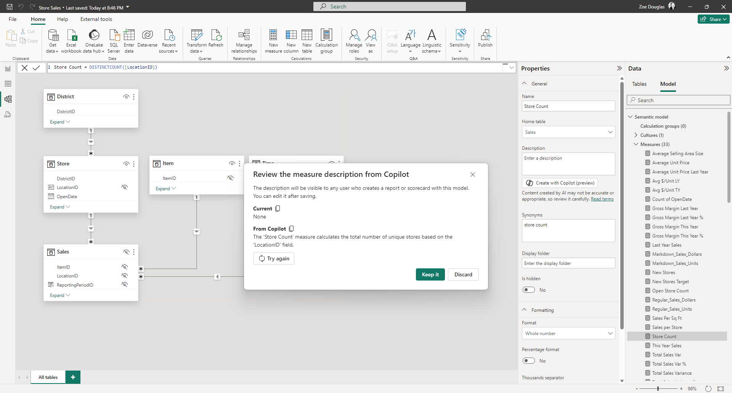
Out-of-the-box Fabric solution

Slide 6
Out-of-the-box Fabric solution
Copilot in Microsoft Fabric isn't supported on trial SKUs
Only paid SKUs (F64 or higher, or P1 or higher) are supported
F64 capacity, West Europe, 1 year reservation - $6112 / month
Copilot is disabled by default unless your Fabric tenant admin enables
Data sent to Azure OpenAI can be processed outside your tenant's geographic region, compliance boundary, or national cloud instance tenant setting (If your tenant or capacity is outside the US or France)

Slide 7
Our solution

Slide 8
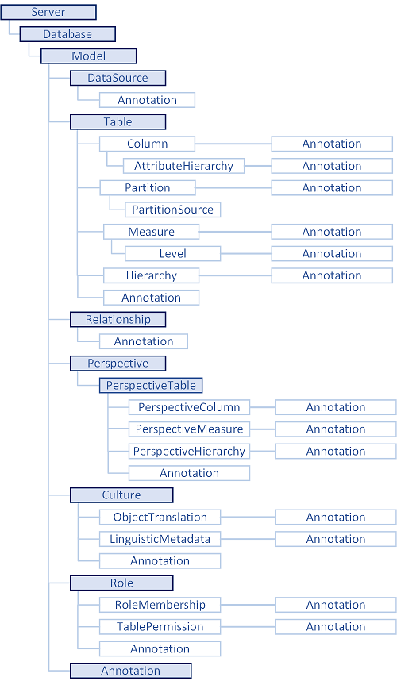
Tabular Object Model (TOM)
Created to support programming scenarios for tabular models
TOM exposes native tabular metadata, such as models, tables, columns, and relationships objects

Slide 9

Tabular Editor skills
TOM explorer
Best Practice Analyzer (BPA)
Data refresh
VertiPaq Analyzer
Dependency tree
Macros
Format measurements and calculated columns
Add prefix to selected measurements
Auto-generate SUM measures from columns
Generate Last Updated table
Copy DAX Expression into the measure's description field
…

Slide 10
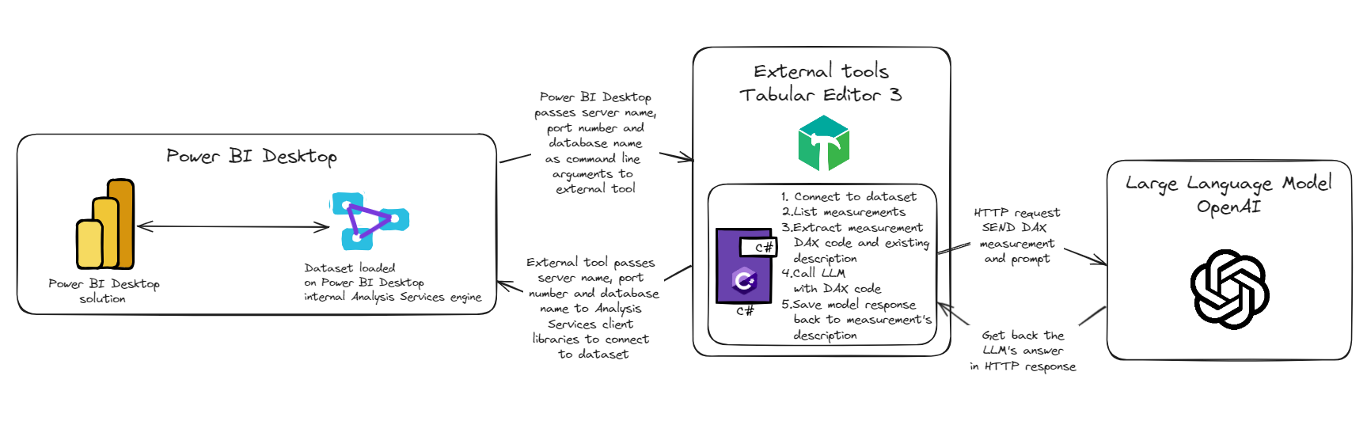
Our solution's architecture

Slide 11
DEMO

Slide 12
Benefits of our solution
Write documentation for different audience with different prompting:
Developers
Business users
Set language of the documentation
Give hints for the AI:
Meaning of abbreviations
Business hints
We could easily change the type of the Large Language Model

Slide 13

Github announcement
https://github.com/DataRockLabs/Budapest-PowerBI-Meetup-10th

Slide 14
Thank you for your attention!

Slide 15
Q&A
Contact: info@datarocklabs.hu

