Slide 1
DHSC powerpoint
This is a placeholder subtitle

Slide 2
Side by Side slide
This is the text on the left side of the slide.
There is a table on the right, with some of the data in mtcars.
speed | dist
4 | 2
4 | 10
7 | 4
7 | 22
8 | 16
9 | 10
Notes:
This is a test speaker note
and inline formatting

Slide 3
R Markdown
This is an R Markdown document. Markdown is a simple formatting syntax for authoring HTML, PDF, and MS Word documents. For more details on using R Markdown see http://rmarkdown.rstudio.com.
When you click the Knit button a document will be generated that includes both content as well as the output of any embedded R code chunks within the document. You can embed an R code chunk like this:
library(dplyr) head(iris) print(iris)

Slide 4
Full slide table
Sepal.Length | Sepal.Width | Petal.Length | Petal.Width | Species
5.1 | 3.5 | 1.4 | 0.2 | setosa
4.9 | 3.0 | 1.4 | 0.2 | setosa
4.7 | 3.2 | 1.3 | 0.2 | setosa
4.6 | 3.1 | 1.5 | 0.2 | setosa
5.0 | 3.6 | 1.4 | 0.2 | setosa
5.4 | 3.9 | 1.7 | 0.4 | setosa

Slide 5
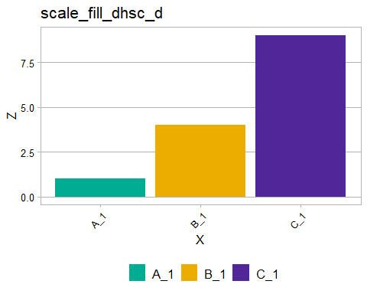
Slide with a plot on it

Slide 6
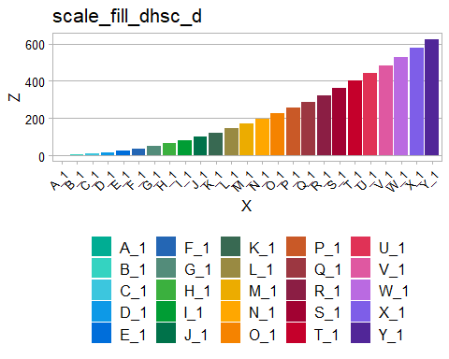
Test slide with code, text and plot
You can also embed code chunks.
The chunk below codes a barplot using the DHSC theme and colour palette.
ggplot(data = sim_series(25), aes(x=X, y=Z, fill=X))+ geom_col()+ scale_fill_dhsc_d()+ theme_dhsc()+ ggtitle("scale_fill_dhsc_d")
Note that the echo = FALSE parameter was added to the code chunk to prevent printing of the R code that generated the plot on the right where the plot is displayed.

