Slide 1
Data Science in Manufacturing Week 1
Andrew Sherlock, Jonathan corney, Danai Korre

Slide 2

Code of conduct
Use welcoming and inclusive language
Be respectful of different viewpoints and experiences
Gracefully accept constructive criticism
Focus on what is best for the community
Show courtesy and respect towards other community members
Be kind

Slide 3
Take the survey
Please answer the pre-course survey: https://edinburgh.onlinesurveys.ac.uk/pre-course-survey-ds4m-22-231

Slide 4
Lecture: Week 1
Introduction to the course and manufacturing context

Slide 5
By the end of this lecture you should:
Understand how the course will work
Know what learning resources are available
Understand what you need to do and how you will be assessed
Develop an understanding on how data science can be applied to manufacturing

Slide 6
Introduction
About this course
General Information
Learning Objectives
Syllabus

Slide 7
Introduction
About this course
General Information
Learning Objectives
Syllabus
Support to develop a computational mindset, learning the tools of software carpentry, and developing a competence in writing and managing software in a manufacturing context.
Introduction to the importance of data in contemporary manufacturing throughout the product lifecycle and current paradigms of data management.
Develop an understanding of data, from microformats to large datasets, including: simple descriptive statistics, exploratory visual analysis, finding, combining and relating datasets (data wrangling), drawing inferences from data.

Slide 8
Introduction
About this course
General Information
Learning Objectives
Syllabus
The course delivered via hybrid teaching, compromising of a series of lectures, discussions and workshop sessions to encourage student-centred learning.
A combination of technical lectures, guest speakers from industry and practical manufacturing experience will be used to allow students to make informed decisions on the selection and effective implementation of such approaches in manufacturing .

Slide 9
Introduction
About this course
General Information
Learning Objectives
Syllabus
Usual timetable:
Friday a.m.
09:00 Discussion on previous week’s topic.
May also include guest speakers.
09:30 Lecture on week’s topic.
10:30 Break
10:50 Workshop (continued in own time)

Slide 10
Introduction
About this course
General Information
Learning Objectives
Syllabus
Rest of week
Complete workshop
If there is demand we can hold evening surgeries (Thursday)

Slide 11
Introduction
About this course
General Information
Learning Objectives
Syllabus
Upon successful completion of this course, you should:
Be familiar with programming with Python, version control with Git and other key software practices.
Have an understanding of data formats, their wrangling and management, relational databases (SQL), CAD formats.
Have developed skills to analyse and visualise a range of data using descriptive statistics and exploratory data analysis.
Understand the ramifications of data collection and use in a manufacturing setting.
Able to criticise data use and practices.

Slide 12
Introduction
About this course
General Information
Learning Objectives
Syllabus
Upon successful completion of this course, you should:
Be familiar with collaborative practices around data collection, analysis and presentation.
Understand the manufacturing context:
Data types found in manufacturing
Strategic use of that data
How data can be used to optimise processes and operations

Slide 13
Introduction
About this course
General Information
Learning Objectives
Syllabus
Upon successful completion of this course, you should:
Have some understanding of particular data science topics:
Data Carpentry
Data visualisation
Machine Learning/AI

Slide 14
Introduction
About this course
General Information
Learning Objectives
Syllabus
LO1 - Program : Identify and deploy strategies for writing, understanding and managing computer programs using Python and version control.
LO2 - Data : The ability to handle, analyse, learn from and visualise a range of data, in a way that demonstrates its relevance to digital manufacturing and create data-driven solutions for various business use-cases.
LO3 - Communicate : Communicate around manufacture relevant issues, supported by the use of multiple data sources and appropriate analysis.

Slide 15
Introduction
About this course
General Information
Learning Objectives
Syllabus
LO4 - Professionalism : Working in collaborative, interdisciplinary data science teams to a professional standard.
LO5 - Data Ecosystem : Understanding the data ecosystem of manufacturing companies

Slide 16
Introduction
About this course
General Information
Learning Objectives
Syllabus
Week | Lecture | Workshop/ Tutorial
1 | Introduction and Foundations | Intro to Python programming and Jupyter Notebooks
2 | Data Carpentry | Intro to Python and Data carpentry
3 | Product Lifecycle / Material Flow | Data cleaning and data carpentry
4 | Data visualization and Exploratory Data Analysis | Data visualisation Exploratory Data Analysis
5 | Current Manufacturing Software / PLM / ERP /MES | Data Representation / Relational databases

Slide 17
Introduction
About this course
General Information
Learning Objectives
Syllabus
Week | Lecture | Workshop/ Tutorial
6 | Guest Lecture | Project feedback and resources
7 | ML / AI | Machine Learning & prediction analytics (Supervised Learning)
8 | Asset Management / IoT | Machine Learning & prediction analytics (Unsupervised Learning and cross validation)
9 | EBoM / MBoM / Geometry / Time Series | Machine Learning & Visual Exercise (Data mining factory data)
10 | Data for Industry 4 / New Business Models / Digital Twin / Digital Thread | Presenting Information

Slide 18
















About me
1995-1998. PhD in 3D shape optimisation, University of Edinburgh
1998-2000. Research Engineer, Mathématiques Appliquées S.A.
2000-2005. Lecturer at University of Edinburgh: Search algorithms in 3D CAD, numerical simulation of electrochemical machining of titanium aluminide
2006-present. CEO ShapeSpace: Spin-out for 3D shape search technology and engineering analytics projects
2012-2015. VP Engineering Actify Inc: CAD software development. Ran development teams in San Francisco, CA, Edinburgh, UK and Minsk, Belarus.

Slide 19



About me
2016-2019. Royal Academy of Engineering Visiting Professor at Uni of Edinburgh
2019-2020. Secondment at Babcock Rosyth.
2019-2020. Senior Lecturer (part-time) at Uni of Edinburgh.
2020-2021. Industrial Chair of Data-driven Manufacturing (part-time) at Uni of Edinburgh.
Aug 2021 - Director of Data-driven Manufacturing (part-time) at NMIS.

Slide 20

Jonathan Corney
Jonathan Corney, Prof, Professor Jonathan Corney, School of Engineering, University of Edinburgh: Is Professor of Digital Manufacturing and has been PI on over £1.8 Million of EPSRC funded research. He has published two books and over 80 papers on various aspects of CAD/CAM and advanced manufacturing. His career started at Heriot-Watt University where he worked on geometric modelling, feature recognition and shape search systems. In 2007 he moved to Strathclyde as Professor of Design and Manufacture where he investigated manufacturing applications of crowdsourcing; Internet cloud interfaces for manufacturing and systems for interactive search of digital media.

Slide 21

Danai korre
Danai Korre, PhD, is a Research Associate at the University of Edinburgh, School of Engineering, in immersive technologies. She has a BSc in Informatics, an MSc in digital media and holds a PhD in Data Science, Human-Oriented Artificial Intelligence and User Experience (UX) research from the University of Edinburgh. She has more than 8 years of experience in EdTech, UX and working with data. She is also a review editor in mobile and ubiquitous computing.

Slide 22
Lectures
Week 1
Introduction and Foundations
Week 2
Data Carpentry
Week 3
Product Lifecycle/ Material Flow

Slide 23
Lectures
Week 4
Data Visualisation and EDA
Week 6
Guest lecture
Week 5
Current Manufacturing Software / PLM / ERP /MES

Slide 24
Lectures
Week 7
Machine Learning and
Artificial Intelligence (ML/AI)
Week 8
Asset Management / IoT

Slide 25
Lectures
Week 9
EBoM / MBoM / Geometry / Time Series
Week 10
Data for Industry 4 / New Business Models/Digital Twin / Digital Thread

Slide 26
Workshops
Intro to Python programming and Notebooks
More Python and intro to Data carpentry
Data carpentry and data cleaning
Data visualisation and Exploratory Data Analysis (EDA)
Data Representation / Relational databases
Assignment 1 feedback and assignment 2 prep
Machine Learning & prediction analytics (Unsupervised Learning)
Presenting Information
Machine Learning & prediction analytics (Supervised Learning)
Machine Learning & visual exercise (Data mining factory data)

Slide 27
Keeping a LEARNING JOURNAL
Students are expected to reflect upon their learning on a week by week basis.
The reflective learning journal is intended to consolidate learning and to help students consciously and intentionally develop Data Science skills.
As Engineers, reflective writing might be new and a little bit confusing but there is a purpose for using it. Reflection has been shown to be a highly effective way of learning.
Your learning journal will be the basis on which we hold the discussion and Q&A each week.
More details and a video are on the website.

Slide 28
What is data science?
Data science implies a focus involving data and, by extension, statistics, or the systematic study of the organization, properties, and analysis of data and its role in inference, including our confidence in the inference [1].

Slide 29
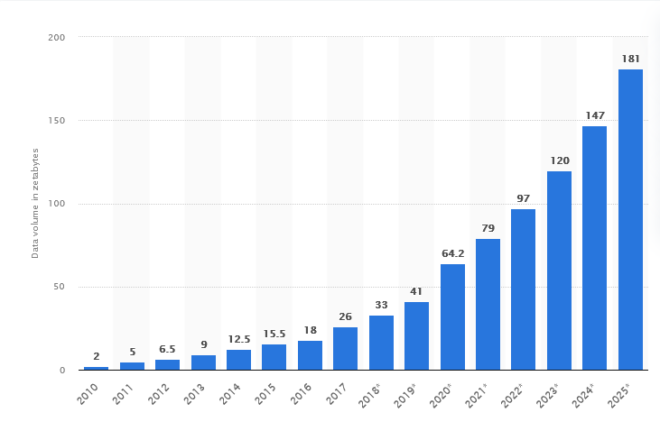
What is data science?
Data science differs from statistics and other disciplines in several important ways:
the ‘data’ part of data science is increasingly heterogeneous: unstructured text, images, video often emanating from networks with complex relationships between their entities [1].
Volume of data/information created, captured, copied, and consumed worldwide from 2010 to 2025 (in zettabytes). Source: Statista

Slide 30
What is data science?
Data science differs from statistics and other disciplines in several important ways:
Analysis, including the combination of the two types of data, requires integration, interpretation, and sense making that is increasingly derived through tools from multiple fields. Most data generated by humans and computers today is for consumption by computers [1].

Slide 31
What is data science?
Scalability: big data helps in decision making providing lots of raw material for the creation of new knowledge.
Scale matters: traditional database models are not particularly suited for knowledge discovery.
They are optimized for fast access and summarization of data, given a user who knows what query they want to ask.
Knowledge discovery searches for patterns in data when users lack a well-formulated query [1].

Slide 32
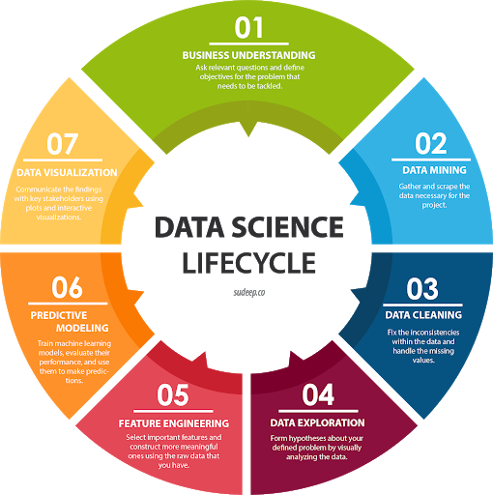
Data Science Lifecycle
Data collection

Slide 33
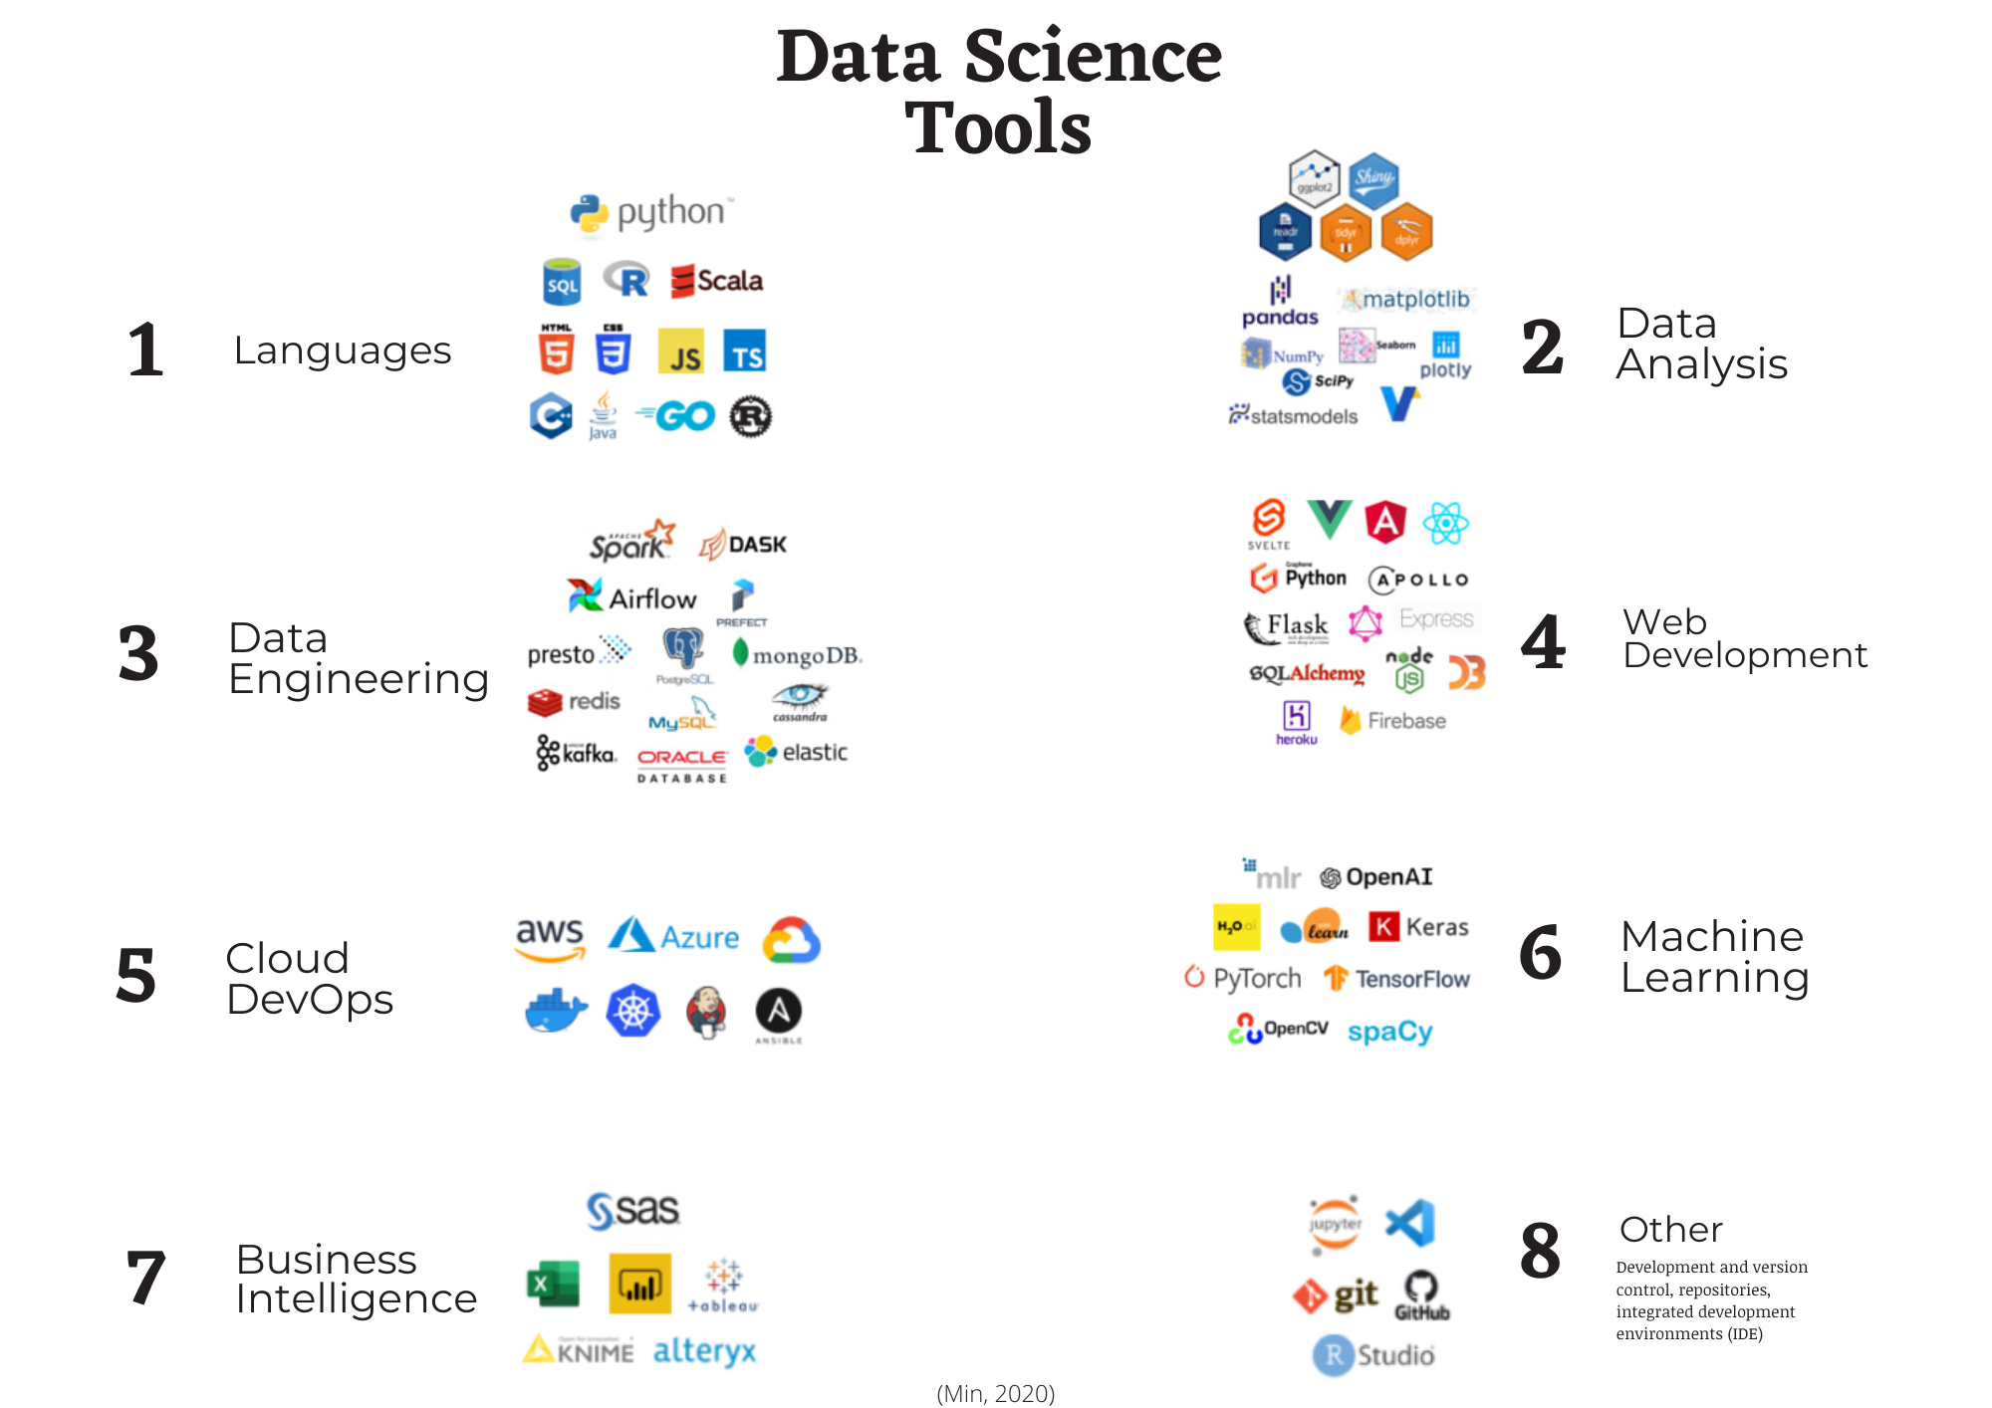
Source: Min

Slide 34
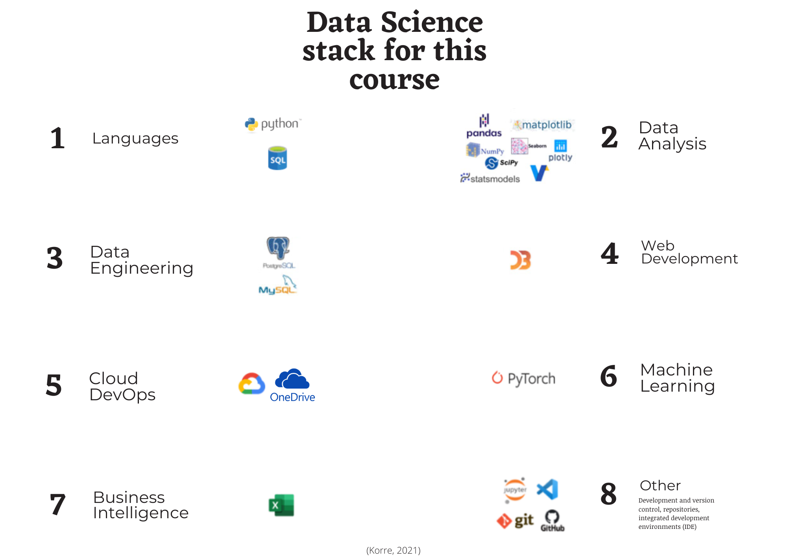

Slide 35
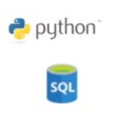
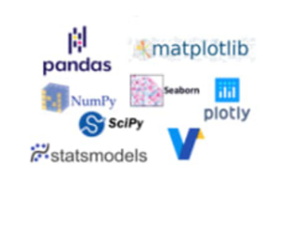
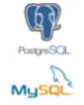


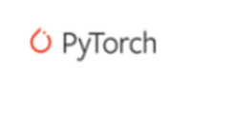
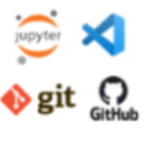


Slide 36
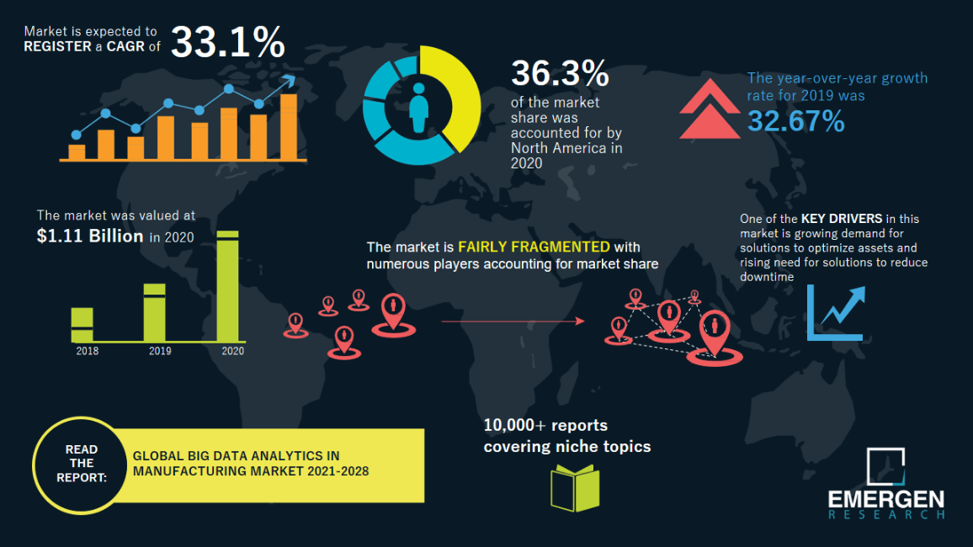
How big is data science in manufacturing?

Slide 37
Notes: How big is data science in manufacturing?
According to one estimate by Emergen Research, “The Big Data Analytics in Manufacturing Industry Market was valued at USD 1.11 billion in 2020 and is expected to reach USD 6.79 billion by 2027, at a CAGR of 33.1% over the forecast period 2021 - 2027. ” [2]

Slide 38
Notes: How big is data science in manufacturing?
In another estimation, “TrendForce forecasts that the size of the global market for smart manufacturing solutions will surpass US$320 billion by 2020.” In another report it was stated that “The global smart manufacturing market size is estimated to reach USD 395.24 billion by 2025, registering a CAGR of 10.7% according to a new study by Grand View Research, Inc.”[3]

Slide 39
Notes: How big is data science in manufacturing?
Big data analytics is a framework of gathering large volume of data for data mining, trend analysis. Over the years, industrialization is taking place at a fast pace and the volume of manufacturing is increasing day by day. Therefore, the massive shift in data generation by manufacturing industry is pushing the global big data analytics in manufacturing industry market. [4]

Slide 40
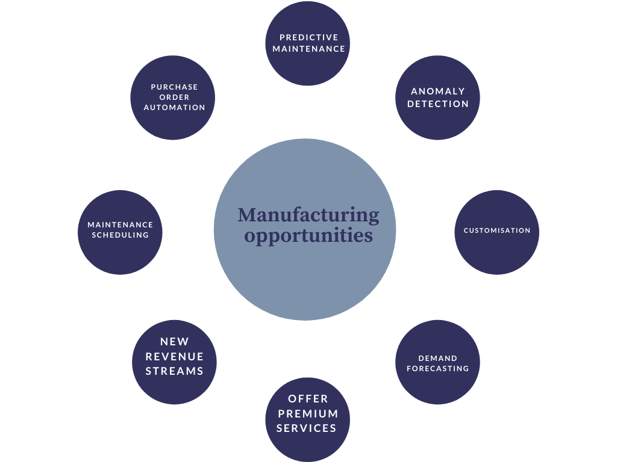
How is data science used in manufacturing
Data science opportunities in manufacturing [5]

Slide 41
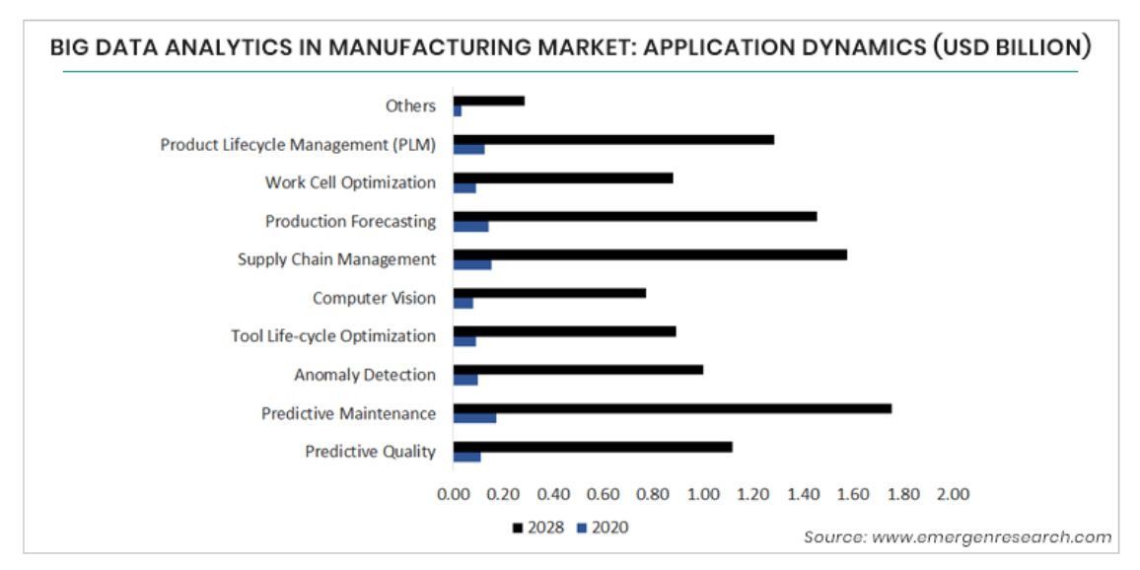
How big is data science in manufacturing? applications and Predictions

Slide 42



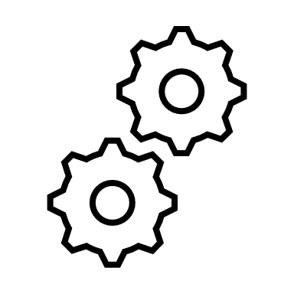
Smart Business: Data-driven manufacturing analytics for value chain
Smart Factory: Enablement of coordinated manufacturing operations
Smart Processes: Enhancement of individual manufacturing processes
Notes:
The data science landscape in other sectors and as fintech is incredibly advanced, with companies hosting large dedicated data science teams with agile organisation and management. This approach is becoming increasingly relevant in adjacent sectors, with the risk the manufacturing community is left behind.
Manufacturering firms typ
The vision of DDM is to be scavengers of data technologies and framework
There is also huge potential for innovative outputs from DDM as the datasets available are generally not found in open source model development environments – NMIS can have key leadership position in developing models and frameworks specifically for the manufacturing sector, drawing in relevant expertise from the data science and manufacturing domains through communities of practice. Our aim is to evaluate, adapt
Scavengers of technologies that are evolving rapidly (MK/AI) which are becoming increasingly relevant in adjacent sectors
Improve the manufacturing communities situational awareness of data science tools and frameworks
Hard for manufacturers to justify a motivated and skills relevant data science team
Maintainig and expanding community of tech vendors of relevant tools
We should not be developing “new” tech – adopting and implementing

Slide 43
`
Smart Business: Data-driven manufacturing analytics for value chain
Smart Factory: Enablement of coordinated manufacturing operations
Smart Processes: Enhancement of individual manufacturing processes
Notes:
The data science landscape in other sectors and as fintech is incredibly advanced, with companies hosting large dedicated data science teams with agile organisation and management. This approach is becoming increasingly relevant in adjacent sectors, with the risk the manufacturing community is left behind.
Manufacturering firms typ
The vision of DDM is to be scavengers of data technologies and framework
There is also huge potential for innovative outputs from DDM as the datasets available are generally not found in open source model development environments – NMIS can have key leadership position in developing models and frameworks specifically for the manufacturing sector, drawing in relevant expertise from the data science and manufacturing domains through communities of practice. Our aim is to evaluate, adapt
Scavengers of technologies that are evolving rapidly (MK/AI) which are becoming increasingly relevant in adjacent sectors
Improve the manufacturing communities situational awareness of data science tools and frameworks
Hard for manufacturers to justify a motivated and skills relevant data science team
Maintainig and expanding community of tech vendors of relevant tools
We should not be developing “new” tech – adopting and implementing

Slide 44

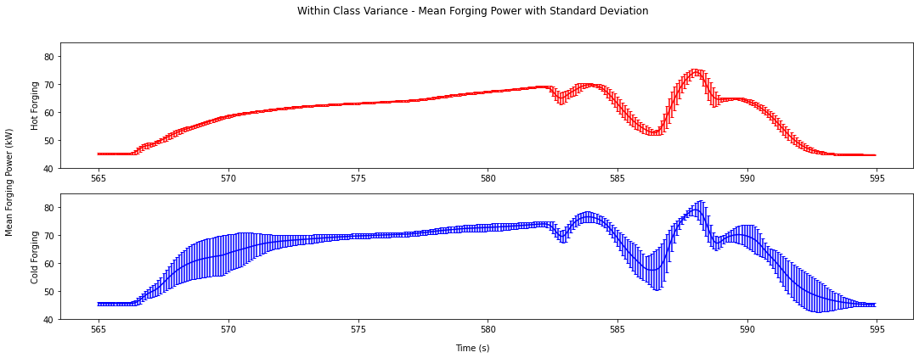
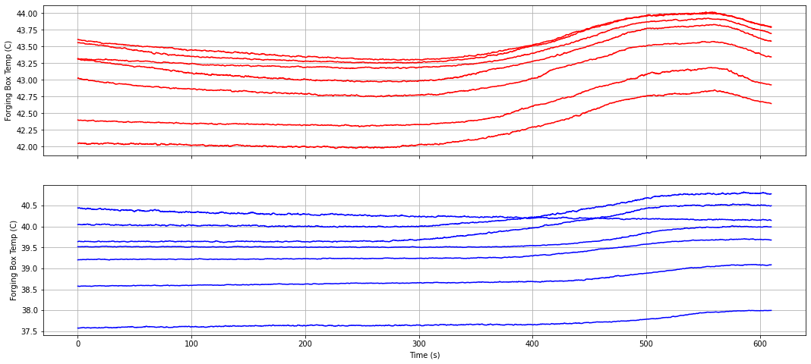
Case Study: Digital Thread
External project led by AFRC technical teams with support of Data Analytics Theme
Objective - explore data engineering/analytics for digital threads of parts manufactured by AFRC Radial Forge and then subsequently machined
Identified machining chatter and currently exploring the relationship with initial radial forging conditions
Notes:
This should be an example of an INTERNAL _colab data project

Slide 45
`
Smart Business: Data-driven manufacturing analytics for value chain
Smart Factory: Enablement of coordinated manufacturing operations
`
Smart Processes: Enhancement of individual manufacturing processes
Notes:
The data science landscape in other sectors and as fintech is incredibly advanced, with companies hosting large dedicated data science teams with agile organisation and management. This approach is becoming increasingly relevant in adjacent sectors, with the risk the manufacturing community is left behind.
Manufacturering firms typ
The vision of DDM is to be scavengers of data technologies and framework
There is also huge potential for innovative outputs from DDM as the datasets available are generally not found in open source model development environments – NMIS can have key leadership position in developing models and frameworks specifically for the manufacturing sector, drawing in relevant expertise from the data science and manufacturing domains through communities of practice. Our aim is to evaluate, adapt
Scavengers of technologies that are evolving rapidly (MK/AI) which are becoming increasingly relevant in adjacent sectors
Improve the manufacturing communities situational awareness of data science tools and frameworks
Hard for manufacturers to justify a motivated and skills relevant data science team
Maintainig and expanding community of tech vendors of relevant tools
We should not be developing “new” tech – adopting and implementing

Slide 46
Example of analytics project : Valve Business
Investigate component variety at valve business on possibility to drive operational improvements.
In particular, the project was in two distinct areas:
Component Similarity.
Determine the degree of component variety and similarity in designs of paddles and valve bodies.
Production Schedules.
Investigate how much schedules can be optimised by taking account of component and feature similarity to reduce overall setup times without compromising on-time delivery.

Slide 47
ShapeSpace model
Works orders
Production operations
Sales order lines
Extracted from Autodesk Vault / Inventor
Extracted from ERP
dupes
similars
linked-by-code
EBOM
MBOM

Slide 48
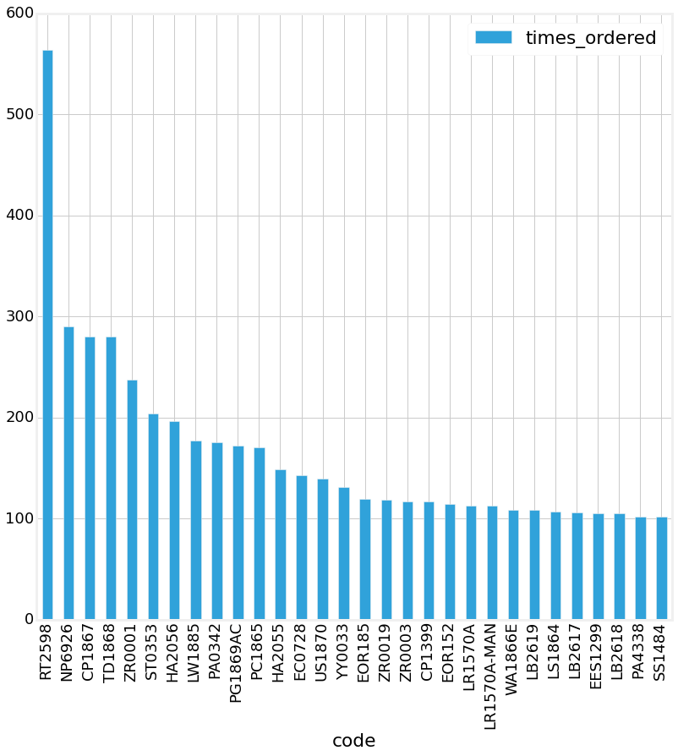
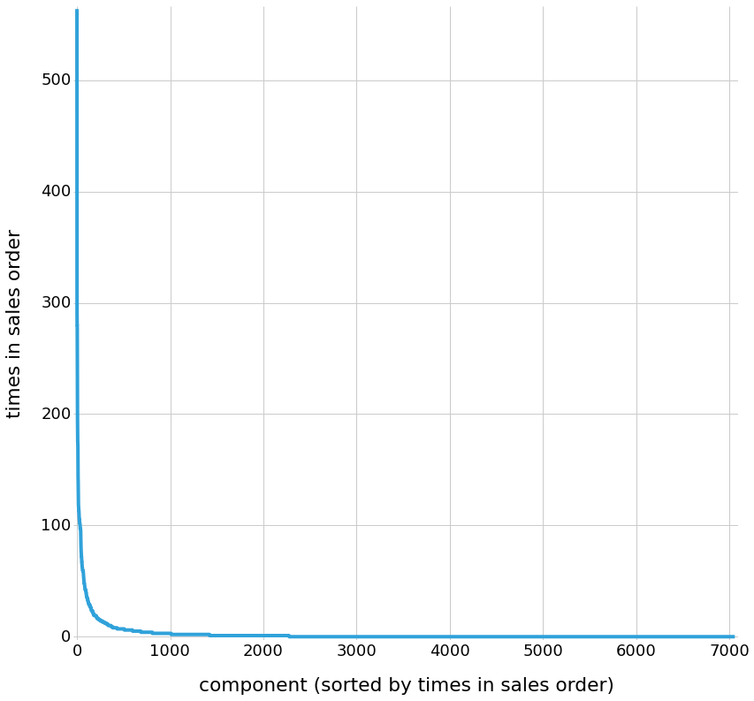
Procurement savings by analysing similar components
Identified frequently used components with high price variance to similar items.
£XXk per year of confirmed cost savings identified.

Slide 49
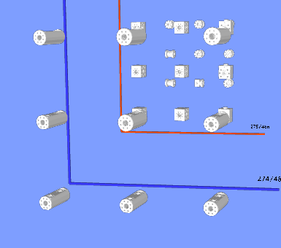
Machining savings by analysing similar components
Identified groups of similar items. Analysed variance of setup times and machining times within groups.
This cluster has the largest potential run time saving of £20,314 (assuming machining rate of £50/hr) if all members of the cluster had the same run time.

Slide 50
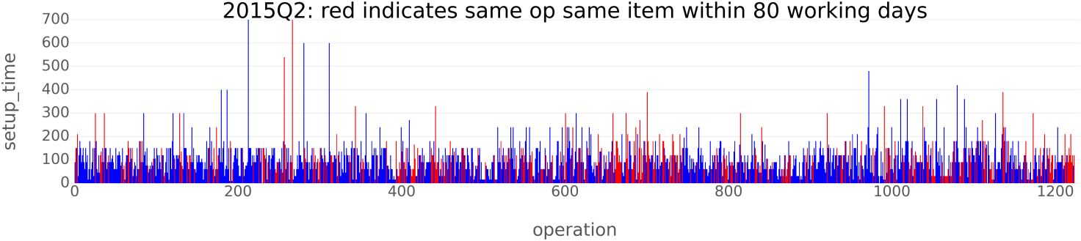
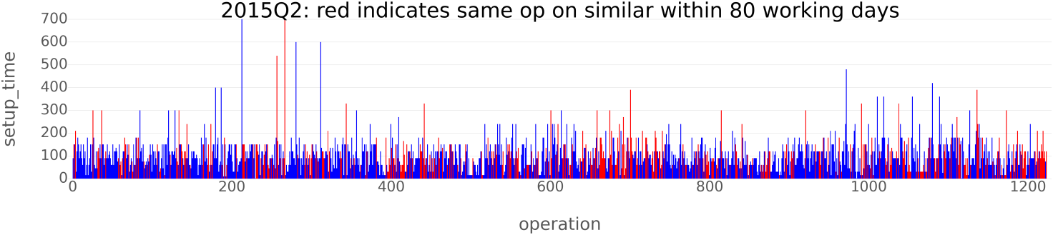
80 working day window

Slide 51
Production Operation Analysis
Analysed how often the same machining operation on the same or similar component was repeated in 4 month planning period.
Around 40% of machining time in set-ups.
Opportunity to reduce set-up times by 33% by batching similar jobs.
Re-engineering process underway to standardise frequently used components to enable larger batch sizes.
Change to a postponement machining strategy – machining some components to a common part-finished state for stock. Then finishing particular operations as demand requires.

Slide 52

Smart Business: Data-driven manufacturing analytics for value chain
`
Smart Factory: Enablement of coordinated manufacturing operations
Smart Processes: Enhancement of individual manufacturing processes
Manufacturing on demand
Notes:
The data science landscape in other sectors and as fintech is incredibly advanced, with companies hosting large dedicated data science teams with agile organisation and management. This approach is becoming increasingly relevant in adjacent sectors, with the risk the manufacturing community is left behind.
Manufacturering firms typ
The vision of DDM is to be scavengers of data technologies and framework
There is also huge potential for innovative outputs from DDM as the datasets available are generally not found in open source model development environments – NMIS can have key leadership position in developing models and frameworks specifically for the manufacturing sector, drawing in relevant expertise from the data science and manufacturing domains through communities of practice. Our aim is to evaluate, adapt
Scavengers of technologies that are evolving rapidly (MK/AI) which are becoming increasingly relevant in adjacent sectors
Improve the manufacturing communities situational awareness of data science tools and frameworks
Hard for manufacturers to justify a motivated and skills relevant data science team
Maintainig and expanding community of tech vendors of relevant tools
We should not be developing “new” tech – adopting and implementing

Slide 53
References
Dhar, V. (2013). "Data science and prediction". Communications of the ACM. 56 (12): 64–73. doi:10.1145/2500499. S2CID 6107147
Emergen Research, h., 2021. Big Data Analytics in Manufacturing Industry Growth 33.1% CAGR During 2020- 2028 | Market Size, Share & Trend. [online] Emergenresearch.com. Available at: <https://www.emergenresearch.com/industry-report/big-data-analytics-in-manufacturing-market> [Accessed 18 October 2021].
Amruthnath, Nagdev. (2020). Data Science in Manufacturing: An Overview.
Big Data Analytics in Manufacturing Industry Market - Global Analysis, Size, Share, Growth, Trends, and Forecast 2019 – 2027 IT & Telecom TMRGL69903 Ongoing Dec 2021
IIoT World, "iiot-world.com," [Online]. Available: https://iiot-world.com/connected-industry/what-data-science-actually-means-to-manufacturing/.
Trapp, R., 2014. Why Businesses Need To Shift Data Analysis From The Center To The Front Line. [online] Forbes. Available at: <https://www.forbes.com/sites/rogertrapp/2014/09/29/why-businesses-need-to-shift-data-analysis-from-the-centre-to-the-front-line/?sh=6c533314773c>

