Slide 1
Data Science in Manufacturing Week 2
Andrew Sherlock, Jonathan corney, Danai Korre

Slide 2
Lecture: Week 2
Data Carpentry

Slide 3
By the end of this lecture you should:
Understand the importance of data quality
Understand data carpentry
How to format data in spreadsheets for effective data use
Carrying out basic quality control and quality assurance

Slide 4
Data carpentry introduction

Slide 5
What is Data Carpentry?
Data carpentry, you may have heard this referred to as data wrangling, refers to the process of cleaning-up and pre-processing your data in order to be able to analyse them properly and derive actionable insights from them.

Slide 6

Why is it important?
GIGO (garbage in - garbage out)
Bad data won’t produce the right information.
Image source: WellDataLabs

Slide 7
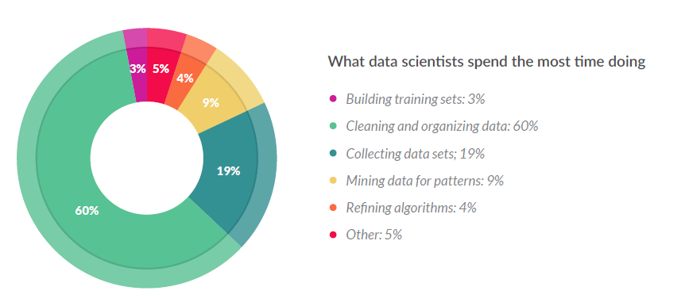
Why is it important?
Source: CrowdFlower

Slide 8
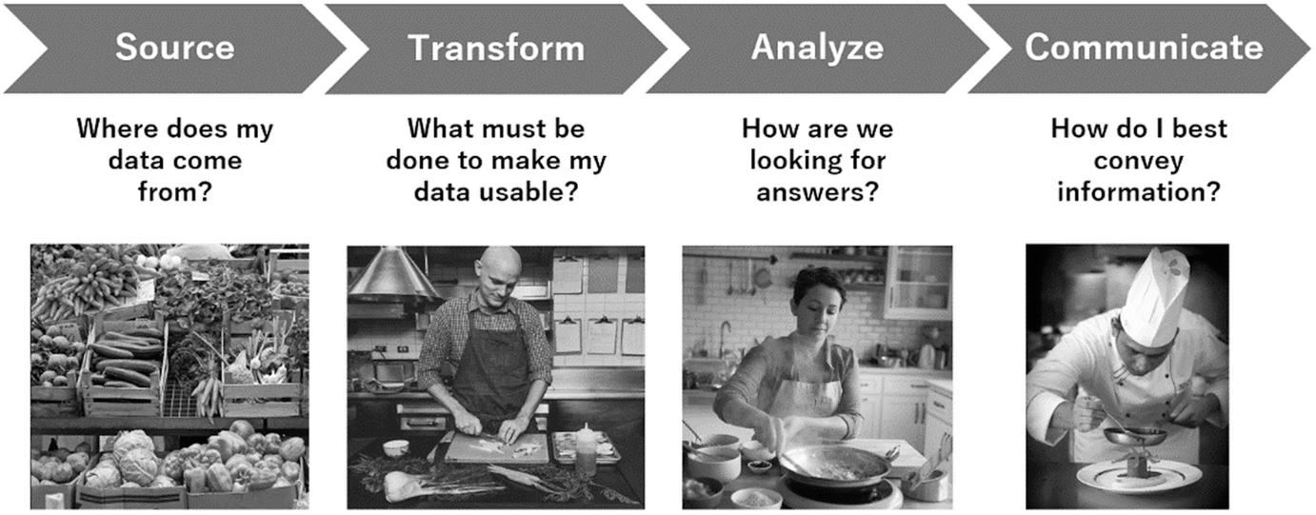
Main parts of working with data
[8]

Slide 9
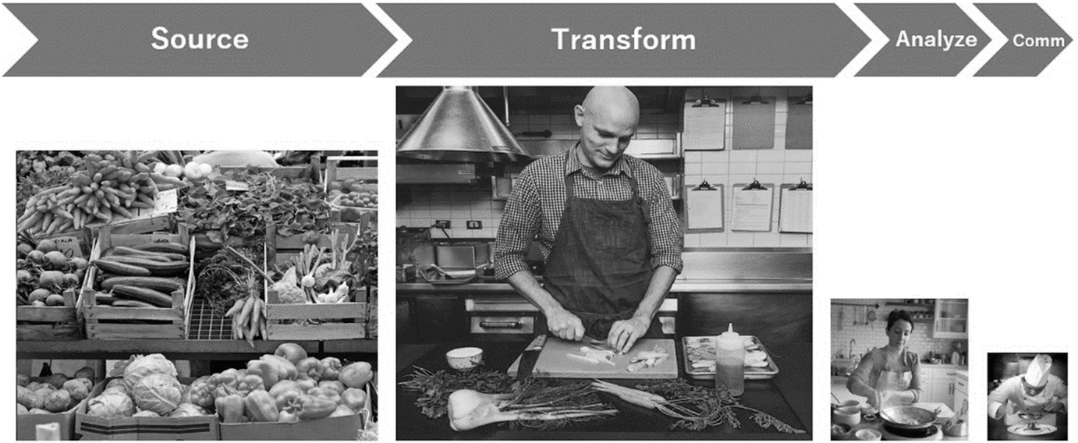
Data carpentry takes the most time

Slide 10
Data mining and Knowledge Discovery Processes
Data carpentry comes before data mining. Data mining is defined as the process of finding anomalies, patterns and correlations within large data sets to predict outcomes. Using a broad range of techniques, you can use this information to increase revenues, cut costs, improve customer relationships, reduce risks and more [2].
Knowledge Discovery Processes (KDP): The process defines a sequence of steps (with eventual feedback loops) that should be followed to discover knowledge (e.g., patterns) in data. [3]

Slide 11
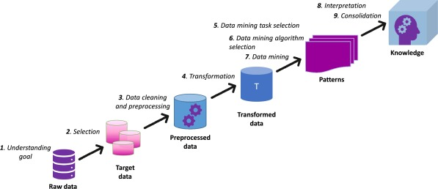
Methodologies for Knowledge Discovery Processes: knowledge discovery in databases (KDD)
Source: Peter Butka, PhD
Notes:
Within the starting field of knowledge discovery in the 1990s, researchers defined the multistep process, which guides users of data mining tools in their knowledge discovery effort. The main idea was to provide a sequence of steps that would help to go through the KDP in an arbitrary domain. As mentioned before, in Fayyad et al. (1996) the authors developed a model known as KDD process.

Slide 12
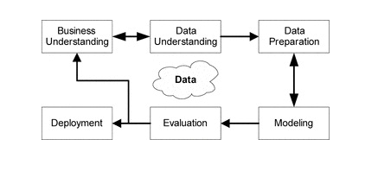
Methodologies for Knowledge Discovery Processes: Cross Industry Standard Process for Data Mining (CRISP-DM)
[4]

Slide 13
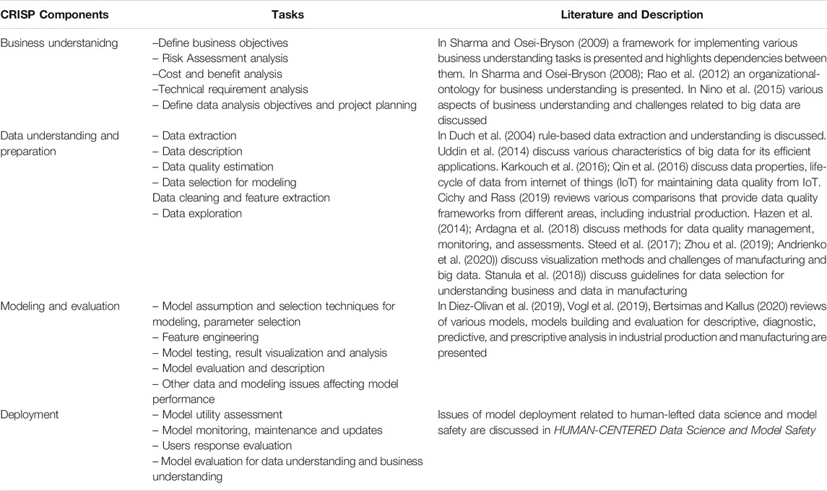
CRISP components
[7]

Slide 14
CRISP components
[7]

Slide 15
knowledge discovery and analysis in manufacturing (KDAM)
Common applications of KDAM include:
detection of root causes of deteriorating product quality,
identification of critical and optimal manufacturing process parameters,
prediction of effects of manufacturing process changes, and
identification of root causes and prediction of equipment breakdown. [4]

Slide 16
Functions particularly relevant to knowledge discovery and analysis in manufacturing (KDAM)
Regression: Defining functional relationships between outputs of interest and multiple and possibly dependent inputs. An example is predicting the dimension of a plastic moulded part given typical ranges of moulding process variables [4].

Slide 17
Functions particularly relevant to knowledge discovery and analysis in manufacturing (KDAM)
Classification: Grouping of objects (products) into classes given previously known input/output (process/product) classifications. An example is association of acceptable and defective parts (two classifications) with the particular production conditions under which the parts were manufactured [4].

Slide 18
Functions particularly relevant to knowledge discovery and analysis in manufacturing (KDAM)
Clustering: Grouping of objects (products) by characteristics where there exist no previously known associations. An example is discovering that a particular employee operating a particular machine tends to produce parts with dimensions on the high side of the target value [4].

Slide 19
Data carpentry process

Slide 20
Data carpentry process
Gathering
Transforming
Cleaning
Storing
Enriching
Validating
Data
Analyse

Slide 21
Transforming
Technique | Definition | Example(s)
Formatting and Encoding | Converting the format of data to the appropriate type | (1) Changing a date that comes to you as a number back to date format; (2) Parsing data that comes from a csv into unique columns; (3) Changing text-based categories to numeric categories so the software can understand it (e.g., Python)
Converting | Transforming data into common units | Transforming global salaries into one common currency so they can be compared
Mathematical Transformation | Using a mathematical process to change data into more useful values | (1) Z-scores (to normalize scale); (2) logarithmic transformations (to make nonlinear data linear)
[5]

Slide 22
Transforming
Technique | Definition | Example(s)
Append, Merge, Filter, or Join | Bringing data in from different tables into one table. | (1) Adding columns to your data, like adding performance data to employee record data; (2) Adding rows to your data, like combining reps from the South Region to a data table containing reps from the East Region; (3) Using criteria to decide which records or fields are included, like creating a table of only employees who are present in both 2019 and 2020 performance reports
Binning | Turning a continuous variable into a categorical one | Turning an engagement survey score (0–100) into a category like “high,” “medium,” and “low”
[5]

Slide 23
Data transformation
Changing data types (discretisation)
Changing range of data values (normalisation)
And many more…
Source: Isabelle Bichindaritz, SUNY Oswego

Slide 24
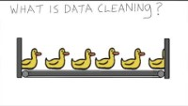
data cleaning
Video source: Data wrangling with MongoDB

Slide 25
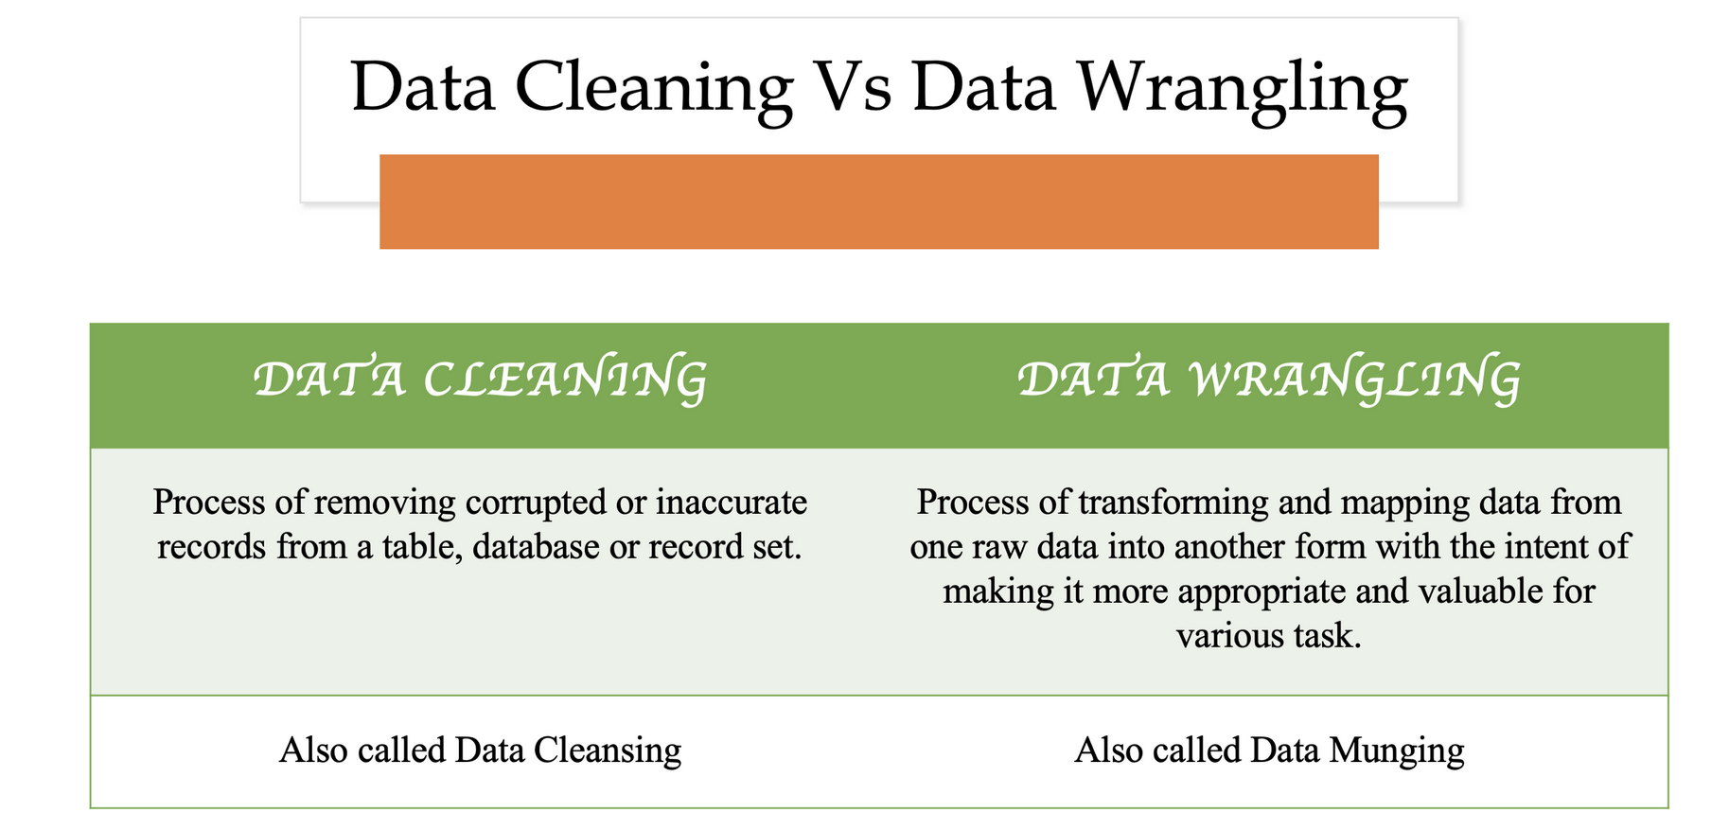
Data cleaning
Slide source: Dr. Monica

Slide 26
Cleaning
Technique | Definition | Example(s)
Imputing | Filling in gaps in your data with educated guesses based on data you do have | Assuming a score on an omitted survey item based on scores provided from similar questions
Check for bad values | Removing corrupted data and bad values. Removing outliers that can potentially skew the results. | In a dataset with values ranging from 1 to 100 there is one that is 300.
Remove duplicates | Removing duplicate entries | Selling data from a specific customer being registered twice
Free-form clean-up | Transforming free-form input data into a standard value. | Changing the values “RU,” “Rutgers,” “Rutgers U,” and “Rutgers New Brunswick” to “Rutgers University” so they can all be tabulated together

Slide 27
Causes for data inaccuracy
Input errors (human errors)
Design errors
Incorrect source data (machine errors)

Slide 28
tools
Excel
OpenRefine
Python

Slide 29
Enriching
The step of enriching your data is optional and refers to the stage of data carpentry where you can augment your data with other data. The combination of your data with data accumulated from other sources can lead to improved accuracy and more meaningful insights [6]. An example would be combining two databases of supplier information where one contains supplier addresses and the other one doesn’t.

Slide 30
validating
According to the Simon (2013), an operational definition of data validation is:
“Data validation could be operationally defined as a process which ensures the correspondence of the final (published) data with a number of quality characteristics.”
[11]

Slide 31
validating
The rules of data validation require repetitive programming processes that help to verify the following:
Quality
Consistency
Accuracy
Security
Authenticity
[9]

Slide 32
validating
Analysis of feedback from stakeholders
Identifying and prioritising problems
Review
Study of datasets, variables and their relations
Assess quality requirements
Satisfactory set of validation rules
Design
Validation rules are formalized
Metrics for data validation rules
Testing and evaluation of results
Refinement of validation rules
Implement
Data are checked against the validation rules
Measure results
Execute
[]

Slide 33
storing
After completing all the steps of data carpentry correctly you should end up with a high-quality dataset that can then be used for analysis to gain insights.
Store your data according to your company's policies
Follow a data management process and be mindful of sensitive data.
Store your data where they can be easily accessed based on the tool you use for analysis.

Slide 34
References
Grieves, Michael. (2005). Product Lifecycle Management: Driving the Next Generation of Lean Thinking.
Sas.com. n.d. What is data mining?. [online] Available at: <https://www.sas.com/en_sg/insights/analytics/data-mining.html>.
Cios, K., 2010. Data mining. New York: Springer.
Mark Polczynski & Andrzej Kochanski (2010) Knowledge Discovery and Analysis in Manufacturing, Quality Engineering, 22:3, 169-181, DOI: 10.1080/08982111003742855
Rosett C.M., Hagerty A. (2021) Data Wrangling. In: Introducing HR Analytics with Machine Learning. Springer, Cham. https://doi.org/10.1007/978-3-030-67626-1_13
Stefanski, R., Sinha, V. and Poddar, A., 2022. Data Wrangling in 6 Steps: An Analyst's Guide For Creating Useful Data. [online] Learn | Hevo. Available at: https://hevodata.com/learn/data-wrangling/#s2
Tripathi, S., Muhr, D., Brunner, M., Jodlbauer, H., Dehmer, M. and Emmert-Streib, F., 2021. Ensuring the Robustness and Reliability of Data-Driven Knowledge Discovery Models in Production and Manufacturing. Frontiers in Artificial Intelligence, 4.
Di Zio, Marco, et al. "Methodology for data validation 1.0." Essnet Validat Foundation, Brussels, Belgium (2016): 1-76.

