Slide 1
Managing Data Science for Social Innovation and Development
Columbia University
NYC Building Energy Utilization
Matthew Zhou, Emily Martinez,
Don Zhongyuan Fang

Slide 2
Background/Context
Global Warming- Climate change
Greener Cities
Greenhouse Gas emissions
Local Law 84- benchmarking online compliance report
Analysis of building energy consumption
City’s greenhouse gas reduction goal of 30% by 2017 below fiscal year 2006 levels
Electricity and natural gas are the two biggest utility type of energy use
Notes:
“Local Law 84 stipulates that all commercial (including multi-family) buildings of 50,000 square feet (approximately 4,645 square meters) or more must report energy and water consumption on an annual basis.” libraries, police stations, firehouses, schools, courthouses, health clinics, community centers and government offices.
such policies including Seattle, San Francisco, and Washington DC, to understand the factors that influence building energy consumption, to create a benchmark for investment-quality comparisons across building types, and to provide the market with sufficient information to account for energy efficiency in investment decisions

Slide 3
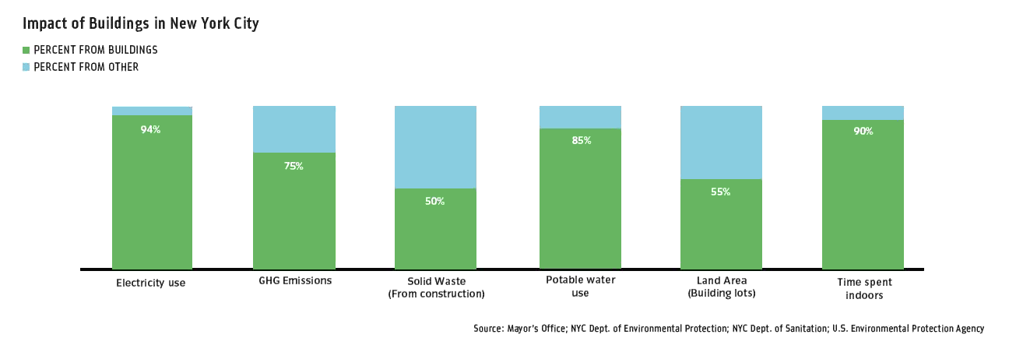
Notes:
“In aggregate, the NYC data is the largest and most current database of observed building energy performance at any scale. It also uniquely describes energy usage across buildings for the nation’s largest city, which is particularly important since the building sector constitutes the largest single sector of energy use in New York City.”

Slide 4
Data Science Outline
QUESTION: What actionable policy insight can we find due to Local Law 84 enforced for its sixth year?
DATA SOURCES*: OpenNYC, 2011-2014 Local Law 84 Energy Benchmarking Data and MapPLUTO NYC Tax lot shape files
TOOLS USED: Python, R, CartoDB
DELIVERABLES & FINDINGS: exploratory analysis and data visualization
OBSTACLES & NEXT STEPS: Cleaning process, adding demographic information and health outcomes, self-reported data and stratification by zip codes, predicting to smaller buildings
*Data Sources and code used may be found here: https://github.com/DataSciNYCEnergyUse/datasets
Notes:
Energy Benchmarking Dataset contains information as energy use intensity (EUI), GHG intensity, and an ENERGY STAR scores calculated by the U.S. EPA’s Portfolio Manager benchmarking tool for each City building. Other variables include, property size, weather EUI, and property type
the EUI expresses a building’s energy use as a function of its size or other characteristics
For eligible facilities Portfolio Manager rates energy performance on a scale of 1–100 enabling building managers to see how their facilities are performing relative to similar buildings nationwide.
Weather normalized energy is a means of adjusting for weather and should be used to compare a building to itself over time.
EPA relies on source EUI as the basis for the ENERGY STAR score
when measuring total energy usage to determine environmental impacts, the source energy is the more accurate measurement - See more at: http://sustainabilityworkshop.autodesk.com/buildings/measuring-building-energy-use#sthash.rPJWoy64.dpuf

Slide 5
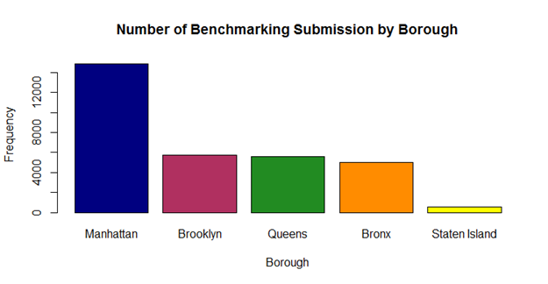
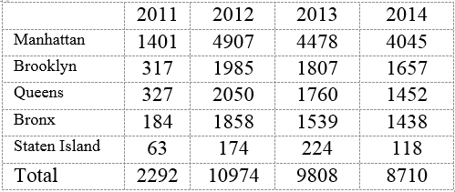
Notes:
Cleaning process: Many outliers and missing data - data entry errors and errors in reporting. In previous analysis conducted on this data, removed remove top and bottom 5% of EUIs and buildings with EUI below 5 or above 1,000 kBtu/psf
Energy Use Intensity, or EUI, which is calculated as the total energy use of the building divided by floor area in units of kBTU per square foot
The two biggest property types are multifamily housing and offices.

Slide 6
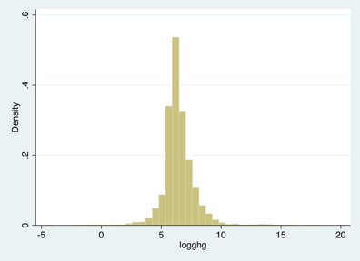
Log-transformed Histogram of Total Greenhouse Gas Emissions in Manhattan

Slide 7
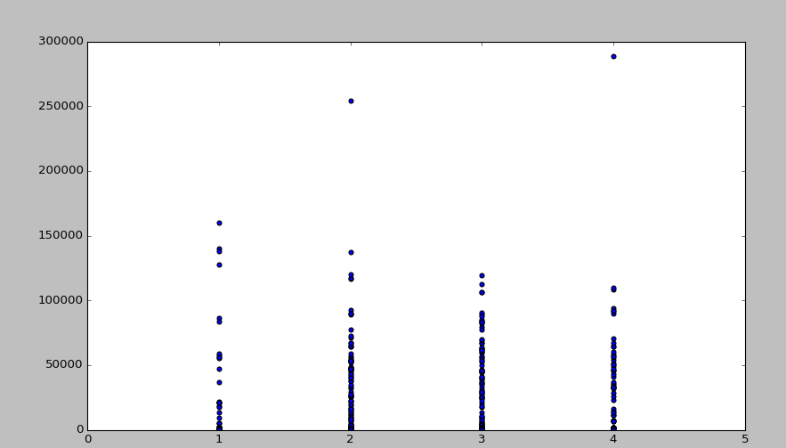
By using library matplotlib.pyplot, we are able to get the scatter charts which shows the relationship between Year and Site_EUI (see below)
Scatterplot of Site Energy Use Intensity, 2011-2014
Notes:
We also use Python to analyze the data that we have. We use python library Pandas to read the csv/excel file and load the 31,796 benchmarking submissions in total from 2011 to 2014 across NYC. After load the data file, we set variables such as Site_EUI, Property_Floor_Area, Total_GHG_Emissions, and Year.
By using library matplotlib.pyplot, we are able to get the scatter charts which showing the relationship between Year and Site_EUI ; and the relationship between Property_Floor_Area and Total_GHG_Emissions. We also use python library Pandas to conduct Regression Analysis on the relationship between Year and Site_EUI, and between Property_Floor_Area and Total_GHG_Emissions.

Slide 8
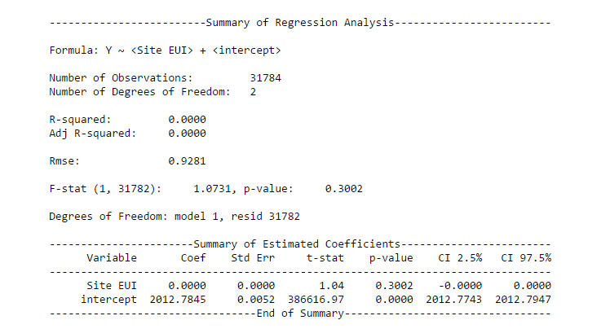
Regression Analysis on Year and Site EUI

Slide 9
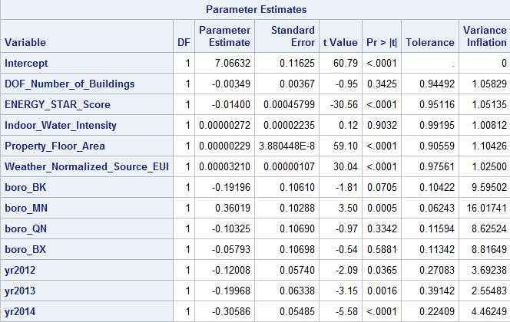
Significant Predictors of GHG Emissions in Benchmarked Buildings
Energy Star Score
Property Floor Area
Site EUI
Weather Score EUI
Manhattan
Years

Slide 10
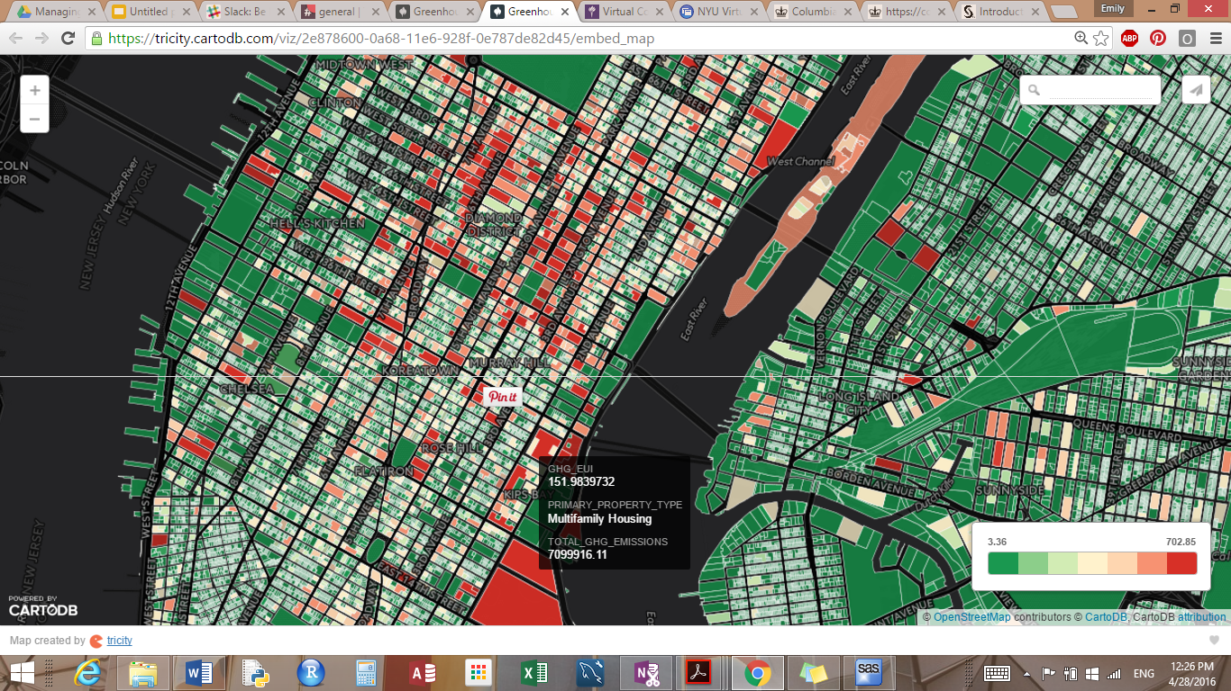
GHG vs. EUI
https://tricity.cartodb.com/viz/2e878600-0a68-11e6-928f-0e787de82d45/embed_map
Notes:
display Type of Property, the ratio of GHG/EUI, and the total GHG produced from that building
building in red are giving off a lot of carbon emissions even when their energy use (self-reported) is low. So people are underreporting.
red represents a higher ratio of carbon emissions relative to the energy that they use
there still are a lot of holes in our dataset when it comes to Queens and Brooklyn
Definition for Source EUI: total amount of all the raw fuel required to operate a property, including losses that take place during generation, transmission, and distribution of the energy in kBtus per gross square foot (kBtu/ft2) of the property
Difference between site EUI and source energy EUI
The energy intensity values in the tables above only consider the amount of electricity and fuel that are used on-site ("secondary" or "site" energy). They do not consider the fuel consumed to generate that heat or electricity. Many building codes and some tabulations of EUI attempt to capture the total impact of delivering energy to a building by defining the term "primary" or "source" energy which includes the fuel used to generate power on-site or at a power plant far away. - See more at: http://sustainabilityworkshop.autodesk.com/buildings/measuring-building-energy-use#sthash.rPJWoy64.dpuf

Slide 11
References & Places to Visit for more Information
Local Law 84 Energy Benchmarking Data Report to the New York City Mayor’s Office of Long-Term Planning and Sustainability (April 11, 2012). Dr. Constantine Kontokosta, Deputy Director of the New York University (NYU) Center for Urban Science and Progress (CUSP) and Founding Director of the NYU Schack Institute's Center for the Sustainable Built Environment.
City of New York LL84 Data Analysis & Quality Assessment (in PDF) (March 14, 2012). Dr. David Hsu, Assistant Professor in the Department of City and Regional Planning at the University of Pennsylvania
New York City Government Building Energy Benchmarking Results 2010 – 2013 http://www.nyc.gov/html/gbee/downloads/pdf/2013%20Annual%20LL84%20Municipal%20Report.pdf
Energy Benchmarking Report for New York City Municipal Buildings November 2011 http://www.nyc.gov/html/planyc/downloads/pdf/publications/Benchmarking-Report-11-23-11.pdf

