Slide 1
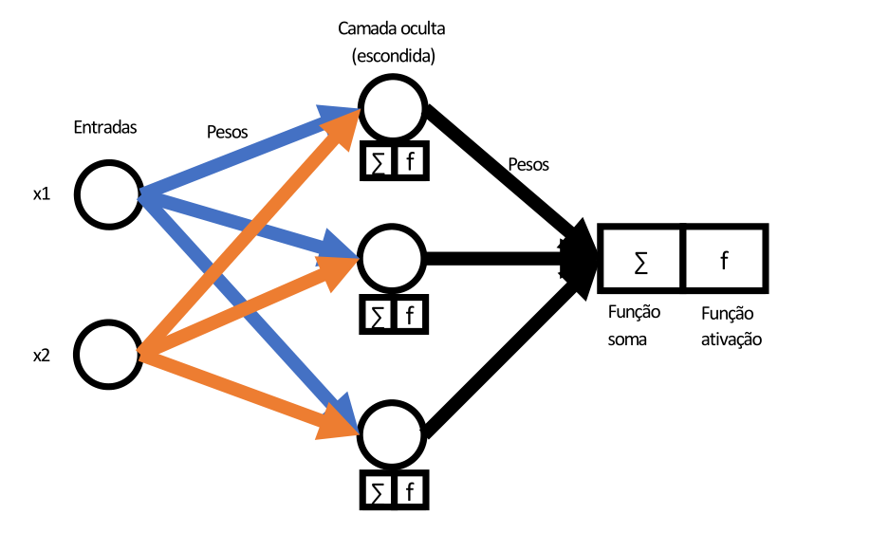
Artificial Neural Networks
Multilayer Perceptron
Hidden Layer
Weight
Weight
Output
Input
Sum
Function
Step
Function

Slide 2
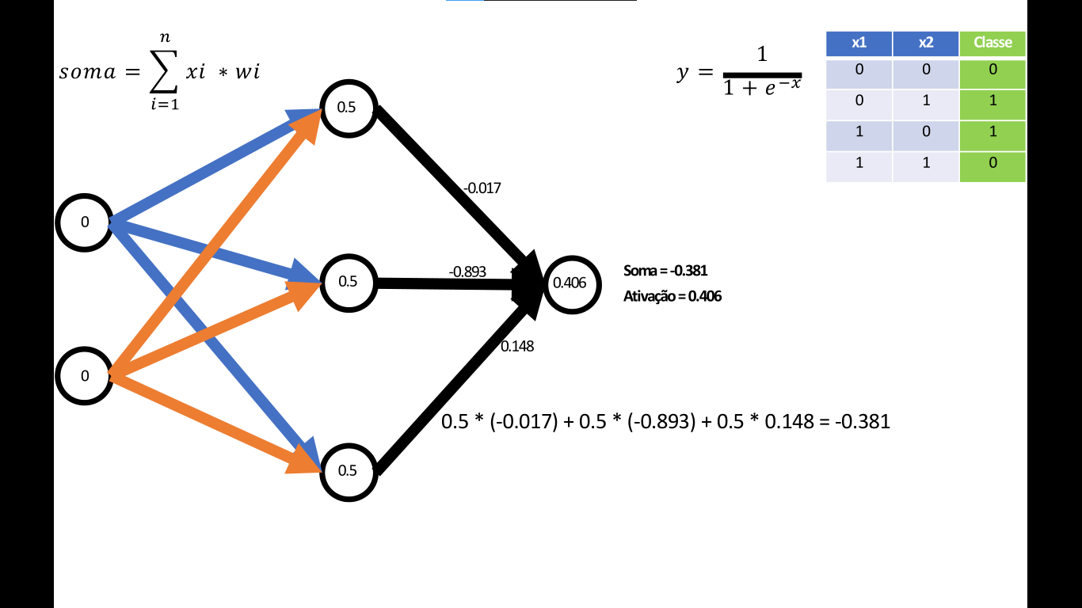
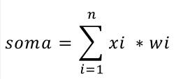
Hidden Layer Calculations for Output Layer

Slide 3
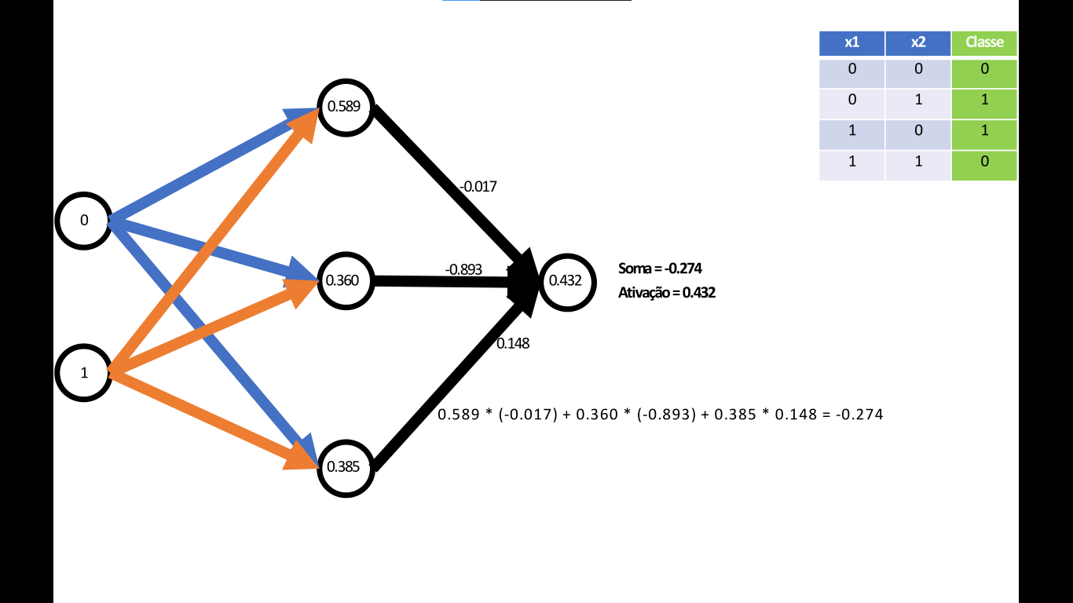
Hidden Layer Calculations for Output Layer

Slide 4

Hidden Layer Calculations for Output Layer

Slide 5

Hidden Layer Calculations for Output Layer

