Slide 1
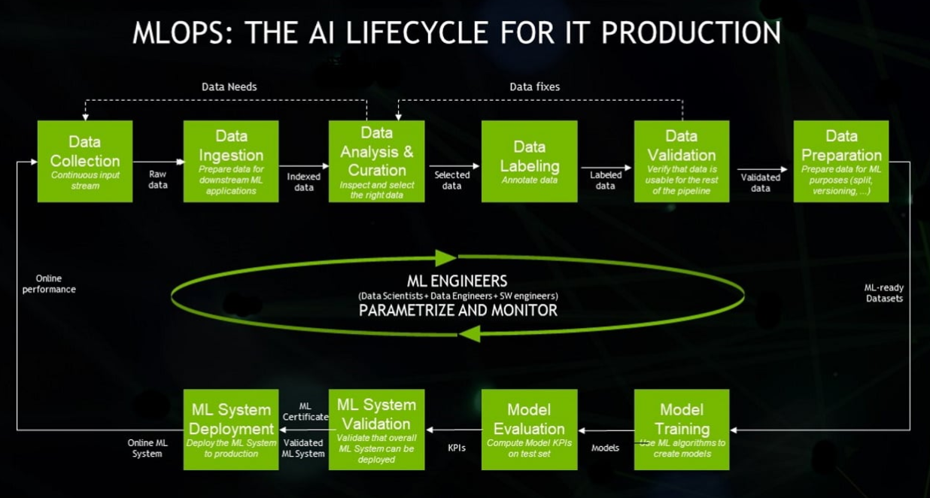
Layer 1 - Data
Data
Collection
Data
Ingestion
Data
Analysis
Data
Labeling
Data
Validation
Data
Preparation
Layer 2 – Machine Learning
Machine
Learning
Deployment
Machine
Learning
Validation
Model
Valuation
Model
Training

Slide 2

Layer 1 - Data
Data
Collection
Data
Ingestion
Data
Analysis
Data
Labeling
Data
Validation
Data
Preparation
Layer 2 – Machine Learning
How to Implement Data Engineering in Practice? #DataEngineering #MLOps
@AndreVianna_BRR
Machine
Learning
Deployment
Machine
Learning
Validation
Model
Valuation
Model
Training

Slide 3
MLOps (Machine Learning Operations)
Layer 1 - Data
Data
Collection
Data
Ingestion
Data
Analysis
Data
Labeling
Data
Validation
Data
Preparation
Layer 2 – Machine Learning
How to Implement Data Engineering in Practice? #DataEngineering #MLOps
@AndreVianna_BRR
Machine
Learning
Deployment
Machine
Learning
Validation
Model
Valuation
Model
Training

Slide 4
MLOps (Machine Learning Operations)
Layer 1 - Data
Data
Collection
Data
Ingestion
Data
Analysis
Data
Labeling
Data
Validation
Data
Preparation
Layer 2 – Machine Learning
How to Implement Data Engineering in Practice? #DataEngineering #MLOps
@AndreVianna_BRR
Machine
Learning
Deployment
Machine
Learning
Validation
Model
Valuation
Model
Training

Slide 5
MLOps (Machine Learning Operations)
Layer 1 - Data
Data
Collection
Data
Ingestion
Data
Analysis
Data
Labeling
Data
Validation
Data
Preparation
Layer 2 – Machine Learning
How to Implement Data Engineering in Practice? #DataEngineering #MLOps
@AndreVianna_BRR
Machine
Learning
Deployment
Machine
Learning
Validation
Model
Valuation
Model
Training

Slide 6
MLOps (Machine Learning Operations)
Layer 1 - Data
Data
Collection
Data
Ingestion
Data
Analysis
Data
Labeling
Data
Validation
Data
Preparation
Layer 2 – Machine Learning
How to Implement Data Engineering in Practice? #DataEngineering #MLOps
@AndreVianna_BRR
Machine
Learning
Deployment
Machine
Learning
Validation
Model
Valuation
Model
Training

Slide 7
MLOps (Machine Learning Operations)
Layer 1 - Data
Data
Collection
Data
Ingestion
Data
Analysis
Data
Labeling
Data
Validation
Data
Preparation
Layer 2 – Machine Learning
How to Implement Data Engineering in Practice? #DataEngineering #MLOps
@AndreVianna_BRR
Machine
Learning
Deployment
Machine
Learning
Validation
Model
Valuation
Model
Training

Slide 8
MLOps (Machine Learning Operations)
Layer 1 - Data
Data
Collection
Data
Ingestion
Data
Analysis
Data
Labeling
Data
Validation
Data
Preparation
Layer 2 – Machine Learning
How to Implement Data Engineering in Practice? #DataEngineering #MLOps
@AndreVianna_BRR
Machine
Learning
Deployment
Machine
Learning
Validation
Model
Valuation
Model
Training

Slide 9
MLOps (Machine Learning Operations)
Layer 1 - Data
Data
Collection
Data
Ingestion
Data
Analysis
Data
Labeling
Data
Validation
Data
Preparation
Layer 2 – Machine Learning
How to Implement Data Engineering in Practice? #DataEngineering #MLOps
@AndreVianna_BRR
Machine
Learning
Deployment
Machine
Learning
Validation
Model
Valuation
Model
Training

Slide 10
MLOps (Machine Learning Operations)
Layer 1 - Data
Data
Collection
Data
Ingestion
Data
Analysis
Data
Labeling
Data
Validation
Data
Preparation
Layer 2 – Machine Learning
How to Implement Data Engineering in Practice? #DataEngineering #MLOps
@AndreVianna_BRR
Machine
Learning
Deployment
Machine
Learning
Validation
Model
Valuation
Model
Training

Slide 11
MLOps (Machine Learning Operations)
Layer 1 - Data
Data
Collection
Data
Ingestion
Data
Analysis
Data
Labeling
Data
Validation
Data
Preparation
Layer 2 – Machine Learning
How to Implement Data Engineering in Practice? #DataEngineering #MLOps
@AndreVianna_BRR
Machine
Learning
Deployment
Machine
Learning
Validation
Model
Valuation
Model
Training

Slide 12
MLOps (Machine Learning Operations)
Layer 1 - Data
Data
Collection
Data
Ingestion
Data
Analysis
Data
Labeling
Data
Validation
Data
Preparation
Layer 2 – Machine Learning
How to Implement Data Engineering in Practice? #DataEngineering #MLOps
@AndreVianna_BRR
Machine
Learning
Deployment
Machine
Learning
Validation
Model
Valuation
Model
Training

Slide 13
MLOps (Machine Learning Operations)
Layer 1 - Data
Data
Collection
Data
Ingestion
Data
Analysis
Data
Labeling
Data
Validation
Data
Preparation
Layer 2 – Machine Learning
How to Implement Data Engineering in Practice? #DataEngineering #MLOps
@AndreVianna_BRR
Machine
Learning
Deployment
Machine
Learning
Validation
Model
Valuation
Model
Training

Slide 14
MLOps (Machine Learning Operations)
Layer 1 - Data
Data
Collection
Data
Ingestion
Data
Analysis
Data
Labeling
Data
Validation
Data
Preparation
Layer 2 – Machine Learning
How to Implement Data Engineering in Practice? #DataEngineering #MLOps
@AndreVianna_BRR
Machine
Learning
Deployment
Machine
Learning
Validation
Model
Valuation
Model
Training

Slide 15
MLOps (Machine Learning Operations)
Layer 1 - Data
Data
Collection
Data
Ingestion
Data
Analysis
Data
Labeling
Data
Validation
Data
Preparation
Layer 2 – Machine Learning
How to Implement Data Engineering in Practice? #DataEngineering #MLOps
@AndreVianna_BRR
Machine
Learning
Deployment
Machine
Learning
Validation
Model
Valuation
Model
Training

Slide 16
MLOps (Machine Learning Operations)
Layer 1 - Data
Data
Collection
Data
Ingestion
Data
Analysis
Data
Labeling
Data
Validation
Data
Preparation
Layer 2 – Machine Learning
How to Implement Data Engineering in Practice? #DataEngineering #MLOps
@AndreVianna_BRR
Machine
Learning
Deployment
Machine
Learning
Validation
Model
Valuation
Model
Training

Slide 17
MLOps (Machine Learning Operations)
Layer 1 - Data
Data
Collection
Data
Ingestion
Data
Analysis
Data
Labeling
Data
Validation
Data
Preparation
Layer 2 – Machine Learning
How to Implement Data Engineering in Practice? #DataEngineering #MLOps
@AndreVianna_BRR
Machine
Learning
Deployment
Machine
Learning
Validation
Model
Valuation
Model
Training

Slide 18
MLOps (Machine Learning Operations)
Layer 1 - Data
Data
Collection
Data
Ingestion
Data
Analysis
Data
Labeling
Data
Validation
Data
Preparation
Layer 2 – Machine Learning
How to Implement Data Engineering in Practice? #DataEngineering #MLOps
@AndreVianna_BRR
Machine
Learning
Deployment
Machine
Learning
Validation
Model
Valuation
Model
Training

Slide 19
MLOps (Machine Learning Operations)
Layer 1 - Data
Data
Collection
Data
Ingestion
Data
Analysis
Data
Labeling
Data
Validation
Data
Preparation
Layer 2 – Machine Learning
How to Implement Data Engineering in Practice? #DataEngineering #MLOps
@AndreVianna_BRR
Machine
Learning
Deployment
Machine
Learning
Validation
Model
Valuation
Model
Training

Slide 20
MLOps (Machine Learning Operations)
Layer 1 - Data
Data
Collection
Data
Ingestion
Data
Analysis
Data
Labeling
Data
Validation
Data
Preparation
Layer 2 – Machine Learning
How to Implement Data Engineering in Practice? #DataEngineering #MLOps
@AndreVianna_BRR
Machine
Learning
Deployment
Machine
Learning
Validation
Model
Valuation
Model
Training

Slide 21
MLOps (Machine Learning Operations)
Layer 1 - Data
Data
Collection
Data
Ingestion
Data
Analysis
Data
Labeling
Data
Validation
Data
Preparation
Layer 2 – Machine Learning
How to Implement Data Engineering in Practice? #DataEngineering #MLOps
@AndreVianna_BRR
Machine
Learning
Deployment
Machine
Learning
Validation
Model
Valuation
Model
Training

Slide 22

MLOps (Machine Learning Operations)
Layer 1 - Data
Data
Collection
Data
Ingestion
Data
Analysis
Data
Labeling
Data
Validation
Data
Preparation
Layer 2 – Machine Learning
How to Implement Data Engineering in Practice? #DataEngineering #MLOps
@AndreVianna_BRR
Machine
Learning
Deployment
Machine
Learning
Validation
Model
Valuation
Model
Training

Slide 23
MLOps (Machine Learning Operations)
Layer 1 - Data
Data
Collection
Data
Ingestion
Data
Analysis
Data
Labeling
Data
Validation
Data
Preparation
Layer 2 – Machine Learning
Forecast
How to Implement Data Engineering in Practice? #DataEngineering #MLOps
@AndreVianna_BRR
Machine
Learning
Deployment
Machine
Learning
Validation
Model
Valuation
Model
Training

Slide 24

MLOps (Machine Learning Operations)
Layer 1 - Data
Data
Collection
Data
Ingestion
Data
Analysis
Data
Labeling
Data
Validation
Data
Preparation
Layer 2 – Machine Learning
Forecast
How to Implement Data Engineering in Practice? #DataEngineering #MLOps
@AndreVianna_BRR
Machine
Learning
Deployment
Machine
Learning
Validation
Model
Valuation
Model
Training

Slide 25
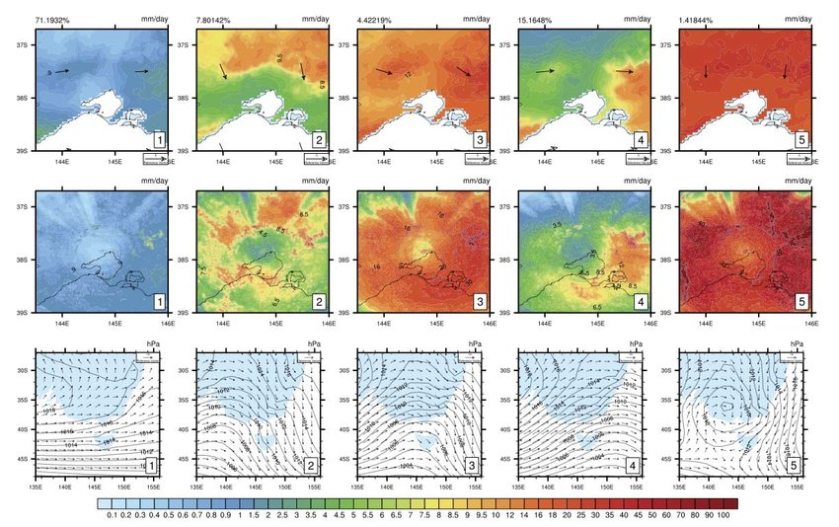
MLOps (Machine Learning Operations)
Layer 1 - Data
Data
Collection
Data
Ingestion
Data
Analysis
Data
Labeling
Data
Validation
Data
Preparation
Layer 2 – Machine Learning
Forecast
How to Implement Data Engineering in Practice? #DataEngineering #MLOps
@AndreVianna_BRR
Machine
Learning
Deployment
Machine
Learning
Validation
Model
Valuation
Model
Training

Slide 26
MLOps (Machine Learning Operations)
Layer 1 - Data
Data
Collection
Data
Ingestion
Data
Analysis
Data
Labeling
Data
Validation
Data
Preparation
Layer 2 – Machine Learning
Forecast
How to Implement Data Engineering in Practice? #DataEngineering #MLOps
User
@AndreVianna_BRR
Machine
Learning
Deployment
Machine
Learning
Validation
Model
Valuation
Model
Training

Slide 27
MLOps (Machine Learning Operations)
Layer 1 - Data
Data
Collection
Data
Ingestion
Data
Analysis
Data
Labeling
Data
Validation
Data
Preparation
Layer 2 – Machine Learning
Forecast
How to Implement Data Engineering in Practice? #DataEngineering #MLOps
User
@AndreVianna_BRR
Machine
Learning
Deployment
Machine
Learning
Validation
Model
Valuation
Model
Training

Slide 28
MLOps (Machine Learning Operations)
Layer 1 - Data
Data
Collection
Data
Ingestion
Data
Analysis
Data
Labeling
Data
Validation
Data
Preparation
Layer 2 – Machine Learning
Forecast
How to Implement Data Engineering in Practice? #DataEngineering #MLOps
User
@AndreVianna_BRR
Machine
Learning
Deployment
Machine
Learning
Validation
Model
Valuation
Model
Training

Slide 29
MLOps (Machine Learning Operations)
Layer 1 - Data
Data
Collection
Data
Ingestion
Data
Analysis
Data
Labeling
Data
Validation
Data
Preparation
Layer 2 – Machine Learning
Forecast
How to Implement Data Engineering in Practice? #DataEngineering #MLOps
User
@AndreVianna_BRR
Machine
Learning
Deployment
Machine
Learning
Validation
Model
Valuation
Model
Training

Slide 30
MLOps (Machine Learning Operations)
Layer 1 - Data
Data
Collection
Data
Ingestion
Data
Analysis
Data
Labeling
Data
Validation
Data
Preparation
Layer 2 – Machine Learning
Forecast
How to Implement Data Engineering in Practice? #DataEngineering #MLOps
User
@AndreVianna_BRR
Machine
Learning
Deployment
Machine
Learning
Validation
Model
Valuation
Model
Training

Slide 31
MLOps (Machine Learning Operations)
Layer 1 - Data
Data
Collection
Data
Ingestion
Data
Analysis
Data
Labeling
Data
Validation
Data
Preparation
Layer 2 – Machine Learning
Forecast
How to Implement Data Engineering in Practice? #DataEngineering #MLOps
User
@AndreVianna_BRR
Machine
Learning
Deployment
Machine
Learning
Validation
Model
Valuation
Model
Training

Slide 32
MLOps (Machine Learning Operations)
Layer 1 - Data
Data
Collection
Data
Ingestion
Data
Analysis
Data
Labeling
Data
Validation
Data
Preparation
Layer 2 – Machine Learning
Forecast
How to Implement Data Engineering in Practice? #DataEngineering #MLOps
User
@AndreVianna_BRR
Machine
Learning
Deployment
Machine
Learning
Validation
Model
Valuation
Model
Training

Slide 33
MLOps (Machine Learning Operations)
Layer 1 - Data
Data
Collection
Data
Ingestion
Data
Analysis
Data
Labeling
Data
Validation
Data
Preparation
Layer 2 – Machine Learning
Forecast
How to Implement Data Engineering in Practice? #DataEngineering #MLOps
User
@AndreVianna_BRR
Machine
Learning
Deployment
Machine
Learning
Validation
Model
Valuation
Model
Training

Slide 34
MLOps (Machine Learning Operations)
Layer 1 - Data
Data
Collection
Data
Ingestion
Data
Analysis
Data
Labeling
Data
Validation
Data
Preparation
Layer 2 – Machine Learning
Forecast
How to Implement Data Engineering in Practice? #DataEngineering #MLOps
User
@AndreVianna_BRR
Machine
Learning
Deployment
Machine
Learning
Validation
Model
Valuation
Model
Training

Slide 35
MLOps (Machine Learning Operations)
Layer 1 - Data
Data
Collection
Data
Ingestion
Data
Analysis
Data
Labeling
Data
Validation
Data
Preparation
Layer 2 – Machine Learning
Forecast
How to Implement Data Engineering in Practice? #DataEngineering #MLOps
User
@AndreVianna_BRR
Machine
Learning
Deployment
Machine
Learning
Validation
Model
Valuation
Model
Training

Slide 36
MLOps (Machine Learning Operations)
Layer 1 - Data
Data
Collection
Data
Ingestion
Data
Analysis
Data
Labeling
Data
Validation
Data
Preparation
Layer 2 – Machine Learning
Forecast
How to Implement Data Engineering in Practice? #DataEngineering #MLOps
User
@AndreVianna_BRR
Machine
Learning
Deployment
Machine
Learning
Validation
Model
Valuation
Model
Training

Slide 37
MLOps (Machine Learning Operations)
Layer 1 - Data
Data
Collection
Data
Ingestion
Data
Analysis
Data
Labeling
Data
Validation
Data
Preparation
Layer 2 – Machine Learning
Forecast
How to Implement Data Engineering in Practice? #DataEngineering #MLOps
User
@AndreVianna_BRR
Machine
Learning
Deployment
Machine
Learning
Validation
Model
Valuation
Model
Training

Slide 38
MLOps (Machine Learning Operations)
Layer 1 - Data
Data
Collection
Data
Ingestion
Data
Analysis
Data
Labeling
Data
Validation
Data
Preparation
Layer 2 – Machine Learning
Forecast
How to Implement Data Engineering in Practice? #DataEngineering #MLOps
User
@AndreVianna_BRR
Machine
Learning
Deployment
Machine
Learning
Validation
Model
Valuation
Model
Training

Slide 39
MLOps (Machine Learning Operations)
Layer 1 - Data
Data
Collection
Data
Ingestion
Data
Analysis
Data
Labeling
Data
Validation
Data
Preparation
Layer 2 – Machine Learning
Forecast
How to Implement Data Engineering in Practice? #DataEngineering #MLOps
User
@AndreVianna_BRR
Machine
Learning
Deployment
Machine
Learning
Validation
Model
Valuation
Model
Training

Slide 40
MLOps (Machine Learning Operations)
Layer 1 - Data
Data
Collection
Data
Ingestion
Data
Analysis
Data
Labeling
Data
Validation
Data
Preparation
Layer 2 – Machine Learning
Forecast
How to Implement Data Engineering in Practice? #DataEngineering #MLOps
User
@AndreVianna_BRR
Machine
Learning
Deployment
Machine
Learning
Validation
Model
Valuation
Model
Training

