Slide 1







Slide 2
How to Implement
Data Engineering
in Practice

Slide 3
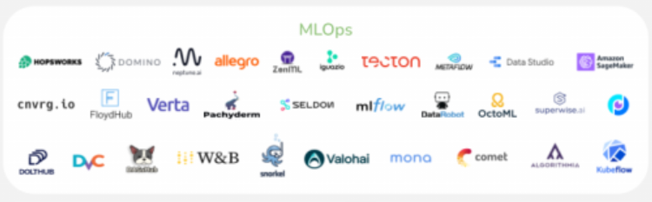
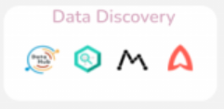
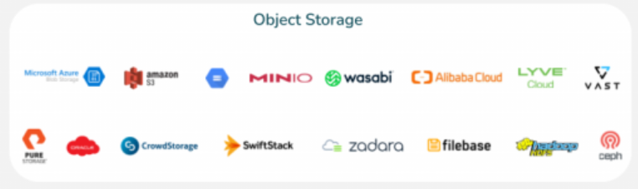
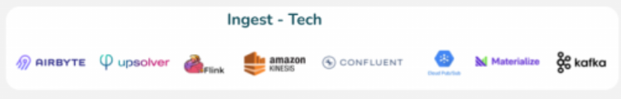
How to Implement Data Engineering in Practice
Data Discovery
MLOps
Object Storage
Ingest - Tech

Slide 4
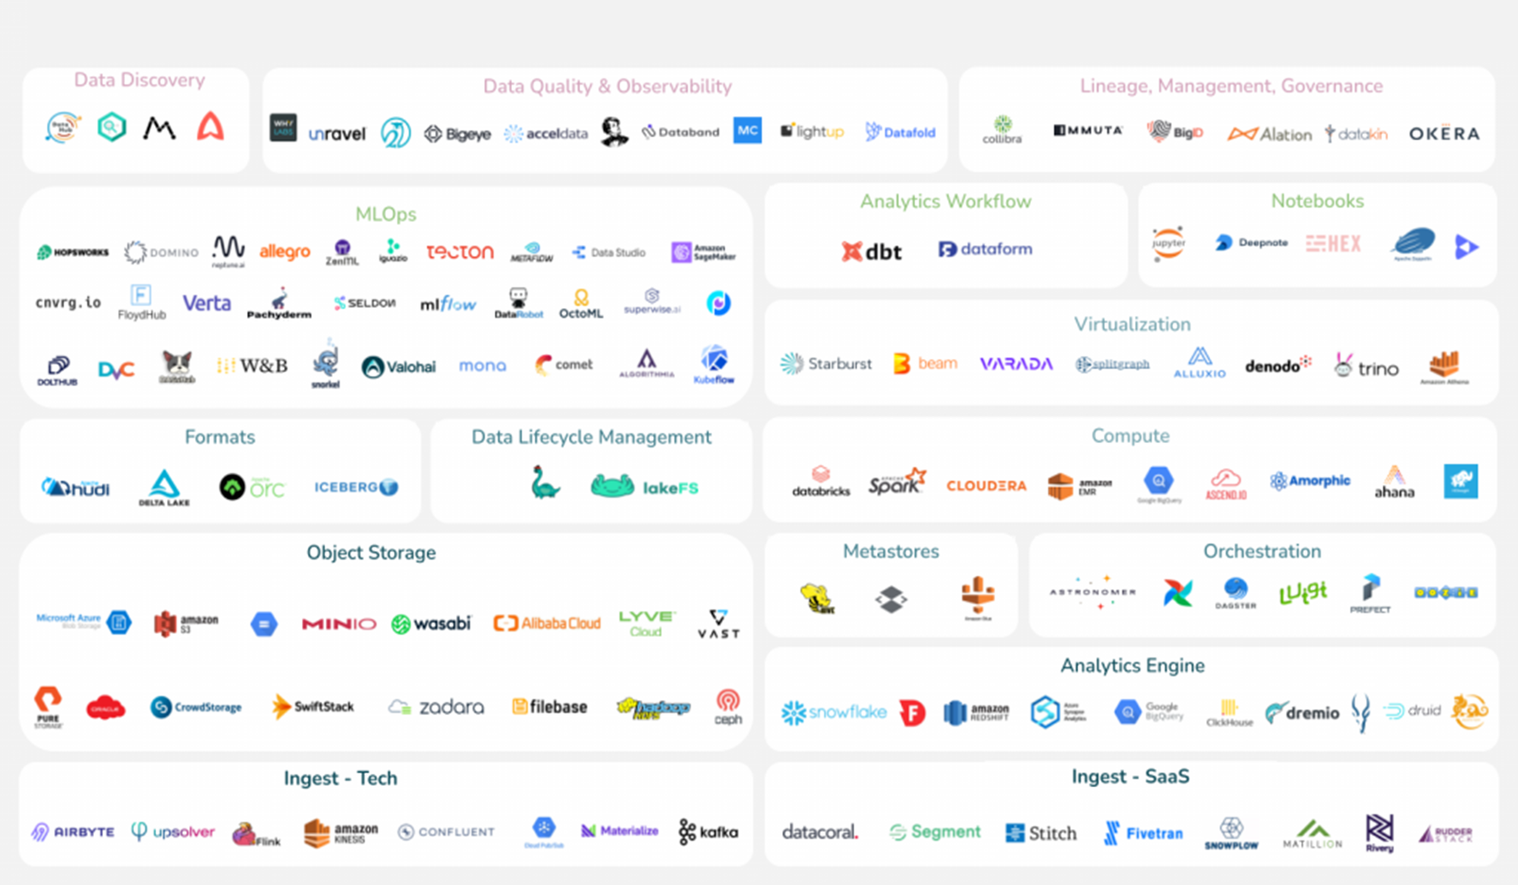
How to Implement Data Engineering in Practice
Data Discovery
Observability
Governance
MLOps
Workflow
Notebooks
Virtualization
Formats
Data Lifecycle
Compute
Object Storage
Metastores
Orchestration
Analytics Engine
Ingest - Data
Ingest - Application

Slide 5
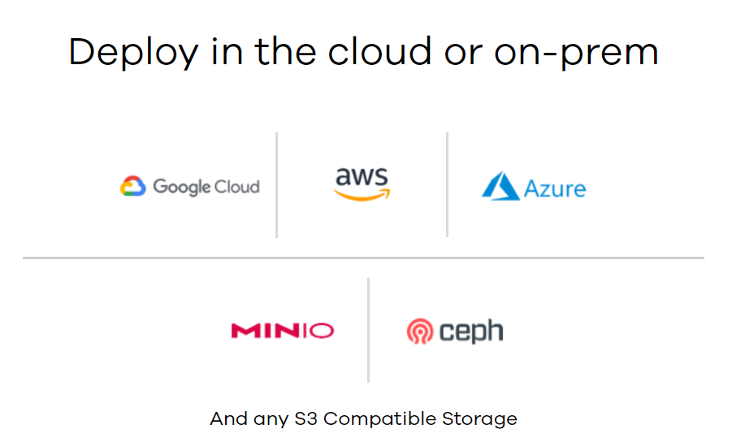

Slide 6


Slide 7
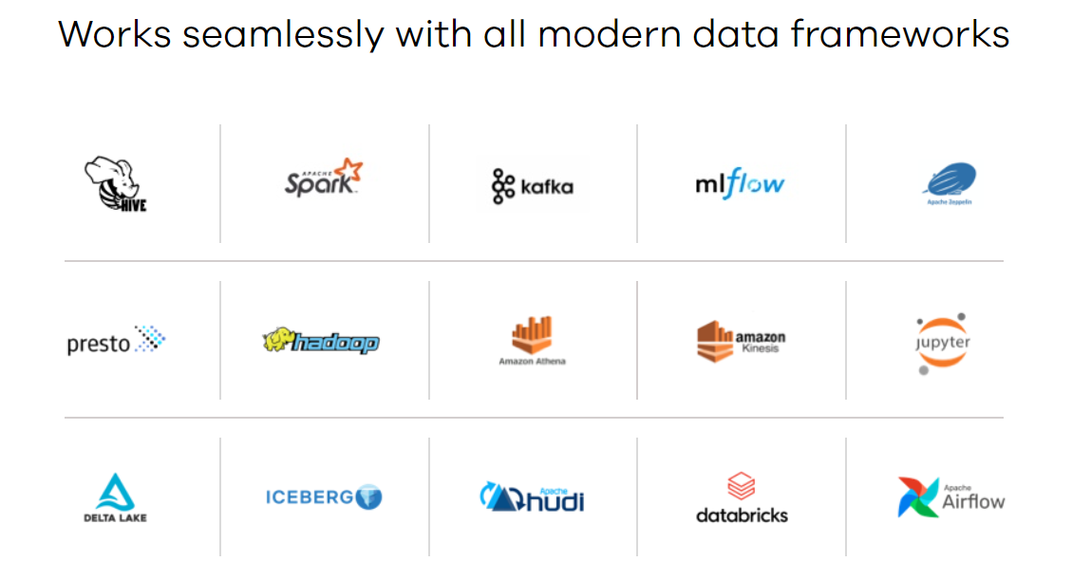

Slide 8
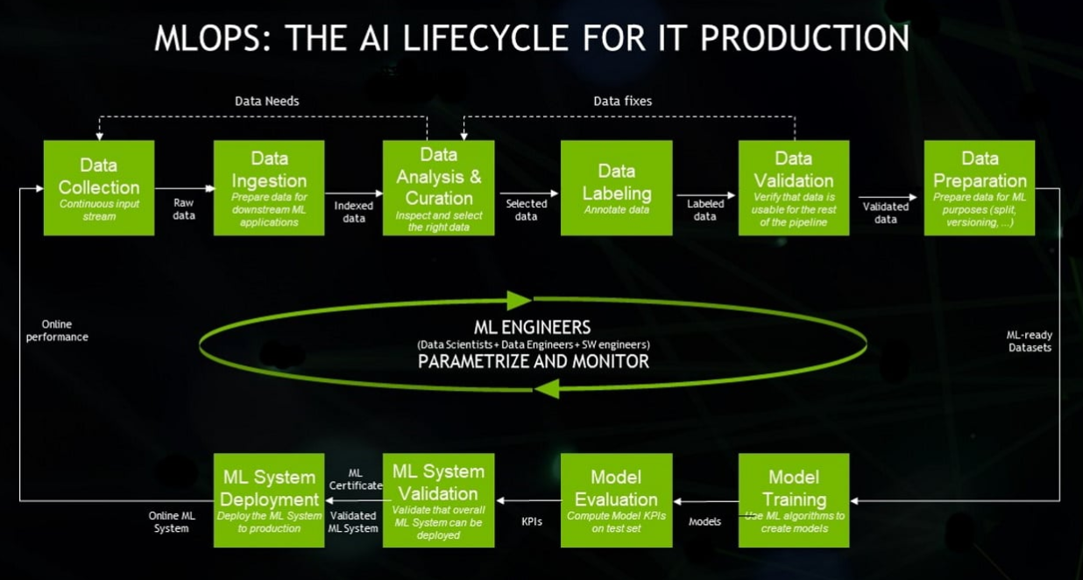
MLOps (Machine Learning Operations)

