Slide 1
FLIGHT PRICE PREDICTION
Study of flight prices

Slide 2
Problem statement
Anyone who has booked a flight ticket knows how unexpectedly the prices vary. The cheapest available ticket on a given flight gets more and less expensive over time. This usually happens as an attempt to maximize revenue based on -
1. Time of purchase patterns (making sure last-minute purchases are expensive)
2. Keeping the flight as full as they want it (raising prices on a flight which is filling up in order to reduce sales and hold back inventory for those expensive last-minute expensive purchases)

Slide 3
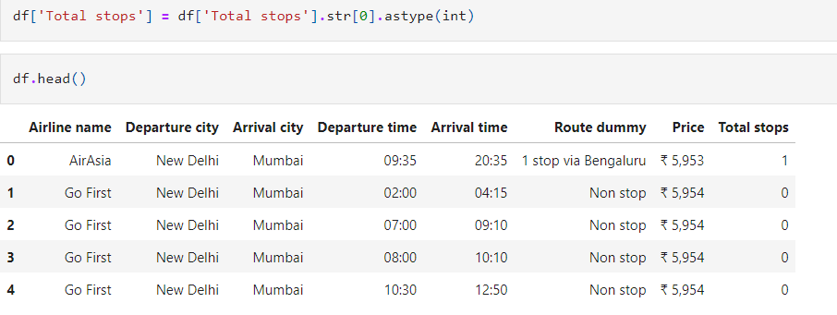
Data cleaning
In these two steps I have extracted the total stops from route column and converted it to integer variable for further analysis.

Slide 4
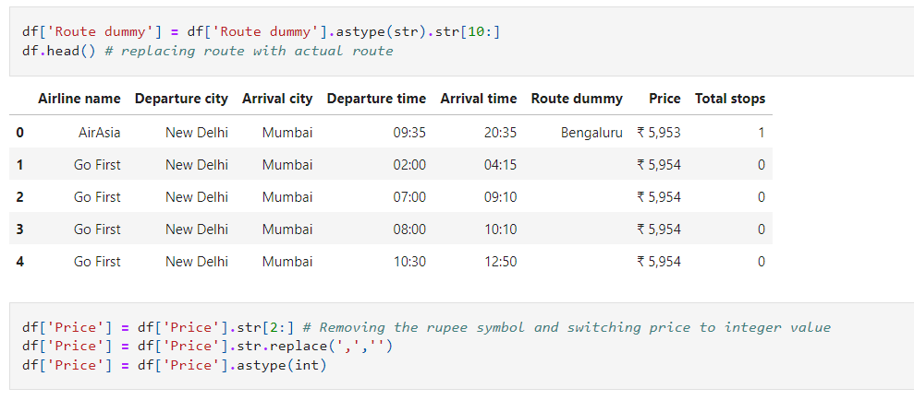
In the next step, the route column was sliced down to only contain the name(s) of the cities and all other text was truncated.
The price variable was also truncated (remove rupee symbol) and the final value was converted into integer for further analysis.

Slide 5
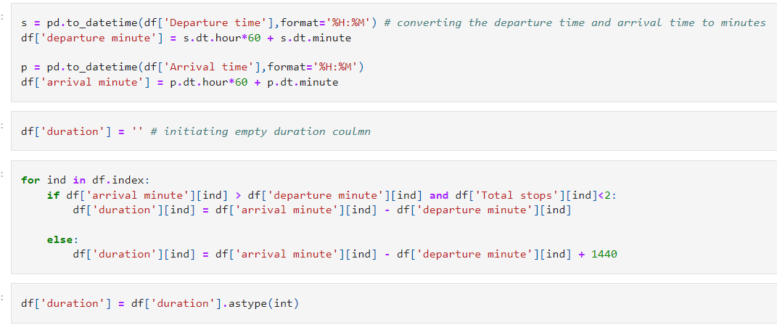
The duration of the flight was calculated using the arrival time and departure time (converted into minutes)
If a flight has more than two stops, it is most likely an overnight flight and one day of flight time was added to the duration in that case.

Slide 6
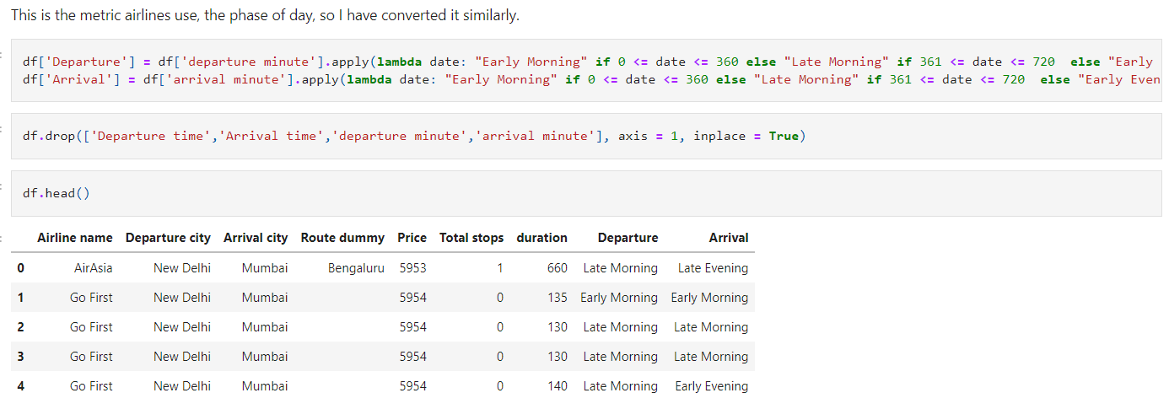
Flight departure/ arrival phase
Frequently, airlines use the phase of day in their options to sort flight. Similarly the departure and arrival times were divided into the phase of day.

Slide 7
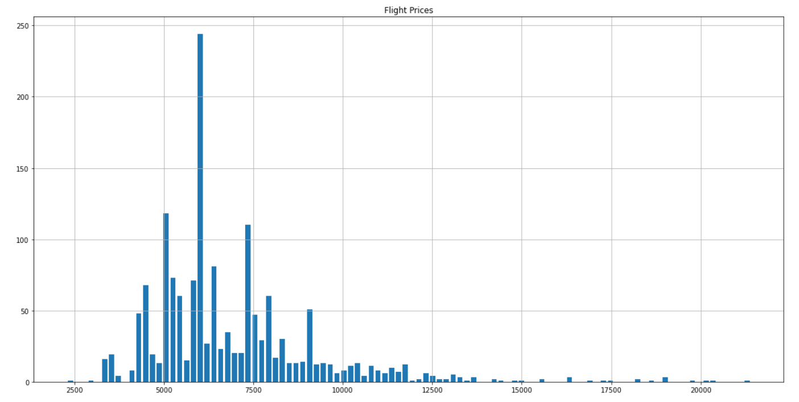
EDA
Histogram of the flight price distribution, here we can see that there are multiple peaks in the data and that this distribution is right skewed.

Slide 8
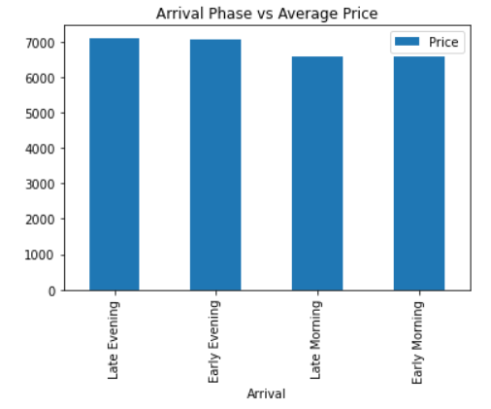
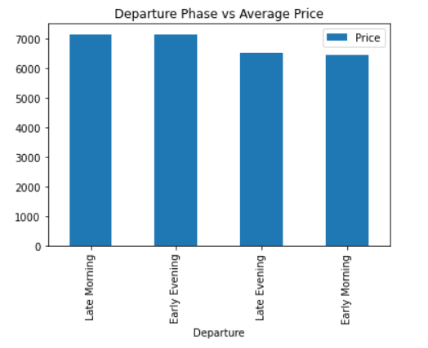
These two graphs show the average flight price according to the time of day during arrival and departure of the flight.
We can observe that early morning (00:00 – 06:00) flights which land either early/ late morning (00:00 – 12:00) are the cheapest in price on average.

Slide 9
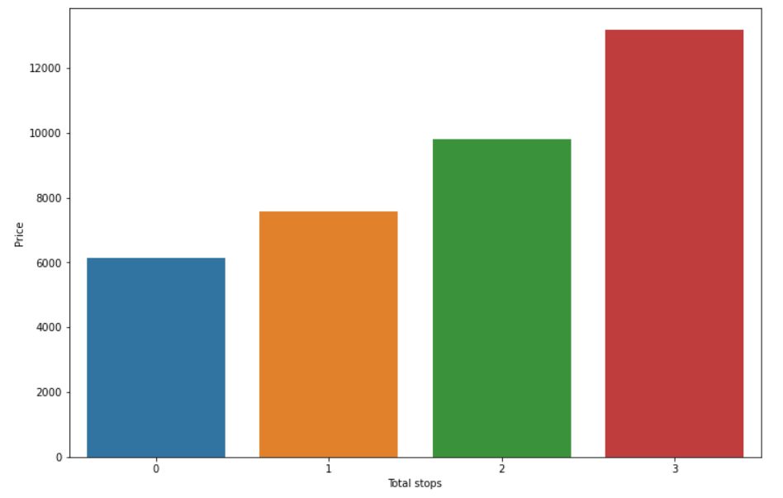
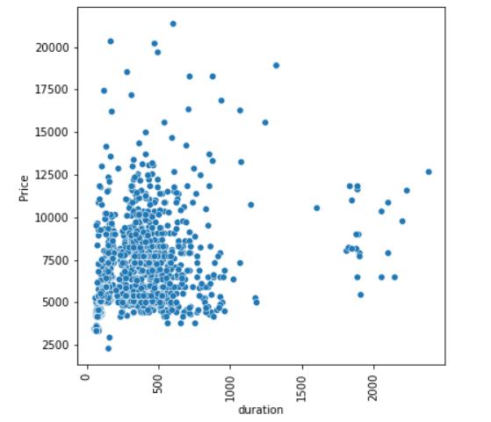
Average price of flight in relation with the number of stops the flight had. We can see appositive co-relation between flight price and the number of stops.
Scatter plot of duration (in min) vs price (in rupees)
There is a lot of noise in this data.

Slide 10
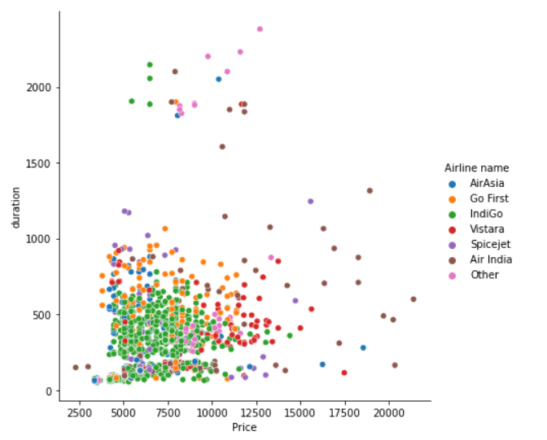
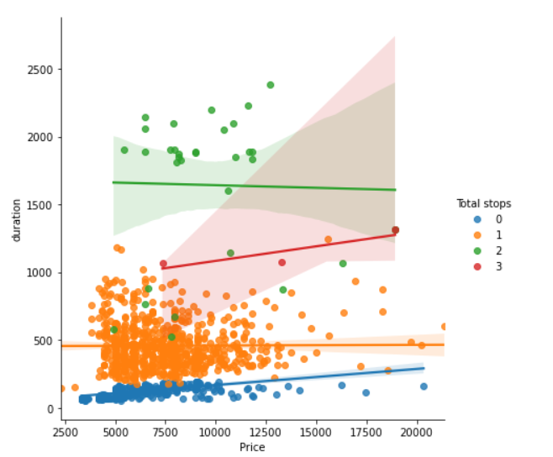
This graph shows the different pricing of airlines in a scatter plot.
Price vs duration with a hue of total stops.

Slide 11
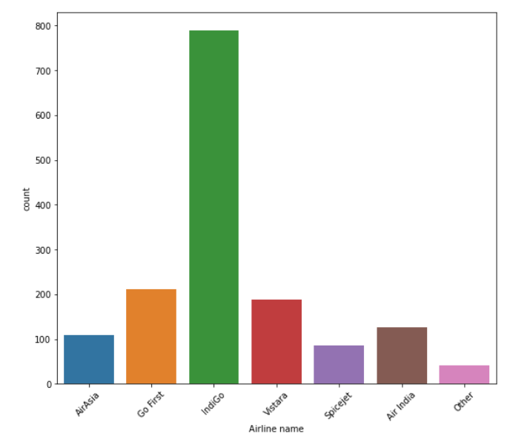
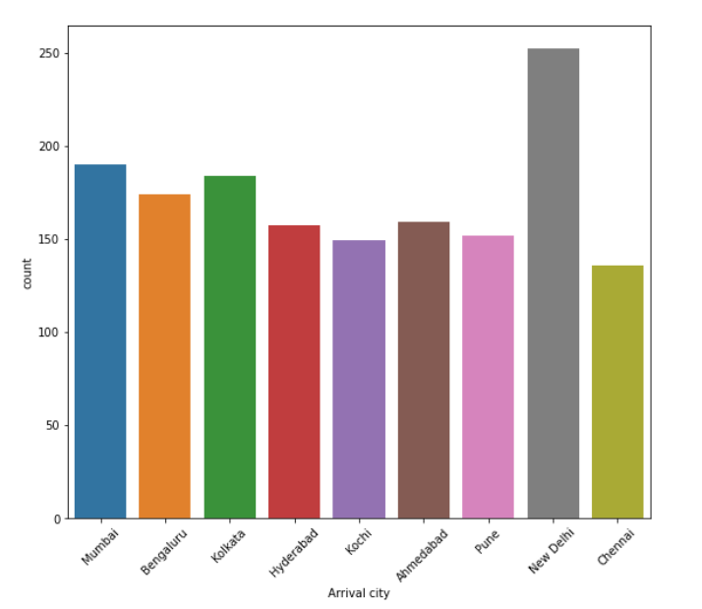
Most popular airlines on the domestic route in India
Most popular arrival cities in India. Delhi is ranked highest as it is the national capital with most traffic flow and is one of the most central cities in India.

Slide 12
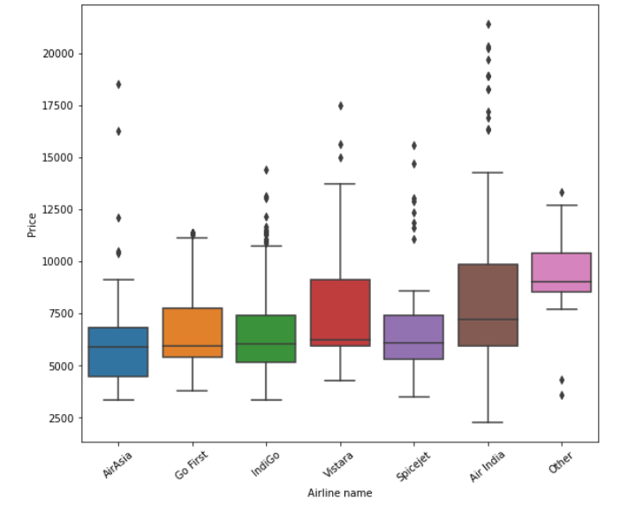
We can observe that IndiGo is not only the most frequent airline in domestic India but it is also one of the cheapest airlines out there. Most people are looking for cheaper flights and hence IndiGo is dominating the market.

Slide 13
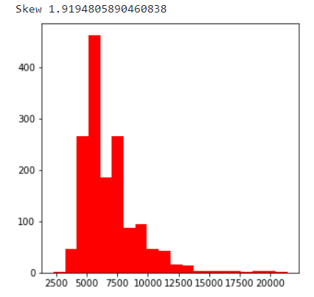
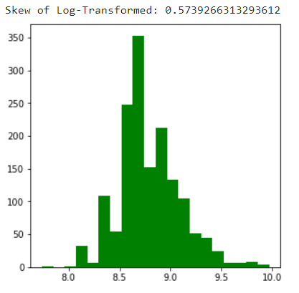
Th
Skew and distribution of the flight price (original data)
Skew and distribution of flight price after taking natural log of the data.
The skewness has been reduced and now our model should perform better.
We can see that now we have a much better bell curve shape by taking log of the price variable.

Slide 14
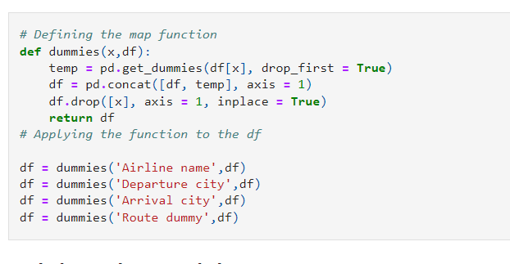
Pre processing data (categorical vars)
Defining a dummy function and creating dummies for the following categorical columns.
This converted categorical variables into 1/0 columns so that the ML algorithms can be used.

Slide 15
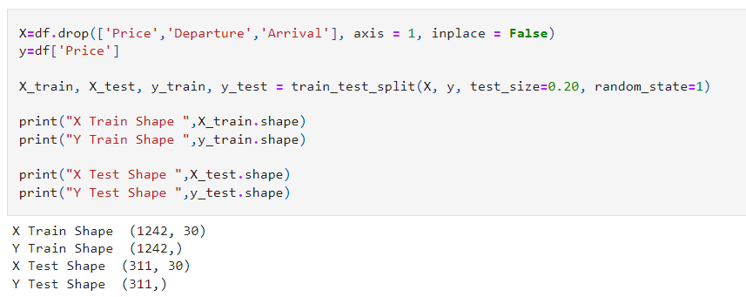
Model building
Price is the target variable. Here we can see the shape off the training and testing data. (80/20)

Slide 16
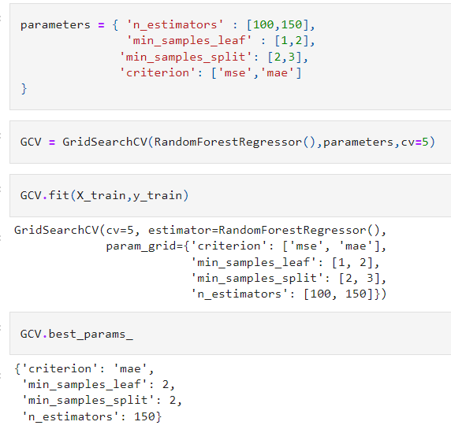
Hyper parameter tuning
Hyper parameter tuning was performed on the best performing algorithm, which was the random forest regression.
These variables were selected, the tuning took many hours to complete.
The best parameters were used to train another accurate model.

Slide 17
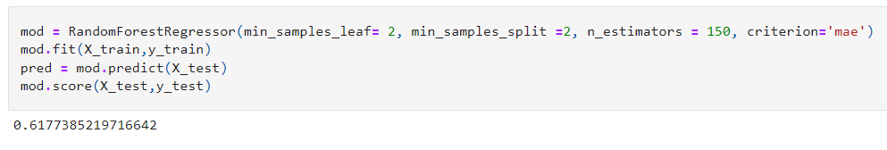
Training best model
This is the best model with a cross validation, R-squared result of 0.617 was the final result

Slide 18
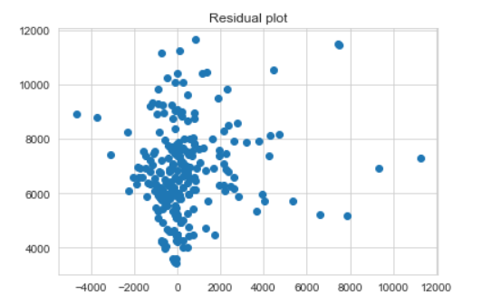
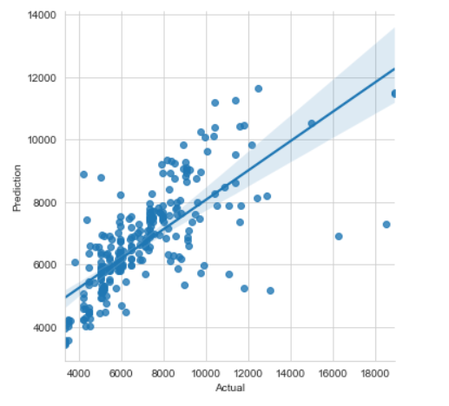
Regression plot of predicted vs actual price
Residual plot of (predicted value – actual value)
After observing these graphs we can conclude that the model is performing fine, but it still need more data for more accurate predictions

Slide 19
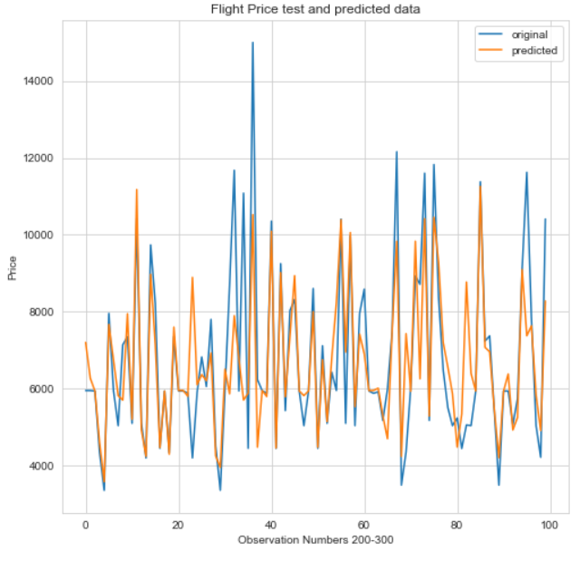
Final conclusion
Considering that this mode contains 72 different flight paths over 1500 data points, with the help of these graphs we can see that the model is performing well.
On average this data has 1502/72 = 21 data points for each flight path.
While the reality is that on average most of the flights are dominated by popular routes like Delhi to Bombay, Bombay to Delhi etc. among the most popular cities.
And the paths with less frequent flights like Ahmedabad to Pune has far less than 5 flight on that path.
To get a more accurate mode, much more data is required.

