Slide 1
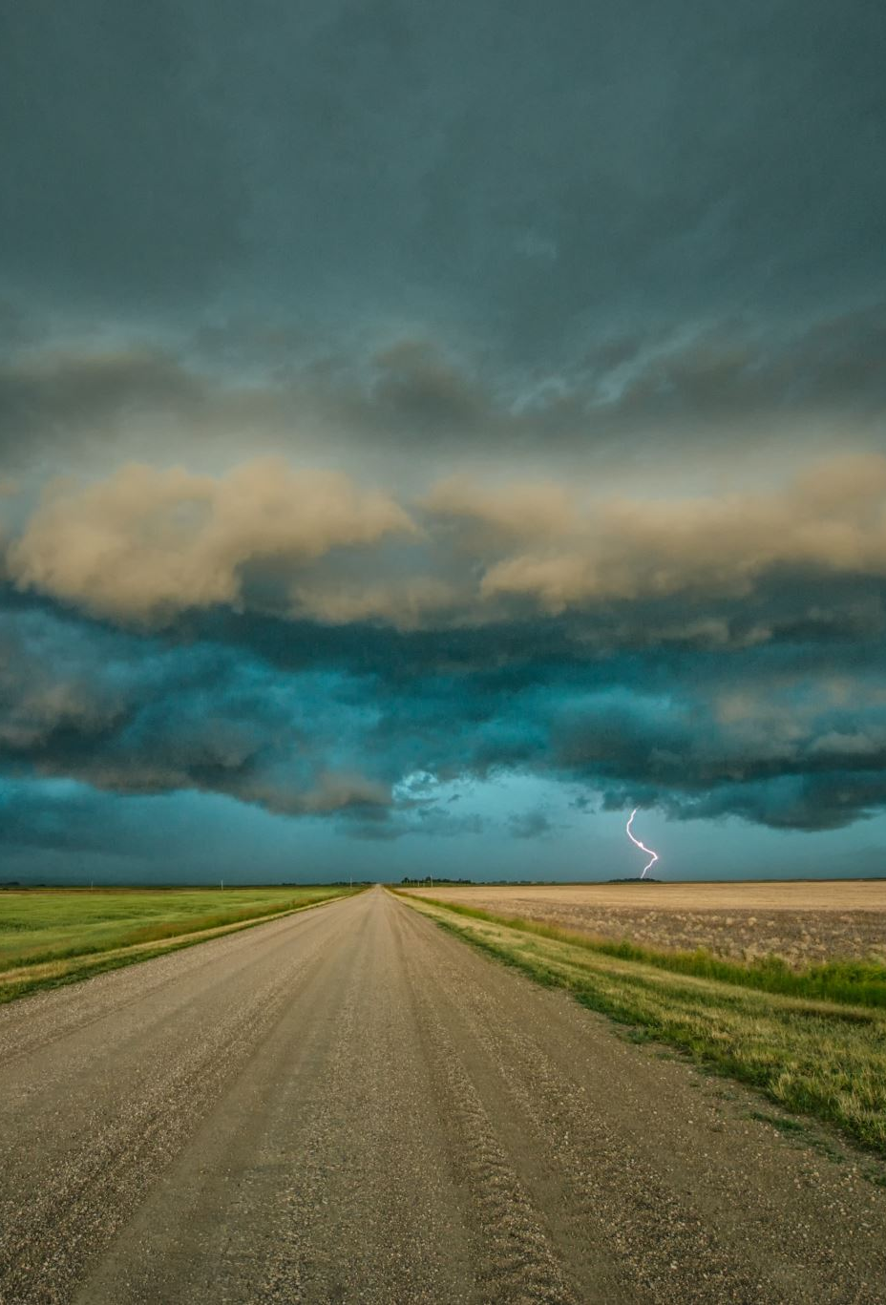
ENERGY USE IN TEXAS
JARDO ANALYTICS INC.
Jenny Friesenhahn
Akshaya Sathiya Moorthy
Robert Lehr
David Goeller
Oliver Eve
Notes:
Robert

Slide 2


OUR FOCUS
TARGET DATA:
Location: Texas
Time: January 2020 – January 2023
Energy Sources: Coal, Natural Gas, Wind, Solar, etc.
GOAL:
Analyze and visualize Texas’s primary energy sources
Determine impacts of 2021 freeze on Texas energy resources
Notes:
Robert

Slide 3
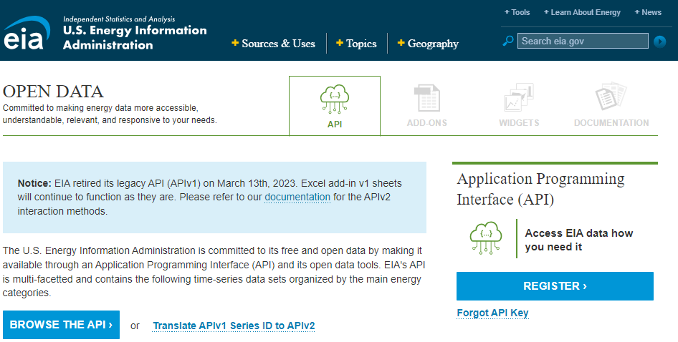
OUR DATA SOURCE
US Energy Information Administration (EIA)
The EIA “collects, analyzes, and disseminates independent and impartial energy information to promote sound policymaking, efficient markets, and public understanding of energy and its interaction with the economy and the environment.”
https://www.eia.gov/opendata/
Notes:
Robert

Slide 4
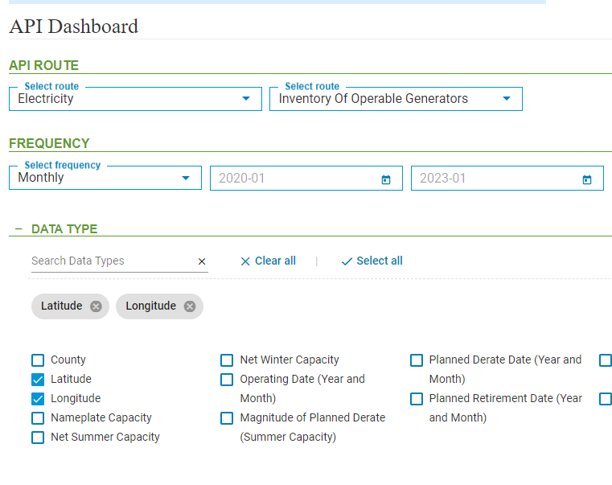
OUR PROCESS
Make initial calls to EIA API
Generator locations
Price
Consumption
Generation
CO2 emissions
Analyze, transform, and export JSON results
Create charts using cleaned data
Notes:
Oliver

Slide 5
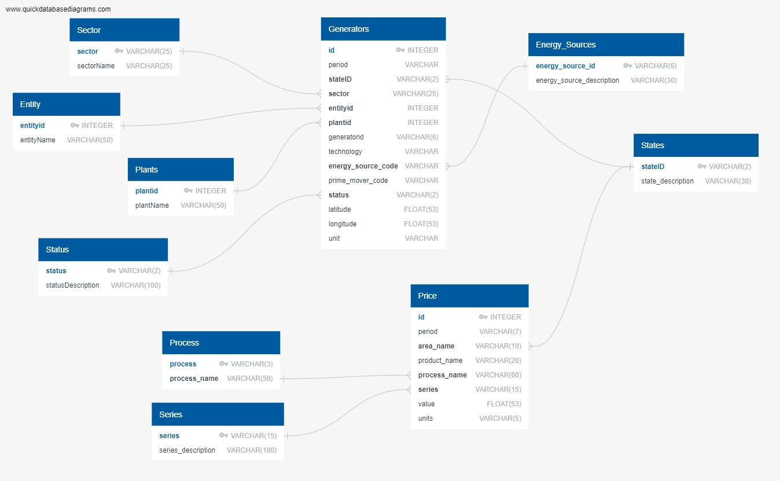
OUR PROCESS
Create SQL database to store dataset
Notes:
Jenny

Slide 6
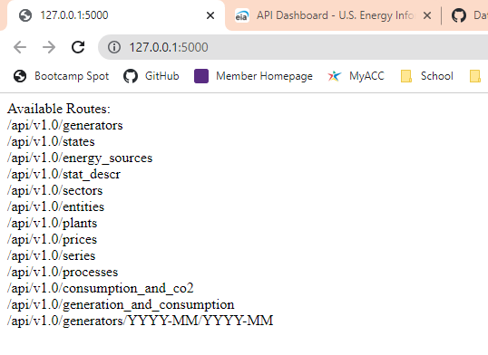
OUR PROCESS
Develop Flask API
Connects to SQL database
Provides API endpoints to users
Powers interactive webpage
Design interactive webpage to display data
Map of generator locations, operating status, and energy type
Graphs of price, consumption, and generation
Notes:
Jenny

Slide 7
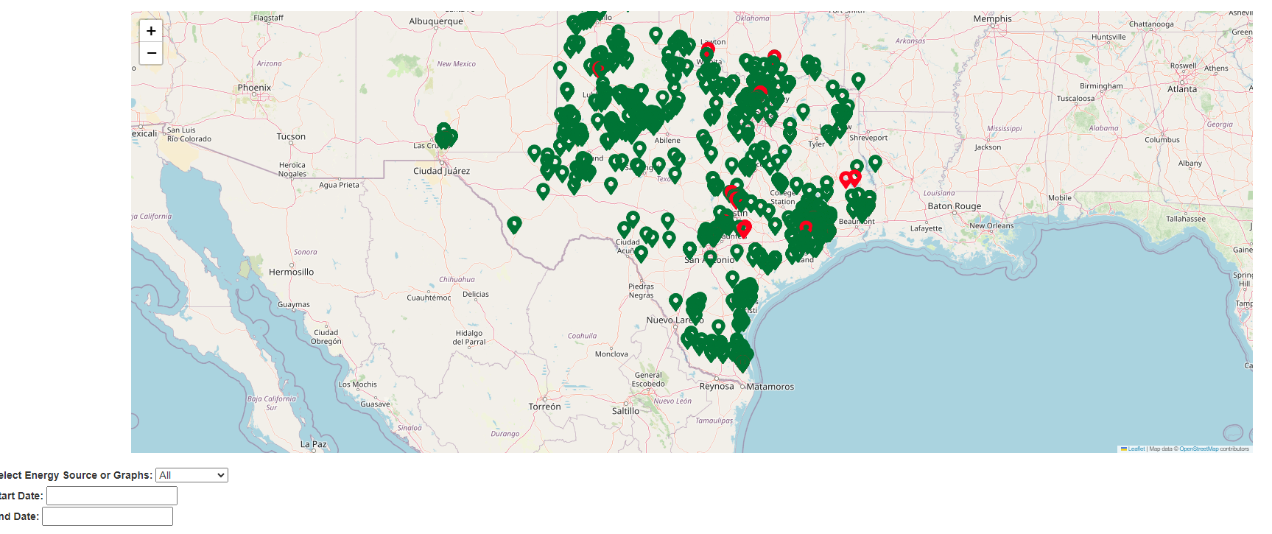
LIVE DEMO
Energy in Texas Visualizations
Notes:
David & Akshaya

Slide 8
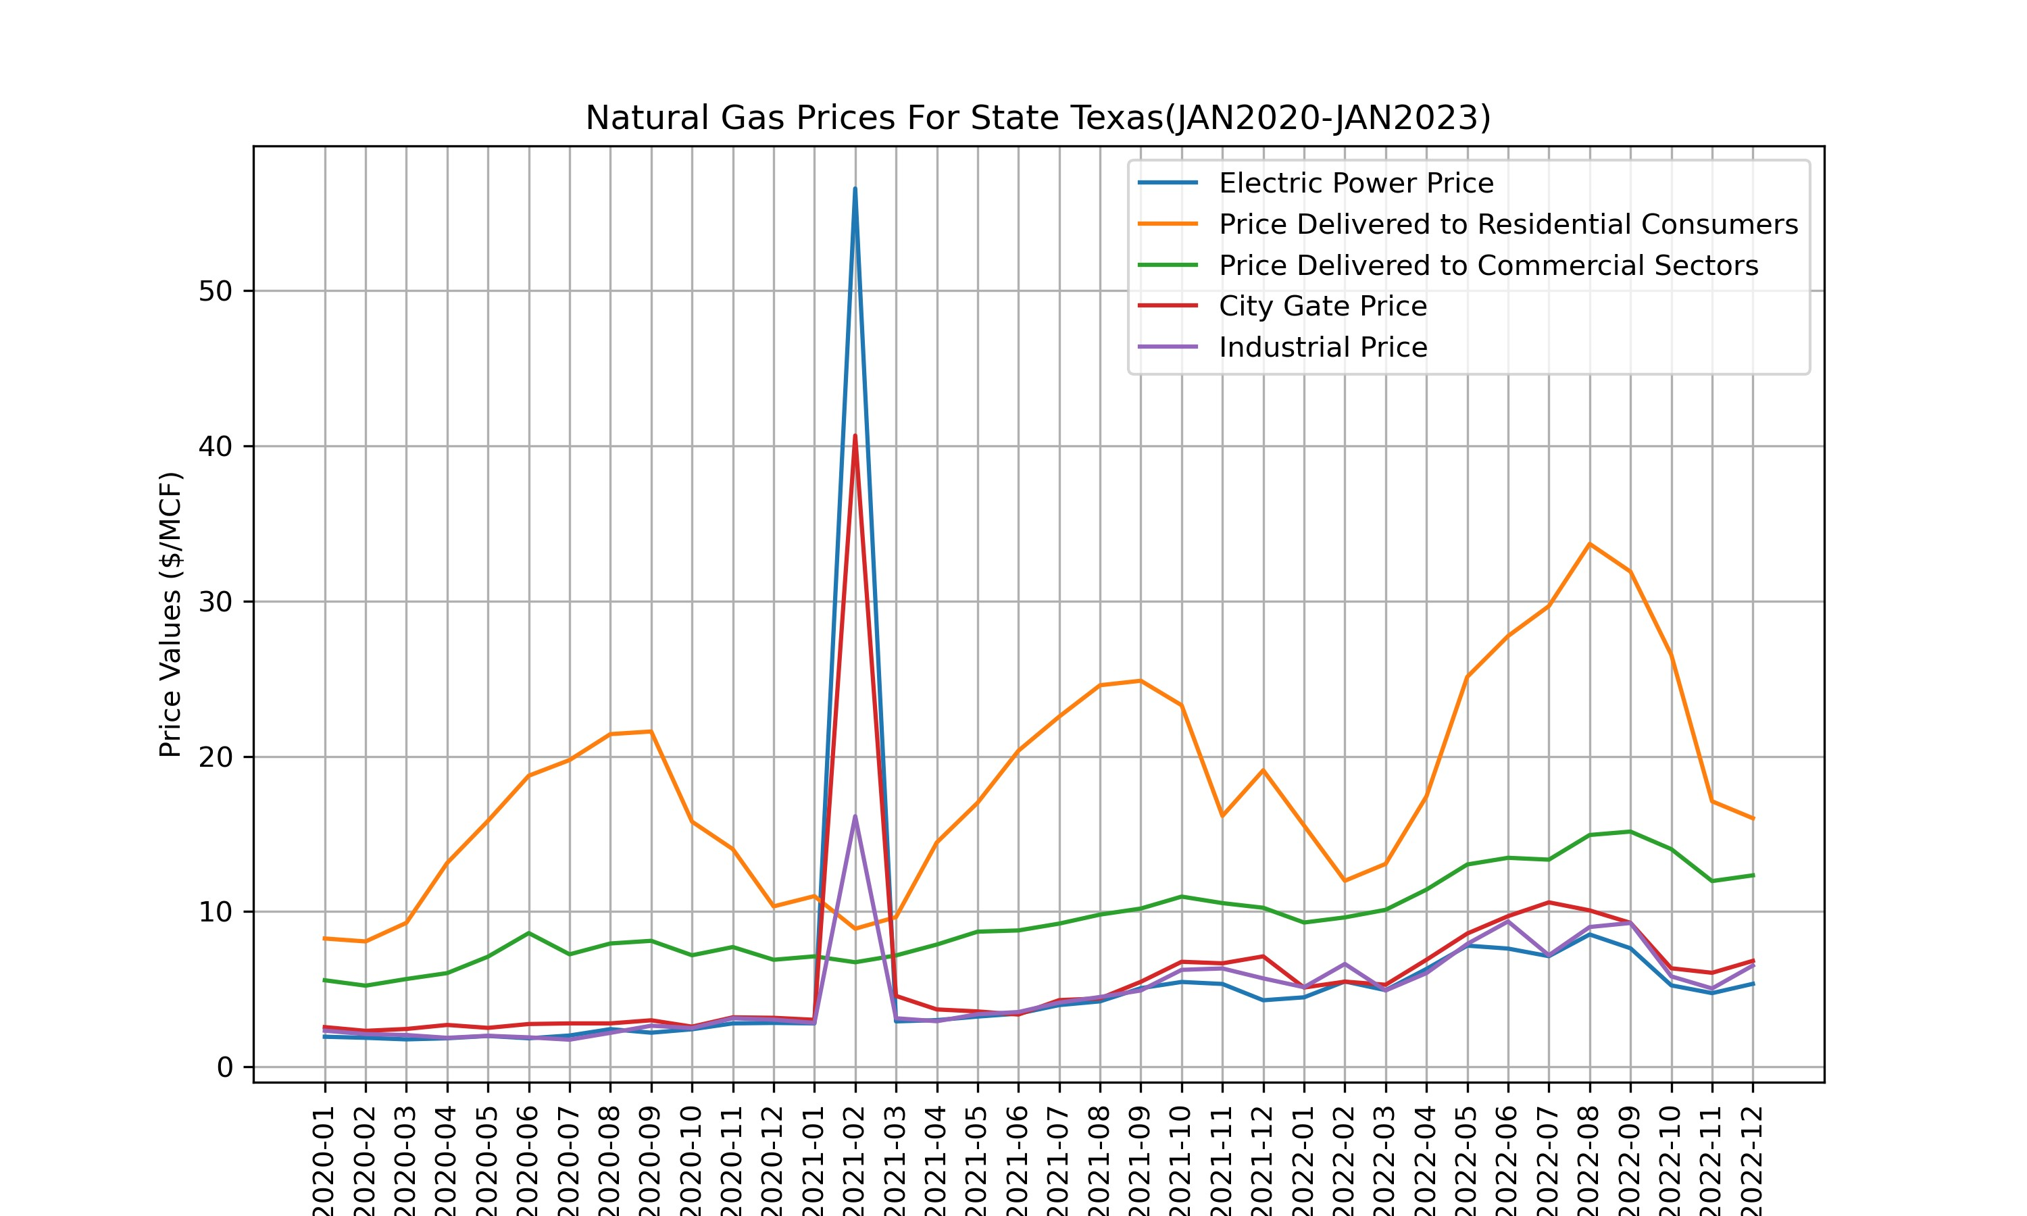
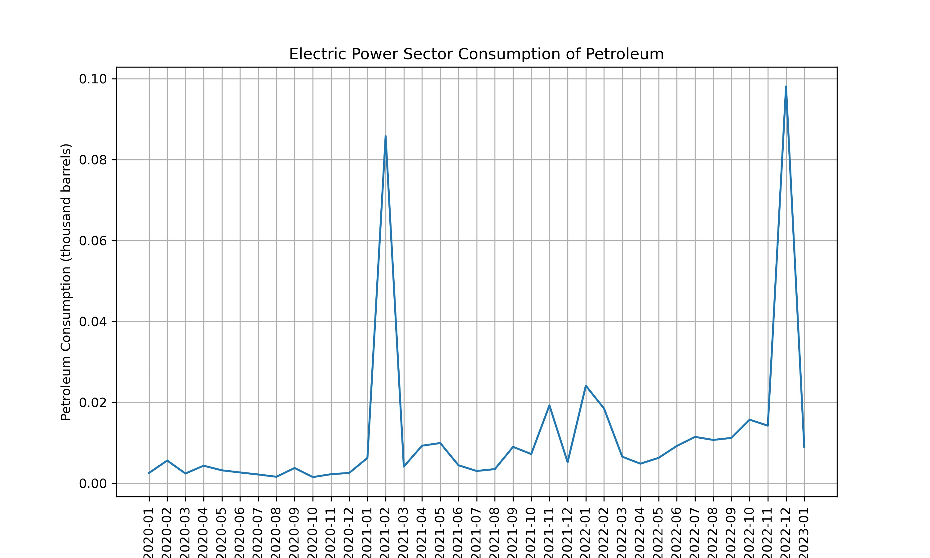
RESULTS
Notes:
Robert

Slide 9
QUESTIONS?
Notes:
Robert

