Slide 1
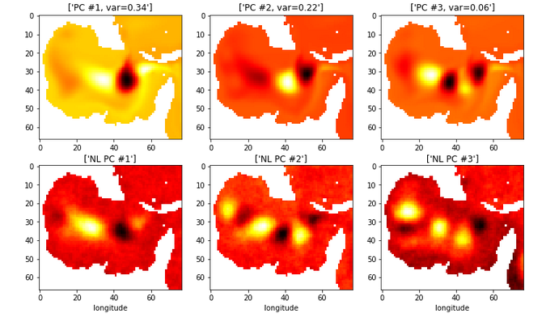
Analysis and dimensionality reduction of Sea Surface Height
Using Principal Component Analysis and Autoencoders

