Slide 1
Making Agriculture a Profitable Business in Myanmar
Presented by
Mind Benders
28.7.2019

Slide 2
Introduction
Agriculture in Myanmar is the main industry in the country, employing 70 percent of the labour force
We mainly focus on Shan State among 14 States
There are three main parts in Shan State
North Shan with three divisions including 31 townships
South Shan with seven divisions including 22 townships
East Shan with three divisions including 13 townships
Notes:
The most common problems of agriculture in Myanmar are :
Landless farmers
The troubling perception among farmers that agriculture is not profitable

Slide 3
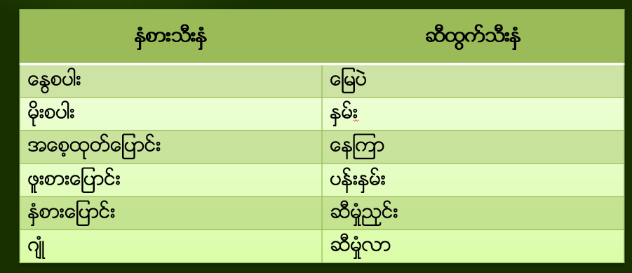
Introduction (Cont’d)
Crop-production data and average-rainfall are collected for five years (2014-2019)
Various crops – rice, groundnuts, beans, sesame, sugarcane, vegetables etc…

Slide 4
Data Source and Collection Technique
Assistant Director (Ministry of Agriculture, Shan State)
12 Officers in Charge for each crop
After collecting data,
Formatting data in a tabular form
Changing into retrievable format
Data Cleaning

