Slide 1
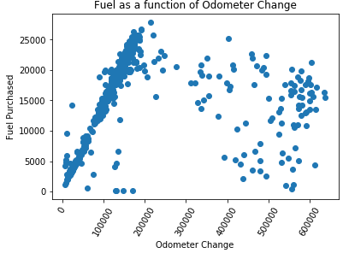
Initial approach: identify the relationship between fuel purchased and miles driven
105 vehicles gained 200,000 miles or more
The Data Tells Us: Some trucks are transformers
Notes:
Approach: calculating the total mileage over the time period tracked, and map it with fuel purchased for that truck.
Initial results: some trucks are transformers

Slide 2
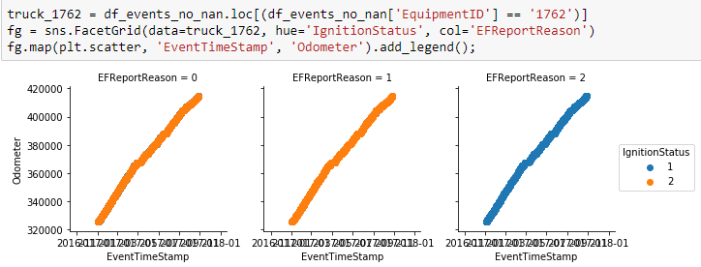
Extranet2.ExactFuelEvent: Odometer reading
Truck 1762 maps appear as expected, with a steady increase in odometer readings over time.

Slide 3
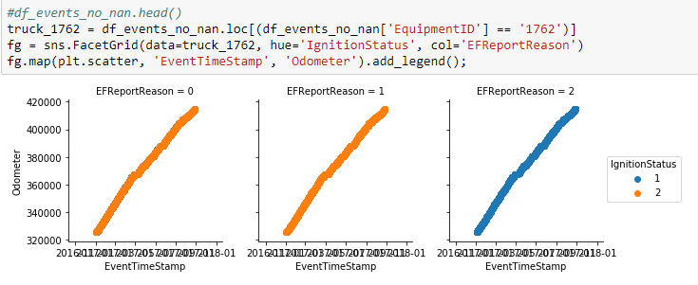
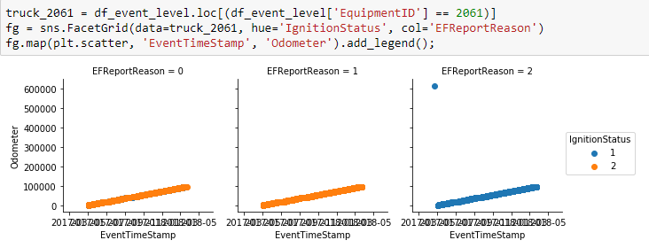
Extranet2.ExactFuelEvent: Odometer reading
Truck 2061 appears to have flaws in the data. It appears to be a new truck with a single random odometer reading greater than 600,000.

Slide 4
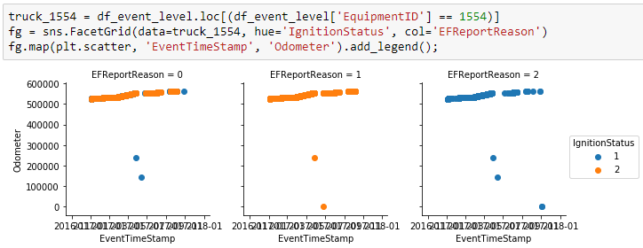
Extranet2.ExactFuelEvent: Odometer reading
Truck 1554 is an older truck, ranging from 500,000 to 600,000 miles with several outliers.

Slide 5
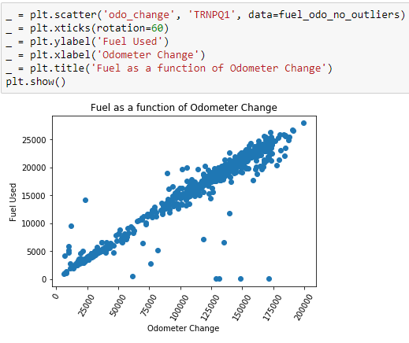
Removing outliers shows the expected linear relationship

Slide 6
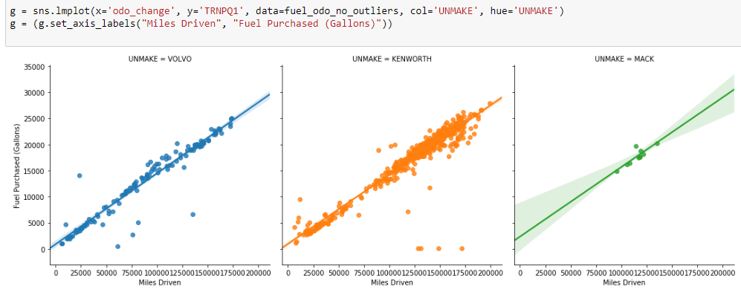

Slide 7
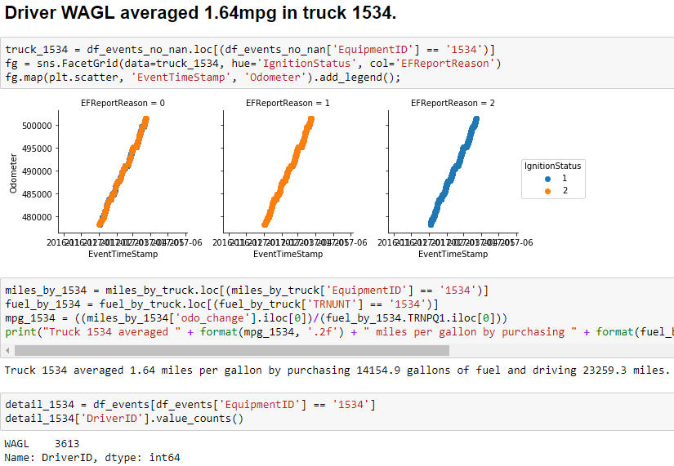

Slide 8
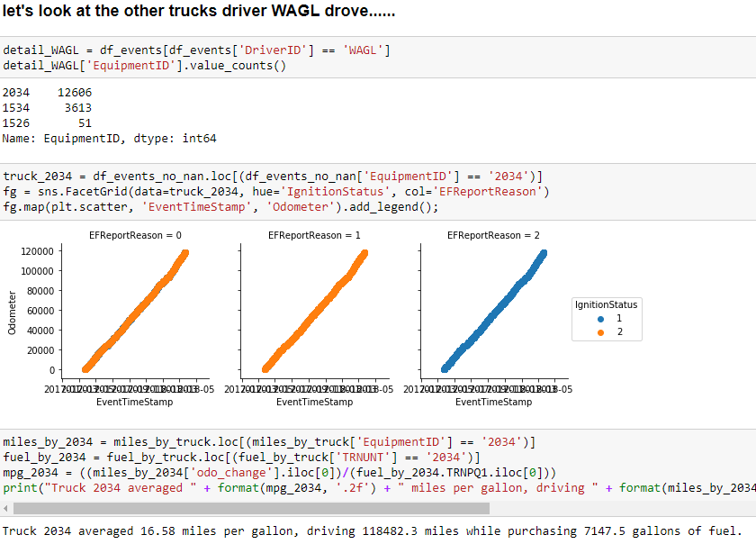
link to plot

Slide 9
Driver | Truck | Mileage | Fuel Purchased | MPG
WAGL | 1534 | 23,259.3 | 14,154.9 | 1.64
WAGL | 2034 | 118,482.3 | 7,147.5 | 16.58
TOTAL |  | 141,741.6 | 21302.4 | 6.65

