Slide 1


Reactive In-Memory Graph-like Index
Junio– 2014
Gabriel Infante-Lopez
Notes:
Quiero presentar la idea general del grafo,
- que es lo que vemos, una single data base de documentos en la base, con una indice en forma de grafo en memoria
por que lo vemos como un grafo (versatilidad a la hora de representar)
por que lo representamos en memoria (queries mas rapidas, seguridad granular)
stack de software que usamos
arquitectura general
estrategia de tolerancia a fallas
estrategias de escalabilidad
conclusiones

Slide 2
Overview
General Idea
Programming with actors.
Architecture.
Patterns for Error Handling.
Patterns for Fault Tolerance.
Patterns for Scalability.

Slide 3
Graph Representation

Slide 4
What can we ask?
Queries using the DB index for entities:
Movies: movies fulfilling a given criteria, e.g., movies with “peter” in their title.
Users: users for a given criteria.
Sentiment Analysis: Movies with positive sentiment.
Queries using the DB index for relations:
Similar movies: movies similar to a given one.
Similar Users: Users similar to a given user.
Notes:
Here I want to make the case that the DB can be very powerful for indexing documents, like the case of ElasticSearch. There they have a very powerful engine and this queries can be answered very nicely. Also that the DB can take weights into considerations and use this weights to provide the best answers.

Slide 5
What else can we ask?
Movies similar to movies I liked,
Movies similar to movies that my friends have seen.
Movies that have receive a positive review by friends of my friends.
People similar to me that is friend of a friend of mine.
People that is similar to me that has written review similars to those I have written.
Movies that are similar in cast and theme to movies I did like.
BTW, I want the match with the best score.
Notes:
This slide is to show that even though info is somehow in the data base, it is difficult to retrieve as there has to be a way to join different tables. Specially if the queries are not fixed beforehand.

Slide 6
In Memory Index
Database
persistence
indexing entities.
In memory graph
traversing,
dijkstra,
mining
security
Notes:
Present the idea of in memory to handle this properties while the database to handle perstistance and all the capabilities of the database to index and retrieve entities

Slide 7
Main Features
Granular Security
Ephemeral Data
Contextual Security
Mining and Traversing and the same time.
Scalability
Fault Tolerance.
Reply as we know it.
Distributed Garbage Collection

Slide 8
Programming with Actors
Notes:
Brief introduction to actors

Slide 9
Actors
Lightweight object.
Sharing threads.
No shared state.
Messages are kept in mailbox and processed in order.
Massive scalable and lighting fast because of the small call stack.

Slide 10
The Actor Model Key Abstraction
C vs Java: You can use memory without having to admin it.
Thread vs actor:
concurrency without dealing with admin of threads.
Don't communicate by sharing memory; share memory by communicating.

Slide 11
A Brief History of the Actor Model
Formalized in 1973 by Carl Hewitt and refined by Gul Agha in mid 80s.
The first major adoption is done by Ericsson in mid 80s.
Invented Erlang and open-sourced in 90s.
Built a distributed, concurrent, and fault-tolerant telcom system which has 99.9999999% uptime

Slide 12
Scala/Akka solutions
Scala provides functional programming plus immutable variables, and immutable collections scala> List(1, 2, 3).par.map(_ + 2) res: List[Int] = List(3, 4, 5)
Akka keeps mutable state internal to actors and communicate with each other through asynchronous messages.
Single thread inside actor
Messages should not have closures, and be immutable and serializable.
Notes:
The example is simple but shows a lot. The list is being share by all threads computing the map. Thereis no raise condition between threads because everyone gets a inmutable variable to fill.
It is also a nice example to show that inmutable variables elimantes non-determinism

Slide 13
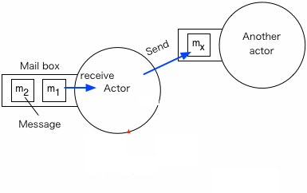
Actor model
Actor = states + mailbox + behaviors (msg handlers)
From outside, can’t manipulate actors directly.
To interact with an actor, must send msgs to it.
Each actor has a mailbox, msgs are put to mailbox, and processed one by one. ← An actor is like a single threaded process; it doesn’t do more than one thing at a time.

Slide 14
Concurrency: Actor vs Thread
Thread:
Heavy weight: Can only create not too many threads; usually: 2000~5000
Shared state ← Source of bugs
Passive: Have to call object.method() to make the object alive.
Actor:
Light weight: Can create millions of actors; usually: ~2.5 million actors/GB
Shared nothing
Active: Actors are alive by themselves. ← Easy to model programs that have millions of on-going things (very high level of concurrency).

Slide 15
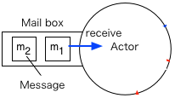
Concurrency: Actor vs Thread
Thread: n dimensions, hard to reason about.
Actor: 1D, one thing at a time.
var1
var2

Slide 16
Concurrency: Actor vs Thread
Actor is a high level logical way to think, to model programs.
At lower level, actors run above a thread pool.

Slide 17
Catch me if you can
try
thread {raise exception}
catch
case e => println(“catch you”)
end
Notes:
Nice example of programming with threads and error handling. This exception is not capture because the raise is given in a different stack that where the catch is. Actors transform this cycle of error handling.

Slide 18
Fault Tolerance in Actor Model
supervisor
worker
worker
worker
worker

Slide 19
Fault Tolerance in Actor Model
supervisor
worker
worker
worker
worker

Slide 20
Fault Tolerance in Actor Model
supervisor
worker
worker
worker
worker
One-For-One restart strategy
One-For-All restart strategy

Slide 21
Programming Model

Slide 22
Programming Model
class Vertex extends Actor with Logging {
var neigs = List[(ActorRef, weight)]()
override def update: Receive = {
case Weight(d) => if(d < min) {
min = d
neighs map {case (ref, weight) => ref ! Weight(min + weight)
}
case AddEdge(ref) => {
neigs = ref::neigs
}
}
}

Slide 23
Akka
Founded by Jonas Boner and now part of Typesafe stack.
Actor implementation on JVM.
Java API and Scala API
Remote Actor
Software Transactional Memory
Modules: akka-camel, akka-mist, akka-spring, akka-guice.
Distributted cluster,
Distributed Publish-Subscribe bus.

Slide 24
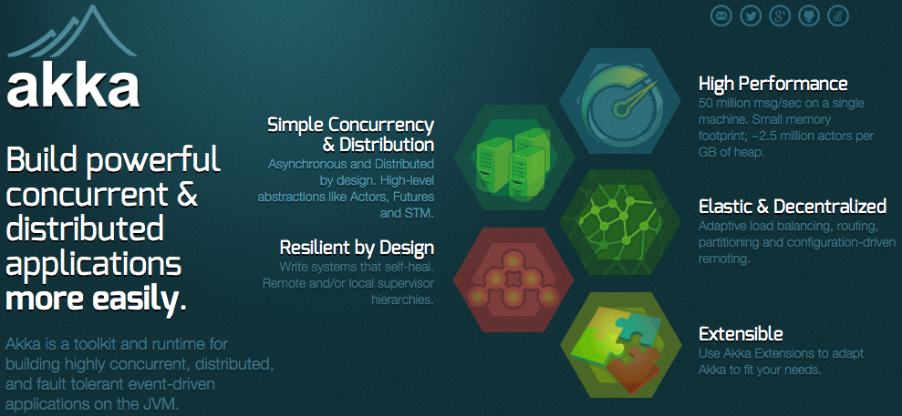
Akka http://akka.io/ (an implementation of actor model)

Slide 25
In Memory Index Main Components

Slide 26
LDS Architecture
Notes:
red are missing components, white are new ones, and blue are existing ones.

Slide 27
Notes:
concepts to discuss with this slide:
there are different components in a deployment,
there is a database cluster, where documents are stored.
the graph is splitted in different components, each leaves in different machines.
there are entry points of the service, that communicate with the database,
there are different clients, that with round robin choose the server.
all are part of a cluster.
all comunication is asyncronous.

Slide 28
Main Components
Communication between client and server is asynchronous.
Different components form an Akka cluster
heartbeats check for the connectivity of the cluster.
information is gossiped.
information about the load of the cluster is also gossiped (clients know the load of the system)
client handles errors as exceptions.
errors are detected in server, communicated to the client, and raised by the client.
client hides actor system.

Slide 29
In Memory Index Service

Slide 30
Notes:
how the state of a qurey is held in the system. by creating actors for each query
which parts are async,
nature of error flow.

Slide 31
Index Service
Query state is held in query handlers.
Query leaves depending on the load of the systems
Collectors reduce information from graph.

Slide 32
Design Key Aspects
How information flows in the system.
who sends what, who stores what, errors as information, status as information.
Who knows what
where are the abstraction layers in our system, who needs to know, who needs to have access. Design differences and usage.
async and decentralized logging.
everything has to be async and non-blocking, including logging.
Decentralized garbage collector.
for how long the system should keep queries running, and who will remove memory
no centralized info handler.
what aspects are fixed by configuration and which are dynamic.
Notes:
it is important to understand how and what information flows in the system, and how this information is also stored in the system. message passing make this distinction very clear. Exceptions can also be seen as information flow and how this information is controlled and handled. The server also generates info that is either errors or normal functionality, our design pictures have how information flows.

Slide 34




Components

