Slide 1
Investing restaurant in Toronto

Slide 2
Introduction
Toronto is the provincial capital of Ontario and the most populous city in Canada, with a population of more than 2.7 Million. It is an international centre of business, finance, arts, and culture, and is recognized as one of the most multicultural and cosmopolitan cities in the world.
Toronto is remarkable in diversity in its food and restaurants. Pakistani, Persian, Portuguese; aboriginal and new fusion; Japanese pancakes and Korean barbecue; fresh pasta in Little Italy, shawarmas in Greektown and the best damn dumplings in Chinatown. Torontonians love to eat out, whether it's sitting at sidewalk bistros on a warm summer night or getting all bundled up for some hot Vietnamese pho.
So, I would love to explore a new investment and business in food. If we think of both city residents and travelers, they may want to choose different types of food. At the same time, they may want to choose local, district or signature Toronto's dishes.
In our business problem, we will perform analysis to understand the current market and decide which market and types of food that we will invest, and create a map with clusters to reveal which areas we should consider to start our business.

Slide 3
Data
Table of postal codes in Toronto will be used to identify the Postal Code, Borough and Neighborhood
Data source: Wikipedia
Geospatial Data of Canada will be used in order to get the latitude and longitude coordinates of a given postal code in Canada as well as Toronto.
Data source: Geospatial Data of Canada from Coursera
Foursquare API data will be used to explore venues around Toronto, the top 5 venues around these areas, explore users' tips, and finally perform clustering.
Data source: Foursquare

Slide 4
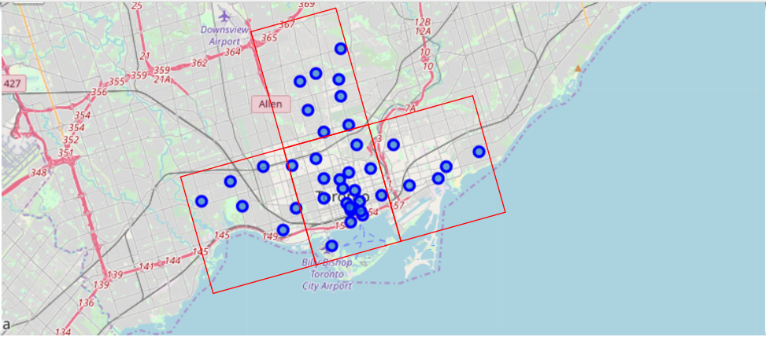
Methodology - Data Preprocessing and Visualisation – Borough and Neighborhood in Toronto

Slide 5
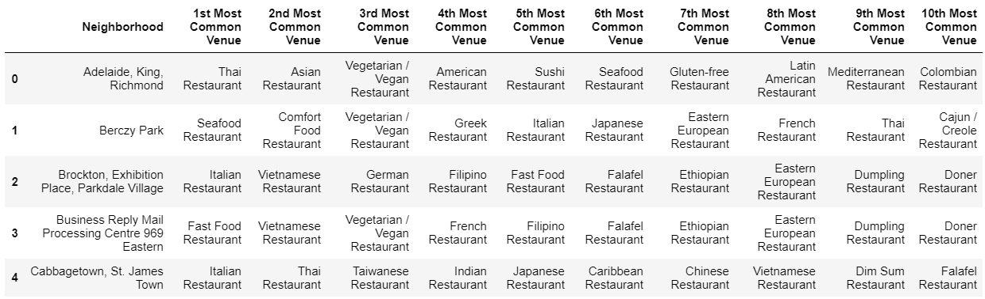
Methodology - Data Preprocessing and Visualisation – Venues in Toronto

Slide 6
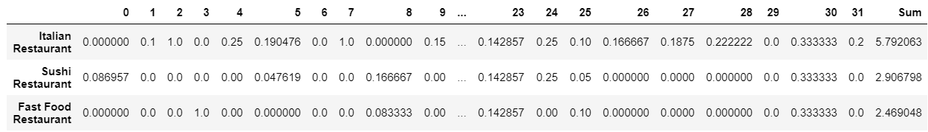
Methodology - Data Preprocessing and Visualisation – Venues in Toronto

Slide 7
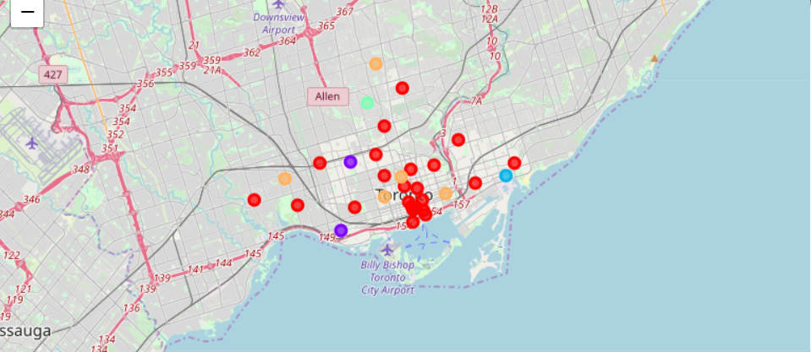
Methodology - Restaurants Clusters in Toronto

Slide 8
Results and Discussion
What to invest?
based on how frequent that the restaurants appearing in the neighborhood, I sum up all the frequency values and found the top 3 types restaurants in each neighborhood, which are
Italian Restaurant,
Sushi Restaurant; and
Fast Food Restaurant.
Where to invest?
For each of the clusters shown above, again with limited information and basing on the fact the more the restaurant appearing, the easier the restaurant that will be accepted by the public, I would recommend considering to invest
Italian Restaurant in Cluster One and Two, targeting at Downtown Toronto
Sushi Restaurant in Cluster Four, targeting at Central Toronto
Fast Food Restaurant in Cluster Three and Five, targeting at Downtown Toronto and East Toronto

Slide 9
Conclusion
After performing several analyses, the current market share and trend of restaurant in each neighorhood are revealed. Considering the frequency and trend, three types of restaurant are targeted. And by performing a clustering analysis, the preferred locations are identified for each of the targeted restaurant. Further analysis will need to be conducted, such as financial and legal situation, customers’ preferences, investment types and etc, to make a more comprehensive and robust investment plan.

