Slide 1
PyTorch Lightning

Slide 2


PyTorch Lightning
Introduction
Python package
framework built on top of PyTorch
claims „making coding complex networks simple“
nice features
logging of training / validation metrics
creating checkpoints
early stopping
training on multiple GPUs, TPUs, and CPUs
Installation:

Slide 3
PyTorch Lightning
Introduction
requires a class with four functions:
__init__()
forward()
configure_optimizers()
training_step()
optional functions
prepare_data()
validation_step()
test_step()
predict_step()

Slide 4

PyTorch Lightning
Comparison PyTorch vs. PyTorch Lightning
your package imports
your package imports
PyTorch
PyTorch Lightning

Slide 5
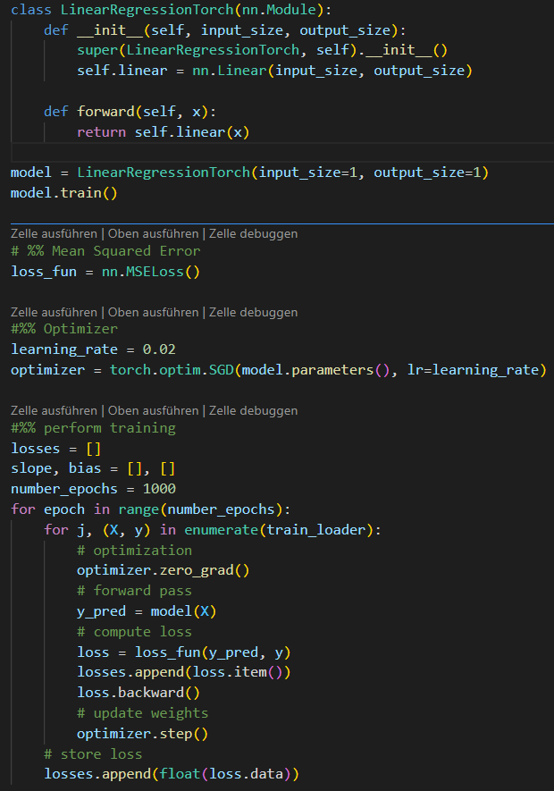
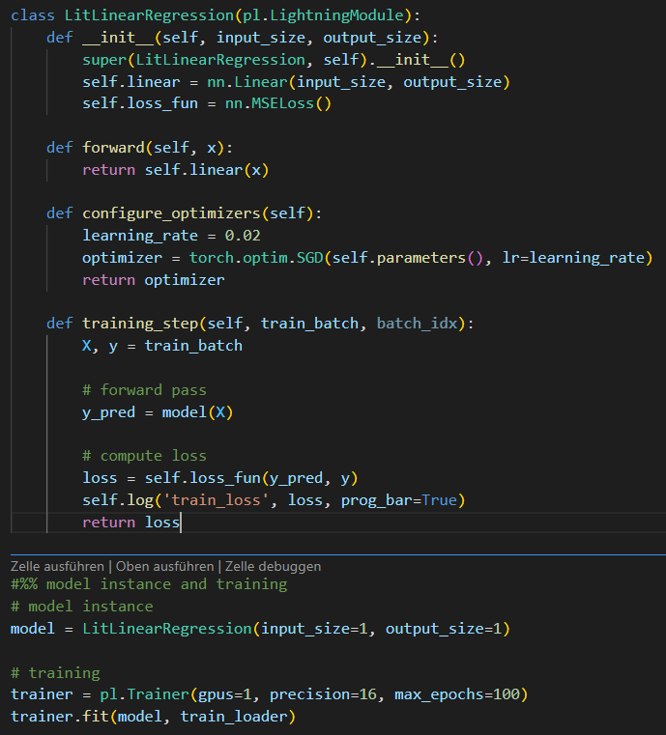
PyTorch Lightning
Comparison PyTorch vs. PyTorch Lightning
Class Inheritance
PyTorch
PyTorch Lightning

Slide 6
PyTorch Lightning
Comparison PyTorch vs. PyTorch Lightning
Optimizer
PyTorch
PyTorch Lightning

Slide 7
PyTorch Lightning
Comparison PyTorch vs. PyTorch Lightning
Training
PyTorch
PyTorch Lightning

Slide 8
Early Stopping

Slide 9
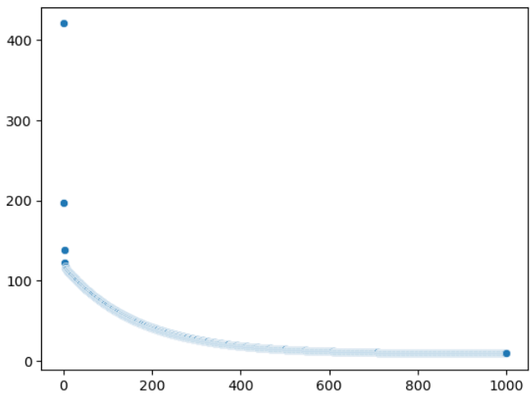
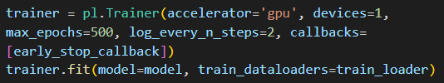
Early Stopping
Additional Features: Early Stopping
Loss
Epoch

