Slide 1
Convolutional Neural Networks:
Object Detection
Bert Gollnick

Slide 2
Object Detection
Introduction
Object Detection is a type of Deep Learning, which​
detects locations of objects in an image​
highlights the area with a rectangle​
Many different algorithms​
Fast R-CNN​
Faster R-CNN​
YOLO (You only look once)​
SSD (Single Shot Detector)​
Typically, custom training setup cumbersome to setup and time-consuming training

Slide 3

Object Detection
detecto
“detecto”
Python package
based on PyTorch
Claims to “build fully-functioning computer vision and object detection model with jus 5 lines” (well, close to)
Relies on Faster R-CNN ResNet-50 FPN

Slide 4

Object Detection
Coding
Simplified dataset with labels and bounding boxes: “apples”, “bananas”
Source: https://www.kaggle.com/datasets/mbkinaci/fruit-images-for-object-detection

Slide 5
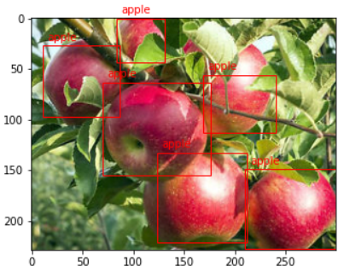
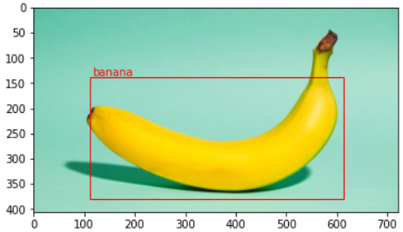
Object Detection
Coding
Result after 20 epochs

