Slide 1
Image Preprocessing
Bert Gollnick

Slide 2
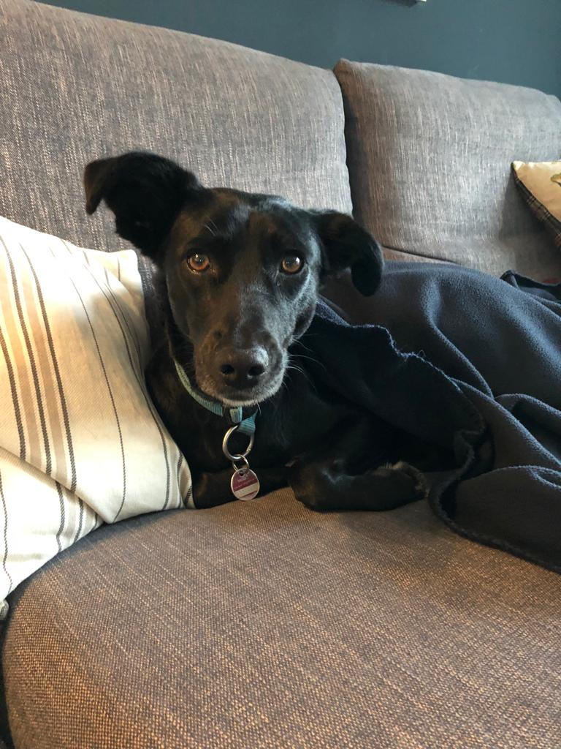
Image Preprocessing
Introduction
Original image
Represented by pixels
Dimensions: (C, H, W)…color, height, width
Pixels are represented as numerical values with [0, …, 255]
Image conversion required by PyTorch
Augmentations can improve model performance
3 for color image
1 for grayscale
number of
horizontal pixels
number of
vertical pixels
Original Image
Notes:
Why not saving complete model: exact directory structure saved, saves path to file with the class → easily breaks when it tries to load the model on a different computer

Slide 3

Image Preprocessing
Resize
Scales an image (usually down); identical tensor shapes required for all images
Original Image
Processed Image
Notes:
Why not saving complete model: exact directory structure saved, saves path to file with the class → easily breaks when it tries to load the model on a different computer

Slide 4
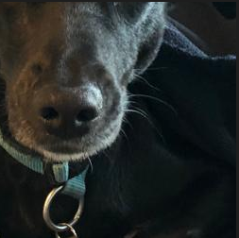
Image Preprocessing
CenterCrop
crops an image at the center
Original Image
Processed Image
Notes:
Why not saving complete model: exact directory structure saved, saves path to file with the class → easily breaks when it tries to load the model on a different computer

Slide 5
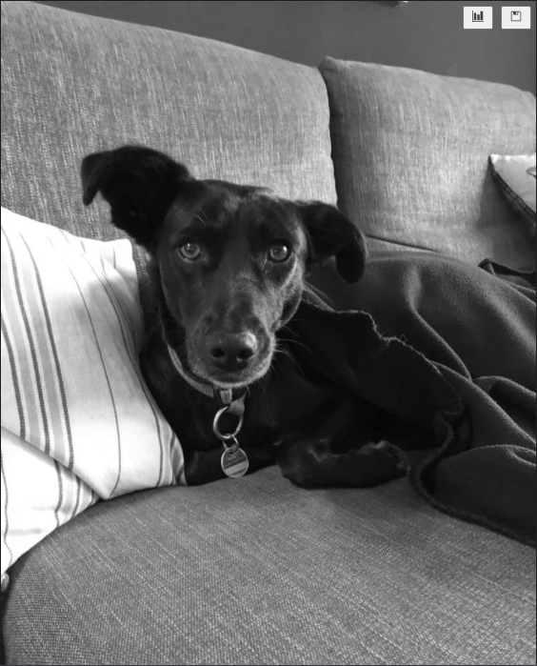
Image Preprocessing
Grayscale
creates grayscale image, reduces color channel dimension from 3 to 1
Original Image
Processed Image
Notes:
Why not saving complete model: exact directory structure saved, saves path to file with the class → easily breaks when it tries to load the model on a different computer

Slide 6
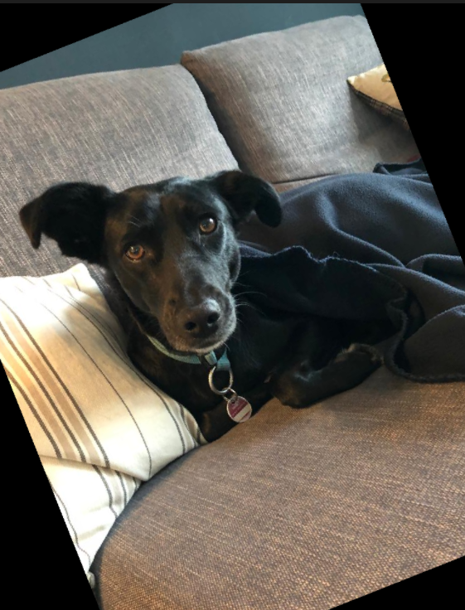
Image Preprocessing
RandomRotation
randomly rotates image within bounds, usually combined with crop.
Original Image
Processed Image
Notes:
Why not saving complete model: exact directory structure saved, saves path to file with the class → easily breaks when it tries to load the model on a different computer

Slide 7
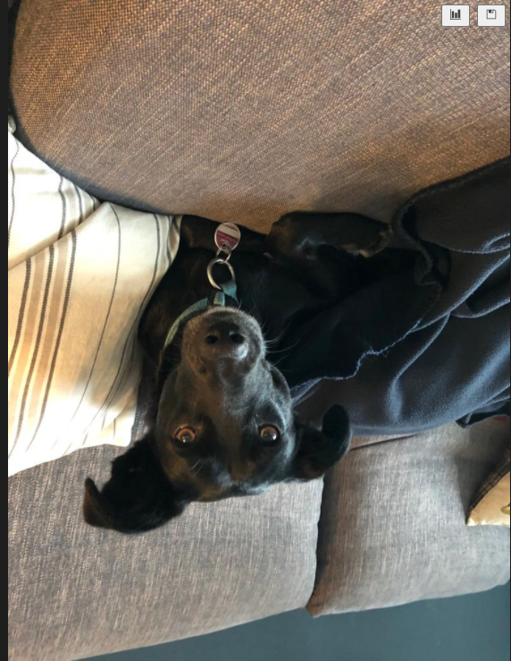
Image Preprocessing
RandomVertialFlip
flips an image with given probability
Original Image
Processed Image
Notes:
Why not saving complete model: exact directory structure saved, saves path to file with the class → easily breaks when it tries to load the model on a different computer

Slide 8
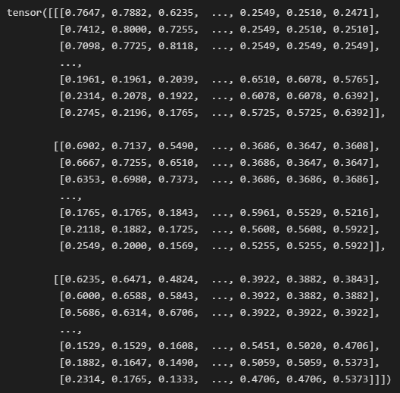
Image Preprocessing
ToTensor
converts a PIL image to tensor with dimensions (C, H, W) and value range [0.0, 1.0]
Original Image
Processed Image
Notes:
Why not saving complete model: exact directory structure saved, saves path to file with the class → easily breaks when it tries to load the model on a different computer

Slide 9
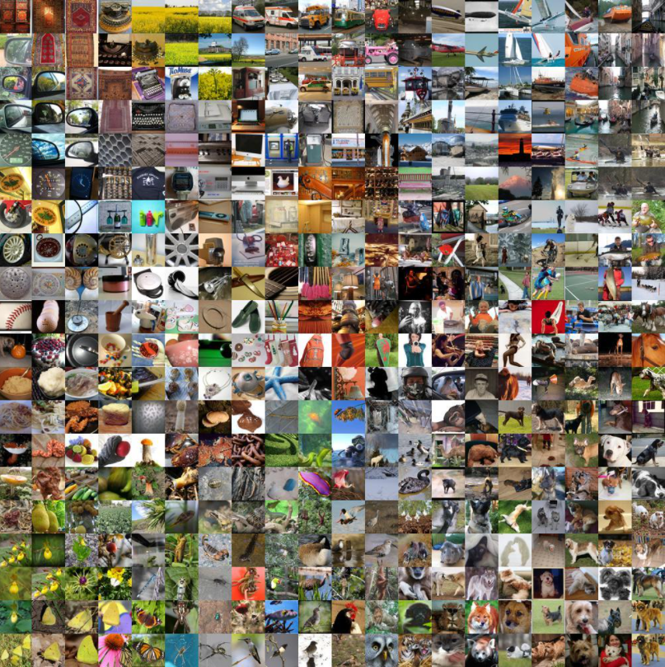
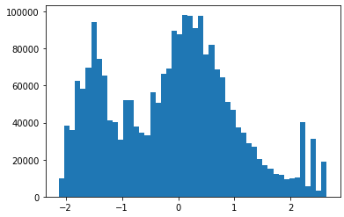
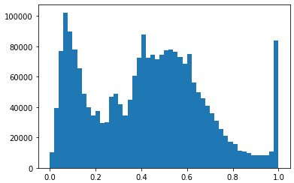
Image Preprocessing
Normalize
normalizes an image with mean and standard deviation
Image is centered around given mean
and has given standard deviation.
Batch of images
e.g. ImageNet
mean = (0.485, 0.456, 0.406)
Sd = (0.229, 0.224, 0.225)
Original Image (created from tensor)
Processed Image
Notes:
Why not saving complete model: exact directory structure saved, saves path to file with the class → easily breaks when it tries to load the model on a different computer

Slide 10
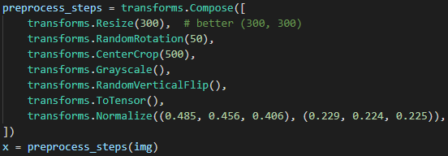

Image Preprocessing
Compose
Performs several transformations at once
composed steps are applied to all images
Let‘s find out in coding lecture.
Notes:
Why not saving complete model: exact directory structure saved, saves path to file with the class → easily breaks when it tries to load the model on a different computer

