Slide 1
Layer Calculations
Bert Gollnick

Slide 2
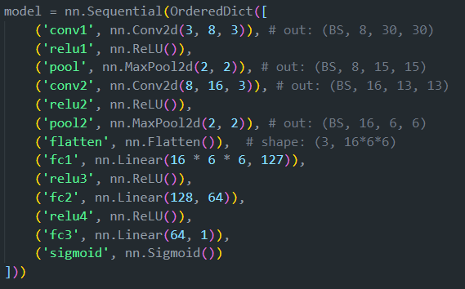
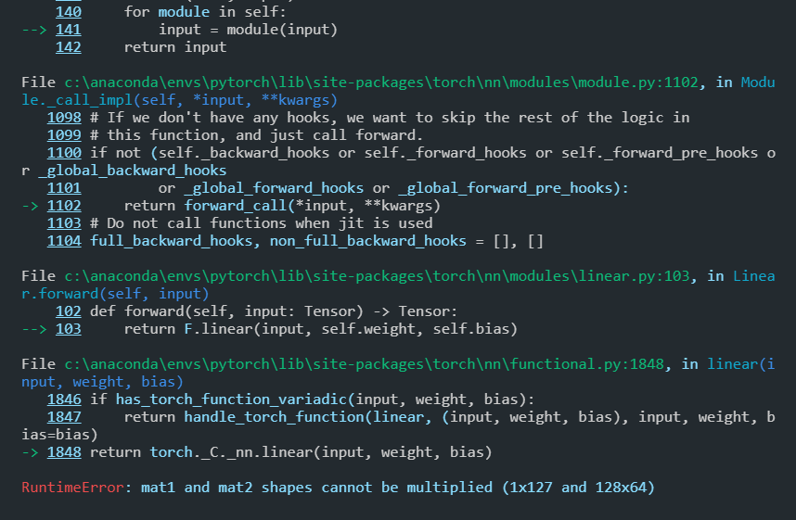

Layer Calculations
Problem
Notes:
Why not saving complete model: exact directory structure saved, saves path to file with the class → easily breaks when it tries to load the model on a different computer

Slide 3
Layer Calculations
Tensor Dimensions
Dimension | Structure | Used for | Example Size
1 | batch_size | Labels/predictions | [16]
2 | batch_size, features | nn.Linear() | [16, 512]
3 | batch_size, channels, features | nn.Conv1d() | [16, 1, 512]
4 | batch_size, channels, height, width | nn.Conv2d() | [16, 1, 224, 224]
5 | batch_size, channels, depth, height, width | nn.Conv3d() | [16, 1, 5, 224, 224]
Notes:
Why not saving complete model: exact directory structure saved, saves path to file with the class → easily breaks when it tries to load the model on a different computer

Slide 4







Layer Calculations
Conv2d Layers
Requires channels: in_channels and out_channels
in_channels
out_channels
number of channels created by convolution
depends on kernel size
will be in_channel size for next convolutional layer
Best practice: conv layers get more and more channels at beginning of network
Color channels: 1
Color channels: 3
Notes:
Why not saving complete model: exact directory structure saved, saves path to file with the class → easily breaks when it tries to load the model on a different computer

Slide 5
Layer Calculations
Transition from Convolutional Layer to Fully Connected
Conv2d has a 4D shape
Fully connected has a 2D shape
Can be achieved with nn.Flatten()
Conv Size
[16, 48, 224, 224]
Fully Connected Size
[16, 48 * 224 * 224]
width
channels * height * width
height
channels
batch size
batch size
Notes:
Why not saving complete model: exact directory structure saved, saves path to file with the class → easily breaks when it tries to load the model on a different computer

Slide 6

Layer Calculations
Fully Connected Layers
Require features NOT channels
in_features: input sample size
out_features: output sample size
Notes:
Why not saving complete model: exact directory structure saved, saves path to file with the class → easily breaks when it tries to load the model on a different computer

