Slide 1
Pretrained Models and Transfer Learning 101
Bert Gollnick

Slide 2
Pretrained Models and Transfer Learning
Introduction
Problem: only small number of images for training
Solution: don‘t train yourself, but use an already trained model
Why?
Existing weights can be used
Use existing features for other classes
Better performance
Save time
Tested architecture
with transfer
learning
Performance
without transfer
learning
Training Time

Slide 3
Pretrained Models and Transfer Learning
Usage
Source Labels
New Labels
Convolutional
Base
Convolutional
Base
Transfer
Learning
Input Layer
Input Layer
Notes:
Left: input layer, e.g. imagenet

Slide 4




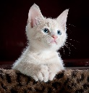

Pretrained Models and Transfer Learning
Example
e.g. bengal,
egyptian mau
Devon rex,
…
Cat Type Classifier
Dog Type Classifier
e.g. labrador,
Shiba inu, …
Source Labels
New Labels
Convolutional
Base
Convolutional
Base
Transfer
Learning
Input Layer
Input Layer
…
…
Notes:
Left: input layer, e.g. imagenet

Slide 5
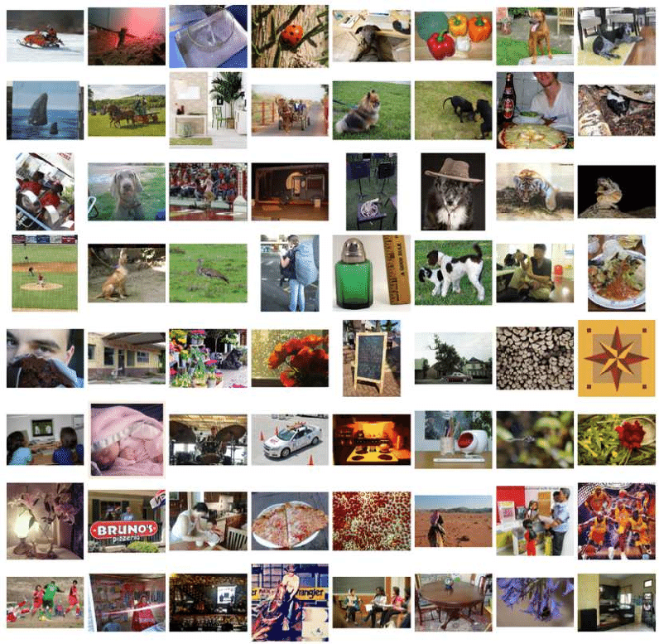
Pretrained Models and Transfer Learning
Imagenet
Imagenet challenge for Large Scale Recognition
Available since 2010
updated every year
1000 categories
> 1 million images
Source: https://www.researchgate.net/figure/Examples-in-the-ImageNet-dataset_fig7_314646236

Slide 6
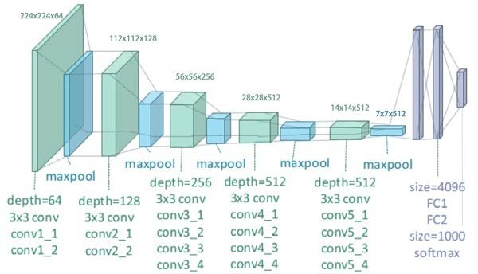
Pretrained Models and Transfer Learning
VGG19
Deep Convolutional Network for large-scale image recognition
Developed for ImageNet challenge
Convolutional Base
Dense Layers
Model Architecture
Source: https://www.researchgate.net/figure/llustration-of-the-network-architecture-of-
VGG-19-model-conv-means-convolution-FC-means_fig2_325137356

