Slide 1
Neural Network from Scratch

Slide 2

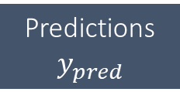



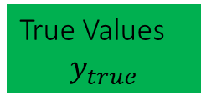
Neural Network from Scratch
Forward Pass
Inputs
Model Parameter
Model Results
Layer 1
Activation 1
True Values
$$y_{true}$$
$$S\left(l1\right)=\frac{1}{1+e^{−l1}}$$
$$l1=Xw+b$$
$$y_{pred}=S(l1)$$
Loss
Function
Loss
Score
Train
Data
X
Predictions
$$y_{pred}$$
$$L={\left(y_{pred}−y_{true}\right)}^{2}$$
updating
Optimizer
Weights
How to update the weights?

Slide 3



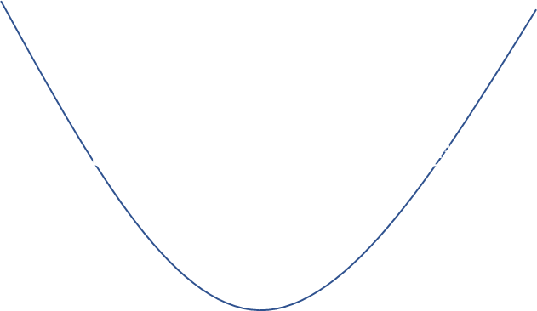

Neural Network from Scratch
Weight Update
$$L={\left(y_{pred}−y_{true}\right)}^{2}$$
$$L_{1}$$
$$L_{2}$$
$$y_{pred}−y_{true}$$
0
Notes:
-from forward pass we got an error
-loss shall be minimized, ideally to zero
-from L1 you need to increase the the y_pred
-from L2 you need to decrease it
-how? Place a tanget at the curve, mathematic tangent is the gradient, so the derivative of function, here loss function to a variable
-that is why it is called gradient descent
-positive property of our loss function: larger errors result in larger absolute gradients

Slide 4

Neural Network from Scratch
Learning Rate
$$L={\left(y_{pred}−y_{true}\right)}^{2}$$
$$L_{1}$$
$$L_{2}$$
$$y_{pred}−y_{true}$$
0
$$w_{new}=w−\frac{dL}{dw}$$
.
LR
with LR e.g. 0.01, 0.001

Slide 5



Neural Network from Scratch
Chain Rule
y=f(x)
z=f(y)
x
Target: get derivative of z to x!
$$\frac{dz}{dx}$$
=
$$\frac{dy}{dx}$$
.
$$\frac{dz}{dy}$$
Chain Rule

Slide 6





Neural Network from Scratch
Weights Update
Inputs
Model Parameter
Model Results
Layer 1
Activation 1
True Values
$$y_{true}$$
$$S\left(l1\right)=\frac{1}{1+e^{−l1}}$$
$$l1=Xw+b$$
$$y_{pred}=S(l1)$$
Loss
Function
Loss
Score
Train
Data
X
Predictions
$$y_{pred}$$
$$L={\left(y_{pred}−y_{true}\right)}^{2}$$
updating
Optimizer
Weights
$$\frac{dL}{dw}=$$
.
$$\frac{dy_{pred}}{dl_{1}}=\frac{dS(l1)}{dl1}$$
.
$$\frac{dL}{dy_{pred}}=2\left(y_{pred}−y_{true}\right)$$
$$\frac{d{layer}_{1}}{dw_{}}=X$$

Slide 7



Neural Network from Scratch
Bias Update
Inputs
Model Parameter
Model Results
Layer 1
Activation 1
True Values
$$y_{true}$$
$$S\left(l1\right)=\frac{1}{1+e^{−l1}}$$
$$l1=Xw+b$$
$$y_{pred}=S(l1)$$
Loss
Function
Loss
Score
Train
Data
X
Predictions
$$y_{pred}$$
$$L={\left(y_{pred}−y_{true}\right)}^{2}$$
updating
Optimizer
Weights
$$\frac{dL}{db}=$$
.
$$\frac{dy_{pred}}{dl_{1}}=\frac{dS(l1)}{dl1}$$
.
$$\frac{dL}{dy_{pred}}=2\left(y_{pred}−y_{true}\right)$$
$\frac{d{layer}_{1}}{db_{}}=$1

Slide 8

Neural Network from Scratch
Dot Product
Finally, weights shall be adapted to map input data to outputs.
Which weight is more similar to X?
Dot product applied
Weight is more similar, if
Magnitude is similar
Angle is similar
Input data X
w1
w2
Angle between vectors
Magnitude (length) of vector
Notes:
Finally the weights

Slide 9

Neural Network from Scratch
Dot Product
Finally, weights shall be adapted to map input data to outputs.
Which weight is more similar to X?
Dot product applied
X
w1
0
1
*
2
3
*
Dot product
$$X∙w1=0 ∗2+1 ∗3$$
Notes:
Finally the weights

