Slide 1
Artificial Intelligence Overview

Slide 2
Artificial Intelligence Overview
Quote
„As soon as it works, no one calls it AI any more.”
John McCarthy

Slide 3
Artificial Intelligence Overview
Present and Future
Narrow AI
Narrow AI
Broad (General) AI
Google Map
Google Search
Self-driving cars
Computers pass
Turing test
Existential threat
AI Assistent
Present
Near Future
Far Future???

Slide 4
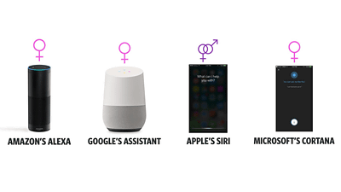
Artificial Intelligence Overview
Artificial Intelligence and their subgroups
Examples: AI Assistent
Siri, Alexa, Cortana, Google Now
Voice recognition systems use
Machine Learning to imitate
human interaction
able to have „natural“ conversations
indistinguishable from humans
Source: https://gigazine.net/gsc_news/en/20170305-alexa-siri-cortana-all-female

Slide 5
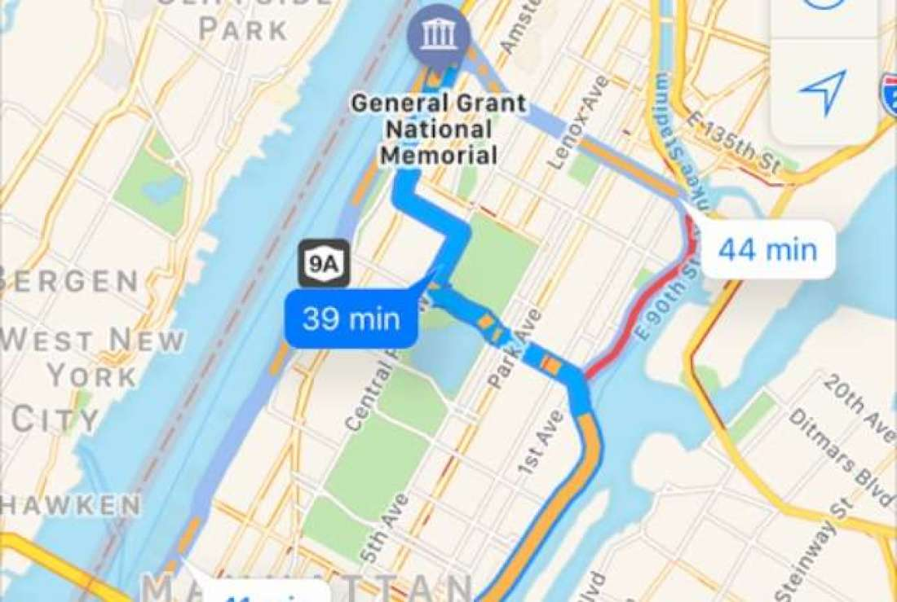
Artificial Intelligence Overview
Artificial Intelligence and their subgroups
Examples: Google Maps Traffic
Analyses speed of traffic through anonymous location data from smartphones
Reduces travel time by suggesting fastest routes
Source: http://mentalfloss.com/article/92958/how-does-google-maps-know-where-traffic

Slide 6

Artificial Intelligence Overview
Artificial Intelligence and their subgroups
Examples: Google Search
Biggest search engine
Offers recommendations
Suggestions based on previous user
searches
Source: www.google.de

Slide 7



Artificial Intelligence Overview
Artificial Intelligence and their subgroups
Artificial Intelligence
broadest term
Machines adapt to different situations
Machine Learning
Statistical techniques provide computers ability to „learn“
Deep Learning
Inspired by human brain
Artificial Neural Networks (ANNs) mimic structure of the brain
Discrete layers of neurons and connections of neurons make up an ANN
Artificial Intelligence
Machine Learning
Deep Learning

