Slide 1
Models

Slide 2




Models
High-Level Analogy
Apple
Sugar
Eggs
Baking Oven
Apple Pie
Ingredients + technical equipment
(Requirements)
Recipe
Result

Slide 3







Models
High-Level Analogy
Label:
„Dog“
„Cat“
Independent Variables
Model
Prediction

Slide 4

Models
Model Development and -application
Model Development
Algorithm
Existing Data
(incl. Target variable)
Create
Model
Model Application
New Data
(excl. Target)
Created
Model
Prediction of
target

Slide 5

Models
Detailed Model Development
Validation
Data
Data
Ingestion
Data Cleansing /
Transformation
Training
Data
Model
Training/
Building
Model
Evaluation
Holdout
Data
Train/Validation Loop
Data Preparation
Modeling
5

Slide 6
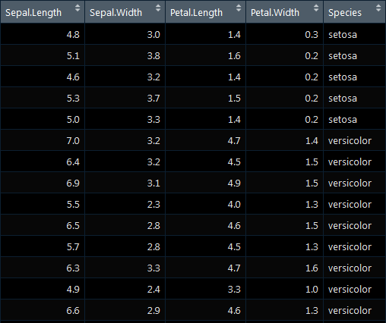
Models
Example
Task: Target variable (dependent variable)
should be predicted.
Predictors (independent variables) are used to create a model based on an existing
relationship between independent and
dependent variable.
Model „learns“ relationship
Learned model can then be applied to new data.
X1
X2
X3
X4
Y
Independent Variables
Target

