Slide 1
Self-Presentation

Slide 2




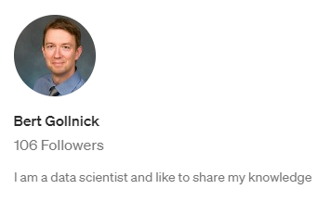

Self Presentation
Who am I?
Bert Gollnick
Aerospace Engineering
Economics
Data Scientist
work with Python, R, SQL, Flutter, HTML
Online courses at Udemy
articles at Medium
Notes:
Dynamic type check…at runtime rather than on compile time
Interpreted…easier to debug (no compilation needed)

