Slide 1
How do Programming Languages work

Slide 2
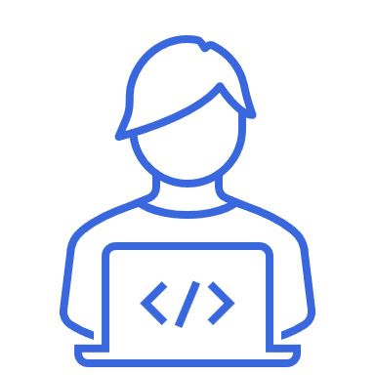
How do programming languages work?
General Overview
A programming language
formal language
human-understandable
produces machine code output
Each computer program is written in a programming language.
Notes:
Dynamic type check…at runtime rather than on compile time
Interpreted…easier to debug (no compilation needed)

Slide 3
How do programming languages work?
Key Ingredients
Syntax
formal rules (similar to grammar rules in spoken languages)
Comments
help you and other to understand the code
no effect on program result
Keywords
reserved word which cannot be used as variable or function name
reserved for compiler/interpreter
Miscellanious
variables, conditional statements, loops, functions and modules
Notes:
Dynamic type check…at runtime rather than on compile time
Interpreted…easier to debug (no compilation needed)

Slide 4
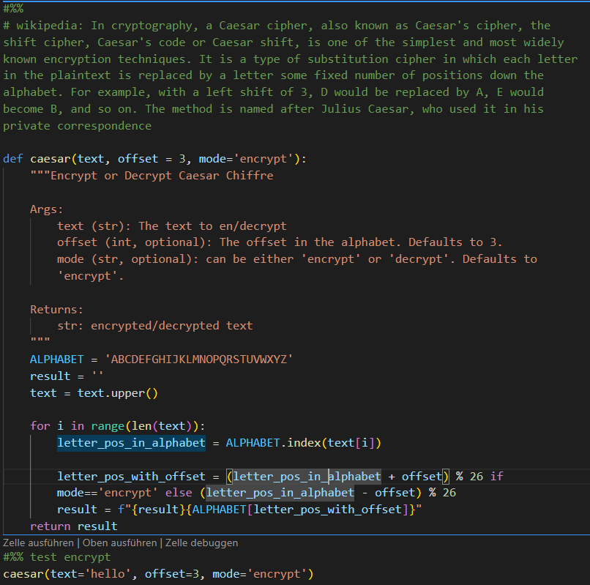
How do programming languages work?
Key Ingredients
Comments
Variables
Function
Notes:
Dynamic type check…at runtime rather than on compile time
Interpreted…easier to debug (no compilation needed)

Slide 5


How do programming languages work?
Compiler and Interpreter
Interpreter
Source code
Interpreter
Compiler
Source code
Compiler
Executor
Notes:
Dynamic type check…at runtime rather than on compile time
Interpreted…easier to debug (no compilation needed)

