Slide 1
What Python is and why you should learn it

Slide 2
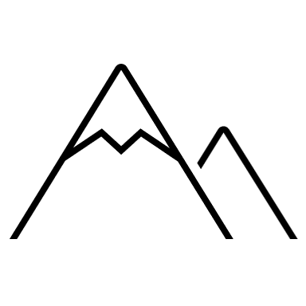

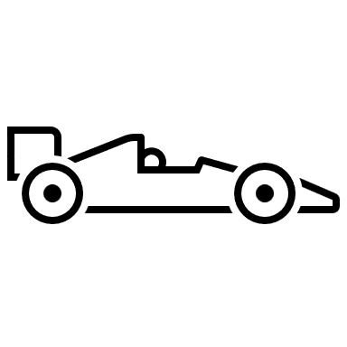
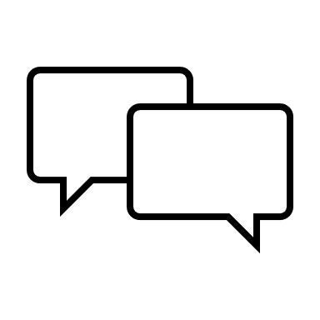
What Python is and why you should learn it
Python High-Level
Python is
High-level programming language
Increased readability
Dynamic type check
Interpreted language
Notes:
Dynamic type check…at runtime rather than on compile time
Interpreted…easier to debug (no compilation needed)

Slide 3
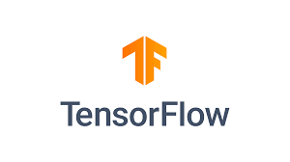
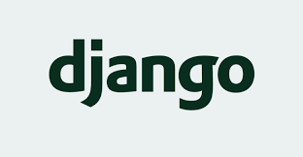

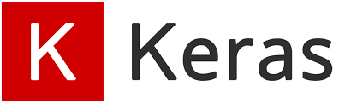

What Python is and why you should learn it
What
Core Python is small, but allows for extensions.
Python is flexible and thus used in many different fields.
Gaming
Web development
Machine Learning, especially Deep Learning
It has a large universe of modules:
Deep Learning (PyTorch, Tensorflow, Keras)
Web Frameworks (Django)
API (Flask)

Slide 4
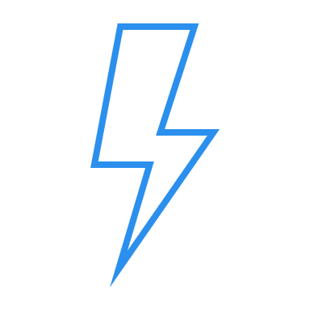
What Python is and why you should learn it
Python history so far
First Release by
Guido von Rossum
Version 2.0
Version 3.0
Version 3.10
1991
2000
2008
2022
Notes:
Version 3.0 not backward compatible, so major change to 2.0

Slide 5
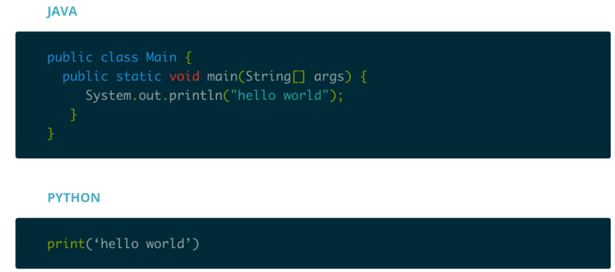
What Python is and why you should learn it
Why
Python is easy to use.
Less code
Good readability

Slide 6
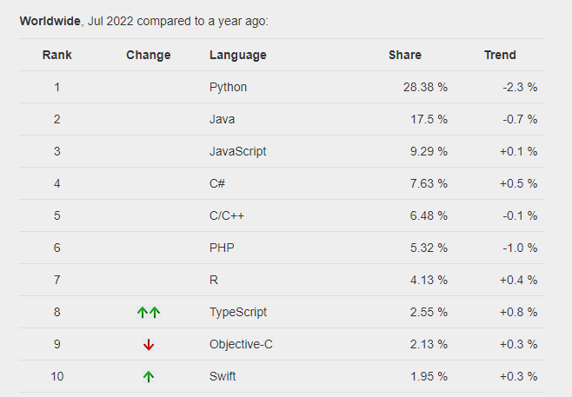
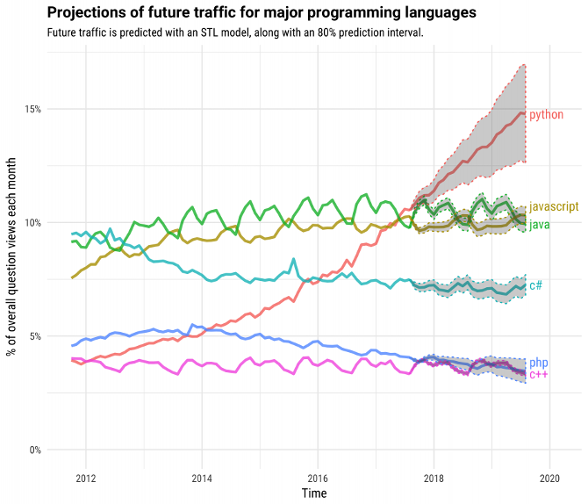
What Python is and why you should learn it
Why - Popularity
Python is most popular and the fastest growing language.
Stackoverflow questions
Source: https://pypl.github.io/PYPL.html

Slide 7
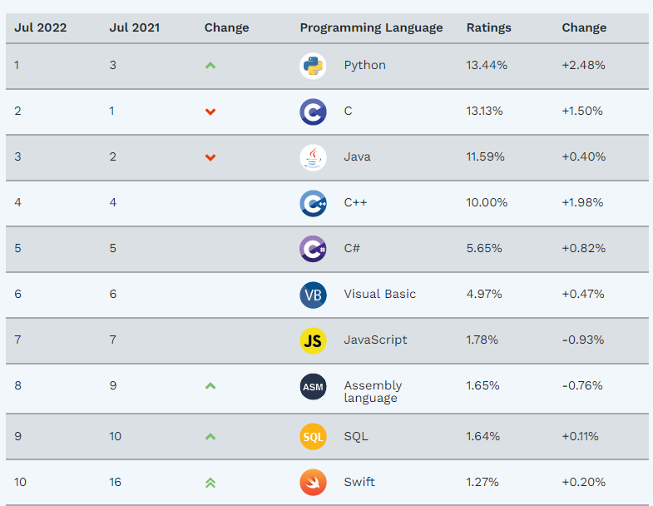
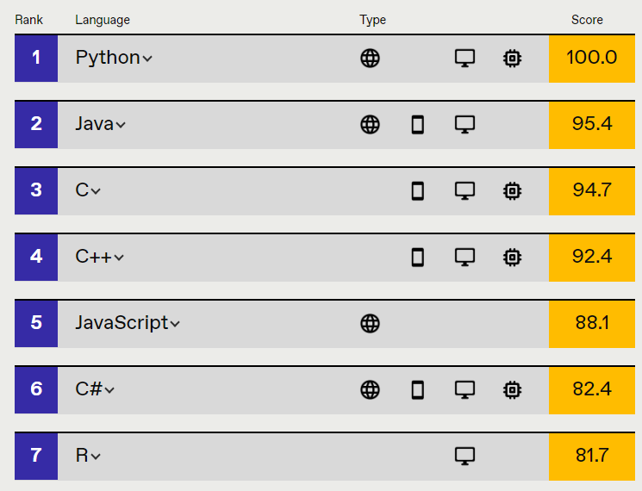
What Python is and why you should learn it
Why - Popularity
https://spectrum.ieee.org/top-programming-languages/#toggle-gdpr
Source: https://www.tiobe.com/tiobe-index/

Slide 8
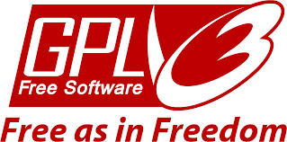
What Python is and why you should learn it
Why
Python is
Free
Notes:
Dynamic type check…at runtime rather than on compile time
Interpreted…easier to debug (no compilation needed)

