Slide 1
Package Manager

Slide 2
PIP Package Manager
Package Manager
PIP…”Package Installer for Python”
De facto Python’s package manager
Command line tool
Install and manage software packages (not included in standard library)
Connects to online repository for public packages
More on https://pypi.org/
Keeps track of dependencies

Slide 3
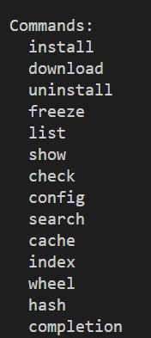



PIP
Important commands
PIP version:
Installing a package
Listing installed packages

Slide 4
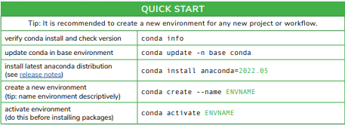
Conda
Important commands
Conda Cheat Sheet

