Slide 1
Motivation

Slide 2
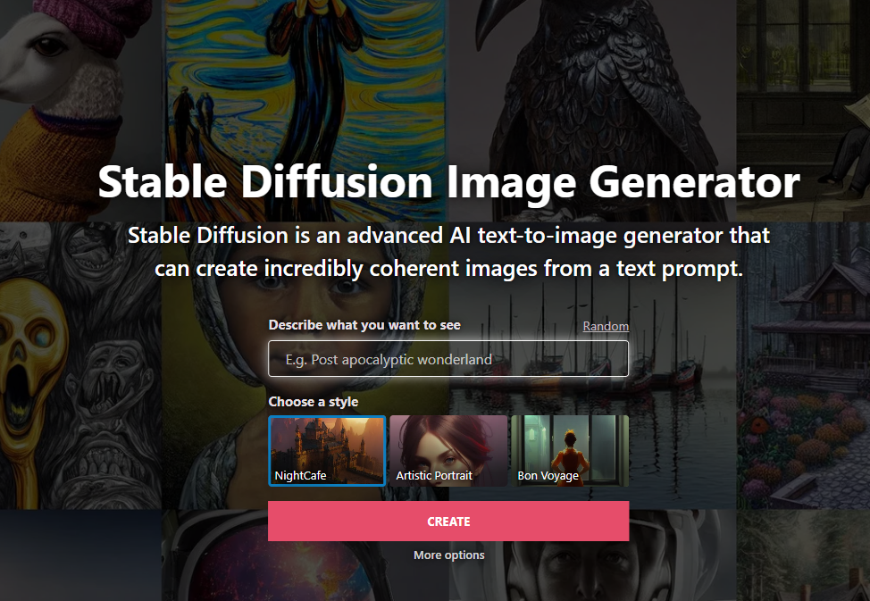
Motivation
Introduction
Understand state of the art deep learning
Text Generation

