Slide 1
System Setup

Slide 2


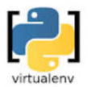





System Setup
Interpreter / Environment / IDE
Python
Interpreter
Environment
Virtualenv
Conda
Integrated Development
Environment (IDE)
Visual Studio
Code
Jupyter
NB Server
Jupyter
Labs
Spider

