Slide 1
Factor Analysis
Bert Gollnick

Slide 2
Factor Analysis
Introduction
Problem
Data with many variables – curse of dimensionality
Finding patterns between observations hard
Visualisation not possible
Main objective
Identify and measure factors that are not directly measureable
FA
Unsupervised learning technique
Very similar to PCA
Based on assumption of existing latent (hidden, not observable) variables
As many latent factors as variables in data

Slide 3
Factor Analysis
Latent Factors
Openness
Conscient-iousness
Extra-version
Agreeable-ness
Neuroti-cism
Example: Big Five
personality traits

Slide 4
Factor Analysis
Principle
Correlated
Variables
Factor
Analysis
Latent
Factors
Required: (observed) correlated variables
FA transforms correlated variables into unobservable, latent factors

Slide 5
Factor Analysis
Principle
F1
X1
U1
w_{1,1}
w_{1,2}
w_{1,3}
w_{1,4}
F2
X2
U2
F3
X3
U3
F4
X4
U4

Slide 6
Factor Analysis
PCA and FA
Principal
Component
Analysis
Factor
Analysis
Intended
Variance
Other
Variance,
e.g. error
X1
X2
X3
X1
X2
X3

Slide 7
Factor Analysis
KMO Criterion
Kaiser-Meyer-Olkin
Measures how good variables can be grouped to factors
Range 0 to 1
Usually >0.5 should be used to proceed
If <0.5 results of FA possibly not useful

Slide 8
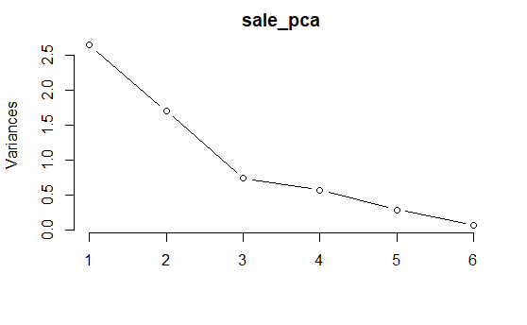
Factor Analysis
Number of Components
Two or three for visualisation
Scree plot
find „elbow“
Kaiser criterion
Eigenvalues > 1
Kaiser criterion
Elbow
criterion

Slide 9
Factor Analysis
Rotation
Base point
All observations load partially on F1 and F2
Hard to interpret
After rotation
Observations load on either F1 or F2
Does not affect explained variance of components
Most common rotation: varimax
Helps to interpret the model
F2
F2new
C
F1new
A
D
B
F1
F
E
G
H

Slide 10
Factor Analysis
Advantages / Disadvantages
+
can test a theory on latent factors
Applicable for feature selection
Well established
-
Requires a theory that you want to test
Subjective interpretation of factors
Factors only represent what was
measured

