Slide 1
Principal Component Analysis
Bert Gollnick

Slide 2
Principal Component Analysis
Introduction
Problem
Data with many variables – curse of dimensionality
Finding patterns between observations hard
Visualisation not possible
Main objective
Project higher dimensional data to lower dimensional space
(reduce number of variables)
Visualise principal components (2D or 3D)
PCA
Unsupervised learning technique
Most popular
Similar to clustering

Slide 3
Principal Component Analysis
Principle
Correlated
Variables
Principal
Component Analysis
Uncorrelated
Principal
Components
Required: correlated variables
PCA transforms correlated variables into uncorrelated principal components
Principal components not interpretable

Slide 4
Principal Component Analysis
Principle
X1
PC1
w_{1,1}
w_{1,2}
w_{1,3}
w_{1,4}
X2
PC2
X3
PC3
X4
PC4

Slide 5
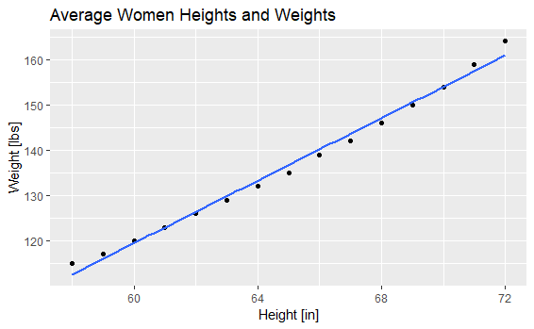
Principal Component Analysis
Example: 2D to 1D
y
Dataset: Women
Highly correlated
PC1 explains 99.8 % of
total variance
Reduction from two to
one dimensions possible
Largest Variation
PC2
PC1
2nd largest Variation
=PC2
x

Slide 6
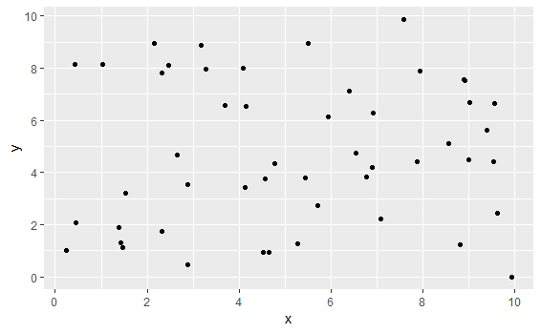
Principal Component Analysis
Example: 2D to 1D
Random Data Points
uncorrelated
PC1 and PC2 have similar
proportion of variance
→ No reduction of dimensions possible

Slide 7
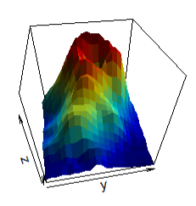
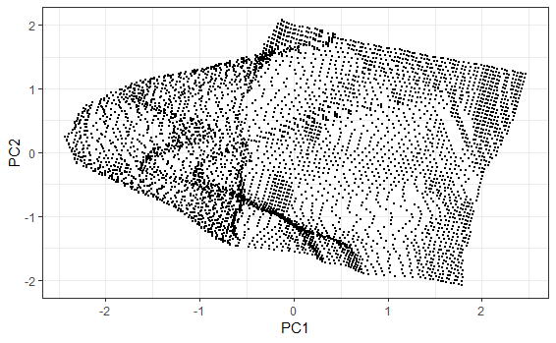
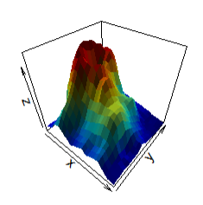
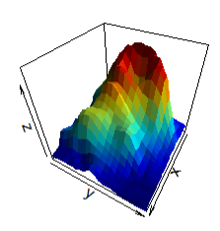
Principal Component Analysis
Example: 3D to 2D
PC1
Volcano
PC2
Principal
Component Analysis

Slide 8
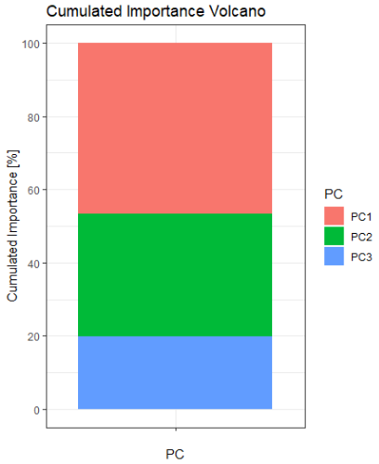
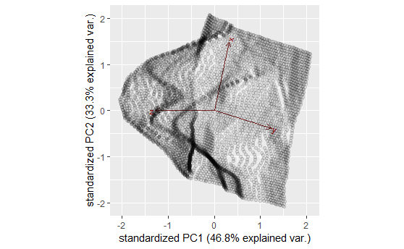
Principal Component Analysis
Example: 3D to 2D
Volcano
PC1 and PC2 cumulative proportion of variance: 80%
PC3 can be left out

Slide 9
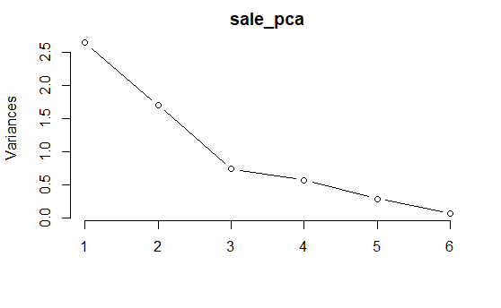
Principal Component Analysis
Number of Components
Two or three for visualisation
Scree plot
find „elbow“
Kaiser criterion
Eigenvalues > 1
Kaiser criterion
Elbow
criterion

Slide 10
Principal Component Analysis
Rotation
Base point
All observations load partially on PC1 and PC2
Hard to interpret
After rotation
Observations load on either PC1 or PC2
Does not affect explained variance of components
Most common rotation: varimax
Helps to interpret the model
PC2
PC2new
C
PC1new
A
D
B
PC1
F
E
G
H

Slide 11
Principal Component Analysis
Advantages / Disadvantages
+
Reduces higher dimensional data to a dimension that can be visualised
Reduces noise
Applicable for feature selection
Well established
-
Requires scaling of data!
Relies on linear assumptions
Very noisy variables can have too large impact

