Slide 1
t-SNE
Bert Gollnick

Slide 2
t-SNE
Introduction
t-Distributed Stochastic Neighbor Embedding
dimensionality reduction technique
uses non-linear projection
Overcomes crowding problem
Takes local and global structure into account
Keeps the distance of points in low dimension constant in high dimension
t-SNE preserves local similarities of observations

Slide 3
t-SNE
Crowding Problem
y
Comes from curse of dimensionality
Mapping from 2D to 1D creates crowed regions
y
x
y
x
x

Slide 4
t-SNE
How it works
Distance measure of all points to all other points
2. Plot all distances of points on a Gaussian Curve
y
Similarity
x
Notes:
S and N come from probability dist across neighboring points

Slide 5
t-SNE
How it works
3. Derive similarity matrix (high dimensional space)
4. Reproduce similarity matrix in
low dimensional space by rearranging points
(Student-t distribution)
Similarity Matrix
Similarity Matrix
Similarity
low
medium
high
perfect
Notes:
S and N come from probability dist across neighboring points

Slide 6
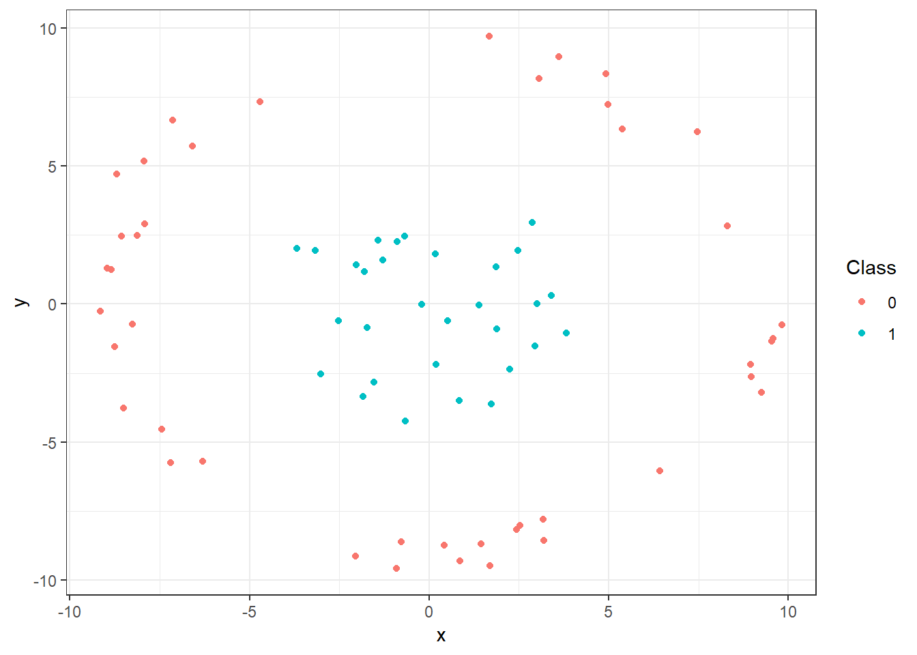
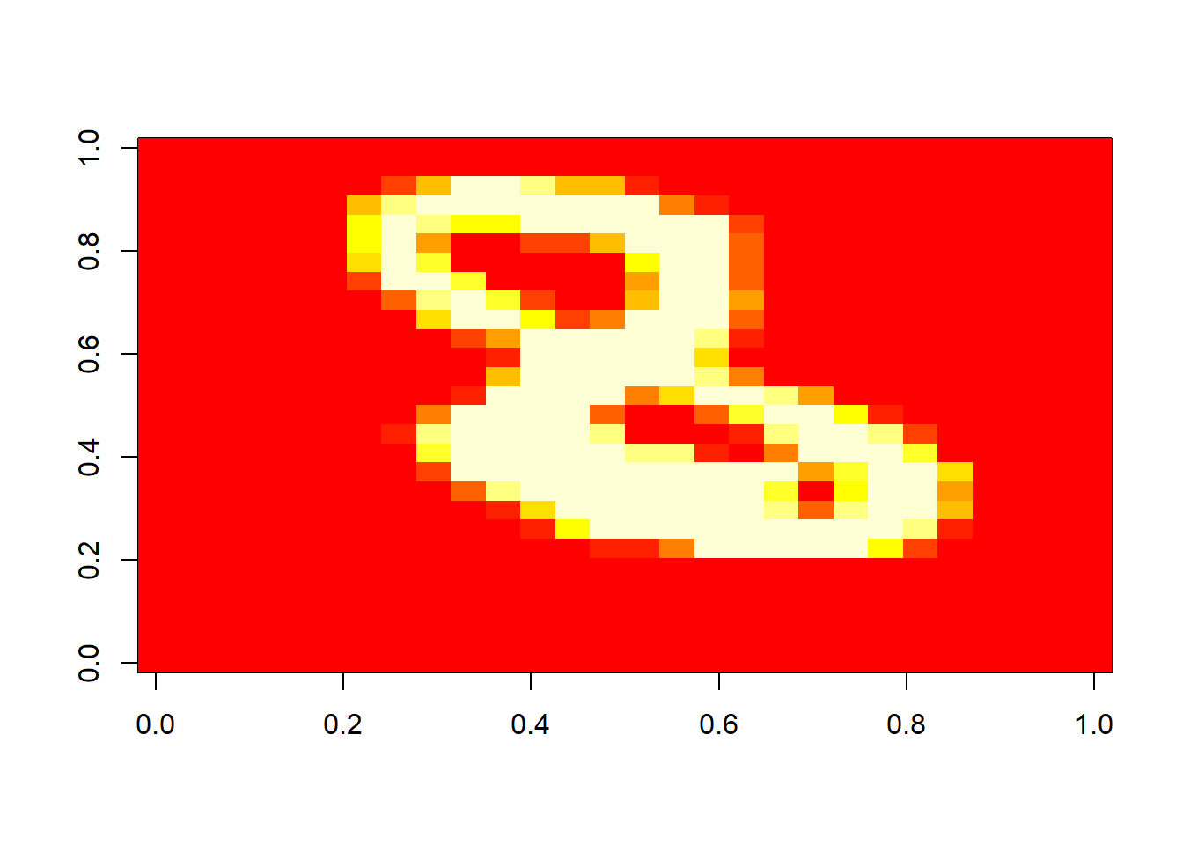
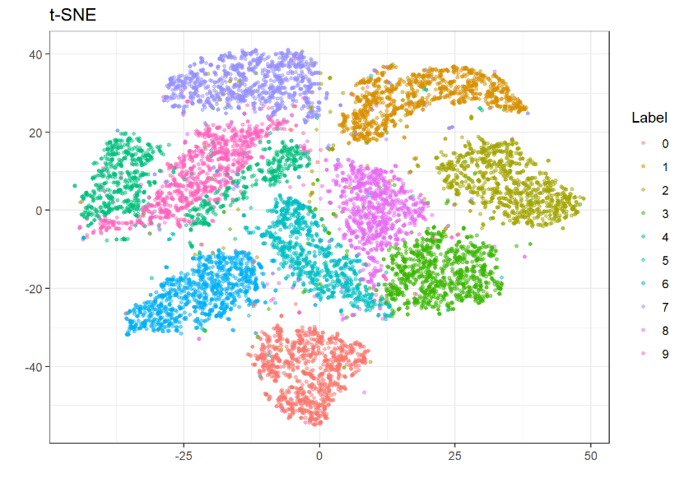
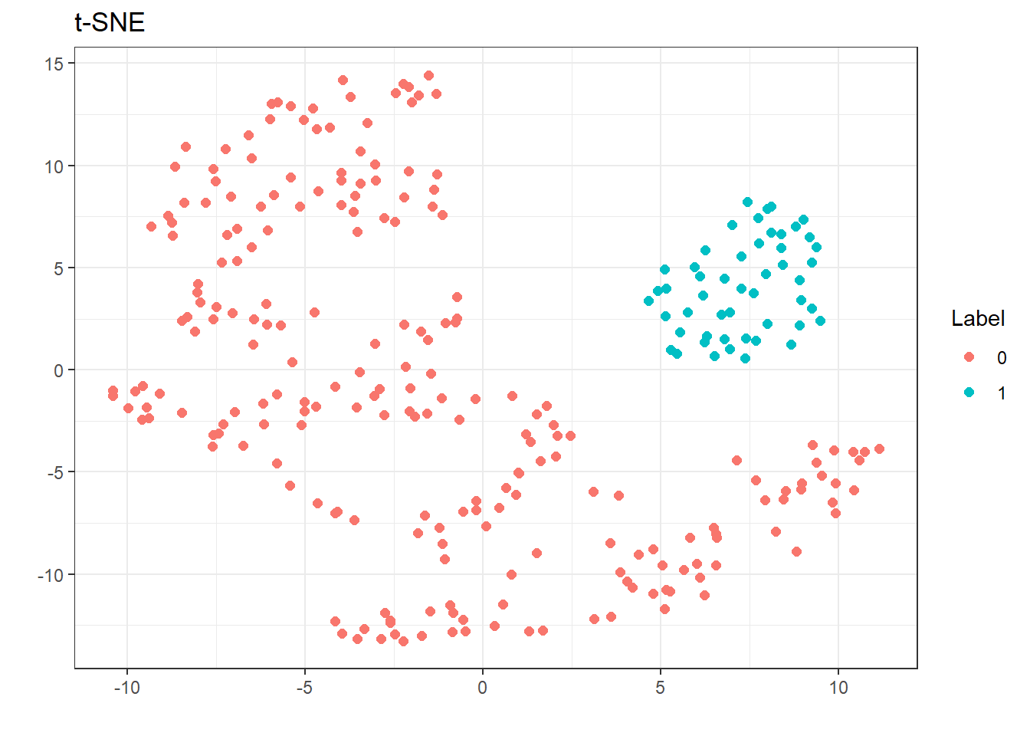
t-SNE
Examples
Spheres
Mnist

Slide 7
t-SNE
Advantages / Disadvantages
+
Can cover more complex structures than PCA
-
Non-convex loss function leads to non-deterministic solution
Uses Euclidean distance, which assumes linearity
Much higher computational effort than PCA

