Slide 1
Object Oriented Programming

Slide 2
Object Oriented Programming
Procedural Programming
sequential code
sequence of instructions executed
executed from top to bottom
can have loops, iterations, …
code blocks split up into functions
program based on functions
typical programming languages C, Basic, …
Execute 01
Execute 02
Execute 03
Execute 04
condition?
Execute 05A
Execute 05B
Execute n

Slide 3
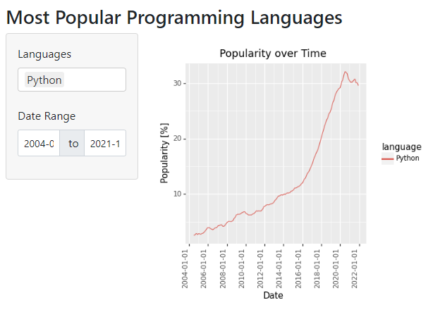

Object Oriented Programming
OOP introduction
programming paradigm
use objects to represent things
objects don‘t need to be processed in certain order
User can interact at different places with app
Source: https://datasciencehamburg.github.io/CodingLanguages.github.io/

Slide 4

Object Oriented Programming
Main Features of OOP
Classes
construction manual (blueprint) to create objects (instances of class)
Class Instance
an object of the class
Methods
functionality to interact with instances

Slide 5



Object Oriented Programming
Class and Instances
class Car
Legend
property
name
max_speed
color
method
start()
stop()
Instance
Instance
name = „family_car“
name = „sports_car“
max_speed = 100
color =„red“
max_speed = 200
color =„black“
start()
stop()
start()
stop()

Slide 6


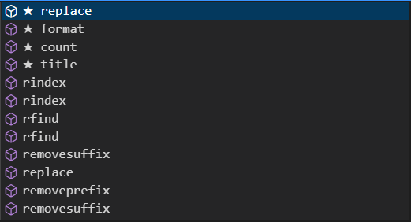
Object Oriented Programming
Why to use OOP?
Classes hold many properties and methods

Slide 7



Object Oriented Programming
Why to use OOP?
simplify problems
Reuseable code pieces
Use smaller pieces of code

Slide 8
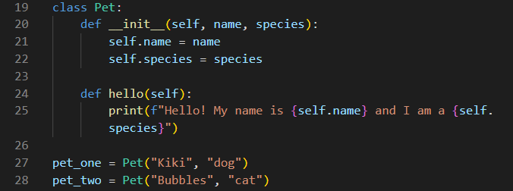
Object Oriented Programming
Creating a Class
class…keyword reserved for creating classes
__init__...function for initializing attributes of class
self…reference to instance object
instances are created by calling the
class and passing required parameters

Slide 9

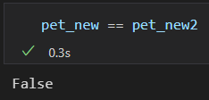
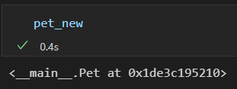
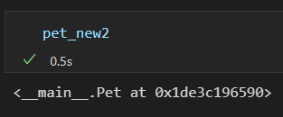
Object Oriented Programming
Instances
Instances are created by typing name of the class together with brackets and required parameters
here: two new instances are created
instance pet_new refers to memory address
instance pet_new2 seems to be identical to pet_new, but
because, pet_new2 is another instance (with the same attributes), but a different memory address

Slide 10
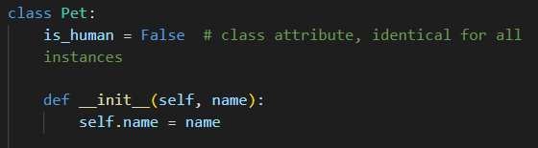
Object Oriented Programming
Instance Attributes
self.name = name creates a class-attribute called name and assigns value of parameter name
attributes created in __init__ are
instance attributes
opposite: class-attribute is the same
for all class instances

Slide 11
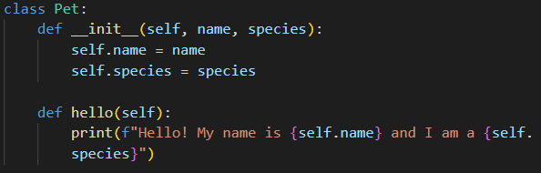
Object Oriented Programming
Instance Methods
functions inside a class
can only be called from instance of class
.hello() method makes use of instance attributes, so it needs to get access – self is passed as parameter

Slide 12
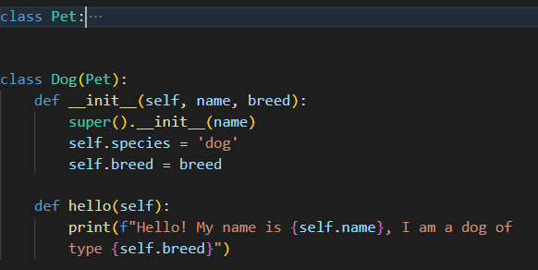
Object Oriented Programming
Class Inheritance
create new classes (derived classes, descendants) based on existing classes (ancestors)
derived class inherits all attributes and methods from ancestor class
ancestor class
descendant class

