Slide 1

Deep Learning Workshop
gollnickdata.de

Slide 2
Machine Learning 101
gollnickdata.de

Slide 3
Machine Learning 101
Classical Programming and Machine Learning
Rules
Classical Programming
Answers
Data
Data
Machine Learning
Rules
Answers
Inspired by: Francois Chollet and J.J. Allaire „Deep Learning with R and Keras“

Slide 4
Machine Learning Overview
Data Transformation
y
x‘
y‘
Classification
Red, if x‘>0
Green, if x‘<=0
x

Slide 5
Types of Machine Learning
Supervised, Unsupervised, Reinforcement Learning
Learning Type
Unsupervised
Supervised
Reinforcement
Learning
Regression
Continuous
Target Variable
Clustering
Categorical
Classification

Slide 6
Types of Machine Learning
Example: School Class
Supervised Learning
Task: Use Label / Target Variable
for Learning/Prediction
Name | Age | Learning Method | Class | Grade
Anton | 14 | A | Sport | 2
Bert | 15 | B | Sport | 2
Clare | 13 | A | Sport | 3
Dave | 16 | B | Math | 1
Emilia | 15 | A | Math | 2
…

Slide 7
Types of Machine Learning
Example: School Class
Unsupervised Learning
Task: Find groups of similar students (clusters)
Sports
Nerds
Others
1 2 3 4 5 6
Athletes
Math
1 2 3 4 5 6

Slide 8
Types of Machine Learning
Example: School Class
Reinforcement Learning
-Assign Learning Method to each student one by one.
-Task: Find which learning method should be chosen in future
-RL Methods find faster solution than A/B tests.
Name | Age | Learning Method | Class | Grade
Anton | 14 | A | Sport | 2
Bert | 15 | B | Sport | 2
Clare | 13 | A | Sport | 3
Dave | 16 | B | Math | 1
Emilia | 15 | A | Math | 2
…

Slide 9

Types of Machine Learning
Example: Student Test Prediction
Classification
Fail / Pass
Regression
Percentage
Score
Existing
Student
Records
Model Type
Outcome

Slide 10
Types of Machine Learning
Example: Classification and Regression Plot
x2
y
Classification
Regression
x1
x

Slide 11
Types of Machine Learning
Example: Student Test Prediction
Property | Classification | Regression
Output / Target Variable | Discrete (class labels) | Continuous numbers
Examples | Fail / pass | Percentage scores
What is searched for? | Decision Boundary, Group membership | Best Fit Line
Evaluation Measure | Accuracy | Sum of squared errors (R²)

Slide 12
Models

Slide 13




Models
High-Level Analogy
Apple
Sugar
Eggs
Baking Oven
Apple Pie
Ingredients + technical equipment
(Requirements)
Recipe
Result

Slide 14







Models
High-Level Analogy
Label:
„Dog“
„Cat“
Independent Variables
Model
Prediction

Slide 15

Models
Model Development and -application
Model Development
Algorithm
Existing Data
(incl. Target variable)
Create
Model
Model Application
New Data
(excl. Target)
Created
Model
Prediction of
target

Slide 16

Models
Detailed Model Development
Validation
Data
Data
Ingestion
Data Cleansing /
Transformation
Training
Data
Model
Training/
Building
Model
Evaluation
Holdout
Data
Train/Validation Loop
Data Preparation
Modeling
16

Slide 17
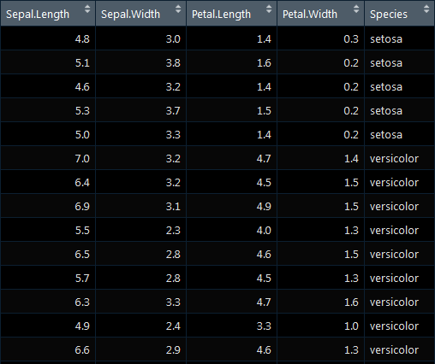
Models
Example
Task: Target variable (dependent variable)
should be predicted.
Predictors (independent variables) are used to create a model based on an existing
relationship between independent and
dependent variable.
Model „learns“ relationship
Learned model can then be applied to new data.
X1
X2
X3
X4
Y
Independent Variables
Target

Slide 18
Our Focus in Today‘s Class
Classification
Learning Type
Unsupervised
Supervised
Reinforcement
Learning
Association
Rules
Regression
Continuous
Target Variable
Deep Learning
Discrete
Clustering
Classification
Dimensionality
Reduction

Slide 19
Analysis Steps

Slide 20
Analysis Steps
Sample Steps
Data Import
Model Training
Missing Data Analysis
Create Predictions
Modeling
Missing Data Treatment
Model Evaluation
Data
Preparation
Categorical Data Treatm.
Separate Dependent /
Independent Feature
Data Splitting
Data Scaling

Slide 21
Logistic Regression

Slide 22
Logistic Regression
Introduction
Suitable for classification tasks (don‘t get confused by „regression“)
Only works for binary classifier
Independent variables can be continous or discrete
Related to classical regression

Slide 23
Logistic Regression
From Linear Regression to Logistic Regression
Linear Regression
Logistic Regression
Y
Y
Sick = 1
Y = m X + n
Cost Function: Least Squares
Healthy
= 0
X
X
Notes:
Problem of exceeding range of 0 to 1 → thus sigmoid function applied

Slide 24
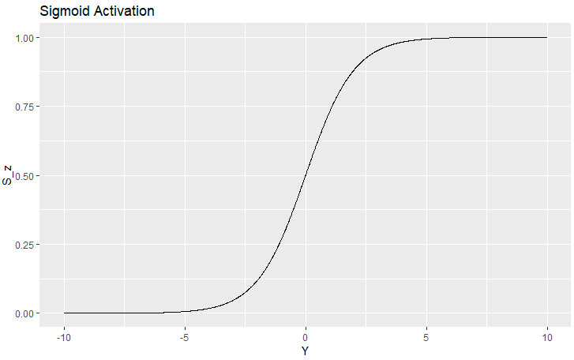
Logistic Regression
From Linear Regression to Logistic Regression
Logistic Regression
$$Y=mX+n$$
Transform Target Variable with Sigmoid Function
$$p=\frac{1}{1+e^{−Y}}$$
Rewrite Formula:
$$Y=ln\left(\frac{p}{1−p}\right)$$
Logit-Transformation of Target Variable:
$$Y=ln\left(\frac{p}{1−p}\right)$$
$$ln\left(\frac{p}{1−p}\right)=mX+n$$
Sigmoid function maps results to 0 to 1 range.
$$S(x)=\frac{1}{1+e^{−x}}$$

Slide 25
Logistic Regression
From Linear Regression to Logistic Regression
Linear Regression
Logistic Regression
Y
Y
Sick = 1
Healthy
= 0
X
X
Notes:
Problem of exceeding range of 0 to 1 → thus sigmoid function applied

Slide 26
Logistic Regression
From Probabilities to Classes
Y
Sick = 1
Threshold
Healthy
= 0
X
Notes:
Problem of exceeding range of 0 to 1 → thus sigmoid function applied

Slide 27
Logistic Regression
From Probabilities to Classes
Y
Sick = 1
Threshold
Healthy
= 0
X
Notes:
Problem of exceeding range of 0 to 1 → thus sigmoid function applied

Slide 28
Classification

Slide 29
Confusion Matrix
Example
Event Occured?
 | Yes | No
Yes | True Pos (Hit) | False Pos (Type I Error) (False Alarm)
No | False Neg (Type II Error) (Miss) | True Neg (Correct Rejection)
Event
Predicted ?
True Outcome
Errors
Notes:
Hit, correct rejection,

Slide 30
Confusion Matrix
Example: Tsunami
Event Occured?
 | Yes | No
Yes | Tsunami was observed, when it actually happened | A tsunami was predicted, but there was none
No | There was a tsunami, but it was not predicted. | No tsunami occurred and nothing was Predicted
Event
Predicted ?
True Outcome
Less-critical Error
Critical Error
Notes:
Hit, correct rejection,

Slide 31
Confusion Matrix
Performance Measures: Accuracy
Numerator
Effect Exists?
Denominator
Effect Exists?
 | Yes | No
Yes | True Pos | False Pos
No | False Neg | True Neg
 | Yes | No
Yes | True Pos | False Pos
No | False Neg | True Neg
Effect
Observed?
Effect
Observed?
Accuracy $= \frac{TP+TN}{TP+TN+FP+FN}$
Usually compared to baseline result or to compare models
Notes:
Hit, correct rejection,

Slide 32
ROC Curve

Slide 33
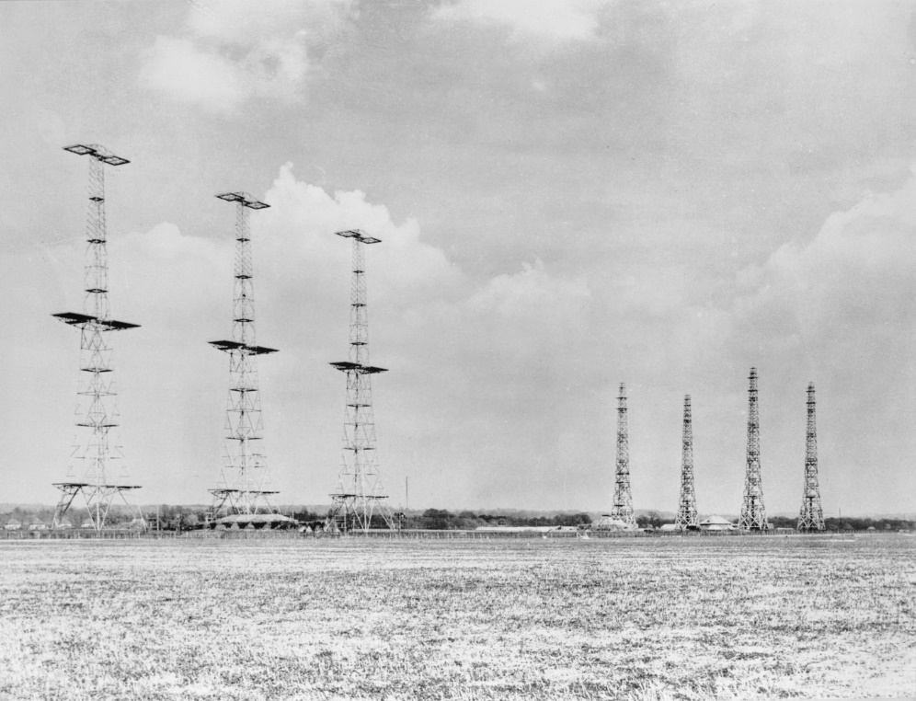
ROC Curve - 101
Introduction
Receiver Operating Characteristics (ROC) Curve
First developed and used during WWII for detecting enemy objects in
battlefields
Later used in psychology, medicine, forecasting of natural hazards, …
… and finally model performance
assessment
Source: https://commons.wikimedia.org/wiki/File:
Chain_Home_radar_installation_at_Poling,_Sussex,_1945._CH15173.jpg

Slide 34
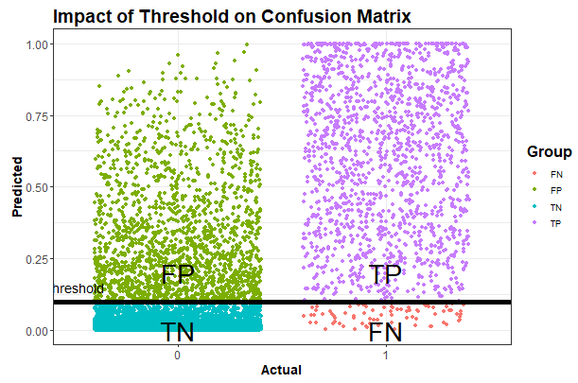
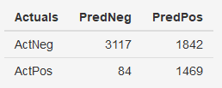
ROC Curve - 101
From Confusion Matrix to ROC Curve

Slide 35
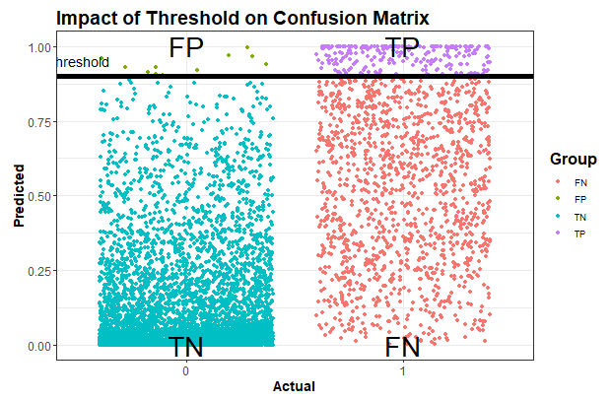
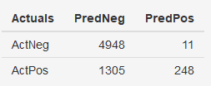
ROC Curve - 101
From Confusion Matrix to ROC Curve

Slide 36
ROC Curve - 101
From Confusion Matrix to ROC Curve
Predicted Class
 | Yes | No
Yes | True Pos (Hit) | False Neg (Type I Error)
No | False Pos (Type II Error) | True Neg (Correct Rejection)
$$TPR=\frac{TP}{TP+FN}$$
Actual Class
→ Y Axis on ROC Curve

Slide 37
ROC Curve - 101
From Confusion Matrix to ROC Curve
Predicted Class
 | Yes | No
Yes | True Pos (Hit) | False Neg (Type I Error)
No | False Pos (Type II Error) | True Neg (Correct Rejection)
Actual Class
$$FPR=\frac{FP}{FP+TN}$$
→ X Axis on ROC Curve

Slide 38
ROC Curve - 101
From Confusion Matrix to ROC Curve
Example
Threshold | TN | FP | FN | TP | FPR | TPR
0.01 | 1318 | 3641 | 3 | 1550 | 0.73 | 1
0.02 | 1776 | 3183 | 10 | 1543 | 0.64 | 0.99
…
0.98 | 4958 | 1 | 1431 | 122 | 0 | 0.08
0.99 | 4958 | 1 | 1448 | 105 | 0 | 0.07

Slide 39
ROC Curve - 101
ROC Curve
Perfect Classification
1
Random Guess
TPR [-]
Better
Classifier
Worse
Classifier
0
0
1
FPR [-]

Slide 40
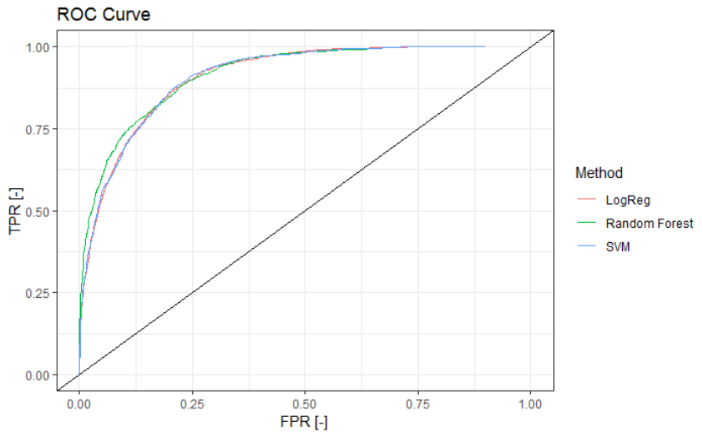
ROC Curve - 101
Purpose
Different methods
can be compared
Source: own graph

Slide 41
Classification Types

Slide 42
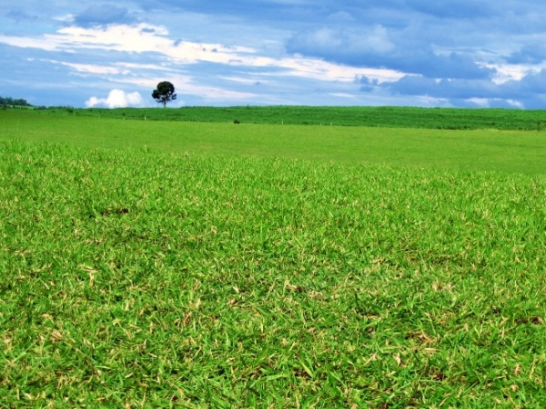
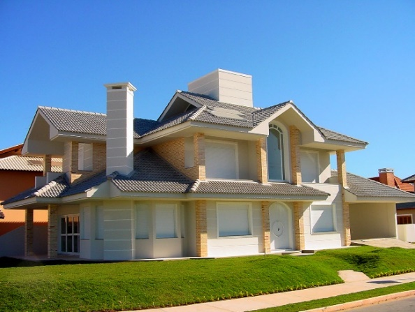
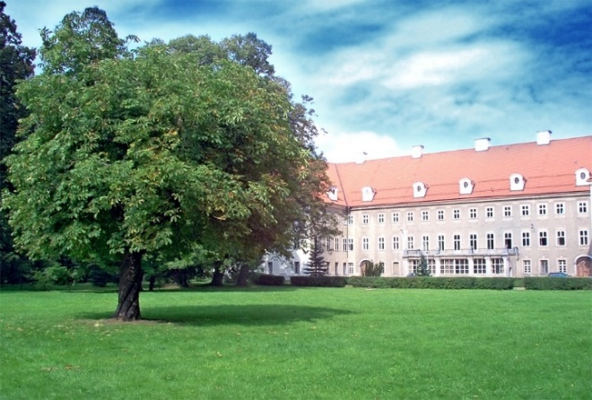
Classification Types
Binary
X: images of houses and / or trees
y:
one label per image
two mutually exclusive classes
Example Label encoding: 0 = tree, 1 = house
y = 0
y = 1
y = 0/1 ?

Slide 43
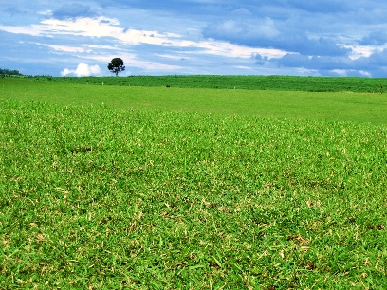
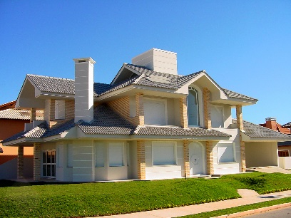

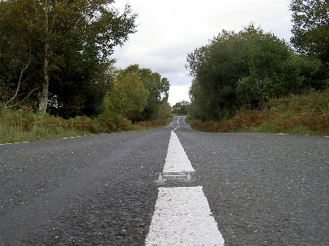
Classification Types
Multi-Class
X: images of houses and / or trees
y:
one label per image
more than two mutually exclusive
Example:
Label encoding: 0 = tree, 1 = house, 2 = road
y = 0
y = 1
y = 0
y = 2

Slide 44
Classification Types
Multi-Label
X: images of houses and / or trees
y:
each image can have more than one class
more than two mutually exclusive classes
Example:
Label encoding: 0 = tree, 1 = house, 2 = road
y = [0]
y = [1]
y = [0, 1]
y = [0,2]

Slide 45
Classification Example
gollnickdata.de

Slide 46

Classification Example
Dataset
Source: https://www.kaggle.com/datasets/fedesoriano/heart-failure-prediction

Slide 47
Main Ingredients
gollnickdata.de

Slide 48
Deep Learning Introduction
Section Overview
Confusing process of interactions
High Level Understanding
Performance
Perceptron
Layers
Activation Functions
Loss Functions
Optimizer
gollnickdata.de

Slide 49
Deep Learning General Overview
gollnickdata.de

Slide 50
Deep Learning General Overview
Introduction
type of machine learning
Covers all learning types (supervised/unsupervised/reinforcement learning)
Different architectures for different purposes
Fully-connected neural networks
Convolutional neural networks
Recurrent neural networks
…
Inspired by the structure and functioning of human brain
Use multiple layers for feature extraction
Each layer uses data from previous layer
Learn different levels of abstraction

Slide 51
Deep Learning General Overview
All Chapters
Learning Type
Unsupervised
Supervised
Reinforcement
Learning
Association
Rules
Regression
Continuous
Target Variable
Deep Learning
Clustering
Categorical
Classification
Dimensionality
Reduction

Slide 52


Deep Learning General Overview
Computer Vision Tasks
Classification and
Object Detection
Semantic
Segmentation
Classification
Object Detection
recognizes pixelwise location of dog/cat
Algorithm recognizes a dog in the image
Algorithm recognizes a dog in the image
Algorithm detects rectangular location of dog
recognizes a dog and cat in the image
Algorithm detects rectangular location of dog/cat

Slide 53
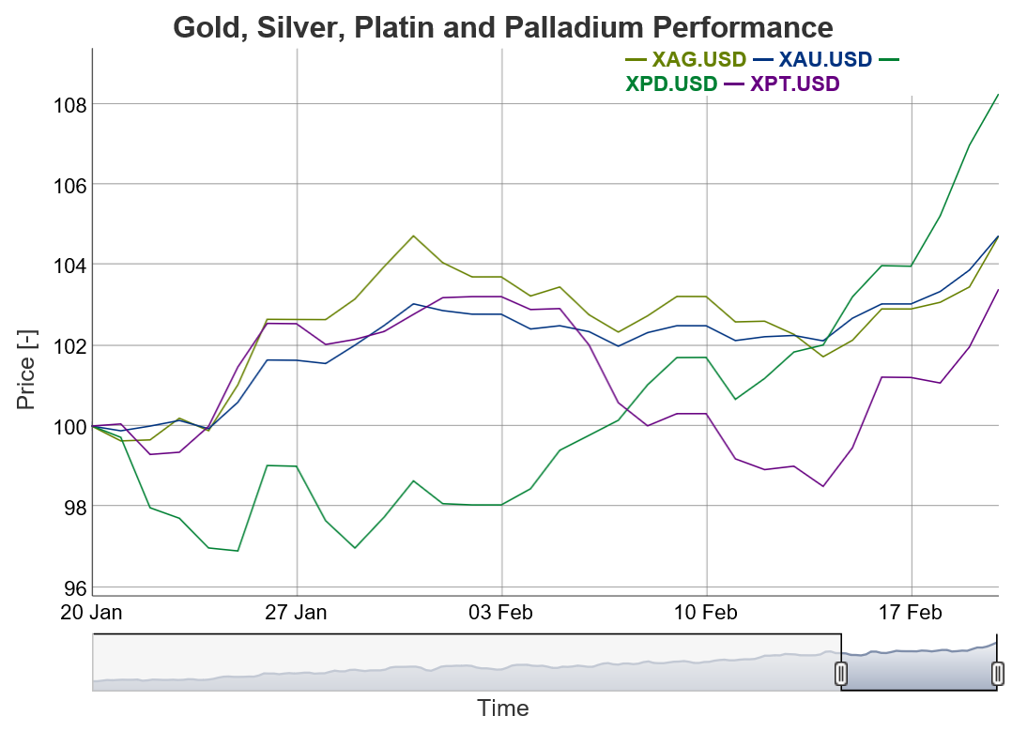

Deep Learning General Overview
Recurrent Neural Networks
Time Series Prediction
Forecasting
Text Generation
Machine Translation

Slide 54
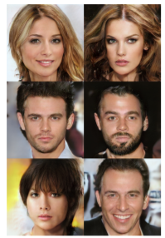

Deep Learning General Overview
GANs and Style Transfer
Style Transfer
Generative
Adversarial Networks
Sources:
[1] https://ndres.me/post/machine-learning-with-gifs-style-transfer/
[1] Karras „PROGRESSIVE GROWING OF GANS FOR IMPROVED QUALITY, STABILITY, AND VARIATION”

Slide 55
Deep Learning: Performance

Slide 56
Deep Learning: Performance
Deep Learning Performance
Classical ML techniques work best for small datasets
With increasing size of available data → neural networks outperform classical techniques
large
neural network
Model Performance
small
neural network
classical ML
techniques
Available Training Data

Slide 57




Deep Learning: Performance
Why did Deep Learning improve so much?
Mainly four reasons why Deep Learning took off.
More
Data
Moore‘s Law
More computing
Power
GPU‘s
Better
Algorithms
Open
Source

Slide 58
Modeling Overview

Slide 59
Deep Learning Overview
Model Creation Workflow
Inputs
Model Parameter
Model Results
Neural Network
Layers
True Values
Y
Loss
Function
Loss
Score
Train
Data
X
Predictions
Y‘
…
updating
Optimizer
Weights

Slide 60
Deep Learning Overview
Creating Predictions
Neural Network
Layers
True Test Values Y
Model Evaluation
Test
Data
X
Predictions
Y‘
…
Weights

Slide 61
From Perceptron to Neural Network

Slide 62
From Perceptron to Neural Network
Perceptron
Input
Values
Weights
Weighted
Sum
Activation
Function
1
w0
x1
w1
x2
w2
Σ
Output
σ
x3
w3
x4
w4

Slide 63
From Perceptron to Neural Network
Perceptron: Example
Input
Values
Weights
Weighted
Sum
Activation
Function
1
0.5
Output
1
2
-1.25
Weighted
sum
1
-2
-0.5
-0.5
0
σ
0
0.25
1
0.5

Slide 64
From Perceptron to Neural Network
Simple and Deep Neural Network
Input Values
Hidden Nodes
Output Nodes
Simple Neural Network
Notes:
Models are built based on layers that are connected

Slide 65
From Perceptron to Neural Network
Simple and Deep Neural Network
Input Values
Hidden Nodes
Output Nodes
Deep Neural Network
Multi-Layer Perceptron
Notes:
Models are built based on layers that are connected

Slide 66
Deep Learning: Layer Types

Slide 67
Deep Learning: Layer Types
Layer Types
Input Layer
Corresponds to independent variables
Taken as batches
Binned data
Categorized data

Slide 68
Deep Learning: Layer Types
Layer Types
Dense Layer
Each input layer is connected to each output layer
Also called fully connected layer
Usually non-linear activation function applied

Slide 69
Deep Learning: Layer Types
Layer Types
1D convolutional layer
Layer consists of filters
Sequentially a subset of input layer is processed
All nodes of input layer used
Input Layer
Convolutional
Layer

Slide 70
Deep Learning: Layer Types
Other Layer Types
Other Layer Types
Recurrent Neural Networks
use recurrent cells
Receive their own output with a delay
applied when context plays a role
Long short-term memory (LSTM)
use „memory cell“
Used for temporal sequences
Input Values
Hidden Nodes
Output Nodes
Notes:
https://towardsdatascience.com/the-mostly-complete-chart-of-neural-networks-explained-3fb6f2367464
Memory cell

Slide 71
Deep Learning Details
Layer Types
Output Layer
Problem Type | Nodes | Output Layer Activation
Regression | 1 | Linear
Multi-Target Regression | N (nr. of targets) | Linear
Binary Classification | 1 | Sigmoid
Multi-Label Classification | N (nr. of labels) | softmax

Slide 72
Deep Learning: Activation Functions

Slide 73
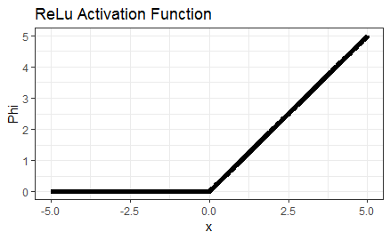
Deep Learning: Activation Functions
Activation Functions
There are different activation functions.
Rectified Linear Unit (ReLu)
Phi = max(0, x)
Most common
Non-linear

Slide 74
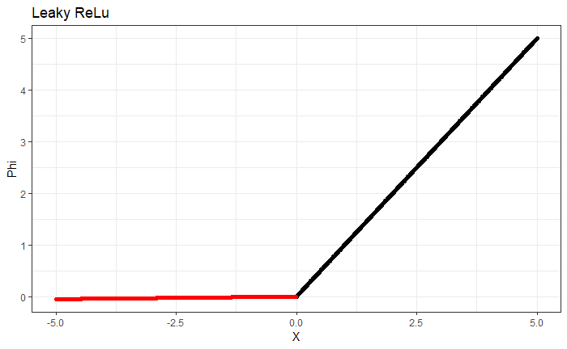
Deep Learning: Activation Functions
Activation Functions
Leaky Rectified Linear Unit (Leaky ReLu)
Phi(x) = x if x>0
alpha * x otherwise
alpha typically 0.01
Instead zero for negative inputs, small gradient
Gradient never zero

Slide 75
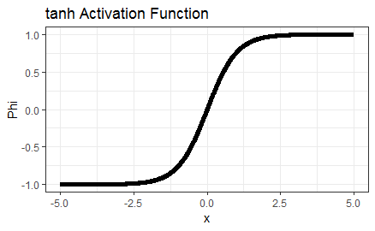
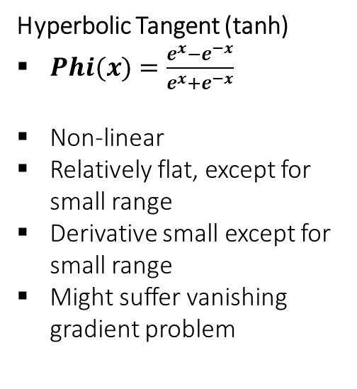
Deep Learning: Activation Functions
Activation Functions
Hyperbolic Tangent (tanh)
$Phi(x)=\frac{e^{x}−e^{−x}}{e^{x}+e^{−x}}$
Non-linear
Relatively flat, except for small range
Derivative small except for small range
Might suffer vanishing gradient problem

Slide 76
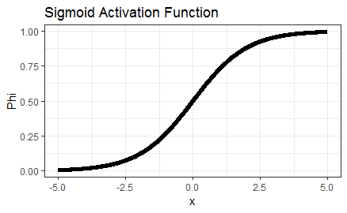
Deep Learning: Activation Functions
Activation Functions
Sigmoid
Phi(x) = 1 / (1+e^{-x})
Non-linear
Relatively flat, except for small range
Derivative small except for small range
Might suffer vanishing gradient problem
Result range 0 to 1

Slide 77
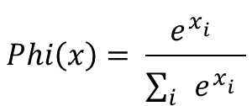
Deep Learning: Activation Functions
Activation Functions
Softmax
Used for multi-class prediction
1
x1
p(x1)
0.03
4
x2
Softmax
p(x2)
0.64
p(x3)
0.09
2
x3
$$Phi\left(x\right)= \frac{e^{x_{i}^{}}}{\sum_{i}{e^{x_{i}^{}}}}$$
p(x4)
0.24
3
x4

Slide 78
Deep Learning: Loss Functions

Slide 79
Deep Learning: Loss Functions
Overview
Evaluates model performance during training
Gradual improvement due to optimizer
Is minimized during training
Multiple loss functions for one model possible (one for each output variable)
Regression
Classification

Slide 80
Deep Learning: Loss Functions
Regression Loss Functions
Regression Losses
Mean Squared Error $MSE=\frac{\sum_{i=1}^{n}{{\left(y_{i}−{\hat{y}}_{i}\right)}^{2}}}{n}$
Mean Absolute Error $MAE=\frac{\sum_{i=1}^{n}{\left|y_{i}−{\hat{y}}_{i}\right|}}{n}$
Mean Bias Error $MBE=\frac{\sum_{i=1}^{n}{\left(y_{i}−{\hat{y}}_{i}\right)}}{n}$
Output layer has 1 node
Typical activation function: linear

Slide 81
Deep Learning: Loss Functions
Binary Classification Loss Functions
Binary Cross Entropy
Applicable for binary classification
Most common
Output layer has 1 node
Typical activation function: sigmoid
$CE=−\left(y_{i}\log{{\hat{y}}_{i}}\right)+(1−$ $y_{i}$ $)\log\left(1−{\hat{y}}_{i}\right)$

Slide 82
Deep Learning: Loss Functions
Binary Classification Loss Functions
Hinge Loss
Also called SVM loss
Applicable for binary classification
Used for maximum margin classifiers
Output layer has 1 node
Typical activation function: sigmoid
$HingeLoss=\sum_{j ≠yi}{max⁡(0, s_{i}−s_{yi}+1)}$

Slide 83
Deep Learning: Loss Functions
Multi-Label Classification Loss Functions
Multi-Label Cross Entropy
Most common loss for multi-label classification
Output layer has n nodes, where n is number of labels
Typical activation function is softmax

Slide 84
Deep Learning: Optimizers

Slide 85
Deep Learning:Optimizer
Overview
During training weights of the model updated to minimize loss function
But how? → Optimizer
Calculates updates of weights based on Loss Function
Brute force (check all combinations) → bad idea!
Educated trial and error → good

Slide 86
Deep Learning:Optimizer
Gradient Descent
Loss
Initialize weights
calc small changes of weights
Adjust individual weights
Min found?
Winner
no
Specific
Weight
Finish

Slide 87
Deep Learning:Optimizer
Gradient Descent
Loss
Problem: local minima
Solution:
convex loss function
Learning rate
Loss
Local
Min
Global Min
X
Specific
Weight

Slide 88
Deep Learning:Optimizer
Learning Rate
Loss
Size of weight changes
High learning rate
Large steps
Risk of overshooting the minimum
Low learning rate
Very precise
Time-consuming
Learning Rate
Too large
weight
Loss
Learning Rate
Too small
weight

Slide 89
Deep Learning:Optimizer
Other Optimizers
Adagrad
Adapts learning rate to features → learning rate = f(weights)
Works well for sparse datasets
Learning rate decreases with time and gets sometimes too small
Adaprop, RMSprop supposed to solve this
Adam
Adaptive momentum estimation
Applies momentum → includes previous gradients into current gradient calculation
Widespread
More Optimizers
Stochastic Gradient Descent, Batch gradient descent, …

Slide 90
PyTorch Tensors
gollnickdata.de

Slide 91
PyTorch - Tensors
Introduction
PyTorch structure to work with variables → PyTorch tensors
Similar to numpy arrays, but more powerful
Automatically calculates gradients
Information about dependencies to other tensors

Slide 92
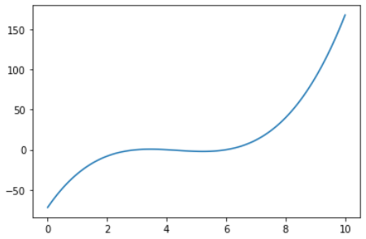
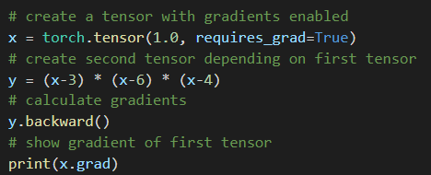


PyTorch - Tensors
Automatic Gradients
Gradients are calculated automatically
$$\frac{dy}{dx}=31$$
x

Slide 93

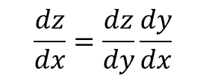
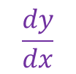
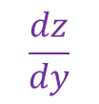
PyTorch - Tensors
Computational Graphs
Simple network:
Input x is used to calculate y, which is used to calculate z.
$$\frac{dy}{dx}$$
$$\frac{dz}{dy}$$
Backpropagation
x
y
z
y = x³
z = 5y - 4
Forward Pass
$$\frac{dz}{dx}=\frac{dz}{dy}\frac{dy}{dx}$$
Change of z based on change of x:
(Chain rule)
$$\frac{dz}{dx}=5∗3x^{2}$$

Slide 94
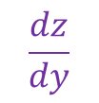
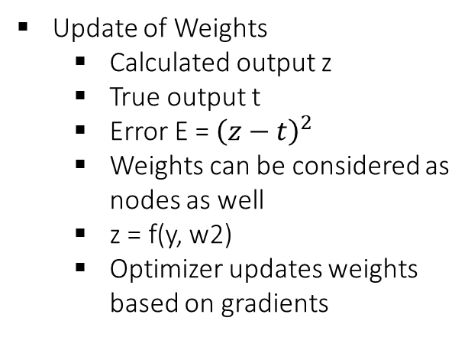
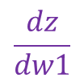
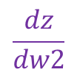
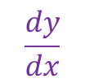
PyTorch - Tensors
Computational Graphs
Update of Weights
Calculated output z
True output t
Error E = ${\left(z−t\right)}^{2}$
Weights can be considered as nodes as well
z = f(y, w2)
Optimizer updates weights based on gradients
w1
w2
$$\frac{dz}{dw1}$$
$$\frac{dz}{dw2}$$
x
y
z
$$\frac{dy}{dx}$$
$$\frac{dz}{dy}$$

Slide 95
PyTorch - Tensors
Computational Graphs: Forward Pass
More complex network with multiple inputs
x₁₂ = f(x₁₁, x₂₁)
x₁₁
x₁₂
y
x₂₁
x₂₂
y = f(x₁₂, x₂₂)
x₂₂ = f(x₁₁, x₂₁)

Slide 96






PyTorch - Tensors
Computational Graphs: Backpropagation
More complex network with multiple inputs
$$\frac{dx_{12}}{{dx}_{11}}$$
$$\frac{dy}{{dx}_{12}}$$
x₁₁
x₁₂
$$\frac{dx_{12}}{{dx}_{21}}$$
y
$$\frac{dx_{22}}{{dx}_{11}}$$
x₂₁
x₂₂
$$\frac{dy}{{dx}_{22}}$$
$$\frac{dx_{22}}{{dx}_{21}}$$

Slide 97
PyTorch - Tensors
Computational Graphs: Forward Pass
Example
x₁₂ = 5*x₁₁ – 3*x₂₁
x₁₁
x₁₂
y
x₂₁
x₂₂
y = 4*x12 + 3*x22
x₂₂ = 2*x₁₁² + 2*x₂₁

Slide 98
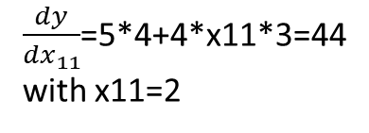







PyTorch - Tensors
Computational Graphs: Backpropagation
More complex network with multiple inputs
$$\frac{dx_{12}}{{dx}_{11}}=5$$
$\frac{dy}{{dx}_{12}}$=4
x₁₁
x₁₂
$\frac{dx_{12}}{{dx}_{21}}$=-3
y
$\frac{dx_{22}}{{dx}_{11}}$=4*x11
$\frac{dy}{{dx}_{11}}$=5*4+4*x11*3=44
with x11=2
x₂₁
x₂₂
$\frac{dy}{{dx}_{22}}$=3
$$\frac{dx_{22}}{{dx}_{21}}=2$$
$\frac{dy}{{dx}_{21}}$=3*2+4*(-3)=-6

Slide 99
Modeling: Section Overview

Slide 100
Modeling: Section Overview
Section Overview
PyTorch Model Training
nn.Module
Training Loop
Model Evaluation
Datasets
Dataloaders
Batches
Activation Functions
Hyperparameter Tuning
Saving / Loading Models

Slide 101
Datasets and Dataloaders

Slide 102
Datasets and Dataloaders
Introduction
Model training ideally should be separated from data preprocessing
Better readability and modularity
Dataset and Dataloader
Interface to Pre-loaded datasets
Interface to custom datasets
Dataset
Stores samples and labels
Dataloader
Iterable wrapped around Dataset

Slide 103
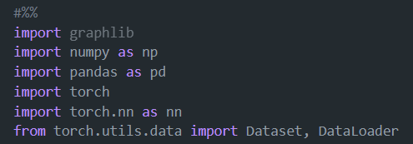
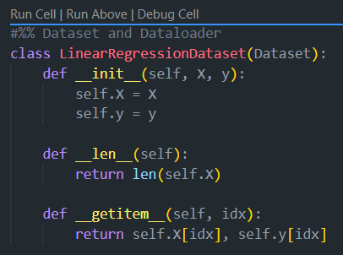
Datasets and Dataloaders
Custom Dataset
Requires three function implementations:
__init__
Runs once during instanciating the object
__len__
Returns number of samples
__getitem__
Loads samples from dataset, pre-processes them and returns them for given index

Slide 104

Datasets and Dataloaders
Dataloader
Dataloader iterates through dataset
Iterations return batches of data
Features
allows for shuffling the data
custom sampling strategies

Slide 105
Batches

Slide 106

Batches
Introduction
Often datasets very large → passing the complete dataset in one step to the model training impossible
Rather smaller bites provides to be consumed by model - batches
Complete dataset
Batch1
Batch2
BatchN
…

Slide 107
Batches
Batch Size
Batch size number of simultaneous provided datasets provided to model.
Defines speed of model training and stability of learning process.
Reasons for using smaller batch sizes
Smaller batch sizes noisier and lower generalization error
Easier to pass a batch of training data in memory (CPU or GPU)
Typical batch sizes
1 – 512
Often multiple of two
Good default: 32

