Slide 1
IMOS Backend & Object Storage
A sneak peek into IMOS’ backend, AWS migration and object storage
Dan Fruehauf
Integrated Marine Observing System

Slide 2
What is IMOS?
Integrated Marine Observing System
Second floor, IMAS building – come say hi!
~40TB of ocean observation data (mostly NetCDF) from various sensors such as:
ARGO floats
Satellite Remote Sensing
HF Radar
And much more…
https://imos.aodn.org.au

Slide 3

High Level Architecture
Facilities
Database
File Storage
Metadata Server
(GeoNetwork)
Data Server
(GeoServer)
Portal
https://imos.aodn.org.au
Users

Slide 4
IMOS’ backend
Backend – the parts of the system/program a user doesn’t see and shouldn’t care about
At IMOS it’s mostly the part that loads new data into the system

Slide 5
IMOS’ backend objectives
Keep data safe
Make only high quality data available for users
Do not increase load on front facing systems
Make this data available as quickly as possible

Slide 6
IMOS’ backend, back in the day…
Files were simply copied as uploaded
Iterate on all files in the filesystem
Probe for changes
Index/reindex those files
Delete files which were deleted
It was that simple, really…
This posed a few core problems as will be described

Slide 7
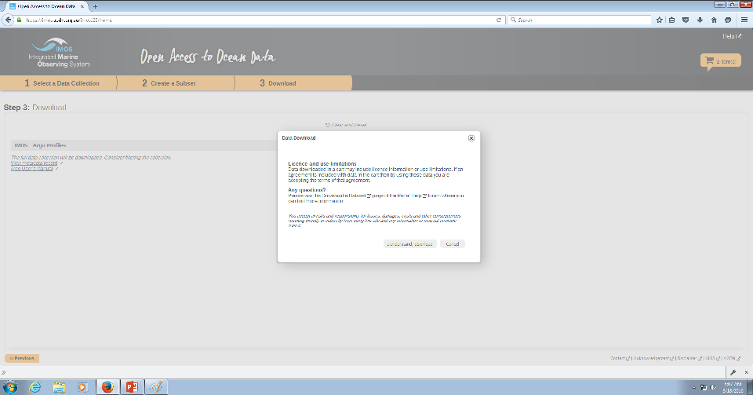
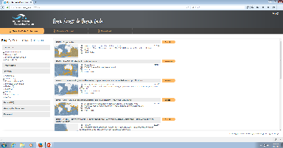
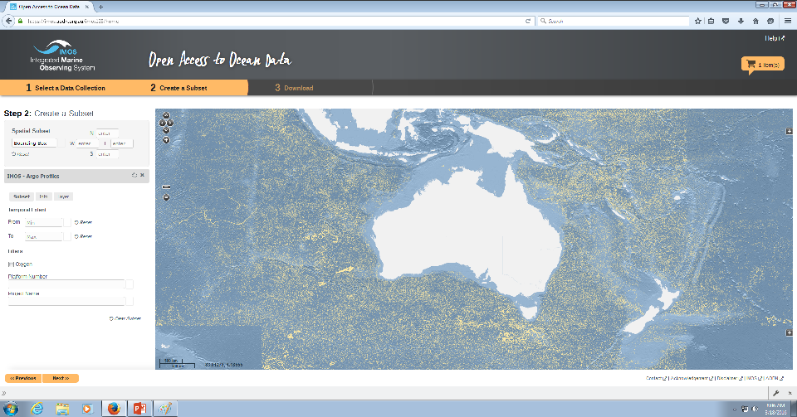
Remote Facility
IMOS
Filesystem
Copy files
Runs Periodically
(Once a day)
IMOS FTP Server
Other Queries
(Downloads)
Users
Hours…
Iterate on Filesystem
(find /data)
Database
Some Queries
(Map Visualizations)
Index Files
Runs Periodically
(Once a day/week)
INSERT INTO …

Slide 8
The problems
Data inconsistency
Some queries may return different results to the user
What the user sees is not what she downloads
High load on the system due to full filesystem scan (`find`)
Would take a very long time to run an index operation on some data sets
Periodic indexing prevents data from being immediately available to users
Indexing takes forever…
Managing a large filesystem
What filesystem to choose for a ~40TB data set?
Linux’s ext4 recommends no larger than 16TB
Prefer to keep data on robust filesystems rather than going on an adventure…

Slide 9
Looking at our own objectives
Keep data safe (Disaster recovery, human error)
FAIL – out of scope for this talk ☺
Make only high quality data available for users
FAIL - we never sanitize the data
Do not increase load on front facing systems
FAIL - long running indexing processes would crunch the database and affect users
(As much as we don’t want to admit it)
Make this data available as quickly as possible
FAIL - might take up to a week for some data to show

Slide 10
Migration to AWS – why move?
(AWS – Amazon Web Services)
Increased expectation of system’s uptime
Inability to scale capacity on research infrastructure
Data retention reliability
More features we actually want
Elastic Map Reduce (Job crunching)
Real Time Analytics
Relational Database Service

Slide 11
Welcome Object Storage
Object Storage is available on AWS
Manages objects instead of files
Hierarchy can be implemented in an artificial way
Very scalable - if implemented correctly
S3 can serve virtually infinite parallel requests
Very reliable - if implemented correctly
Is unfortunately a subset of what a filesystem can do

Slide 12
Object Storage – The Limitations
Things that run fast:
Put (Store an object)
Get (Retrieve an object)
Things that work not very fast:
List (Like `ls` or `find`)
Bugger! we’ll have to restructure some stuff at IMOS!!
Partially retrieve an object
You’ll have to retrieve the whole object
Want to access a NetCDF header? Download the whole file!
Rename an object
Forget about `mv`!
Essentially it’s a bit like a black hole
You can’t find anything - unless you have an index
Requires a more “programmatic” approach

Slide 13
Object Storage Implementations
AWS Simple Storage Service – S3 in short
Google Cloud Storage
Microsoft’s Azure Storage
NeCTAR Object Store

Slide 14
S3 Specific Features
Versioning
Safety when deleting/overwriting files, retains old versions
Virtually unlimited size
Affordable
$0.033 per GB/month in AU
Each object guaranteed to be stored in at least 3 different locations
Reliable
Offers 99.99% availability
Durability of 99.999999999%
(0.000000001% chances of losing an object, 1 in 100 billion)

Slide 15
Exploring black holes…
Moving to AWS didn’t solve any of the problems listed before
But it certainly helped us be on the right track to find solutions
Significant architecture changes were required
Conceptual changes were required
Operate on a per-file basis
Think objects, not files!
Automate data handling as much as possible

Slide 16
Remote Facility
S3
Object Storage
IMOS FTP Server
The “Pipeline”
Users
Database

Slide 17
IMOS FTP Server
Notify Facility
(Send Email)
Human Intervention
S3
Object Storage
Incoming Directory
Temporary Filesystem
Error Directory
Temporary filesystem
Monitor Filesystem
Events
Handler Process
Few seconds per file – worst case
Database
Per data type logic
NetCDF Fixing
NetCDF Checking
Hierarchy Building
Indexing of files
Persistent
Queueing
Message Broker

Slide 18
Benefits of new design
Peace of mind
Data is safe!
Consistent user experience
New data is processed immediately
Data is checked, feedback provided immediately to uploader(s)
Good data available within seconds
Bad data never reaches the users
“Real Time Data” is actually real time!
Lower overall load on the system
No peak load, system is constantly humming
Decreased workload on data admin team
They essentially became a bit like programmers
Dependent services can scale much better

Slide 19
Revisit objectives
Keep data safe (Disaster recovery, human error)
PASS- in S3 we trust. Versioning protects against human error
Make only high quality data available for users
PASS – sanitize individual files
Do not increase load on front facing systems
PASS – humming systems means we have a constant, stable and low load
Bulk uploads are throttled
Make this data available as quickly as possible
PASS – data is handled within seconds of upload

Slide 20
Looks familiar?
Object Storage
One of our services works exactly like that!!
(Can you name it?)
Crunching Worker
Crunching Worker
Crunching Worker
Crunching Worker
Crunching Worker
Crunching Worker
Crunching Job
Other long running scientific jobs may also be modeled this way.

Slide 21
Useful Links
IMOS Portal:
https://imos.aodn.org.au
All our code on Github:
https://www.github.com/aodn
Data Services (“Pipeline” code):
https://www.github.com/aodn/data-services
IMOS Data on S3:
http://data.aodn.org.au

Slide 22
Questions?
Dan Fruehauf
Integrated Marine Observing System
dan.fruehauf@utas.edu.au
malkodan@gmail.com

