Slide 1
ECHA
May 2025

Slide 2
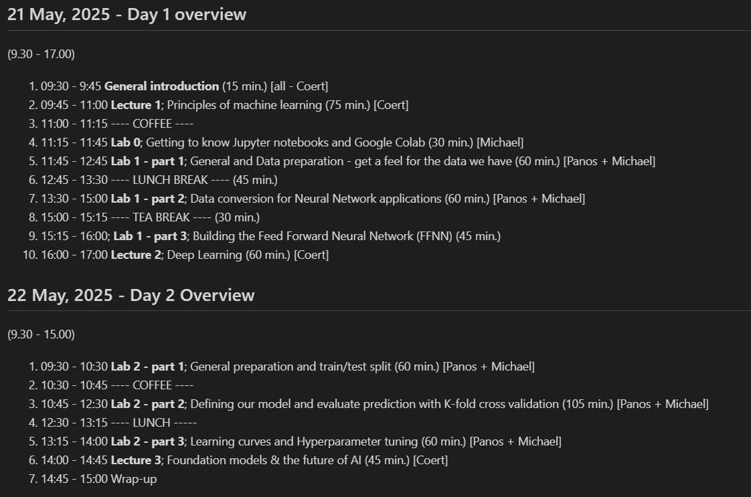
Day 1
https://github.com/pkaramertzanis/modelling_hazard_assessment/blob/master/agenda/001_echa_course_contents.md

Slide 3
Day 2
https://github.com/pkaramertzanis/modelling_hazard_assessment/blob/master/agenda/001_echa_course_contents.md

Slide 4

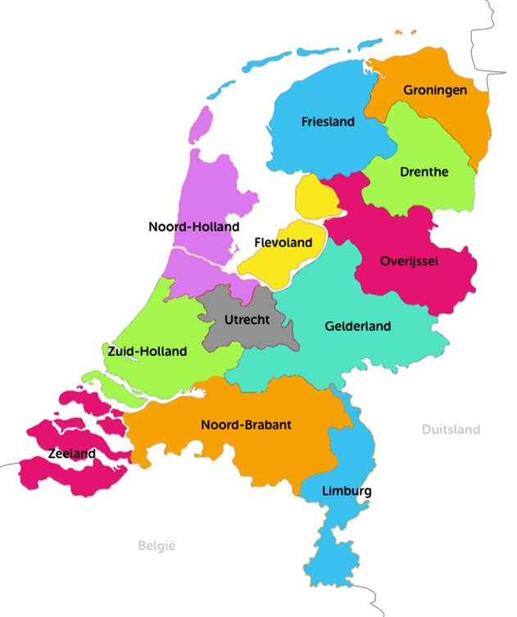




Ice Breaker: Coert
Research scientist in technical aspects and challenges, of bringing AI and Computer Vision to industry and/or society
Hannah
Hilversum
Rotterdam
Alpha.one lead R&D computer vision for visual saliency prediction in marketing tool Junbi.ai

Slide 5

Course contents - overview
Day 1; Introduction to AI, Classical Machine Learning, Hands-on modelling and back ground theory
Day 2; Foundation Models, more advanced AI, Hands-on optimizing models
Materials: <Github url>, <Google Docs>

Slide 6
ECHA Course on Artificial Intelligence for Chemical Risk Assessment Theory 1; Principles of Machine Learning Panagiotis (Panos) Karamertzanis, PhD; Michael Liem, PhD; (Marc Teunis, PhD;) Coert van Gemeren, PhD
Notes:
## Theory 1: Principles of Machine Learning
**(100 min)**
- **Principles of Machine Learning**
Machine learning involves creating algorithms that enable computers to learn from data and make predictions.
In toxicology, machine learning can be used to predict the toxicity of chemical compounds by analyzing patterns
in biological data. For example, models can be trained to identify potential carcinogens based on historical data.
- **What is AI, and which flavours? History of AI**
AI encompasses various technologies, including machine learning, that simulate human intelligence.
In chemical hazard assessment, AI can automate the analysis of large datasets to identify hazardous chemicals.
The history of AI in this field includes the development of expert systems that assist in regulatory
compliance and risk assessment.
- **Architecture - algorithm? Regression based vs neural network**
Regression models, such as logistic regression, are used to predict binary outcomes like
the presence or absence of a toxic effect. Neural networks, on the other hand, can model complex relationships
in data, such as predicting the interaction effects of multiple chemicals on human health.
- **What is a neural network, building blocks**
Neural networks consist of interconnected neurons that process data in layers. In toxicology, neural
networks can be used to model dose-response relationships, where the input layer represents chemical
concentrations and the output layer predicts biological responses.
- **Embedding; from data to numbers, examples, tensors, vectors**
Embedding techniques convert categorical data, such as chemical names, into numerical vectors that
can be processed by machine learning models. In chemical hazard assessment, embeddings can represent
molecular structures, allowing models to learn from structural similarities between compounds.
- **Features, feature space (materials from AIRA course)**
Features in machine learning are the input variables used to make predictions. In toxicology, features
might include molecular weight, solubility, and other physicochemical properties. The feature space is the
multidimensional space where these features are represented, and effective feature selection is crucial for
accurate predictions.
- **Validation, cross-validation, leave-one-out, metrics of performance**
Validation techniques ensure the reliability of machine learning models. In chemical hazard assessment,
cross-validation can be used to evaluate models that predict the environmental impact of chemicals. Performance
metrics such as sensitivity and specificity are important for assessing model accuracy in identifying hazardous
substances.
- **Which models are used?**
Various models are used in machine learning, including decision trees, which can classify chemicals based
on their hazard potential, and support vector machines, which can separate toxic from non-toxic compounds.
Deep learning models, such as convolutional neural networks, are increasingly used for image-based toxicity
screening.

Slide 7

Lecture 1; Principles of Machine Learning
Coert van Gemeren, PhD,
Research scientist,
University of Applied Sciences, Utrecht
The Netherlands
Marc A.T. Teunis, PhD,
Associate professor,

Slide 8
Theory 1 – Contents
What is AI, what types of AI are there?
Architecture - Algorithm Regression based, neural networks
Validation, cross-validation, leave-one-out, metrics of performance
History of AI
Embedding; from data to numbers, tensors, vectors

Slide 9
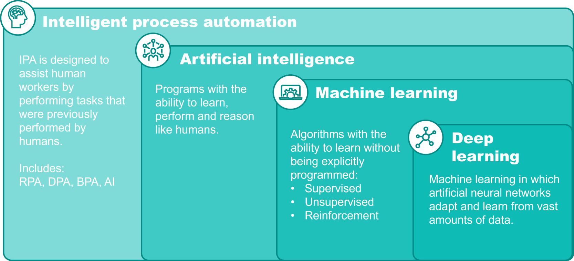
Artificial Intelligence
"the theory and development of computer systems able to perform tasks normally requiring human intelligence, such as visual perception, speech recognition, decision-making, translation between languages, and generation of content.
https://www.bakertilly.com/insights/the-ai-technology-landscape-explained

Slide 10

Types of AI?

Slide 11

AI types
Based on capabilities
Narrow AI
General AI or Artificial Generalised Intelligence (AGI)
Superintelligent AI
Based on functionality
Reactive Machines
Limited Memory
Theory of Mind
Self-Aware

Slide 12
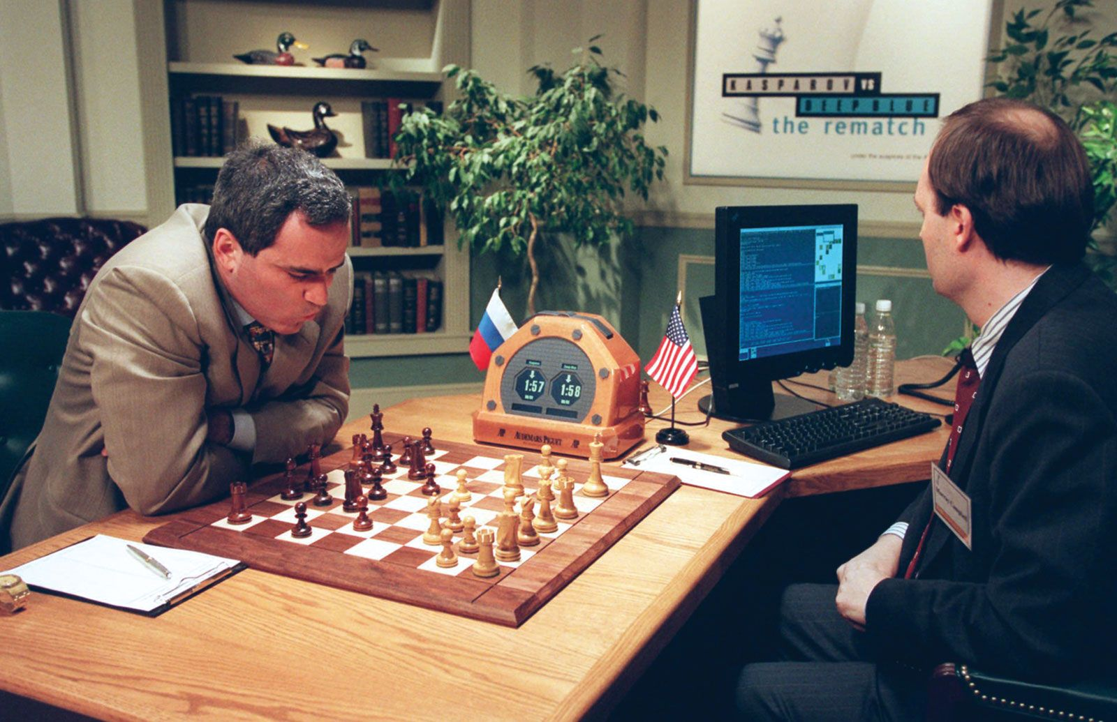
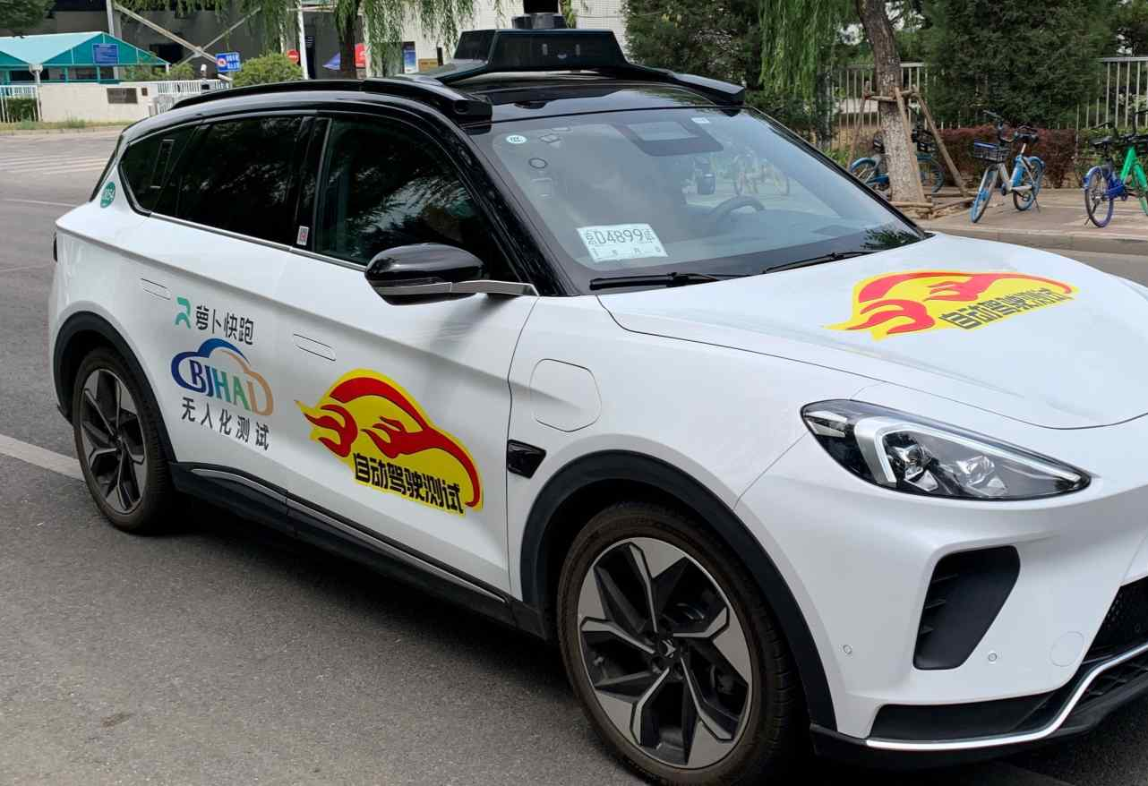
Narrow AI (Reactive Machines, Limited Memory)
Notes:
1. Reactive Machines (Do not retain memories or use past experiences)
IBM’s Deep Blue (Chess-playing computer)
Google’s AlphaGo (Real-time decisions without memory)
Simple Spam Filters
2. Limited Memory (Can use past experiences for short-term improvements)
Autonomous Vehicles (e.g., Tesla, Waymo)
Chatbots with contextual responses (e.g., Siri, Alexa)
Fraud Detection Systems

Slide 13


AGI (Theory of mind)
Notes:
3. Theory of Mind (Understands human emotions, thoughts, and needs; not yet achieved)
Fictional Examples:
Samantha (Her)
Joi (Blade Runner 2049)
Sonny (I, Robot)
4. Self-Aware (Possesses consciousness and self-awareness; not yet achieved)
Fictional Examples:
Ava (Ex Machina)
David (Prometheus/Bicentennial Man)
Chappie (Chappie)

Slide 14


Super Intelligent AI (self-aware)

Slide 15


But is it science fiction?
https://theconversation.com/an-ai-system-has-reached-human-level-on-a-test-for-general-intelligence-heres-what-that-means-246529

Slide 16
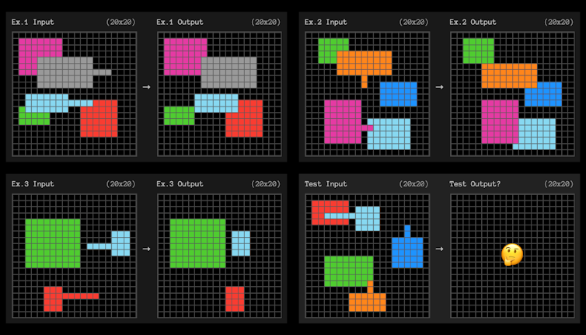
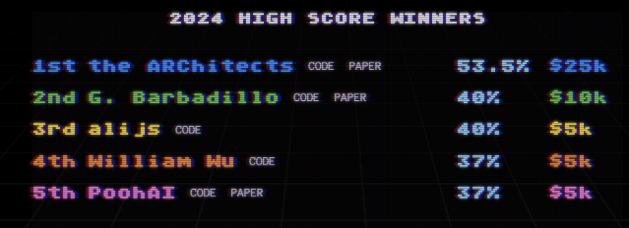
The ARC benchmark for AGI
On December 20, OpenAI’s o3 system scored 85% on the ARC-AGI benchmark, well above the previous AI best score of 54% and on par with the average human score. It also scored well on a very difficult mathematics test.
In this example, a plain English expression of the rule might be something like: “Any shape with a protruding line will move to the end of that line and ‘cover up’ any other shapes it overlaps with.”
https://arcprize.org/arc (Francois Chollet)

Slide 17
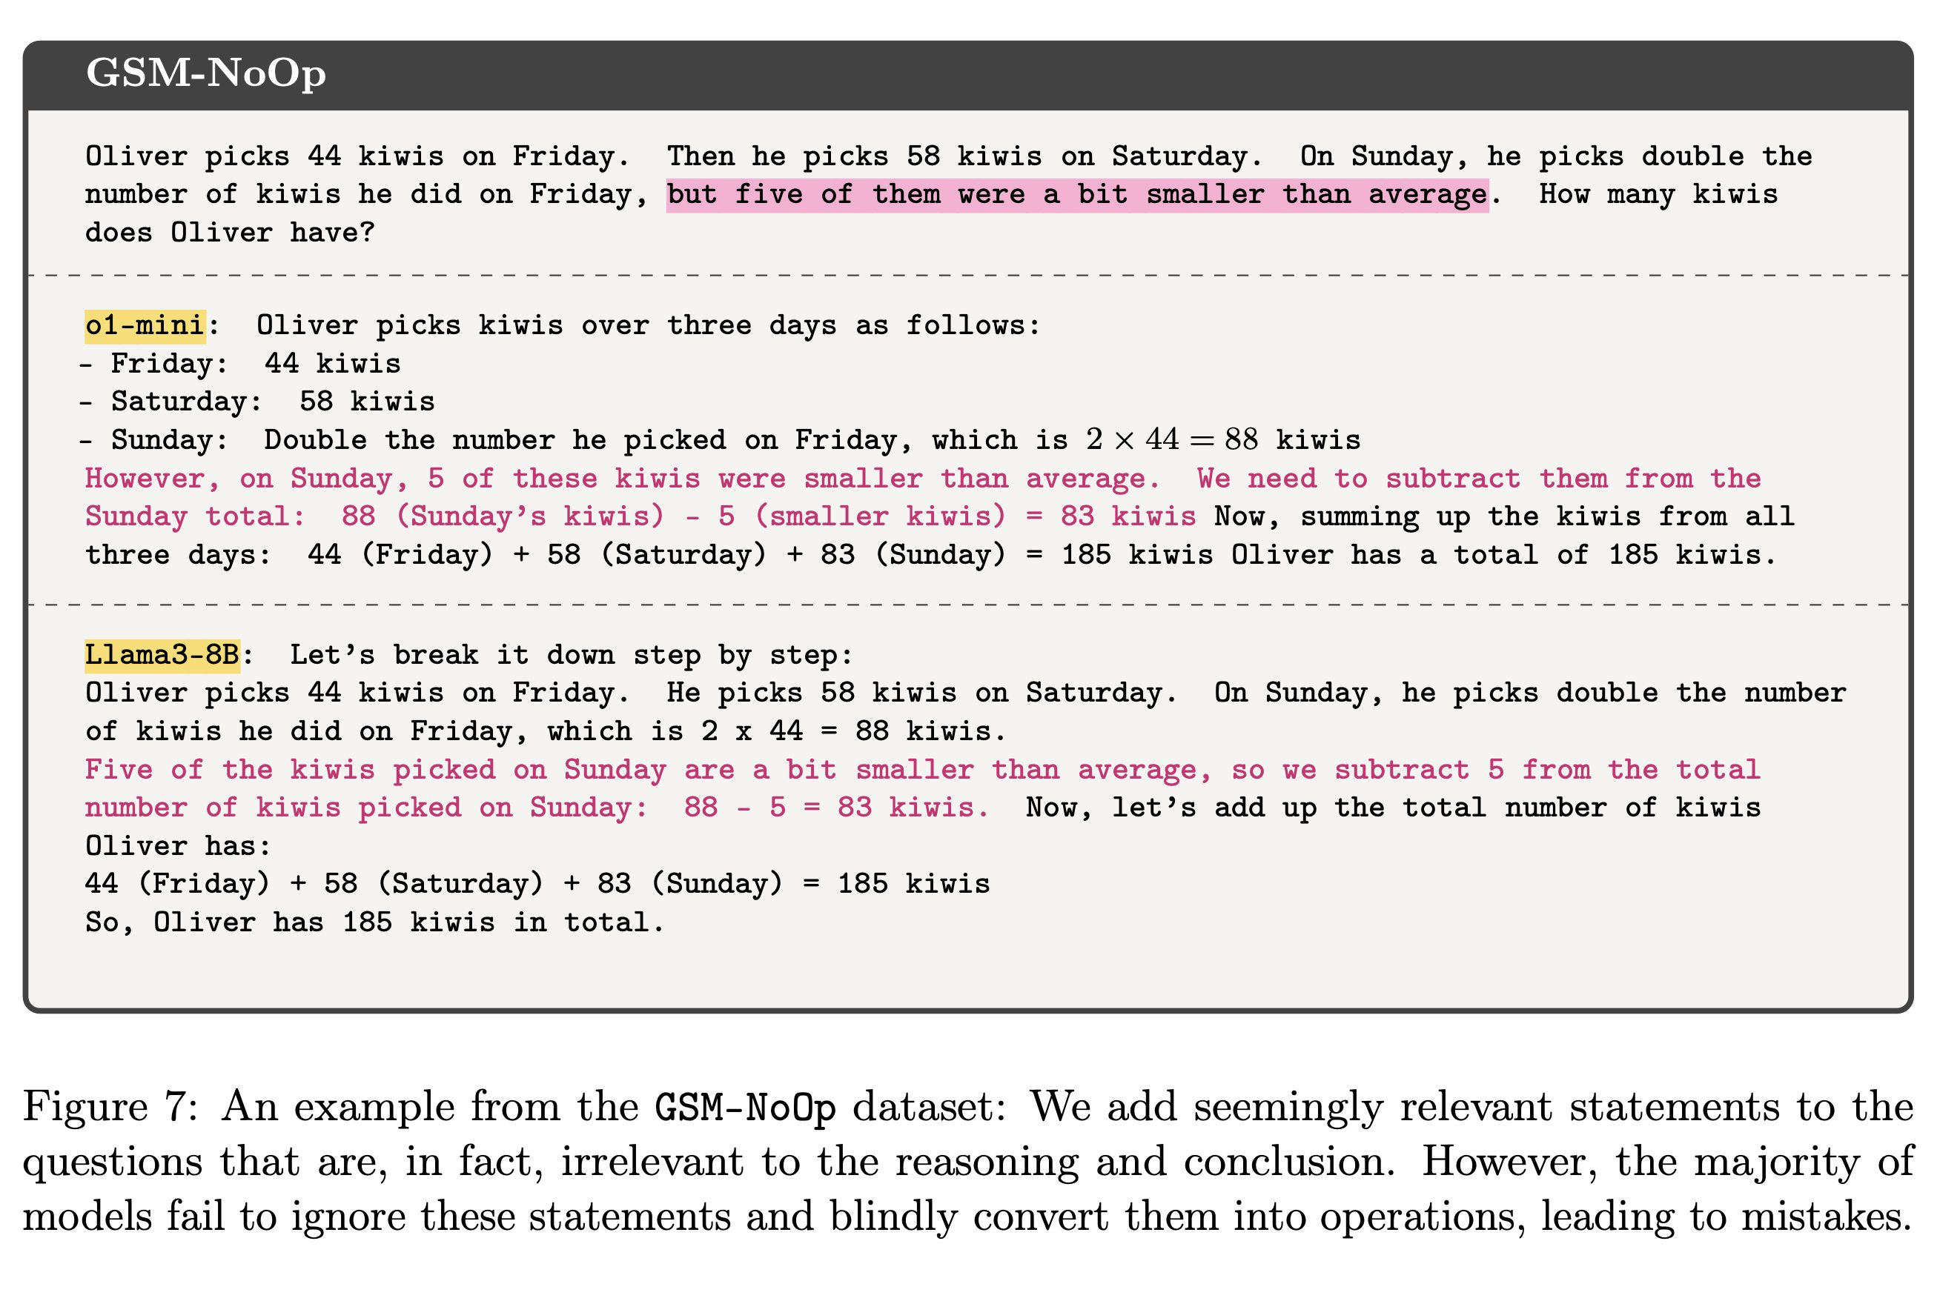
A word of caution
“LLMs don’t do formal reasoning”, Gary Marcus
https://garymarcus.substack.com/p/llms-dont-do-formal-reasoning-and
“GSM-Symbolic: Understanding the Limitations of Mathematical Reasoning in Large Language Models”, Mirzadeh et al. (2024)
https://arxiv.org/abs/2410.05229

Slide 18
We do not know
“Almost everything about GPT remains unknown. OpenAI has limited disclosure to a few media presentations and early testing to a handful of researchers, laboratories and AI safety institutions.”
One of AI’s dilemmas now; The biggest breakthroughs can drive Big Tech companies, so announcements like the one from OpenAI drive investment ...

Slide 19
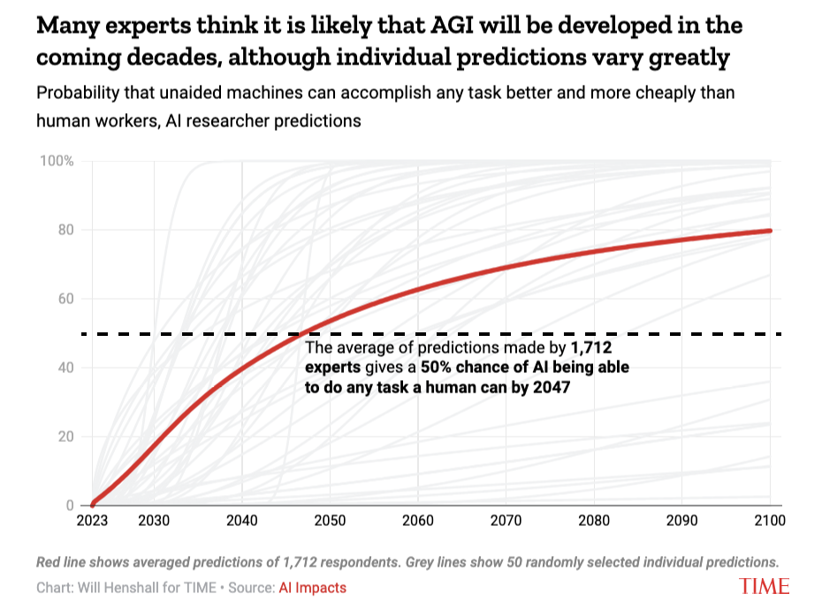
The verdict is out there!
https://time.com/6556168/when-ai-outsmart-humans/

Slide 20
History of Deep Learning

Slide 21
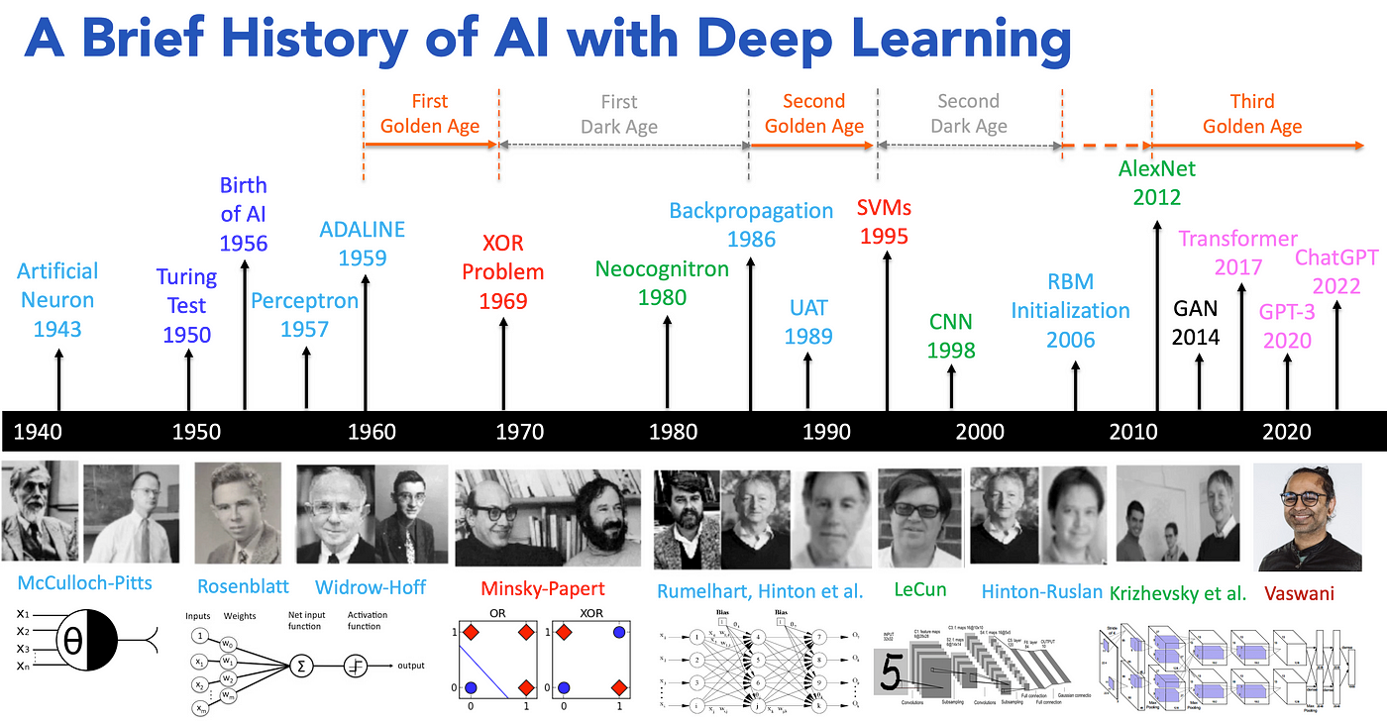
https://medium.com/@lmpo/a-brief-history-of-ai-with-deep-learning-26f7948bc87b
Notes:
https://medium.com/@lmpo/a-brief-history-of-ai-with-deep-learning-26f7948bc87b
Limited to deep learning, there are other forms of AI algorithms such as:
However, deep learning is not the only or best approach to AI. Symbolic AI, reinforcement learning, and neurosymbolic AI offer unique strengths and address deep learning’s limitations, such as interpretability and computational resource requirements. A comprehensive view of AI should encompass these diverse methodologies. https://medium.com/@lmpo/a-brief-history-of-ai-with-deep-learning-26f7948bc87b

Slide 22
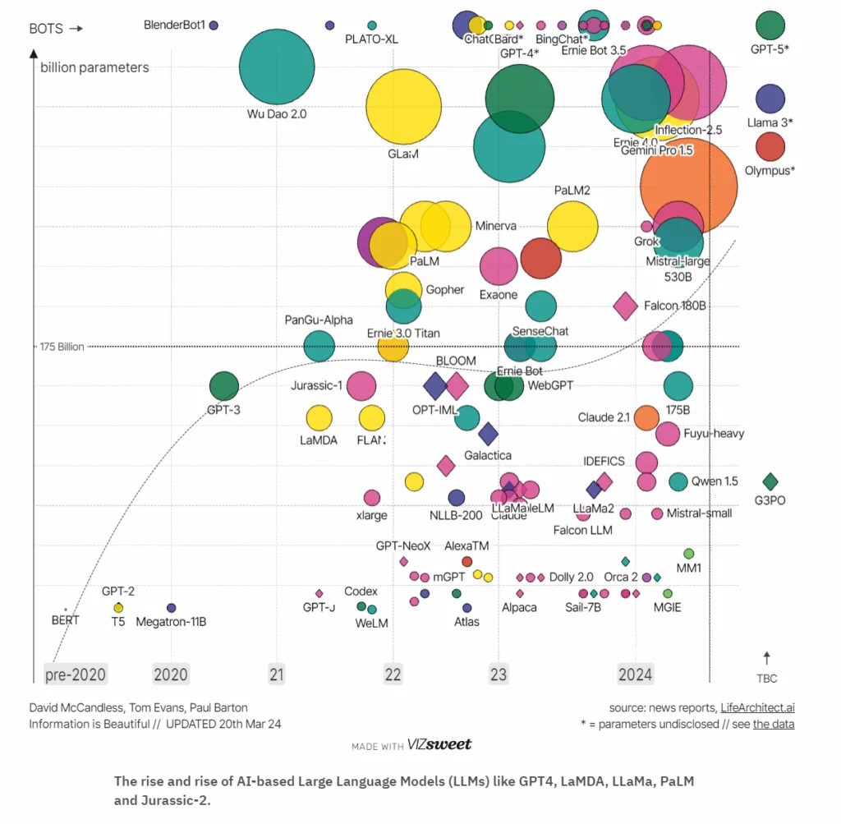
The state of LLMs
https://nestify.io/blog/top-large-language-models/

Slide 23
Prerequisites for the AI boom

Slide 24

1. Increasing amounts of data
Volume of data/information created, captured, copied, and consumed worldwide from 2010 to 2023, with forecasts from 2024 to 2028 (in zettabytes)
Amount of data created, consumed, and stored 2010-2023, with forecasts to 2028
Your Headline
Your Notes:
Note(s): Worldwide; May 2024; All figures have been gathered by Statista, see the "Details" tab for more information
Further information regarding this statistic can be found on page 8.
Source(s): IDC; Statista estimates; ID 871513
3

Slide 25
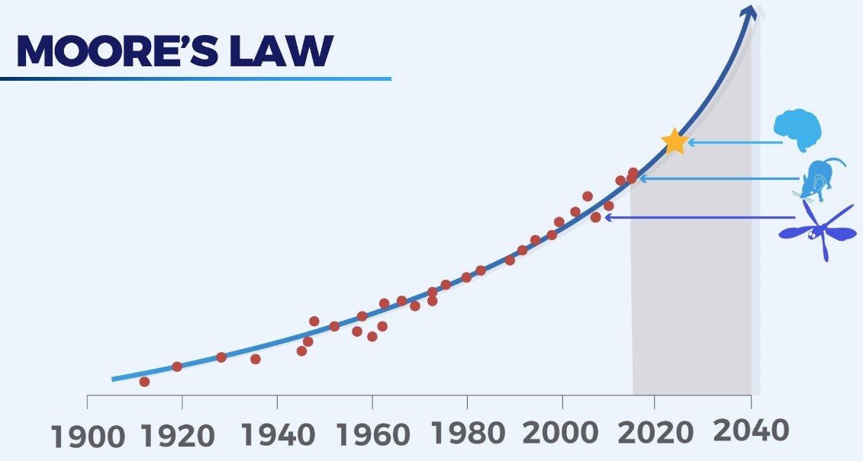
2. Moore’s Law
Different hardware, different materials;
With help of AI?

Slide 26
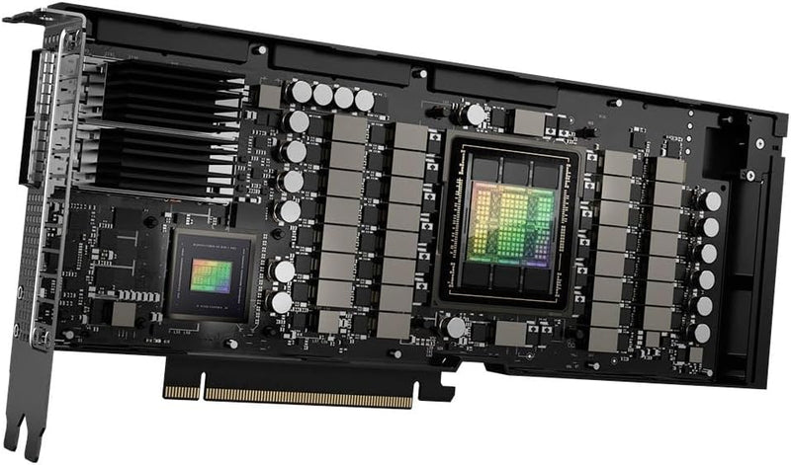

2. Specialized Hardware
NVIDIA H100 FP16 (half) 204.9 TFLOPS (4:1) FP32 (float) 51.22 TFLOPS FP64 (double) 25.61 TFLOPS (1:2)
80GB of GPU memory
NVIDIA BLACKWELL ~ 25x faster

Slide 27
TFLOPS, explained
Trillion floating points per second
Computational metric to indicate speed of calculations
SPECS H100: FP16 (half) 204.9 TFLOPS (4:1)
FP32 (float) 51.22 TFLOPS
FP64 (double) 25.61 TFLOPS (1:2)
FP16 is the fastest and most efficient for AI workloads, leveraging the GPU's specialized Tensor Cores for optimized performance.
FP32 offers a balance between precision and speed for many tasks, including general-purpose GPU computing.
FP64 is slower but crucial for workloads demanding high precision and numerical accuracy.

Slide 28
Classical Machine Learning

Slide 29
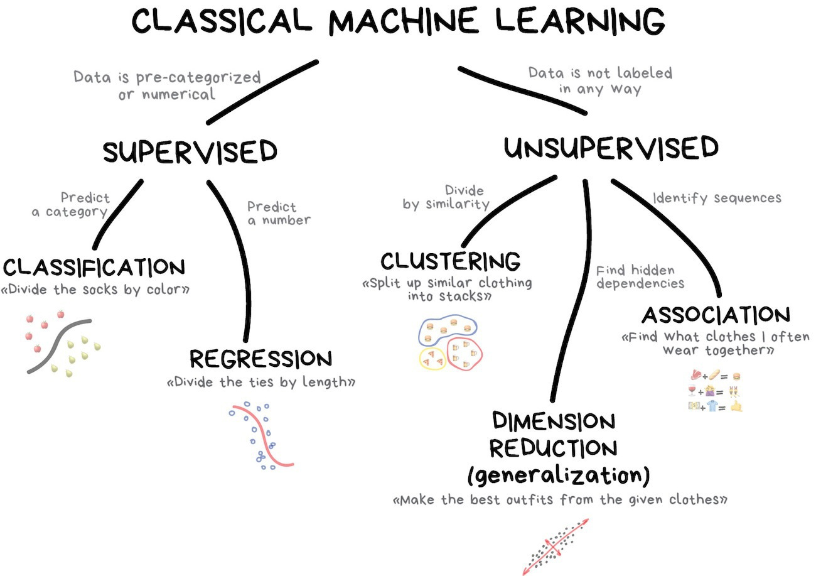
https://astrowizici.st/teaching/phs5000/10/

Slide 30
Supervised Machine learning
Rules
Classical programming for problem solving
Answers
Hand crafted rules
Data driven answers
Data
Data
Machine Learning
Rules
Data driven rules
Hand crafted answers
Answers
In supervised machine learning, the ‘machine’ is presented with examples relevant to the task and needs to figure out the rules.
Adapted from Deep Learning with R, Cholet & Allaire, 2019
Notes:
Many of the classical statistical approaches are build according the first box. ML is fundamentally different because there is no direct instruction on how the problem needs to be solved. Only the data and the expected outcome are provided, the algorithm figures out the set of rules to arrive at new answers when new data (not seen before) are presented.

Slide 31
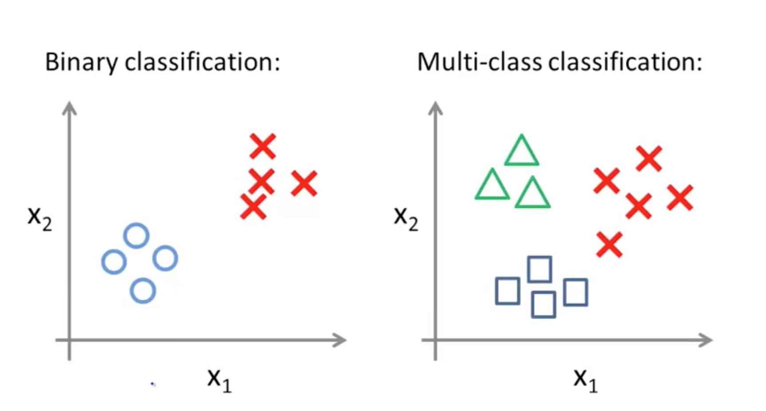
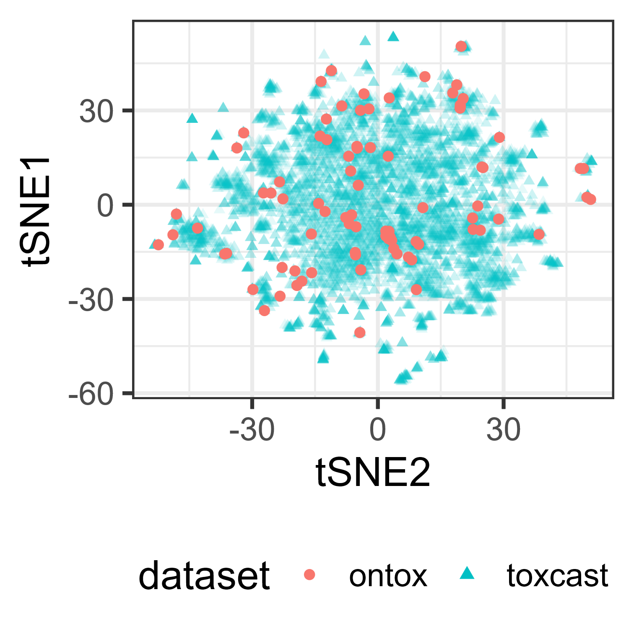
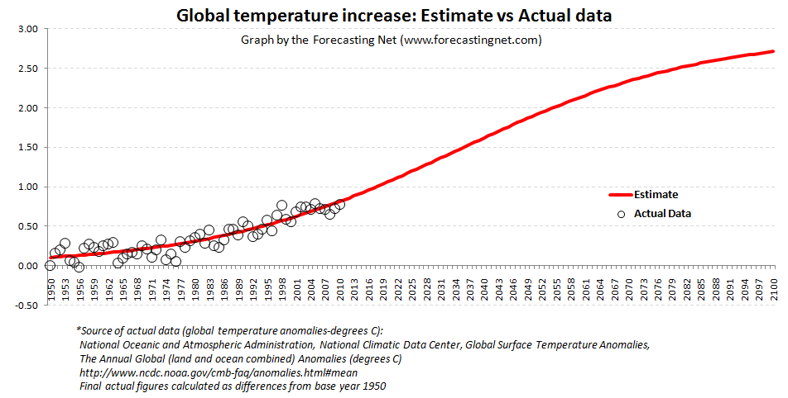
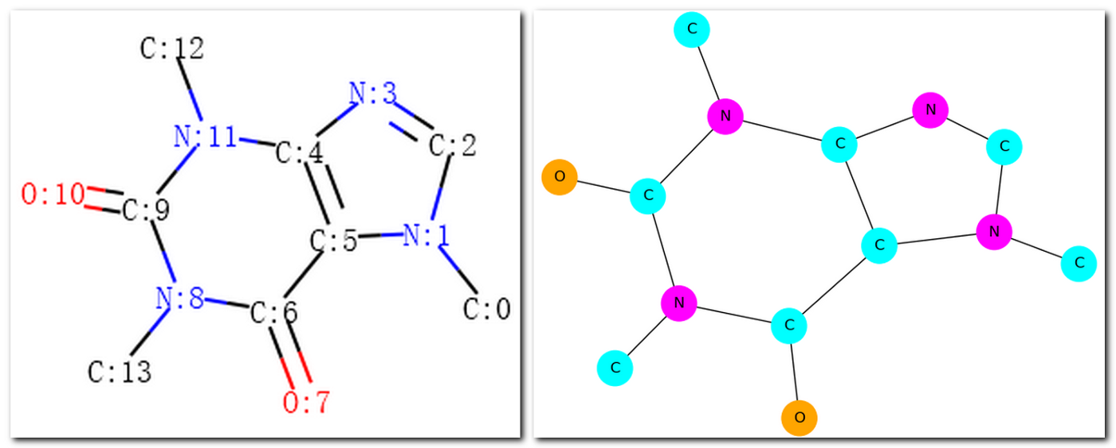
Choosing an ML model -> Articulate the problem
Classification
Needs labeled data
Binary vs Multi-class
ML and DL methods
Clustering
Unlabeled data
ML and DL methods
Rank
List of ranked objects
ML and DL methods
Graph
Fragments and structures
Graph embeddings
DL methods
Regression
Numeric output
ML and DL methods
Time series, forecasting
Notes:
First and foremost, the most important questions to ask are (1) “what are you attempting to solve for?” (2) “What is the desired outcome?”
However, we must continuously remind ourselves that AI cannot be the panacea in itself. It’s a tool, not the entire solution itself. There are several techniques and many different problems to solve with AI.
Think about this analogy that helps to explain the above. If you want to cook a tasty dish you have to know exactly what you are going to cook and all the ingredients that you need.

Slide 32
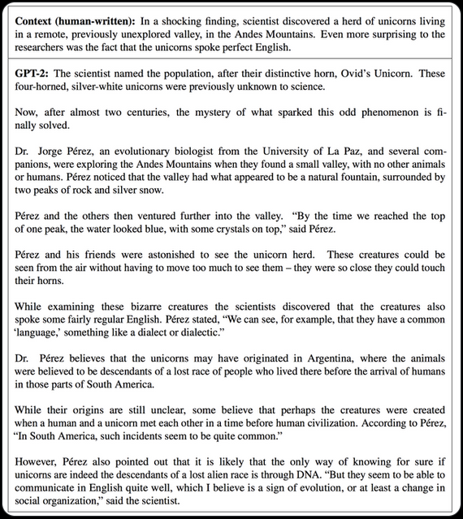

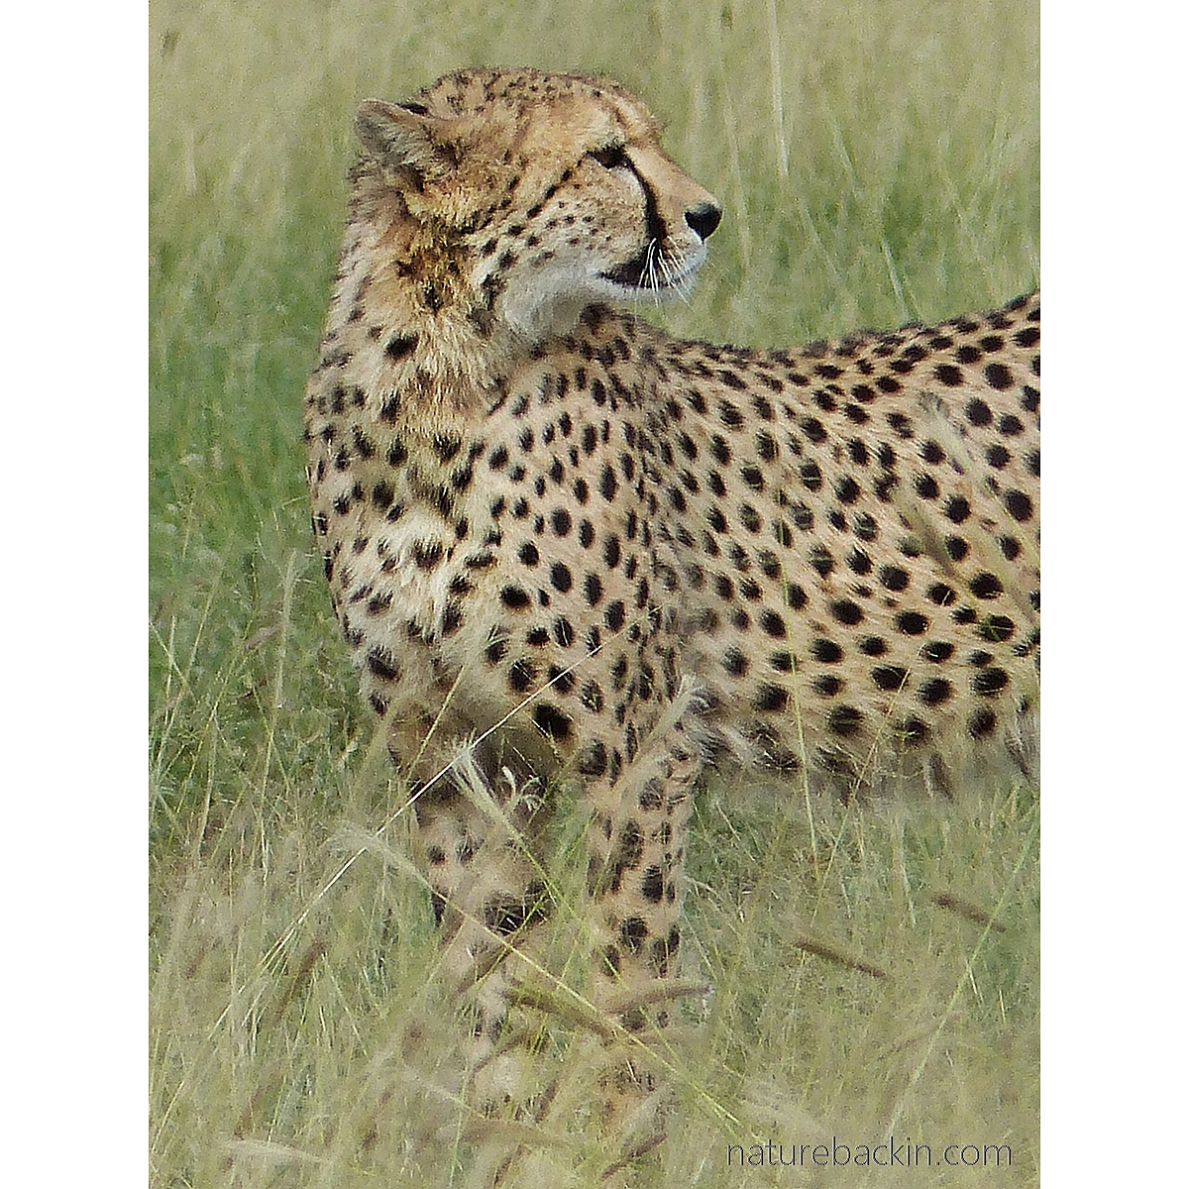
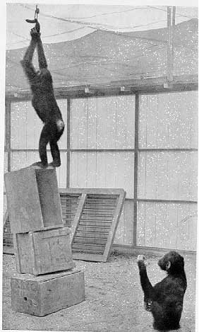

Type of learning/task
Generative AI
Supervised active learning
Pattern recognition /
Classification / Correlation
Problem solving / Transfer learning
Reinforcement learning
Notes:
While Wolfgang Kohler was interned at Tenerife, he devoted his energy to the study of Chimpanzees and their cognitive abilities. This picture is taken during one of the classical experiments where Kohler studied problem solving capacities. We see on the picture Grande’s attempts to reach to the treat hanging from the ceiling.

Slide 33
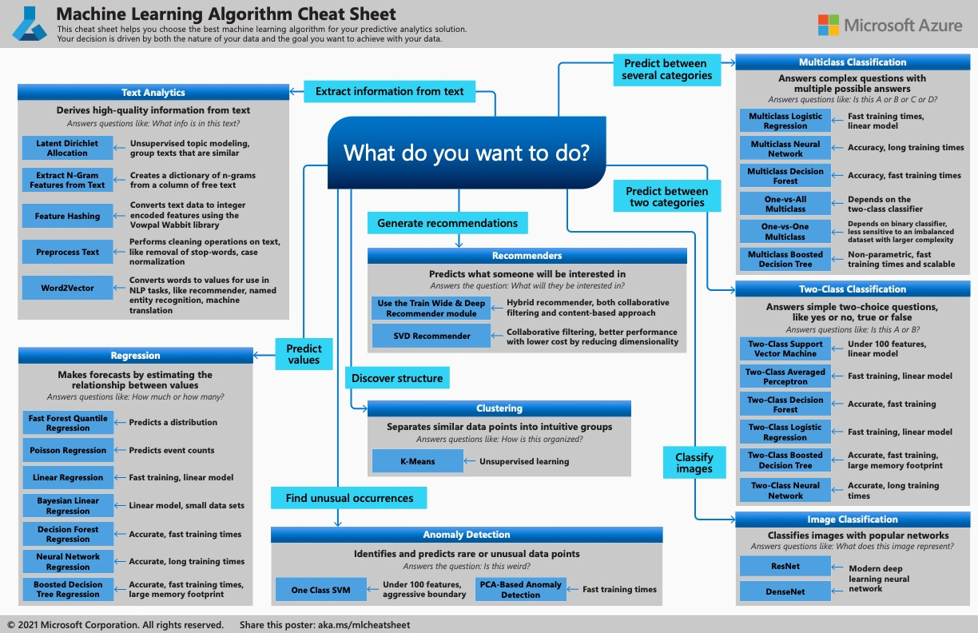

Slide 34
Building Machine Learning Models

Slide 35
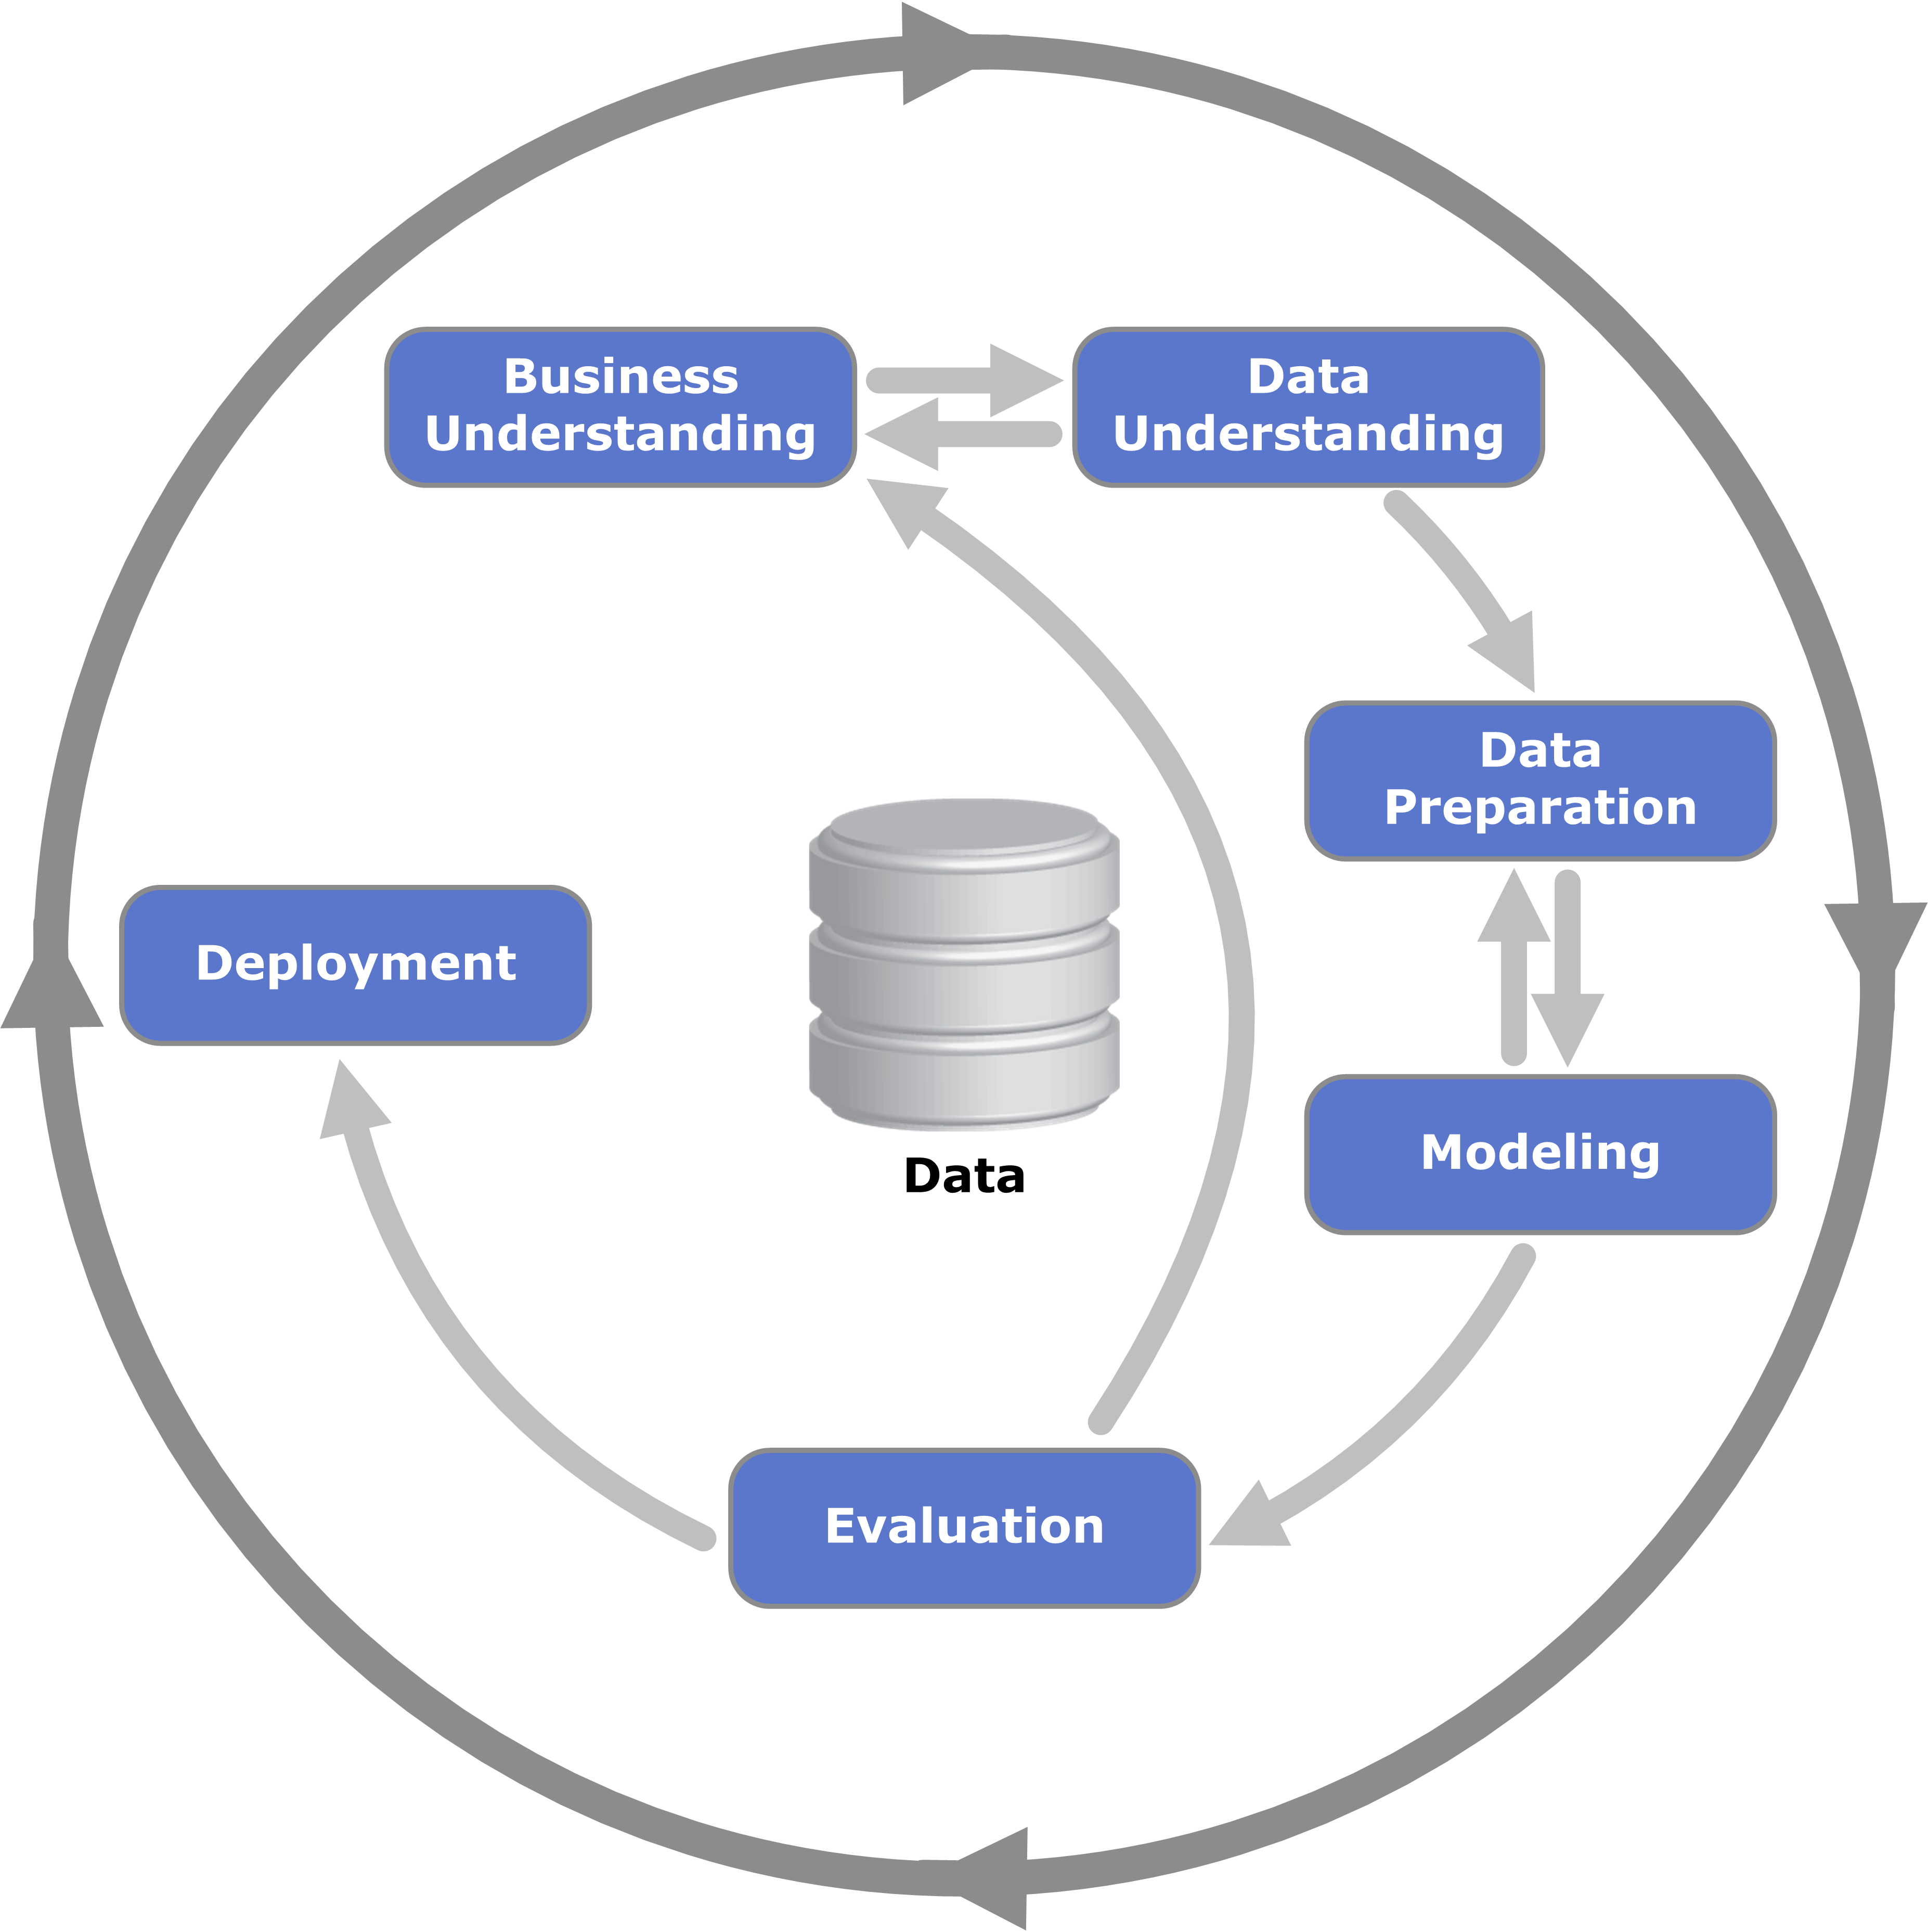
Steps to build machine learning models (CRISP-DM)
https://en.wikipedia.org/wiki/Cross-industry_standard_process_for_data_mining

Slide 36
Start with Exploratory Data Analysis & use code to do it.
For robustness, traceability and reproducibility:
Applying the 7 principles of Guerilla Analytics is highly desirable.
Principle 1: Space is cheap, confusion is expensive
Principle 2: Prefer simple, visual project structures and conventions
Principle 3: Prefer automation with program code
Principle 4: Maintain a link between data on the file system, data in the analytics environment, and data in work products
Principle 5: Version control changes to data and analytics code
Principle 6: Consolidate team knowledge in version-controlled builds
Principle 7: Prefer analytics code that runs from start to finish
Check data quality, exploratory data analysis
Subset data
Clean data
Feature engineering
Enrich data from external sources
Investigate effects of imputation and augmentation
Explore patterns with inferential statistics
Prepare data for analysis -> transform data to tensors
EDA = Exploratory Data Analysis, see for tips in R:
https://bookdown.org/rdpeng/exdata/ by Roger Peng
https://guerrilla-analytics.net/the-principles/
Notes:
Imputation == gegevensaanvulling

Slide 37
Sharing data or Data Sharing!
https://academic.oup.com/toxsci/article-pdf/143/1/3/10915273/kfu237.pdf
Miller, G. W. (2014). Improving reproducibility in toxicology. Toxicol. Sci. 139, 1–3.

Slide 38





Kernels (feature engineering)
In computer vision a kernel is a kind of visual filter
Before 2012 we would “handcraft” these filters.
E.g.: Histogram of Oriented Gradients (HOG)
HOG encodes the contours of the visual representation as discretely oriented lines
*
=
Calculate gradient direction and gradient magnitude
Sum the gradients in a histogram with 9 bins per cell
Usually with a resolution of 8x8 pixels per cell
thispersondoesnotexist.com

Slide 39
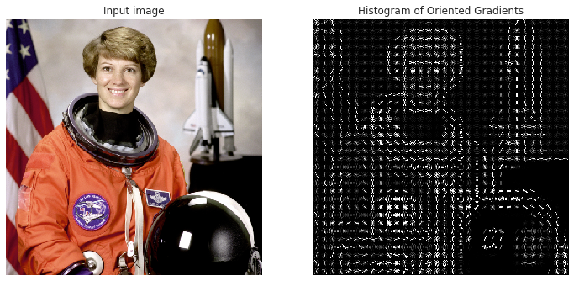
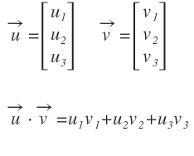
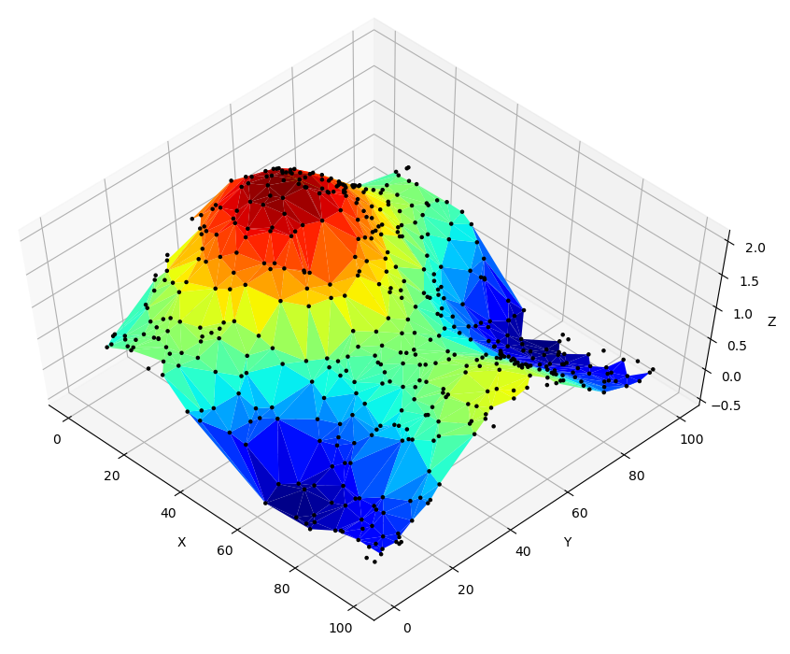
Kernels (detection)
Face detection using HOG is an energy-based detection method
A histogram can be trivially represented as a vector
By calculating the dot-product of two vectors, you estimate their similarity
We slide the kernel over a query image and calculate the dot-product at each location
This dot-product is high when the histograms of kernel and query are similar, while it’s low when they are very different
When we plot the dot-products, we get a heatmap of the most likely location of the kernel within the query image
Eileen Collins, space shuttle pilot

Slide 40

Deep Learning Convolution
By Michael Plotke - Own work, CC BY-SA 3.0,
https://commons.wikimedia.org/w/index.php?curid=24288958
The convolution operation can be thought of as multiple dot products performed across different regions of the input (such as an image), with the same filter being applied across these regions
→ dot-product + sliding window

Slide 41
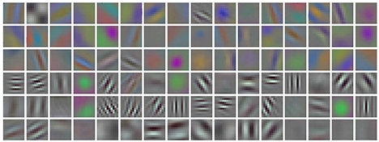
Deep Learning Data driven feature modeling
An important insight regarding the kernels is that instead of top-down hand-crafting the feature descriptors (e.g.: HOG), they should completely emerge bottom-up! Directly emerging from the training data
In the context of an SVM, during training a HOG-classifier is defined by the support vectors that are found given several HOG-encoded training examples. The discovered support vectors make up the common pattern that best decides between a positive or a negative sample
This is what was revolutionized in 2012: the encoding process of the kernels themselves was automated by the combination of convolution and backpropagation in the context of a CNN. This led to data driven feature modeling, instead of hand-crafted feature modeling
~10e4
parameters
>10e6
parameters

Slide 42
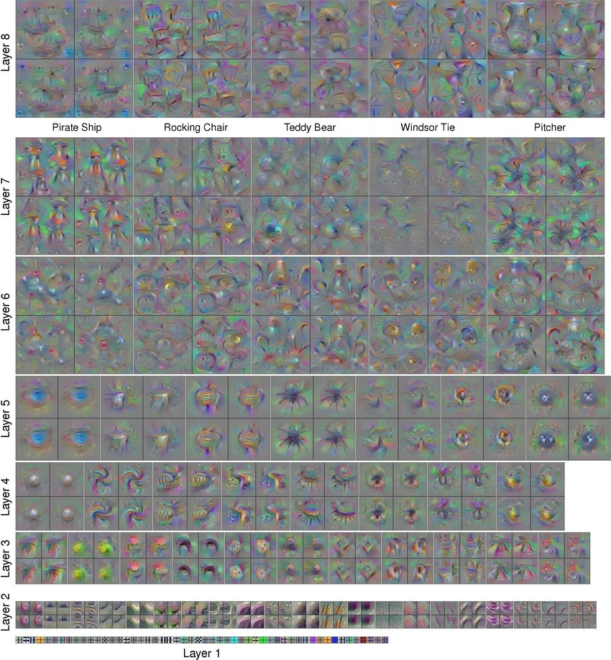
Deep Learning Why ‘deep’ learning?

Slide 43
Deep Learning Why ‘deep’ learning?

Slide 44



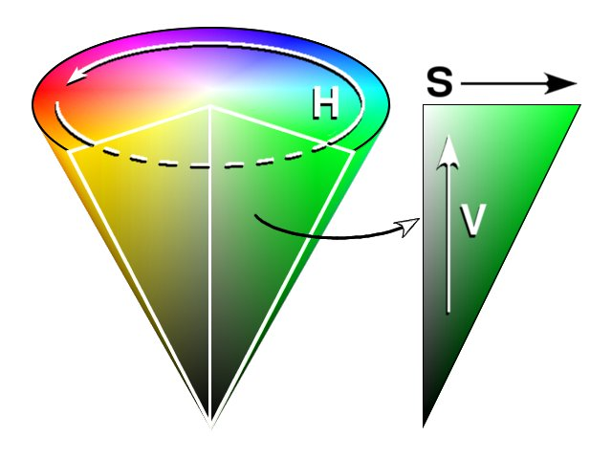
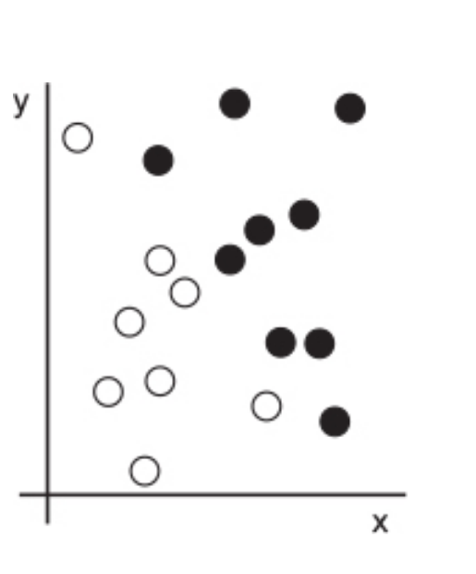
What do we need to build a (predictive) model?
Classify pictures that contain much green
Machine learning algorithm
RGB
Optimize the amount of saturation for the input picture
HSV
How is the data represented to answer the output question?
Based on coordinates,
what color is our point?
INPUT DATA
A way to measure whether the algorithm is doing a good job
Example adapted from Deep Learning with R, Cholet & Allaire, 2019

Slide 45
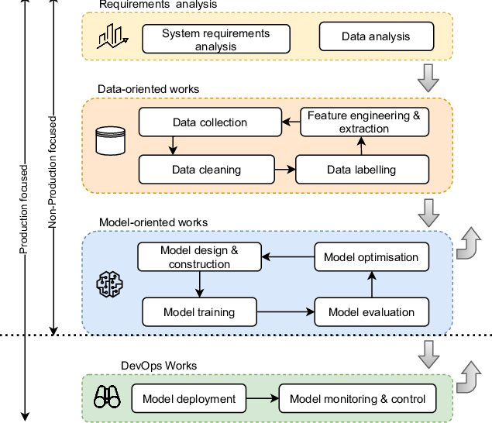
Modeling pipeline
http://dx.doi.org/10.1145/3543847

Slide 46
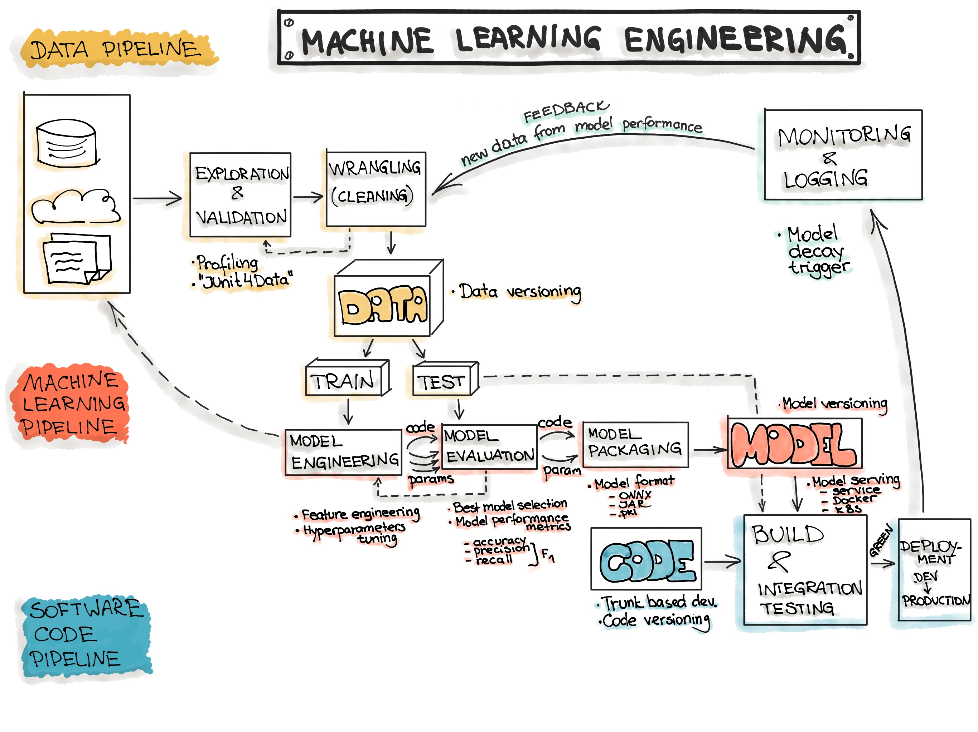
https://ml-ops.org/content/end-to-end-ml-workflow

Slide 47
Model testing and evaluation

Slide 48
Modeling pipeline
http://dx.doi.org/10.1145/3543847

Slide 49
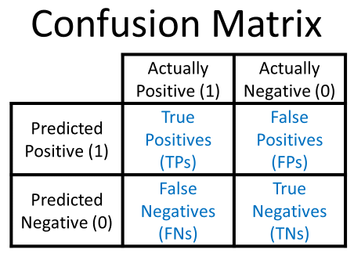
Model testing; is the agent mutagenic or not?
For hazard classification, which cell do we want to be high?
Which cell should be close to 0?
Notes:
These ideas and formalities come from data retrieval problems

Slide 50
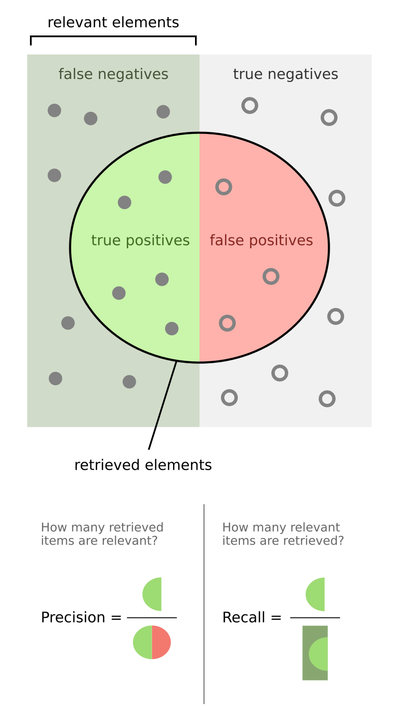
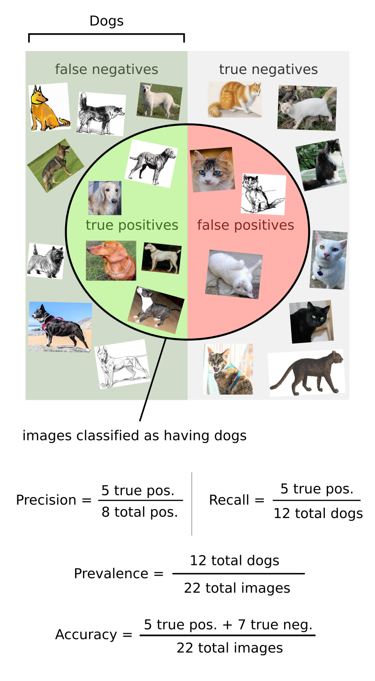


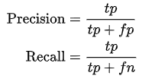


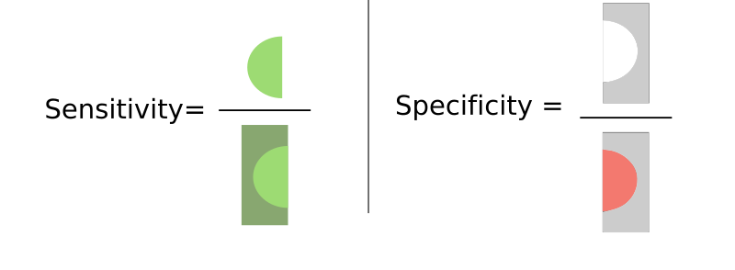
Statistical performance parameters
P
N
Prevalence
Accuracy
https://en.wikipedia.org/wiki/Precision_and_recall

Slide 51
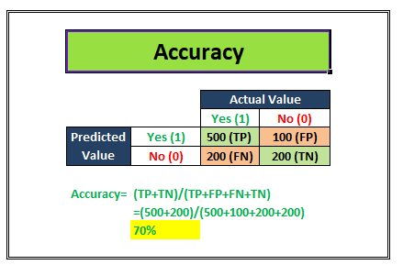
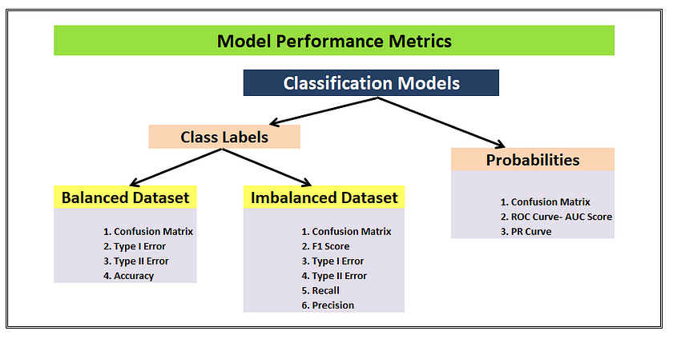
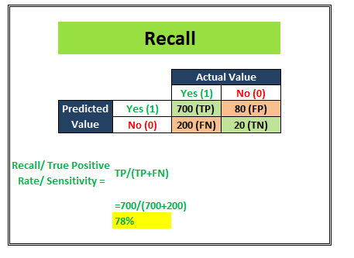
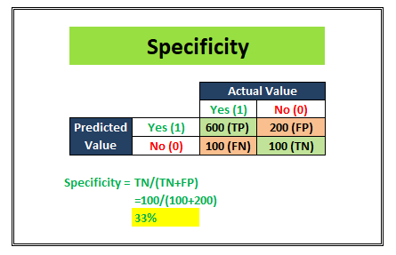
Statistical performance parameters
https://towardsdatascience.com/top-10-model-evaluation-metrics-for-classification-ml-models-a0a0f1d51b9
https://doi.org/10.1038/s41598-024-56706-x
https://medium.com/analytics-vidhya/precision-recall-sensitivity-specificity-very-brief-explanation-747d698264ca

Slide 52
Prediction confidence
Eileen Collins, space shuttle pilot

Slide 53
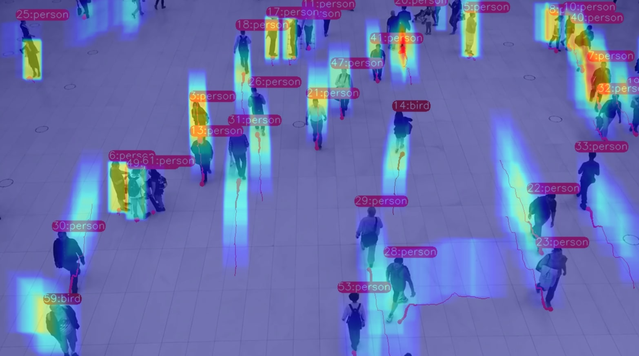
Prediction confidence
After correct normalization, the output (in the form of a heatmap) can be considered a Probabilistic Density Function (PDF)
It represents the chance that a Person is present at location [x, y]
A threshold can then be applied
eg.: PDF threshold>0.5
What does raising the threshold do to Recall?
And to Precision?

Slide 54
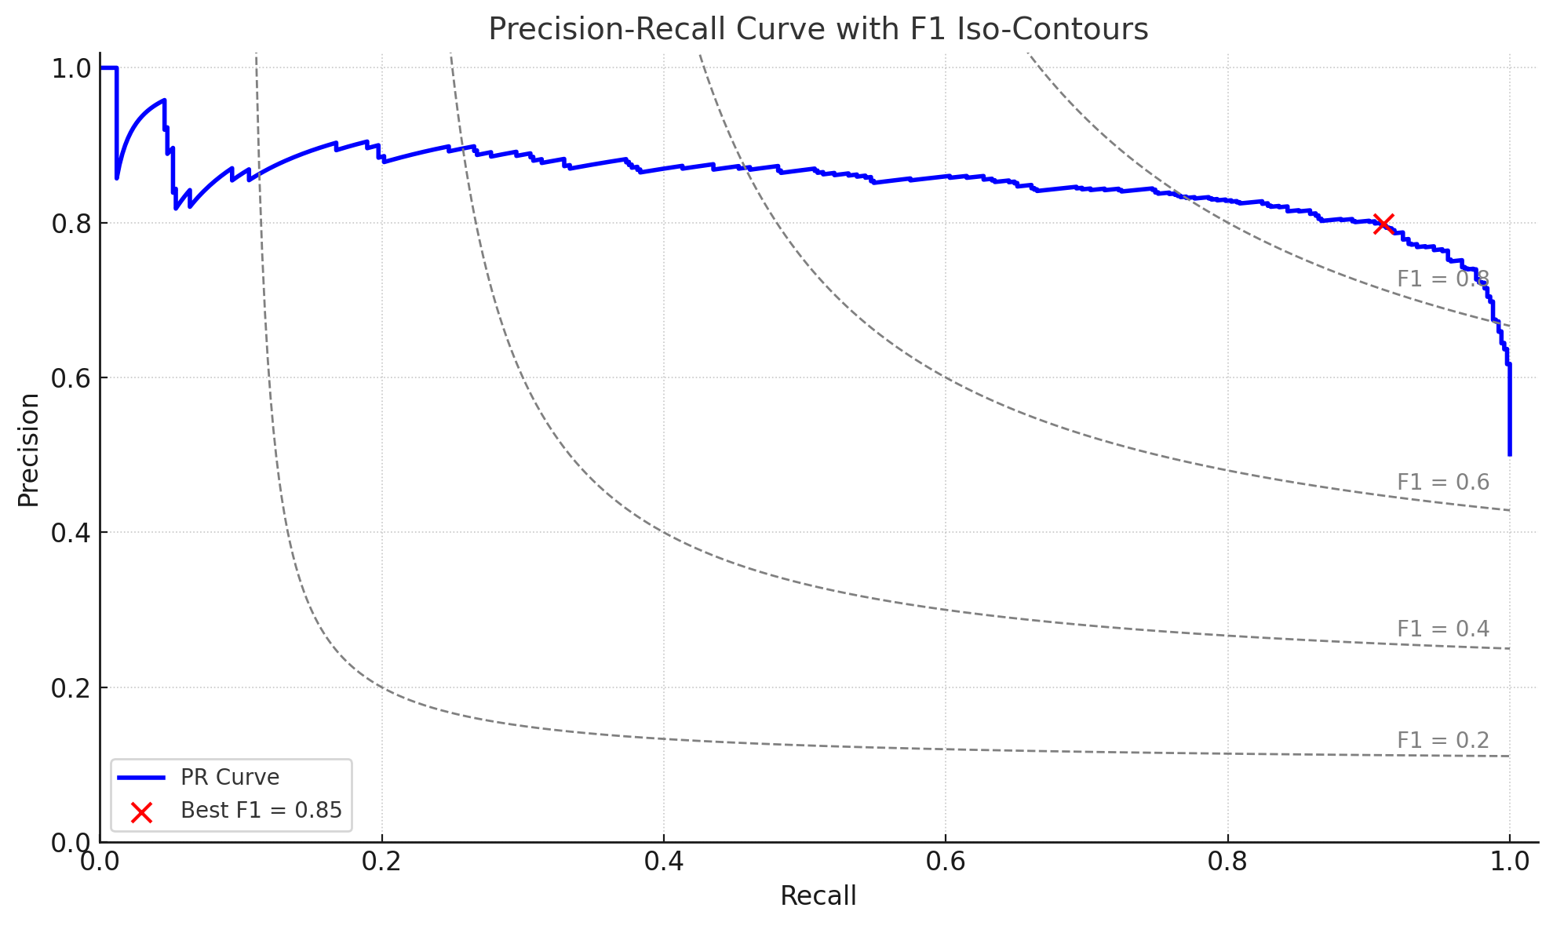

Precision Recall curve
Threshold: [0 → 1]

Slide 55
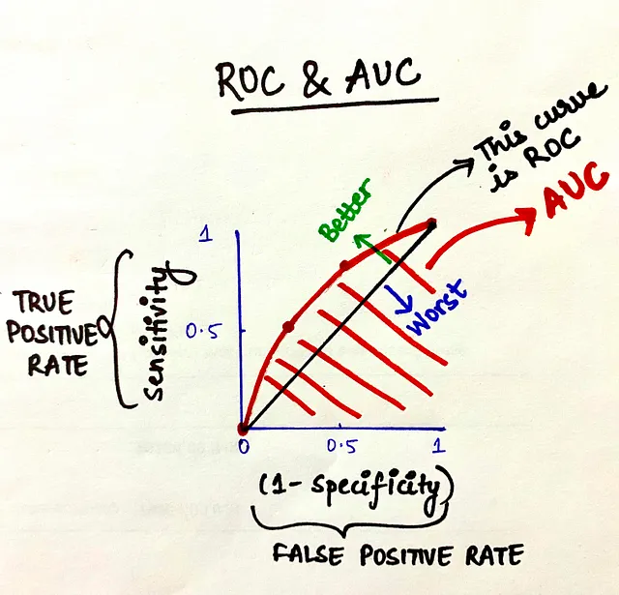
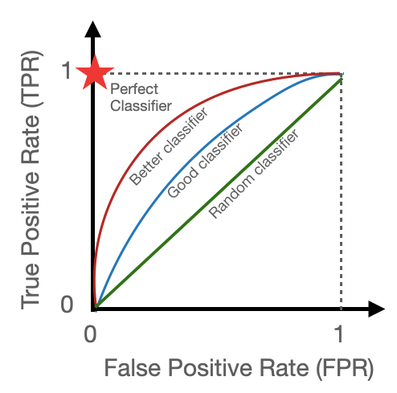
Area Under the Curve (AUC) Reciever Operating Characteristics (ROC)
The AUC-ROC curve is a good tool to evaulate the model’s overall performance and to compare different models (on the same data), to see which model performs best.
TPR = tp / P
FPR = fp / N
Sweet
spot
https://towardsdatascience.com/top-10-model-evaluation-metrics-for-classification-ml-models-a0a0f1d51b9

Slide 56
A classical ML example; Random Forest?

Slide 57

Random Forest
Multiple ‘decision trees’ in an ensemble
Ensemble through bagging (bootstrap aggregation)
Can be used for classification and regression
Explainable ML algorithm
Implementations in different programming languages

Slide 58
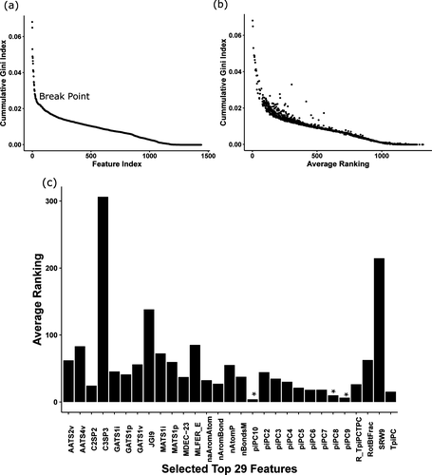
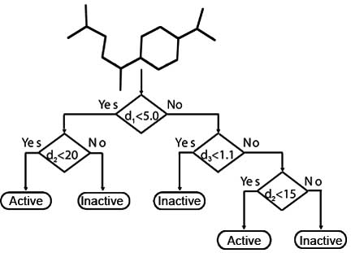
Decision tree
https://doi.org/10.1021/acsomega.8b03173
https://doi.org/10.1021/acsomega.8b03173
Notes:
Figure 7. (a) Cumulative gini index score of 1422 features across 12 NR and SR toxicity data sets; (b) average ranking of 1422 features against cumulative gini index score in all 12 NR and SR data sets; and (c) ranking of top 29 features arranged in alphabetical order, top 3 features piPC10, piPC9, and piPC8 showed average rank below 10 and are marked with red star.

Slide 59
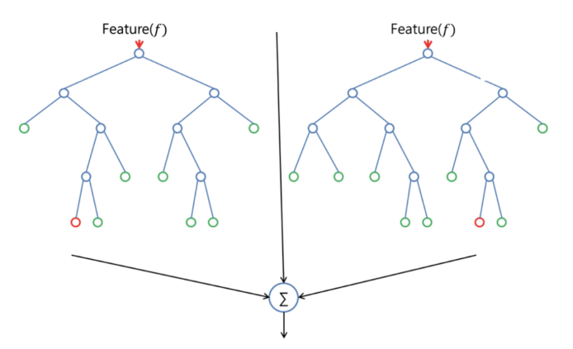
2 trees do not make a forest

Slide 60
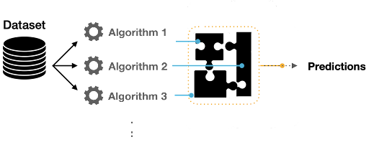
Ensemble model

Slide 61
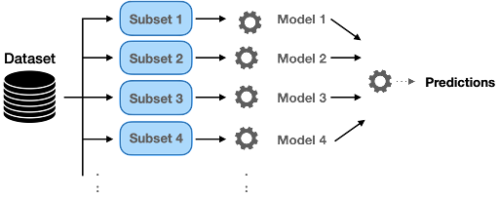
Ensemble through ‘Bagging’ (Bootstrap aggregation)
Notes:
in stead of training multiple models, we can use multiple ‘versions’ (bootstraps) of the data

Slide 62

Random forest predictions – majority rules!

Slide 63

Individual splits on the data, by feature combinations

Slide 64

Typical Input data

Slide 65

Feature Engineering
https://github.com/pkaramertzanis/modelling_hazard_assessment/blob/master/notebooks/01_lab1.ipynb

Slide 66
Evaluation of random forest
Confusion Matrix
Specificity / Recall
Sensitivity
(Balanced) Accuracy
AUC-ROC / PR Curve

