Slide 1
ECHA Course on Artificial Intelligence for Chemical Risk Assessment Lecture 2; Deep Learning Panagiotis (Panos) Karamertzanis, PhD; Michael Liem, PhD; (Marc Teunis, PhD;) Coert van Gemeren, PhD
Notes:
## Theory 1: Principles of Machine Learning
**(100 min)**
- **Principles of Machine Learning**
Machine learning involves creating algorithms that enable computers to learn from data and make predictions.
In toxicology, machine learning can be used to predict the toxicity of chemical compounds by analyzing patterns
in biological data. For example, models can be trained to identify potential carcinogens based on historical data.
- **What is AI, and which flavours? History of AI**
AI encompasses various technologies, including machine learning, that simulate human intelligence.
In chemical hazard assessment, AI can automate the analysis of large datasets to identify hazardous chemicals.
The history of AI in this field includes the development of expert systems that assist in regulatory
compliance and risk assessment.
- **Architecture - algorithm? Regression based vs neural network**
Regression models, such as logistic regression, are used to predict binary outcomes like
the presence or absence of a toxic effect. Neural networks, on the other hand, can model complex relationships
in data, such as predicting the interaction effects of multiple chemicals on human health.
- **What is a neural network, building blocks**
Neural networks consist of interconnected neurons that process data in layers. In toxicology, neural
networks can be used to model dose-response relationships, where the input layer represents chemical
concentrations and the output layer predicts biological responses.
- **Embedding; from data to numbers, examples, tensors, vectors**
Embedding techniques convert categorical data, such as chemical names, into numerical vectors that
can be processed by machine learning models. In chemical hazard assessment, embeddings can represent
molecular structures, allowing models to learn from structural similarities between compounds.
- **Features, feature space (materials from AIRA course)**
Features in machine learning are the input variables used to make predictions. In toxicology, features
might include molecular weight, solubility, and other physicochemical properties. The feature space is the
multidimensional space where these features are represented, and effective feature selection is crucial for
accurate predictions.
- **Validation, cross-validation, leave-one-out, metrics of performance**
Validation techniques ensure the reliability of machine learning models. In chemical hazard assessment,
cross-validation can be used to evaluate models that predict the environmental impact of chemicals. Performance
metrics such as sensitivity and specificity are important for assessing model accuracy in identifying hazardous
substances.
- **Which models are used?**
Various models are used in machine learning, including decision trees, which can classify chemicals based
on their hazard potential, and support vector machines, which can separate toxic from non-toxic compounds.
Deep learning models, such as convolutional neural networks, are increasingly used for image-based toxicity
screening.

Slide 2

Lecture 2; Artificial Neural Networks (ANNs) and Deep Learning
Coert van Gemeren, PhD,
Research scientist,
University of Applied Sciences, Utrecht
The Netherlands
Marc A.T. Teunis, PhD,
Associate professor,

Slide 3
Lecture 2 – Contents
What is Deep Learning?
Input data for Neural Networks
Programming Platforms
Building Deep Learning Models
Model Validation

Slide 4

What are Artificial Neural Networks?

Slide 5
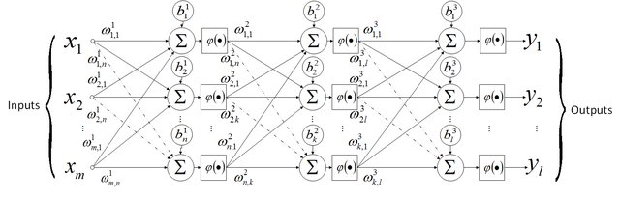
How does a machine learn?
Notes:
Nou, dan plak je gewoon een lading van die dingen achter elkaar en profit

Slide 6
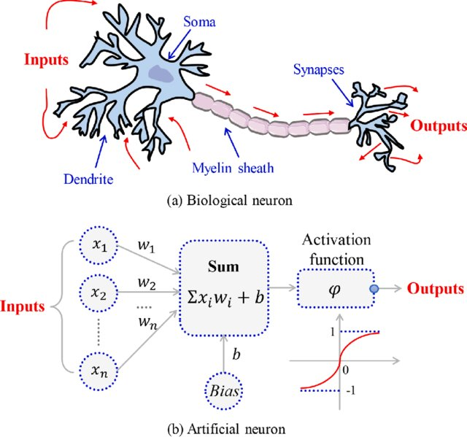
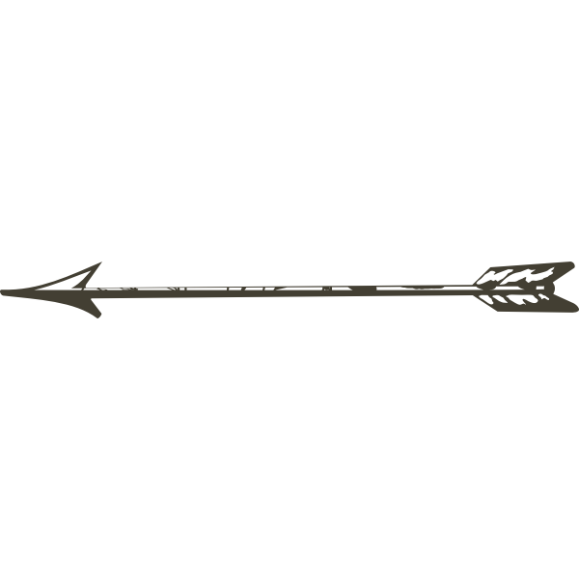
Neurons, but are they really?
Biological Neural network
Picture: Meng et al., (2020). DOI: 10.3390/w12020600
Computer Neural network
Here be Math

Slide 7


Bias explained; The tendency to do a certain thing, by default

Slide 8
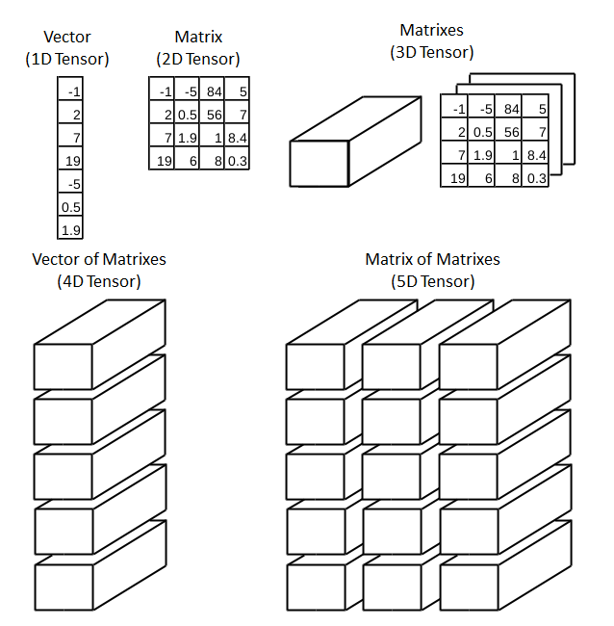
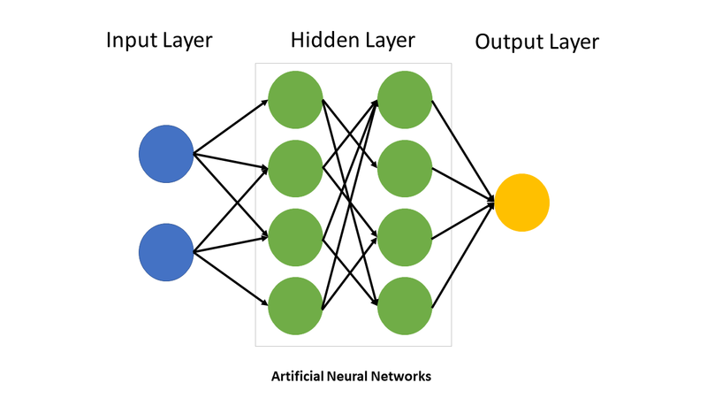
neuron = dot = function()
TseKiChun, CC BY-SA 4.0 <https://creativecommons.org/licenses/by-sa/4.0>, via Wikimedia Commons
Notes:
Input van sensoren, lagen met verwerking, mogelijke uitkomst ergens

Slide 9
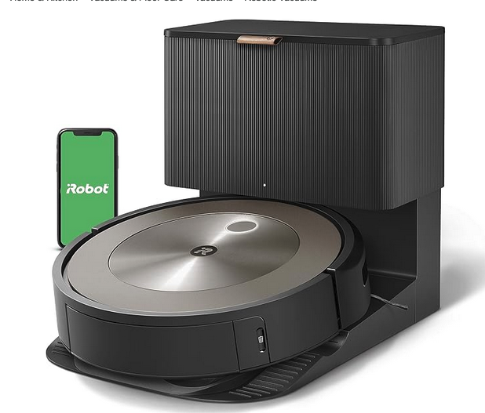
My fancy vacuum cleaner
hairball?
toy?
bag?
shoe?
...etc
slide: Courtesy of Dr. Alyanne M. De Haan, 2024
Notes:
Robotstofzuiger: meerdere uitkomsten mogelijk. Die krijgen een activatie. Meest actieve wint.

Slide 10
Random initialization
hairball?
toy?
bag?
shoe?
...etc
Nope, hairball
slide: Courtesy of Dr. Alyanne M. De Haan, 2024
Notes:
Blijkbaar moest deze veel activatie en de rest niets

Slide 11
Adapt weights
hairball?
toy?
bag?
shoe?
...etc
Nope, hairball
slide: Courtesy of Dr. Alyanne M. De Haan, 2024
Notes:
Je zou de activatie van deze neuronen dus een beetje de goede kant op willen duwen

Slide 12
Untill prediction is right
hairball?
toy?
bag?
shoe?
...etc
slide: Courtesy of Dr. Alyanne M. De Haan, 2024
Notes:
Maar deze activatie hing af van de layer ervoor

Slide 13
Adaptation of the complete network
← Backpropagation ←
“train the model”
Notes:
Maar die hangen weer af van de laag er onder. Dus die neuronen ook een duw.

Slide 14
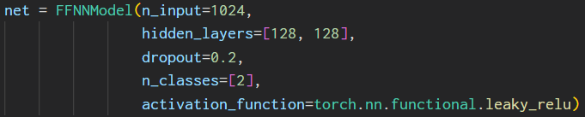
ANN implementation

Slide 15
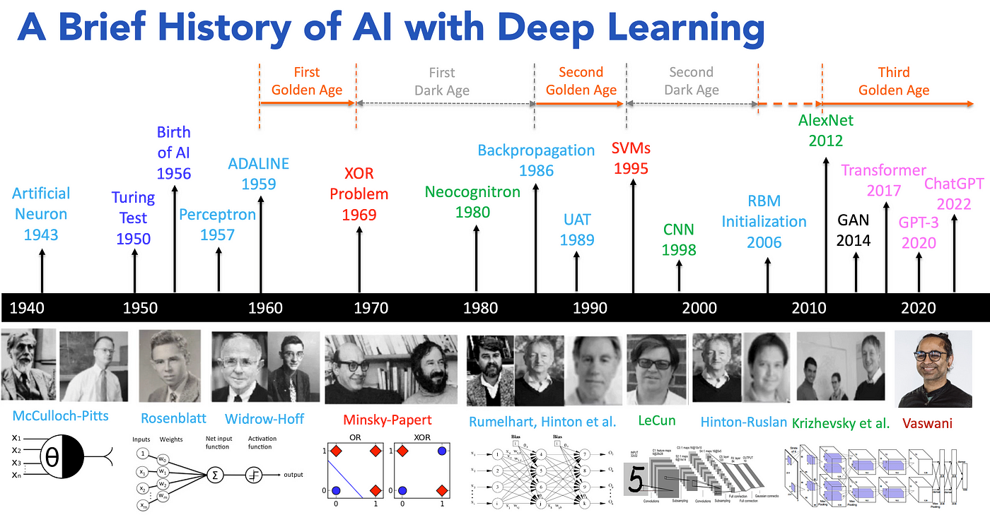

Slide 16
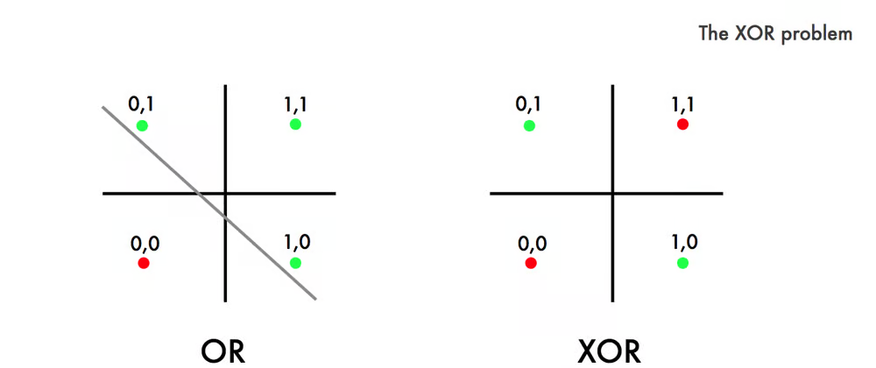
The XOR problem

Slide 17
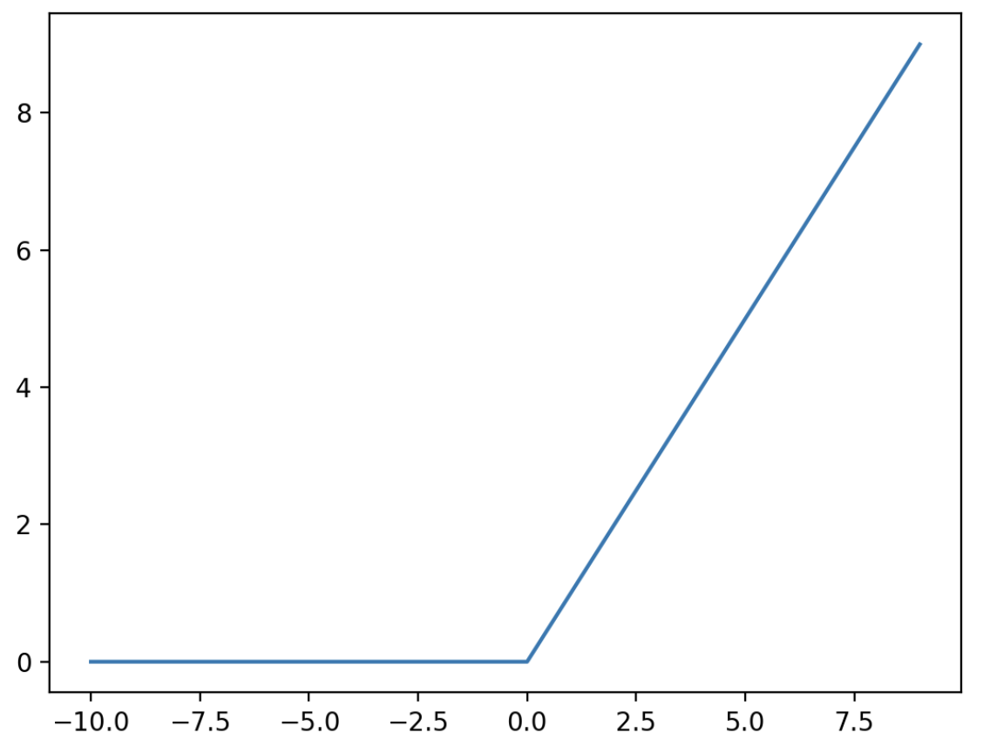
Activation functions: non-linearities
Rectified Linear Unit (ReLU): f(x) = max(0, x)
Leaky ReLU
Without non-linearities an ANN is essentially only a series of matrix multiplications, because any combination of linear functions is still linear:
if f(x) and g(x) are both linear functions, then f(g(x)) is linear

Slide 18
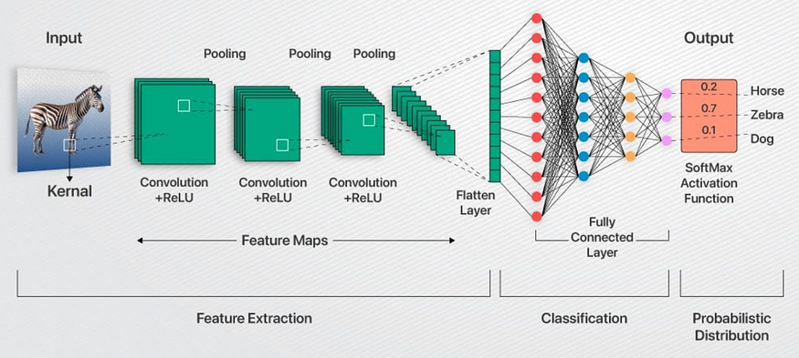

Slide 19

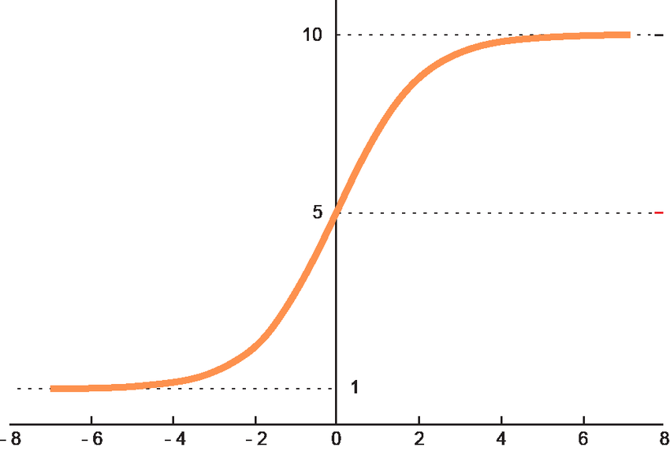
Activation functions: non-linearities Softmax
Softmax:
Can you name a nice property of
the multivariate Softmax function?
1.0
1.0
0.5
0.0

Slide 20
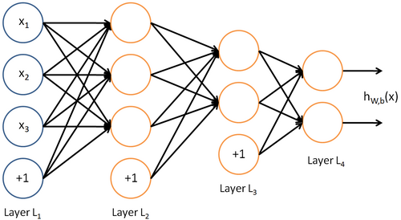
Dropout

Slide 21
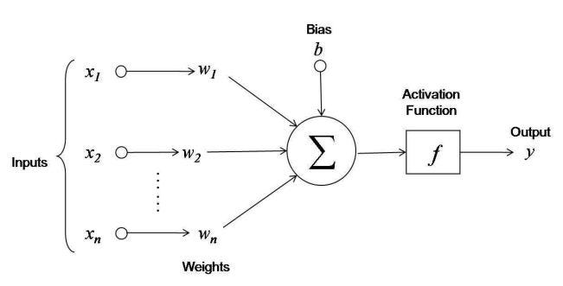
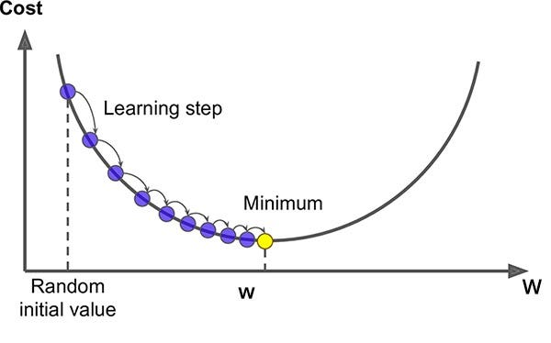
Artificial Neural Network
....the term “deep learning” comes from neural networks that contains several hidden layers, also called “deep neural networks”
3Blue1Brown; https://www.youtube.com/watch?v=aircAruvnKk

Slide 22
What is a deep learning model?

Slide 23
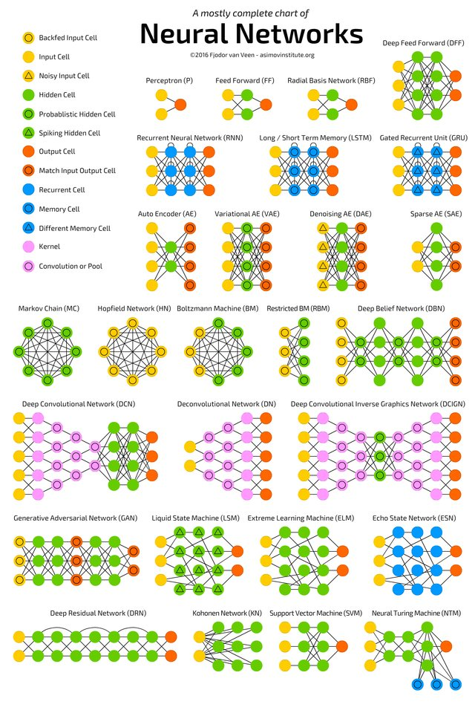
Choosing an architecture
Select model for the task
Start simple
Experiment with the topology or model flavor
Use data partitioning or K-fold cross validation
Run with simulations of the data
Compare methods/models to compare performance
Tune hyperparameters

Slide 24
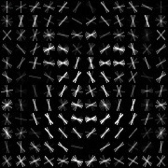
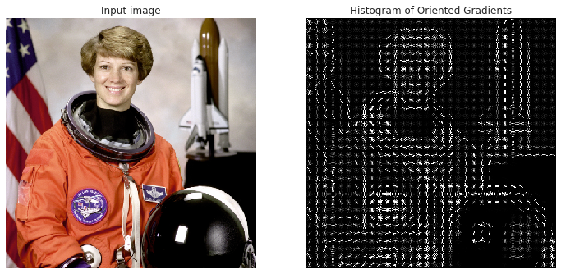
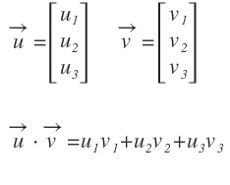
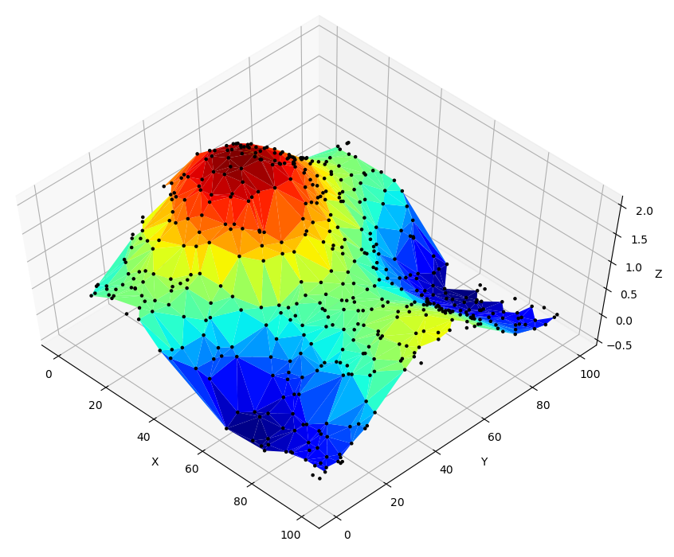
Deep Learning Kernels (detection)
Face detection using HOG is an energy-based detection method
A histogram can be trivially represented as a vector
By calculating the dot-product of two vectors, you estimate their similarity
We slide the kernel over a query image and calculate the dot-product at each location
This dot-product is high when the histograms of kernel and query are similar, while it’s low when they are very different
When we plot the dot-products, we get a heatmap of the most likely location of the kernel within the query image
Eileen Collins, space shuttle pilot

Slide 25

Deep Learning Convolution (2D)
By Michael Plotke - Own work, CC BY-SA 3.0,
https://commons.wikimedia.org/w/index.php?curid=24288958
The convolution operation can be thought of as multiple dot products performed across different regions of the input (such as an image), with the same filter being applied across these regions
→ dot-product + sliding window

Slide 26
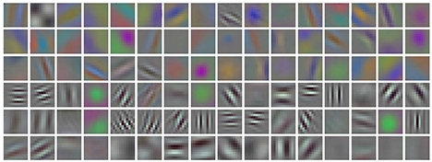
Deep Learning Data driven feature modeling
An important insight regarding the kernels is that instead of top-down hand-crafting the feature descriptors (e.g.: HOG), they should completely emerge bottom-up! Directly emerging from the training data
In the context of an SVM, during training a HOG-classifier is defined by the support vectors that are found given several HOG-encoded training examples. The discovered support vectors make up the common pattern that best decides between a positive or a negative sample
This is what was revolutionized in 2012: the encoding process of the kernels themselves was automated by the combination of convolution and backpropagation in the context of a CNN. This led to data driven feature modeling, instead of hand-crafted feature modeling
~10e4
parameters
>10e6
parameters
“Imagenet classification with deep convolutional neural networks” Krizhevsky et al - NIPS-2012

Slide 27
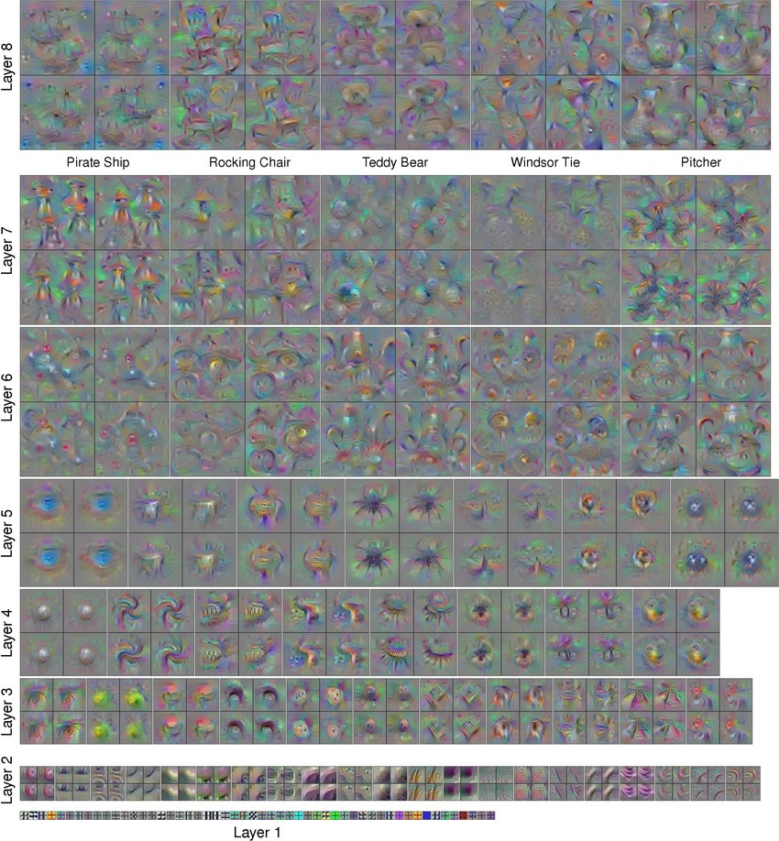
Deep Learning AlexNet: 7 hidden layers VGG: 16 hidden layers → ResNet: up to 151 hidden layers Multiple meanings to deep

Slide 28
Deep Learning

Slide 29
Loss function(s)
“A loss function is a method of evaluating how well your machine learning algorithm models your featured data set. In other words, loss functions are a measurement of how good your model is at predicting outcomes. ”
https://builtin.com/machine-learning/common-loss-functions
Notes:
The cost function and loss function refer to the same context (i.e. the training process that uses backpropagation to minimize the error between the actual and predicted outcome). We calculate the cost function as the average of all loss function values, whereas we calculate the loss function for each sample output compared to its actual value.

Slide 30
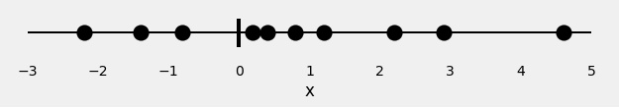
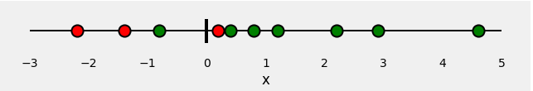
A simple binary prediction model
label y=1, green
label y=0, red
1 feature vector
So, our classification problem is quite straightforward: given our feature x, we need to predict its label: red or green.
Since this is a binary classification, we can also pose this problem as: “is the point green” or, even better, “what is the probability of the point being green”? Ideally, green points would have a probability of 1.0 (of being green), while red points would have a probability of 0.0 (of being green).
https://towardsdatascience.com/understanding-binary-cross-entropy-log-loss-a-visual-explanation-a3ac6025181a

Slide 31

Binary Cross Entropy function
If we fit a model to perform this classification, it will predict a probability of being green to each one of our points. Given what we know about the color of the points, how can we evaluate how good (or bad) are the predicted probabilities? This is the whole purpose of the loss function! It should return high values for bad predictions and low values for good predictions.
For a binary classification like our example, the typical loss function is the binary cross-entropy / log loss.
y_{i}: label (green, y = 1; red, y = 0)
p(y_{i}): the predicted probability of the point being green
for all N points
https://towardsdatascience.com/understanding-binary-cross-entropy-log-loss-a-visual-explanation-a3ac6025181a

Slide 32
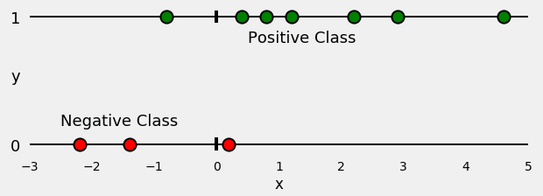
Split data in positive and negative samples
https://towardsdatascience.com/understanding-binary-cross-entropy-log-loss-a-visual-explanation-a3ac6025181a

Slide 33
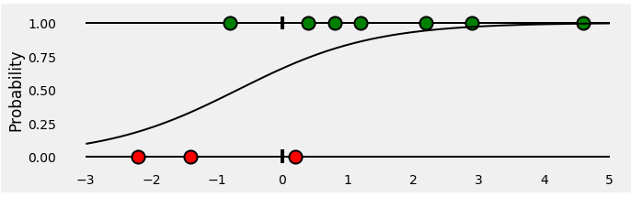
Logistic regression model to predict red and green
a Logistic Regression to classify our points. The fitted regression is a sigmoid curve representing the probability of a point being green for any given x
https://towardsdatascience.com/understanding-binary-cross-entropy-log-loss-a-visual-explanation-a3ac6025181a

Slide 34
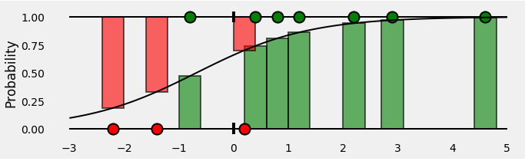
Assigning ‘true-class’ probabilities to all points
The bars represent the predicted probabilities associated with the corresponding true class of each point!
https://towardsdatascience.com/understanding-binary-cross-entropy-log-loss-a-visual-explanation-a3ac6025181a

Slide 35
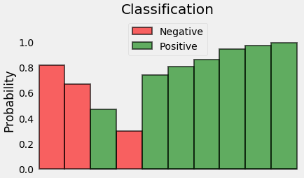
Rearrange the probabilities
Since we’re trying to compute a loss, we need to penalize bad predictions, right? If the probability associated with the true class is 1.0, we need its loss to be zero. Conversely, if that probability is low, say, 0.01, we need its loss to be HUGE!
It turns out, taking the (negative) log of the probability suits us well enough for this purpose (since the log of values between 0.0 and 1.0 is negative, we take the negative log to obtain a positive value for the loss).
https://towardsdatascience.com/understanding-binary-cross-entropy-log-loss-a-visual-explanation-a3ac6025181a

Slide 36
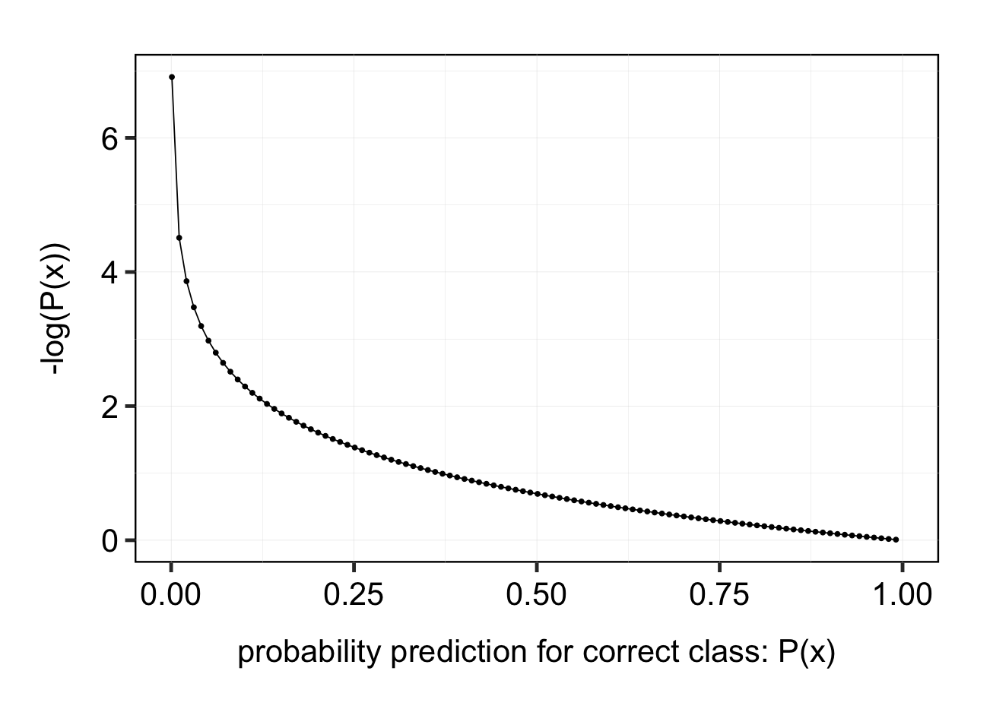
-log(P(x))
## loss function visually
probs <- seq(0.001, 1, by = 0.01)
min_log_probs <- -log(probs)
tibble(
probs = probs,
min_log_probs = min_log_probs
) |>
ggplot(aes(x = probs, y = min_log_probs)) +
geom_point() +
xlim(c(0,1)) +
geom_line() +
xlab("probability prediction for correct class: P(x)") +
ylab("-log(P(x))") +
citrulliner::theme_individual()
after: https://towardsdatascience.com/understanding-binary-cross-entropy-log-loss-a-visual-explanation-a3ac6025181a

Slide 37
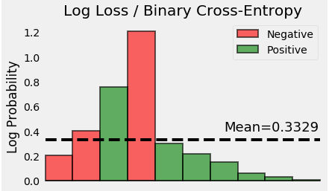
Calculation of the mean loss value
Result of the negative log of probabilities for all our points
Resulting in a mean of:
0.3329
So, we conclude that the binary cross-entropy / log loss of this toy example is 0.3329!
https://towardsdatascience.com/understanding-binary-cross-entropy-log-loss-a-visual-explanation-a3ac6025181a

Slide 38
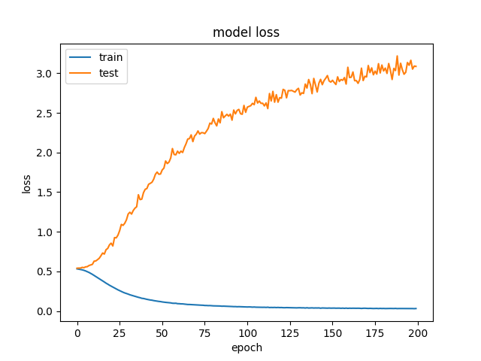
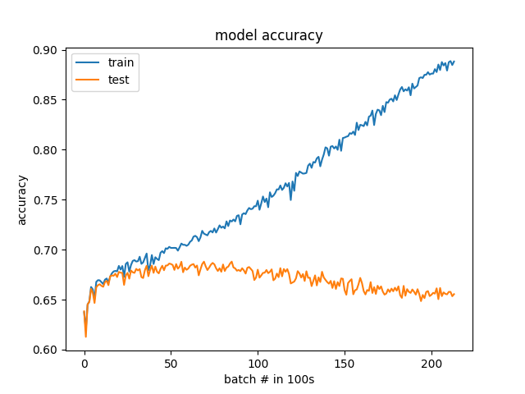
Evaluation of neural networks (loss and accuracy)
https://medium.com/@penpencil.blr/what-is-the-difference-between-training-loss-validation-loss-and-evaluation-loss-c169ddeccd59

Slide 39
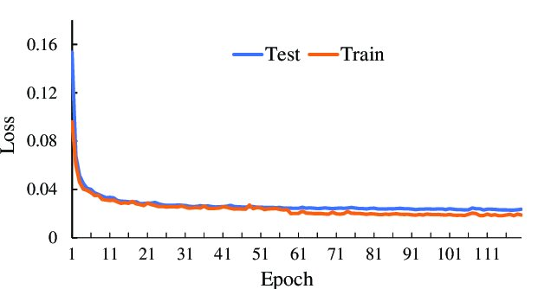
Validation (and test loss) should be low for good models that have high generalization capacity
http://dx.doi.org/10.1109/ACCESS.2021.3068861

Slide 40
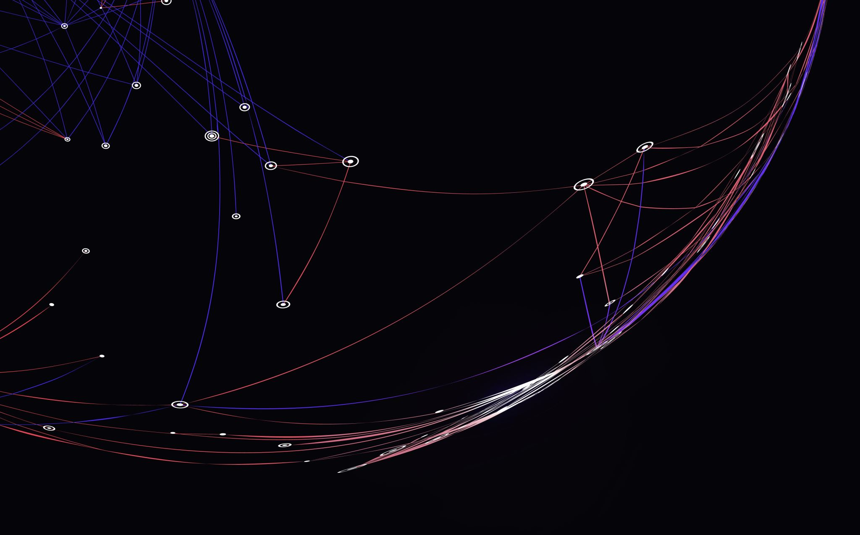
Input data
Tensors are generalizations of vectors, that function as input for ML algorithms.
Let’s look at some examples

Slide 41
Tensors
1D Tensor: No real-world data
2D Tensor: Vector data
(samples, features)
3D Tensor: Time series or sequence
(samples, timesteps, features)
4D Tensor: Images (samples, height, width, channels) or (samples, channels, height, width)
5D Tensor: Video (samples, frames, height, width, channels)
https://towardsdatascience.com/deep-learning-introduction-to-tensors-tensorflow-36ce3663528f

Slide 42
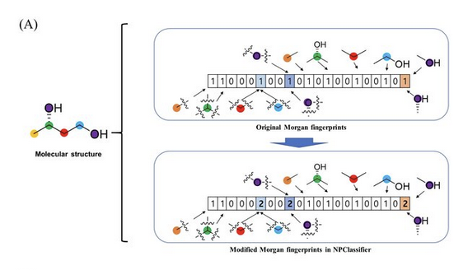
Chemical structure embedding?
http://dx.doi.org/10.26434/chemrxiv.12885494

Slide 43
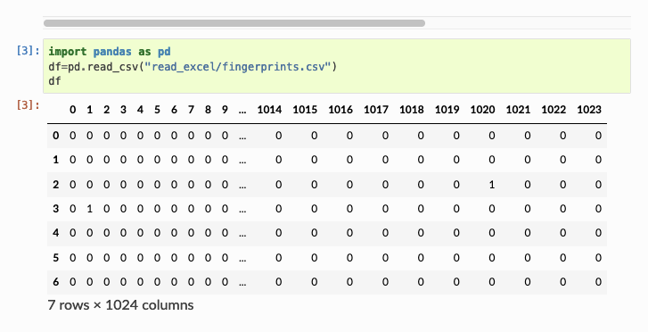
QSAR; Morgan fingerprints (2D-tensor data)

Slide 44
Preparing the dataset for model training and evaluation

Slide 45
Question
How do we train a model that generalises well over ‘unseen’ data?
Answer:
Exploratory data analysis
Use part of the data for training and another part of the data for validation/testing.
But, how?

Slide 46
Split data into subsets
Training Set:
To train the model to find patterns in the data, related to the outcome that the model should predict.
Validation Set:
To evaluate and fine-tune a machine learning model during training, helping to assess the model’s performance and make adjustments (to stear the training process).
Test Set:
To evaluate the final performance of a trained model.
https://encord.com/blog/train-val-test-split/

Slide 47
Different strategies for splitting
Random sampling (balanced data)
Stratified sampling (unbalanced data)
Holdout Validation with Validation Set (larger datasets, lower computational costs)
Cross-validation (smaller datasets – computationally intensive)
Leave-one-out Cross-Validation (computationally very intensive, but robust)
https://www.linkedin.com/pulse/data-splitting-strategies-machine-learning-swapnil-sharma/

Slide 48
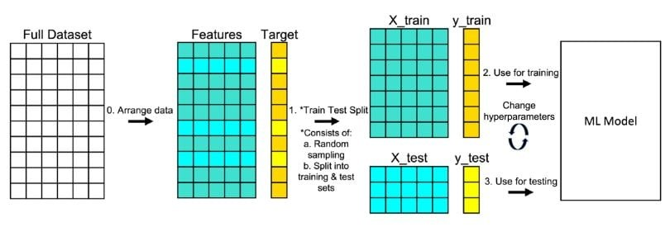
1. Random sampling (single splits)
https://www.linkedin.com/pulse/data-splitting-strategies-machine-learning-swapnil-sharma/

Slide 49
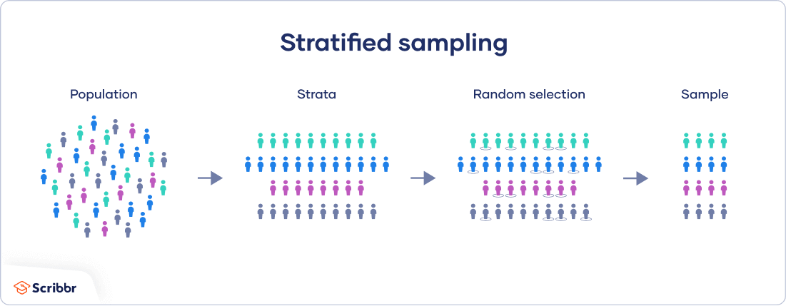
2a. Stratified; “Disproportinate Stratefied Sampling”
https://www.scribbr.com/methodology/stratified-sampling/
Notes:
First, you need to decide whether you want your sample to be proportionate or disproportionate.
Proportionate versus disproportionate sampling
In proportionate sampling, the sample size of each stratum is equal to the subgroup’s proportion in the population as a whole.
Subgroups that are less represented in the greater population (for example, rural populations, which make up a lower portion of the population in most countries) will also be less represented in the sample.
In disproportionate sampling, the sample sizes of each strata are disproportionate to their representation in the population as a whole.
You might choose this method if you wish to study a particularly underrepresented subgroup whose sample size would otherwise be too low to allow you to draw any statistical conclusions.
Sample size
Next, you can decide on your total sample size. This should be large enough to ensure you can draw statistical conclusions about each subgroup.
If you know your desired margin of error and confidence level as well as estimated size and standard deviation of the population you are working with, you can use a sample size calculator to estimate the necessary numbers.

Slide 50
2b Stratified; “Proportinate Stratefied Sampling”
n=16 (~40% of pop.)
10/41
(10/41)*16
12/41
(12/41)*16
8/41
(8/41)*16
10/41
(10/41)*16
41
https://www.scribbr.com/methodology/stratified-sampling/
Notes:
First, you need to decide whether you want your sample to be proportionate or disproportionate.
Proportionate versus disproportionate sampling
In proportionate sampling, the sample size of each stratum is equal to the subgroup’s proportion in the population as a whole.
Subgroups that are less represented in the greater population (for example, rural populations, which make up a lower portion of the population in most countries) will also be less represented in the sample.
In disproportionate sampling, the sample sizes of each strata are disproportionate to their representation in the population as a whole.
You might choose this method if you wish to study a particularly underrepresented subgroup whose sample size would otherwise be too low to allow you to draw any statistical conclusions.
Sample size
Next, you can decide on your total sample size. This should be large enough to ensure you can draw statistical conclusions about each subgroup.
If you know your desired margin of error and confidence level as well as estimated size and standard deviation of the population you are working with, you can use a sample size calculator to estimate the necessary numbers.

Slide 51
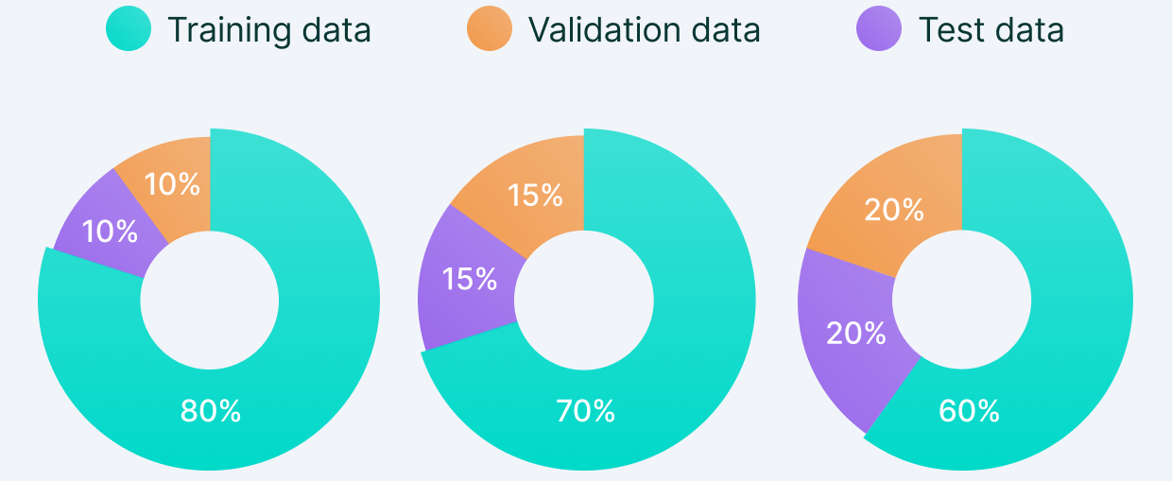
3. Holdout Validation with Validation Set
https://www.linkedin.com/pulse/data-splitting-strategies-machine-learning-swapnil-sharma/

Slide 52
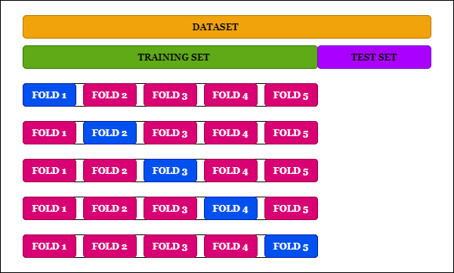
4. Cross-Validation
`

Slide 53
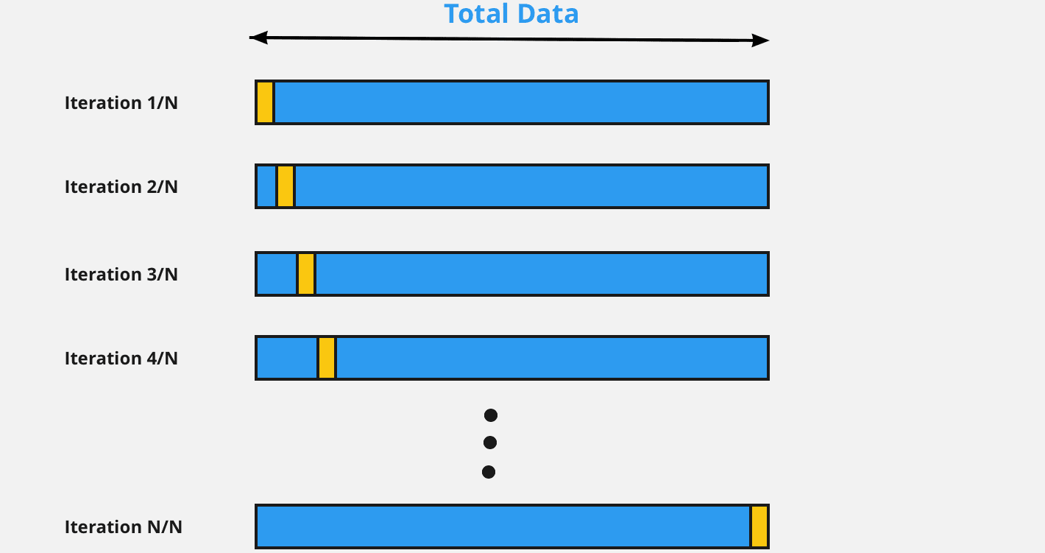
5. Leave-on-out Cross-Validation
https://www.linkedin.com/pulse/data-splitting-strategies-machine-learning-swapnil-sharma/

Slide 54
Platforms and implementations

Slide 55









Open Source programming languages / frameworks
Statistics
Machine Learning
Deep Learning
Visualization
Bioinformatics
Chem-informatics (RCDK)
Statistics
Machine Learning
Deep Learning
Visualization
Bioinformatics
Natural Language Processing
Chem-informatics (RDKit)
Graph Database
Graph Visualization
Graph Algorithms
https://rviews.rstudio.com/2020/07/20/shallow-neural-net-from-scratch-using-r-part-1/
https://rviews.rstudio.com/2020/07/24/building-a-neural-net-from-scratch-using-r-part-2/

Slide 56
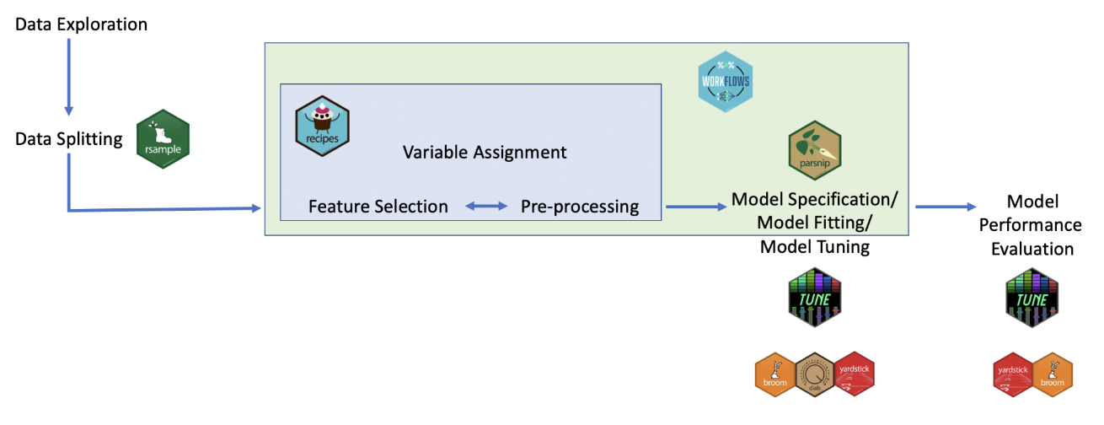
Tidymodels (for R)
Split data
Model specification
Recipe (algorithm, engine, task, data, predictors)
Workflow (model specs + recipe)
Tune
Fit
Test
Evaluate

Slide 57


