Slide 1

A use case of K-Nearest Neıghbour classıfıcatıon Alican CömerT

Slide 2
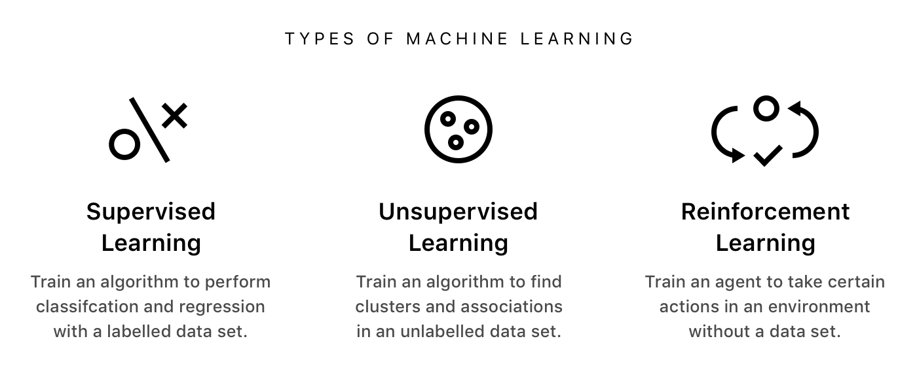
Types of Machine Learning
Header of section
2
ManP/CTG2 | 2018-10-27
© Robert Bosch GmbH 2018. All rights reserved, also regarding any disposal, exploitation, reproduction, editing, distribution, as well as in the event of applications for industrial property rights.

Slide 3
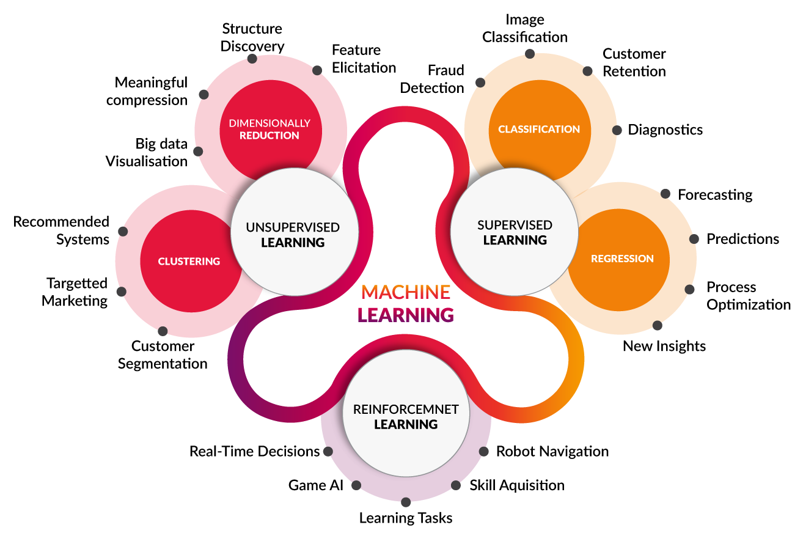
Machine Learning Use Cases
Header of section
3
ManP/CTG2 | 2018-10-27
© Robert Bosch GmbH 2018. All rights reserved, also regarding any disposal, exploitation, reproduction, editing, distribution, as well as in the event of applications for industrial property rights.

Slide 4
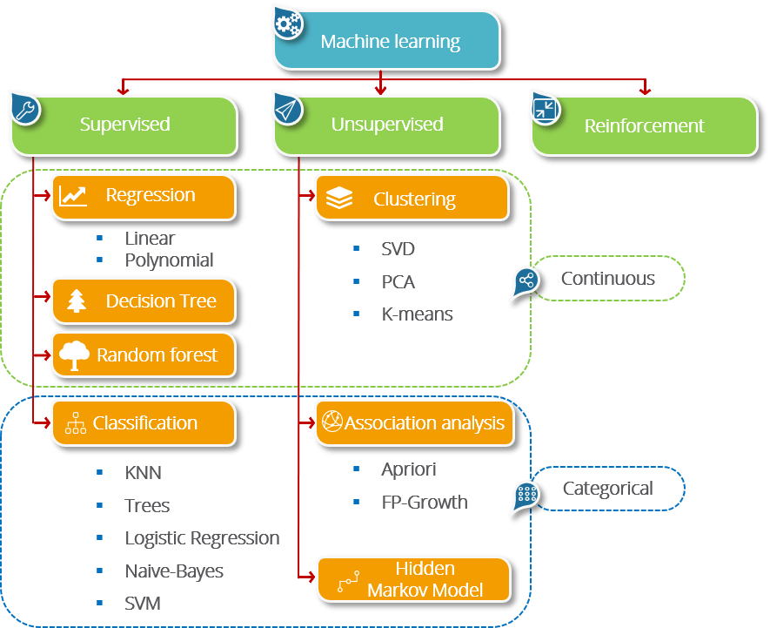
Machine Learning Techniques
Header of section
4
ManP/CTG2 | 2018-10-27
© Robert Bosch GmbH 2018. All rights reserved, also regarding any disposal, exploitation, reproduction, editing, distribution, as well as in the event of applications for industrial property rights.

Slide 5

K Nearest Neighbour Algorithm
Supervised Learning
5
ManP/CTG2 | 2018-10-27
© Robert Bosch GmbH 2018. All rights reserved, also regarding any disposal, exploitation, reproduction, editing, distribution, as well as in the event of applications for industrial property rights.

Slide 6
K Nearest Neighbour Algorithm
Instance-Based Classifiers
Store the training records
Use training records to predict the class label of unseen cases
6
ManP/CTG2 | 2018-10-27
© Robert Bosch GmbH 2018. All rights reserved, also regarding any disposal, exploitation, reproduction, editing, distribution, as well as in the event of applications for industrial property rights.

Slide 7
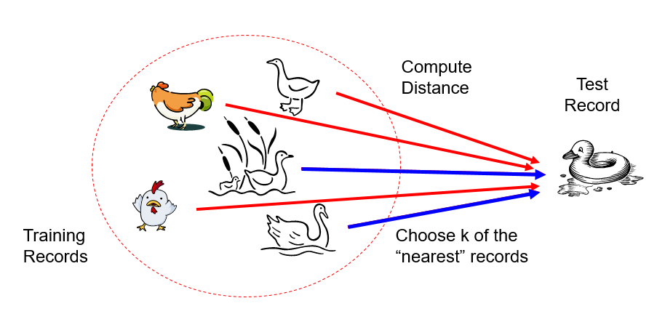
K Nearest Neighbour Algorithm
Basic idea:
If it walks like a duck, quacks like a duck, then it’s probably a duck
7
ManP/CTG2 | 2018-10-27
© Robert Bosch GmbH 2018. All rights reserved, also regarding any disposal, exploitation, reproduction, editing, distribution, as well as in the event of applications for industrial property rights.

Slide 8
K Nearest Neighbour Algorithm
Requires three things
The set of stored records
Distance Metric to compute distance between records
The value of k, the number of nearest neighbors to retrieve
To classify an unknown record:
Compute distance to other training records
Identify k nearest neighbors
Use class labels of nearest neighbors to determine the class label of unknown record (e.g., by taking majority vote)
8
ManP/CTG2 | 2018-10-27
© Robert Bosch GmbH 2018. All rights reserved, also regarding any disposal, exploitation, reproduction, editing, distribution, as well as in the event of applications for industrial property rights.

Slide 9
K Nearest Neighbour Algorithm
K-nearest neighbors of a record x are data points that have the k smallest distance to x
9
ManP/CTG2 | 2018-10-27
© Robert Bosch GmbH 2018. All rights reserved, also regarding any disposal, exploitation, reproduction, editing, distribution, as well as in the event of applications for industrial property rights.

Slide 10
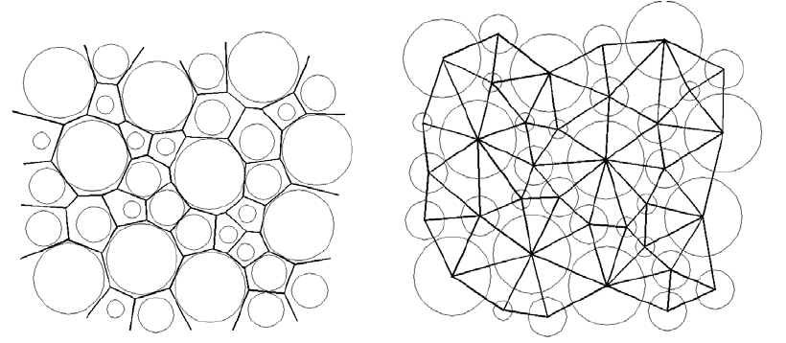
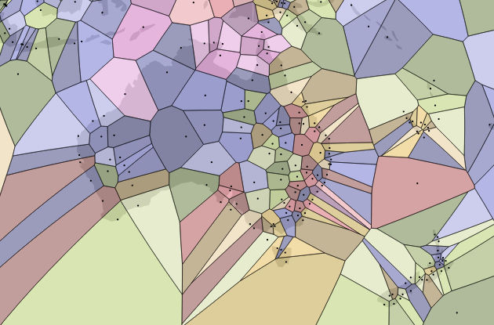
Voronoi Diagram
K Nearest Neighbour Algorithm
A map centred on Australia and New Zealand with points at airports generating a Voronoi diagram
10
ManP/CTG2 | 2018-10-27
© Robert Bosch GmbH 2018. All rights reserved, also regarding any disposal, exploitation, reproduction, editing, distribution, as well as in the event of applications for industrial property rights.

Slide 11
Pros & Cons
K Nearest Neighbour Algorithm
Pros:
No assumptions about data — useful, for example, for nonlinear data
Simple algorithm — to explain and understand/interpret
High accuracy (relatively) — it is pretty high but not competitive in comparison to better supervised learning models
Versatile — useful for classification or regression
Cons:
Computationally expensive — because the algorithm stores all of the training data
High memory requirement
Stores all (or almost all) of the training data
Prediction stage might be slow (with big N)
Sensitive to irrelevant features and the scale of the data
11
ManP/CTG2 | 2018-10-27
© Robert Bosch GmbH 2018. All rights reserved, also regarding any disposal, exploitation, reproduction, editing, distribution, as well as in the event of applications for industrial property rights.

