Slide 1
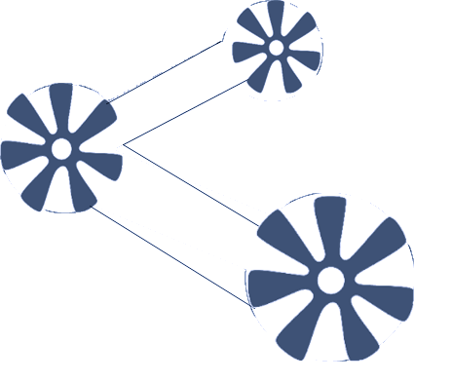





Slide 2
LINEAR REGRESSION - OLS
Regression analysis is a statistical technique used to describe relationships among variables.
The simplest case to examine is one in which a variable Y, referred to as the dependent or target variable, may be related to one variable X , called an independent or explanatory variable, or simply a regressor.
If the relationship between Y and X is believed to be linear, then the equation for a line may be appropriate:
Where β0 is an intercept term and β1 is a slope coefficient.
In simplest terms, the purpose of regression is to try to find the best fit line or equation that expresses the relationship between Y and X .

Slide 3
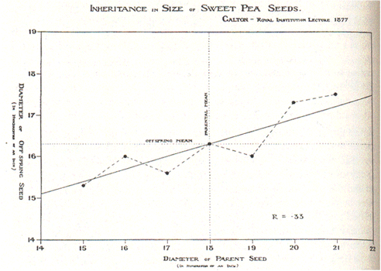
Linear Regression
“Essentially, all models are wrong, but some are useful”
George Box

Slide 4
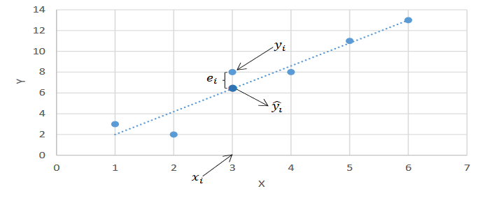
Regression

Slide 5
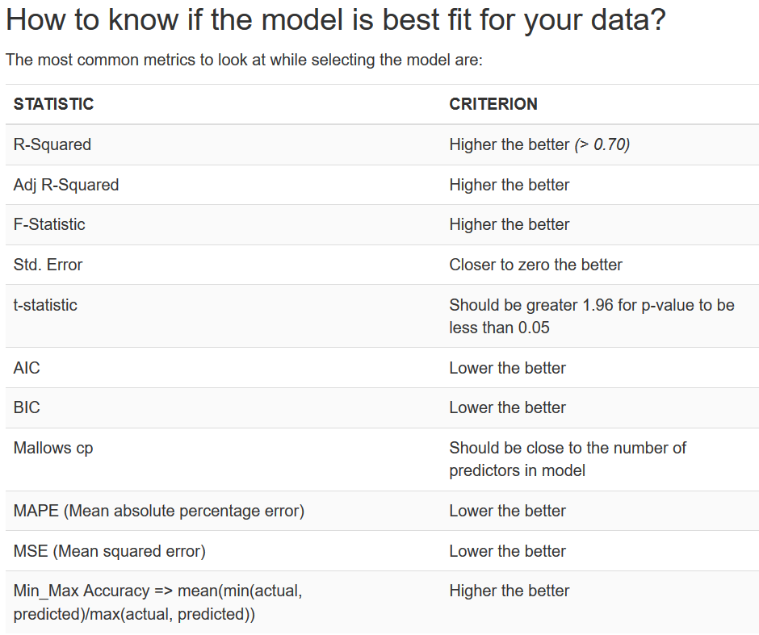

Slide 6
Regression Plot Means
Residuals vs Fitted – No Pattern !
Normal Q-Q – Are you normal ?
Scale Location – homoscedastic or not?
This plot shows if residuals are spread equally along the ranges of predictors. This is how you can check the assumption of equal variance (homoscedasticity). It’s good if you see a horizontal line with equally (randomly) spread points.
Residuals vs Leverage – Who are the most effective ones ?!
This plot helps us to find influential cases

Slide 7


