Slide 1
Macroeconomic Report
December 2019

Slide 2
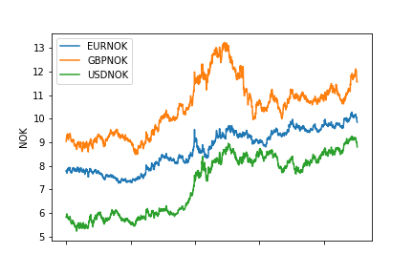

Slide 3
No further depreciaton expected for the exchange rate
Interest rate expected to stop increasing
Weak oil prices will:
Reduce the profitability in the petroleum sector
Reduce the transfers to the State Pension Fund

