Slide 1
Evaluating Names
Bad code by any other name smells as 💩

Slide 2
What is quality code?
Gives the correct answer?
Fast?
Clean!

Slide 3
Well-written prose/code
Technical Writing
Coding
Selected words that
Express intent
Correct parts of speech
Technicality ↔ audience
Not misleading
Selected names that
Express intent.
Correct parts of speech
Length ↔ scope
No disinformation
Clean code is simple and direct.
Clean code reads like well-written prose.
Gary Booch

Slide 4

Good names…
Reveal intent
Use the proper parts of speech
Have the proper length for their scope
Avoids disinformation and encodings

Slide 5
Signs of bad names
A comment
Consulting
Stack Overflow
Documentation/help
Going into the code to understand the name

Slide 6
Good names…
reveal intent
use the proper parts of speech
have the proper length for their scope
avoids disinformation and encodings
Names are not for your convenience, they are your primary tools for communicating intent. And communicating intent is always your first priority.
Robert Martin

Slide 7
How to express intent
Data: What is it?
Function/method: What does it do?

Slide 8
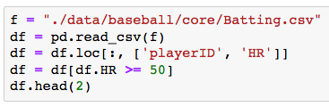
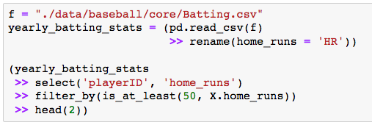
Exercise 1 Do the names reveal intent?
Block 1 – Standard pandas
Block 2 – dfply module

Slide 9
Classic R/pandas code → Bad/No Names
The name f is actually ok
(more on this later)
The name df does not
express what the data frame is.
The name loc does not express what this method does.
🧙🏿‍♂️Wingardiam Leviosa.

Slide 10
Good names…
reveal intent
use the proper parts of speech
have the proper length for their scope
avoids disinformation and encodings

Slide 11
Parts of Speech
Variables → nouns
Functions → verbs
Boolean Variables/Functions → predicates

Slide 12






Using the proper part of speech makes code read like prose
This work well with objects and piping
Even better with the right mix of both

Slide 13
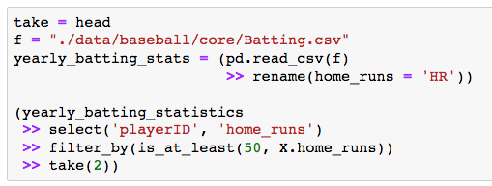
Exercise 2 Are the names using the correct part of speech?
Block 2 – dfply module
These functions are
verbs
These variables are
nouns
Boolean function is
predicate
A function that is not a
verbs

Slide 14

I beg to differ …
Function names are always verbs
Nouns work when representing a parts-of-the-whole
Image source: http://saltares.com/blog/computing/book-review-clean-code/

Slide 15



Preposition and Parts-of-the-whole Is head really that bad?
Pipe
Reads yearly_batting_stats’s head
i.e. possessive form
Method dot chain
Reads yearly_batting_stats’s head
i.e. possessive form
Function call
Reads head of yearly_batting_stats
i.e. prepositional phrase using of
Think: ”f of x” for f(x) in math

Slide 16
Good names…
reveal intent
use the proper parts of speech
have the proper length for their scope
avoids disinformation and encodings

Slide 17
Scope Length Rules Variables
Small Scope == Short Names
Larger Scope == Longer Names
Short names
Only used locally
Easy to figure out
Length grows as scope grows
Hard to find origin
Needs to be self-contained
f is ok
it only live on these 2 lines
yearly_batting_stats likely spans the whole file → needs to be long/descriptive.

Slide 18


Scope Length Rules Functions
Smaller Scope == Longer Names
Large Scope == Short Name
Self-documenting
Not inconvenient
Only used locally
Length shrinks as scope grows
Reader gains familiarity
Not inconvenient
Easy to read/reread
Called exactly once
Provides documentation
dplyr function
are perfect for
their scope (huge)

Slide 19
Good names…
reveal intent
use the proper parts of speech
have the proper length for their scope
avoids disinformation and encodings

Slide 20
Disinformation
First Step
Whenever meaning evolves …
Introduce names that reveal intent
Names
change
Intent
changes
Disinformation

Slide 21
Encodings
Example from 70/80’s
Hungarian Notation
Encodings in 2019
lSalary → Long int
pX → pointer
No need
Powerful IDEs
An excess of memory
Great compilers

Slide 22
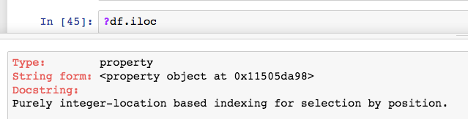
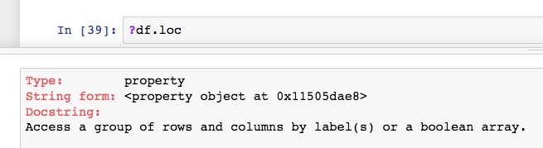
Avoid disinformation and encodings
There is also iloc.
What’s the difference between loc and iloc
iloc/loc → location?
Disinformation: Not locations, instead data at that location.
i in iloc → integer
Encoding: Why not
write out integer?
Pick a better name
I always need to consult
stack overflow/help/docs
when using iloc and loc.
A clear sign of a bad name

Slide 23
When evaluating your student’s code, spend some time on names!
Do their names reveal intent?
Do they use the proper part of speech?
Are they the right length for their scope?
Do they avoid disinformation and encoding?

Slide 24
More Great Quotes!
Instead of imagining that our main task is to instruct a computer what to do, let us concentrate rather on explaining to human beings what we want a computer to do.
Donald Knuth
Any fool can write code that a computer can understand.
Good programmers write code that humans can understand.
Martin Fowler

Slide 25
Clean Code Resources
Usenet post on names
Clean Code, a book by Robert Martin
www.cleancoders.com, videos by Robert Martin and friends
Refactoring Code, a book by Martin Fowler

