Slide 1
Thoughts from a first-time Data Science instructor
Wei Wei
Metropolitan State University

Slide 2
Outline
My assessments in an introductory Data Science course
Difference between intro data science and intro stats courses
My questions of assessing intro Data Science

Slide 3
My assessments in the introductory Data Science and Visualization Course
Reading Assignments
Homework Assignments
Course Project
Exams

Slide 4
Reading assignments
Assign articles from Toward Data Science, Data Science Weekly Newsletter, and Data Science Medium
Articles are related to the career of data science, data visualization, and statistical analysis
Provide 3-5 questions related to the article and the materials covered

Slide 5
Reading assignments
3 Common data science career transitions, and how to make them happen
Complete beginning, software engineers, and new CS or Math grads
The art of cleaning your data
Missing values, outliers, irrelevant features and bad data

Slide 6
Reading assignments
The most in demand skills for data scientists
General skills and technology skills
Used for data visualization modules
3rd wave data visualization
The 5 basic statistics concepts data scientists need to know
Descriptive stats, Probability distributions, dimension reduction, over and under sampling, and Bayesian stats
Used for statistical hypothesis testing modules
Using data science to help women make contraceptive choices

Slide 7
Homework assignments
Questions are from Modern Data Science with R by Baumer, Kaplan and Horton
Submit code and answer using comments

Slide 8
Course project
Inspired from Dear Data project
Students collect data about their daily-life for two weeks
Multiple topics
Students formulate their own hypotheses and test their hypotheses
Data visualization
Data analysis
Not much data cleaning

Slide 9
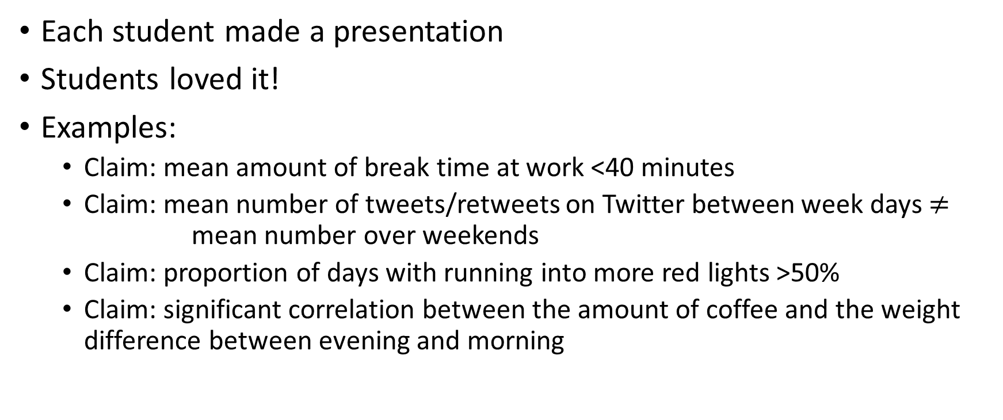
Course project
Each student made a presentation
Students loved it!
Examples:
Claim: mean amount of break time at work <40 minutes
Claim: mean number of tweets/retweets on Twitter between week days $≠$ mean number over weekends
Claim: proportion of days with running into more red lights >50%
Claim: significant correlation between the amount of coffee and the weight difference between evening and morning

Slide 10
Exams
Midterm and Final exams
Paper test and Computer test
Paper test: Close-book and close-notes
Multiple choice questions in Data visualization, R functions, Data ethics, Business information system
Computer test: R
Open-resources

Slide 11
Assessing intro stats versus assessing intro data science
Common things:
Intro stats is a prerequisite to intro data science
Data Visualization
Statistical Analysis

Slide 12
Assessing intro stats versus assessing intro data science
Stats
Logical thinking skills
Conceptual understanding
Distributions and Analysis (Hypothesis testing)
No coding or minimal coding
STATCRUNCH
MINITAB
Excel

Slide 13
Assessing intro stats versus assessing intro data science
Data science
Coding
Programming thinking skills
Creative thinking skills
Data cleaning and visualization
Minimal stats analysis

Slide 14
My questions of assessing intro Data Science course
Ideas on assessment questions?
How would you assess coding?
Open resource vs close-book and close-notes?

Slide 15
Questions and Comments?

