Slide 1
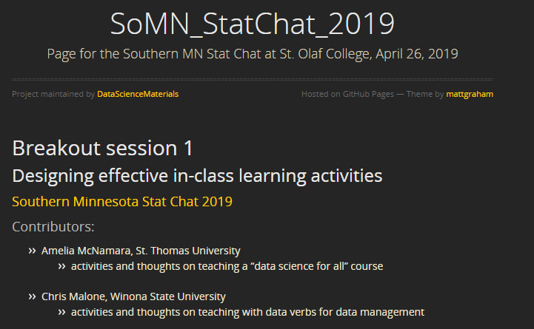
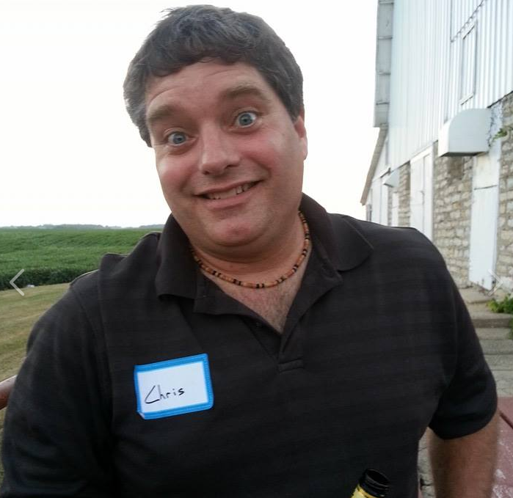
Email: cmalone@winona.edu

Slide 2
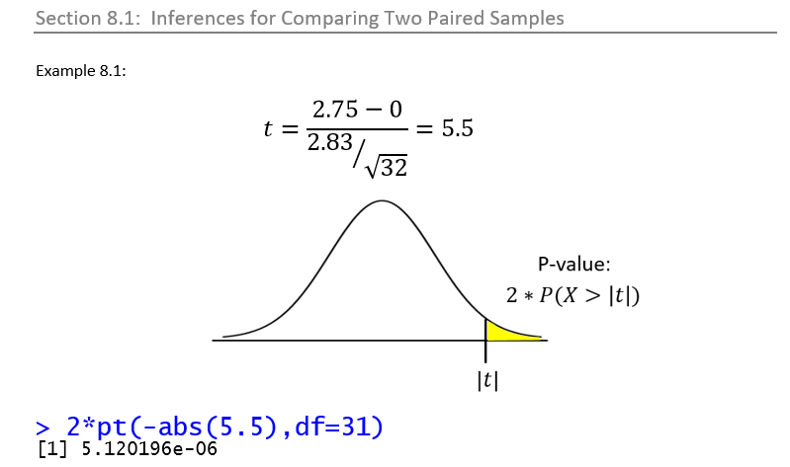

Slide 3
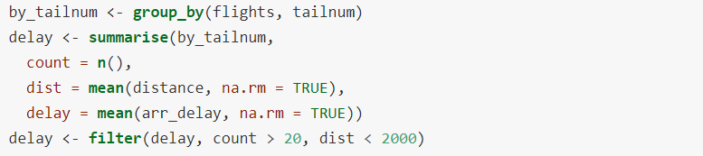
:
:
:

Slide 4
Data Wrangling Requires

Slide 5
Data Wrangling Requires
CODE

Slide 6
Data Wrangling Requires
PROCESS
CODE

Slide 7
Data Wrangling Requires
PROCESS
CODE

Slide 8
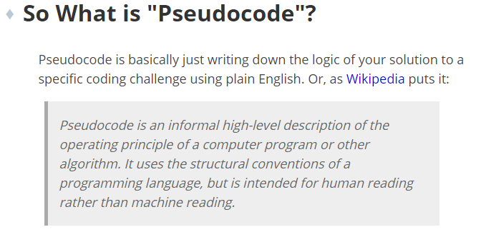
Language of Code

Slide 9
Language of (Tabular) Data
> SELECT: Collect columns
> FILTER: Collect rows
> MUTATE: Create new columns

Slide 10


Email: cmalone@winona.edu
Chris Malone
Professor, Data Science and Statistics
Winona State University

