Slide 1
Attrition Analysis
Anish Patel
Case Study 2

Slide 2
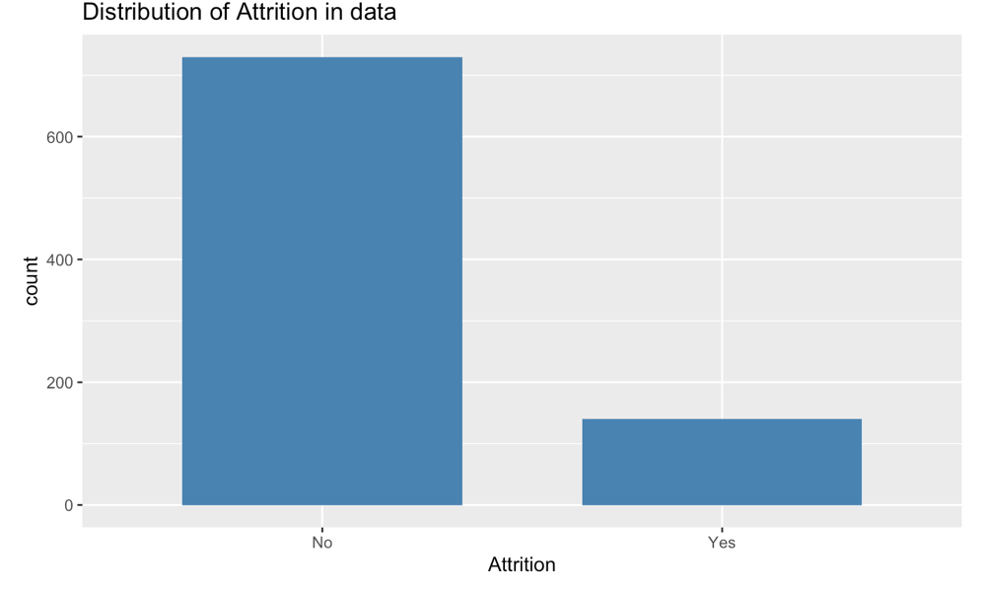
How much attrition do we currently see?
About 1/5 of the company is turned over
Retaining these worker could leave to massive savings in employee training
Notes:
Employees that leave to company is about 1/5th

Slide 3
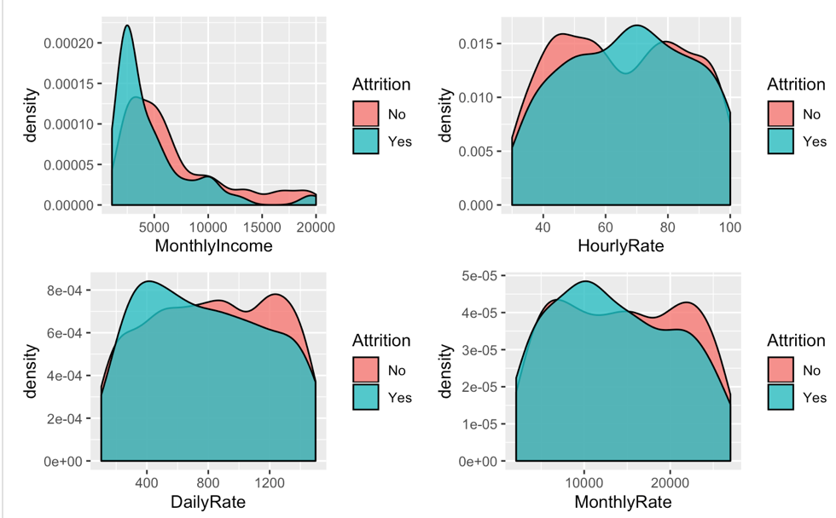
Pay rate and attrition
Visual evidence to suggest that there is more attrition at the lower income ranges and warrants a deeper look but not clear we need to look at other variables
Notes:
Attrition is much higher at lower pay ranges

Slide 4
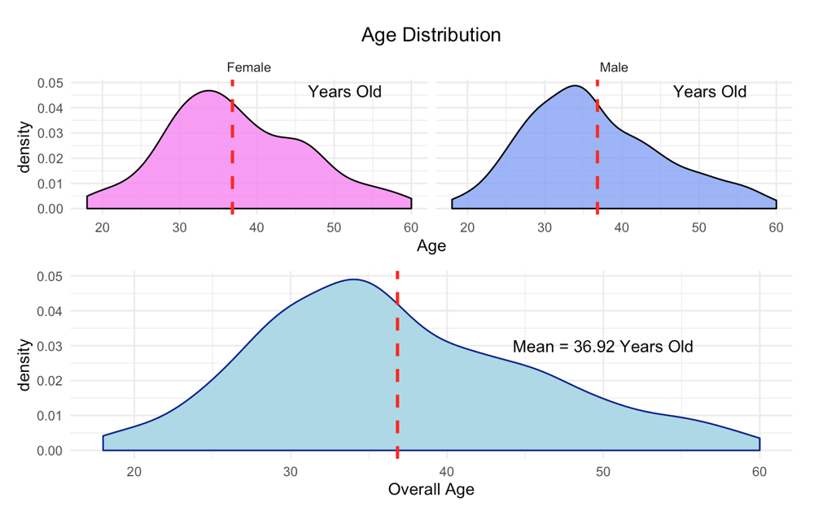
Age distribution of workers
The distribution of male and female employees are the same.
Doesn’t seem like male vs. female distribution of ages are different
Notes:
Male and female employee ages have similar distributions. The median ages is around 37 years old. Young families

Slide 5
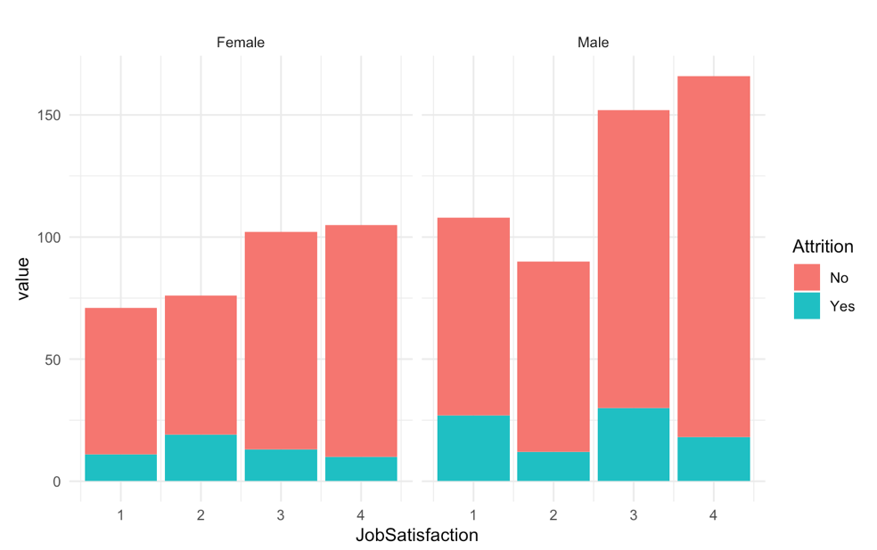
Job Satisfaction and attrition
There appears to be visual evidence that low job satisfaction leads to higher attrition.
here is higher attrition for males with low job satisfaction when compared to females

Slide 6
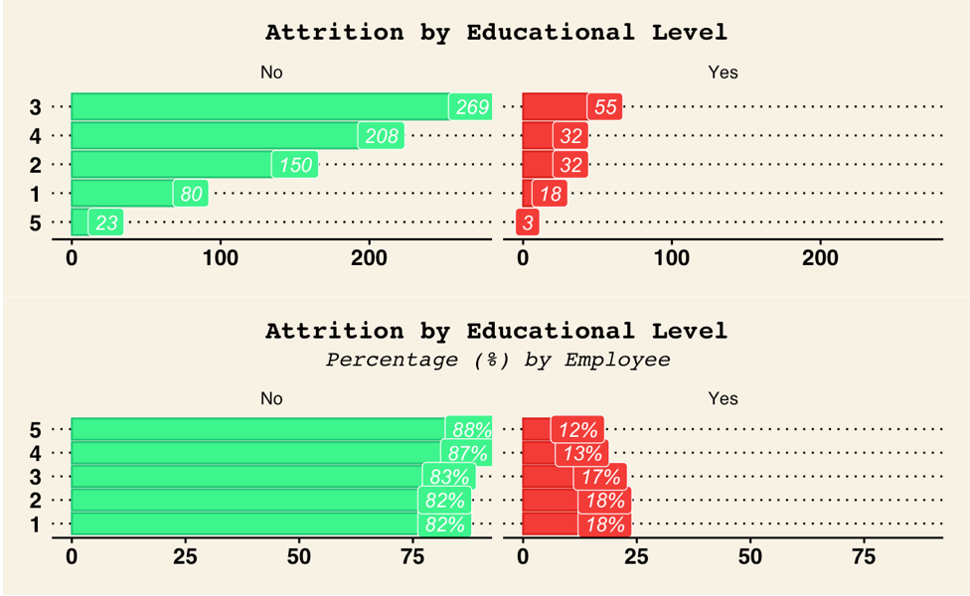
Attrition by Education Level
Employees with lower education are more likely to leave the company.
Notes:
Lower education levels have higher turn over

Slide 7
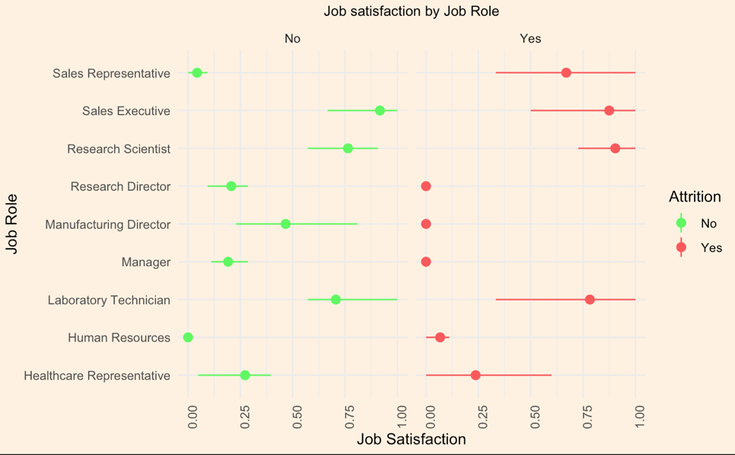
Attrition by Job Satisfaction and Role
Directors and Managers with low job satisfaction are likely to leave to company
Notes:
What does this tell us? Job roless such as Research Director, Manager, Human Resources have very low Job satisfaction score amongst who have churned. The score in these job roles is low for employees who have not churned but this indicates that they are likely to churn

Slide 8
Results from Different Models
Models | Sensitivity | Specificity | Accuracy
KNN | 10% | 93% | 79%
Naïve Bayes | 51% | 92% | 84%
Decision Tree | 64% | 89% | 86.78%
Root mean square error from linear regression model for monthly income prediction is 208.34

Slide 9
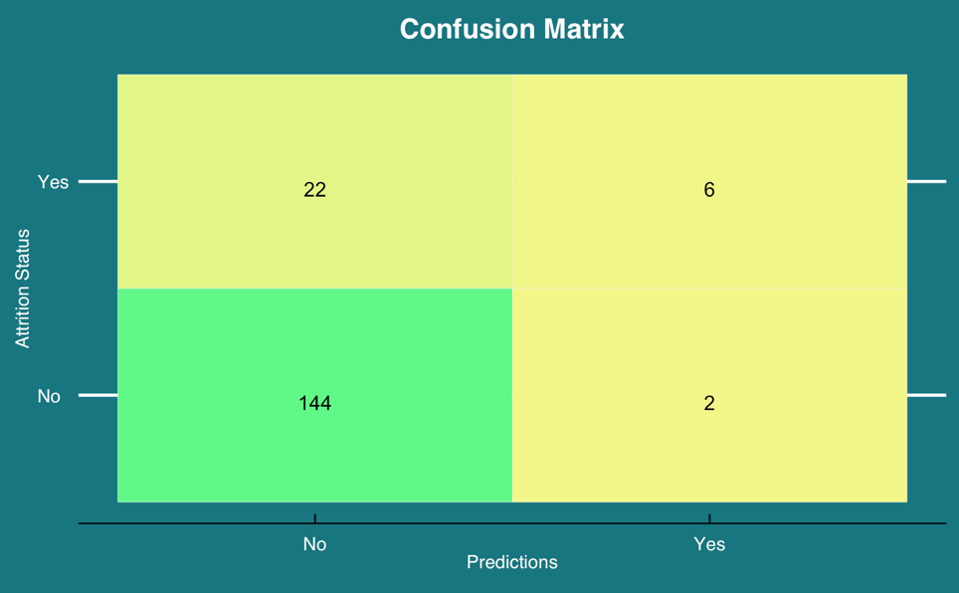
Confusion Matrix
The decision tree model is best at predicting no attrition
Model makes correct prediction of 150 out of 174 with a total accuracy of 86%
Notes:
No idea

Slide 10
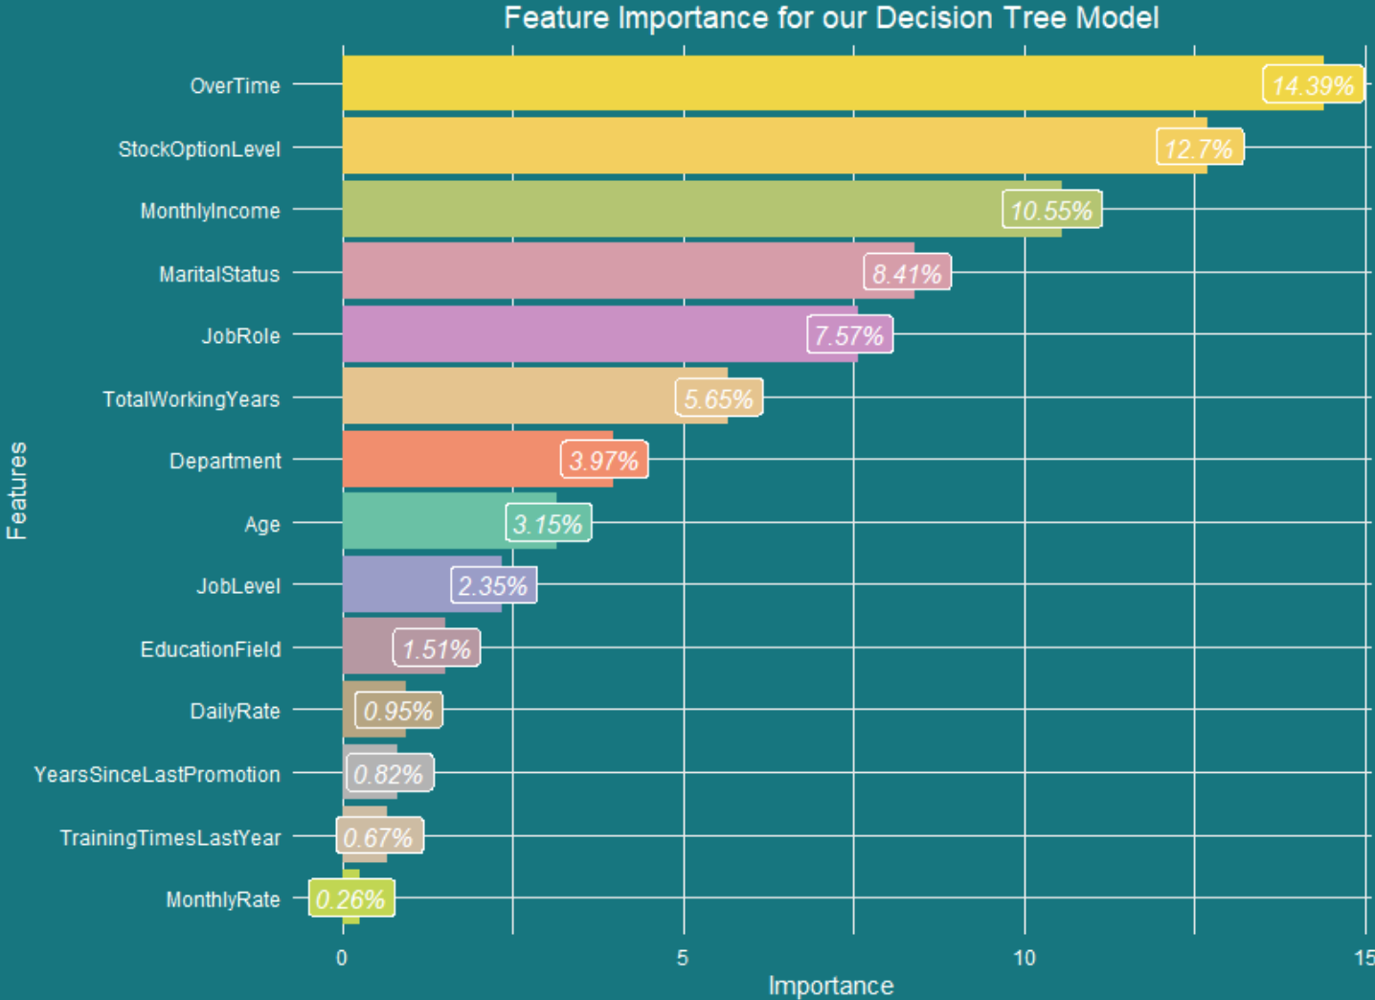
Decision Tree Levels
---Overtime
------Stock Options
---------Monthly Income
------------Job Role
Notes:
Why tree is muchless ??

Slide 11
Future studies and Questions
Should all employees be give stock options?
How should overtime be implemented in a way to lower attrition?
Investigate job roles with highest attrition further to gain insights on how to retain talent
Notes:
Monthly income most important?

Slide 12
Appendix
For detail information on the data and methods please see the link below:
https://github.com/DataScienceMustang/CaseStudy2

