Slide 1

Machine Learning with scikit-learn
Intro to Data Science using Jupyter
PART 2:
A
2018 training by

Slide 2
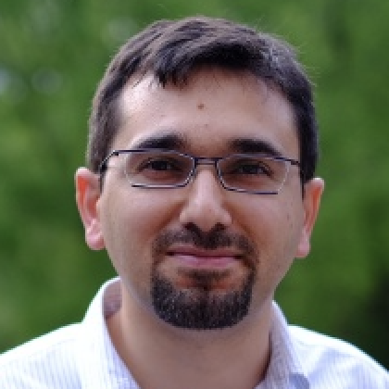



Presented by
Ozgur Ozturk, PhD
Data Scientist
at
twitter.com/@DrOzTurk
linkedin.com/in/DrOzTurk
To download these slides:
tinyurl.com/ModelEvaluation

Slide 3

To hear about our future trainings, Signup at:
meetup.com/DataSciencePros

Slide 4
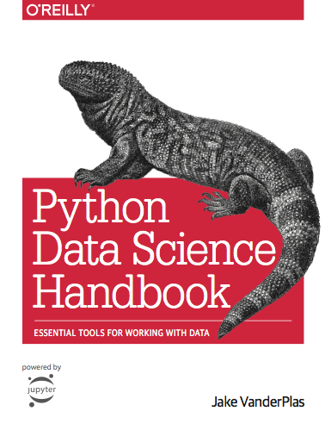
Based on
Free online
https://jakevdp.github.io/PythonDataScienceHandbook/

